Slide 1
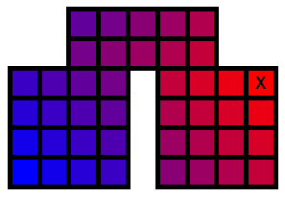
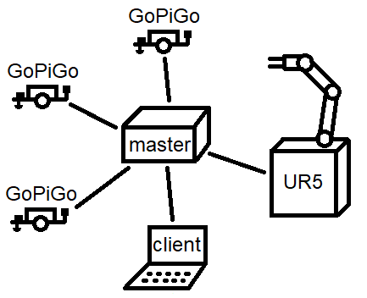
VarastoRobo – Master
Santtu Nyman TVT17SPL
Oulu University of Applied Sciences
Information Technology, Option of Device and Product Design
Introduction
The aims of this project were to make autonomous storage management system, where multiple devices work in co-operation, to bring the ordered item to the user and surveil the premises in case of intruders.
Objectives
This part of VarastoRobo -project was to design a specification for communication between devices used in the storage system and to create software, to coordinate all devices, to bring ordered items to user.
Methods or what ever
Design of the communication specification was done considering transferred information, ease of implementation and code reuse on master server.
Figure 1. communication between devices
To make devices work in co-operation, “master server” software was created to control all devices in the system. The master server is center of point of communication between different parts of the system, as seen in figure 1.
The system uses both TCP and UDP for messaging. UDP is used for broadcasting to all devices in local network and TCP connection are used for one to one communication between the master server and other devices. The master server is single threaded, because it needs only little processing power, but communication between devices is done in parallel using asynchronous IO.
Figure 2. distance grid to target (x)
The master server creates paths for GoPiGos for transporting items form the storage to a user.
The master server transforms data that represents different parts of the system to grid of open cells and this
grid is then transformed to distances to desired location, as seen in figure 2. These distance grids are used to create the paths of GoPiGos as lists of directions. GoPiGos are assigned different priorities for deciding how, devices drive around each other.
Cross-platform JSON parser library was also created for reading configurations of the master server and to be later used in other projects.
Results
Shared communication specification was written and used as the basis for communication between devices, and master server software was written. The system worked as planned.
Conclusions
The development team learned valuable lessons working with much bigger team than in any previous projects. Experience working with asynchronous IO using sockets was gained with using then on the master server. JSON language’s syntax was learned while creating parser for it and, it’s practical use while using it for configuring the master server. Also writing the communication specification was interesting experience.
ID00BQ11 Product Design and Implementation
ECTS Credits: 15
Date of Publication: 2019, December
Instructors: Eero Nousiainen

