Slide 1
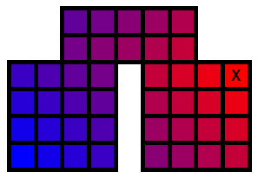
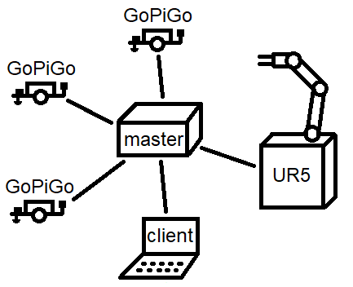
VarastoRobo –project, master server and network communication
Santtu Nyman TVT17SPL
Oulu University of Applied Sciences
Information Technology, Option of Device and Product Design
Introduction
The aims of this project were to make autonomous storage management system, where multiple devices work in co-operation, to bring the ordered item to the user and surveil the premises in case of intruders.
Objectives
This part of VarastoRobo -project was to design a specification for communication between devices used in the storage system and to create software, to coordinate all devices, to bring ordered items to user.
Methods or what ever
Design of the communication specification was done with transferred information, ease of implementation and code reuse on master server taken to consideration.
Figure 1
To make devices work in co-operation, “master server” software was created to control all devices in the system. The master server is center of point of communication between different parts of the system, as seen in figure 1. The system uses both TCP and UDP for messaging.
The master server broadcasts information for user’s client software UDP messages. These broadcast messages are also used to uncover the master server’s IP address for other devices. All devices connect to the master server of the system using TCP connections. The TCP connection is used to transfer commands to control devices of the system and used to control the entire system from user’s client software.
Figure 2.
The master server creates paths for GoPiGos for transporting items form the storage to a user. The master server transforms data that represents different parts of the system to grid of open cells and this grid is then transformet to distances
to desired location, as seen in figure 2. these distance maps are used to create the paths of GoPiGos. GoPiGos are assigned different priorities for deciding how, devices drive around each other.
Cross-platform JSON parser library was also created for reading configurations of the master server and to be later used in other projects.
Results
Shared communication specification was written, and master server software was written. The system worked as planned.
Conclusions
The development team learned valuable lessons working with much bigger team than in any previous projects. Experience working with asynchronous IO using sockets was gained with using then on the master server. JSON language’s syntax was learned while creating parser for it and, it’s practical use while using it for configuring the master server.
References
GoPiGo3 website: www.dexterindustries.com/gopigo3/
UR5 website: www.universal-robots.com/products/ur5-robot/
I DO NOT CARE ABOUT THIS REFERENCE TRASH
ID00BQ11 Product Design and Implementation
ECTS Credits: 15
Date of Publication: 2019, December
Instructors: Eero Nousiainen

