Slide 1
Flying TOOLTIP
HOVERCRAFT Team
18/06/2020

Slide 2





MISSION: Flying tooltip on hover
Team Participants:
Zubenko Herman (QA)
Yarovuy Vitaliy (Software Dev)
Westhof Jarno (Software Dev)
Pokolenko Olha (QA)

Slide 3
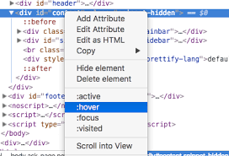
MISSION: Flying tooltip on hover
WEAPON:
CHROME PLUGIN
CHALLENGE:
Save users from being confused
Add TIPS for tools

Slide 4
Flying tooltip on hover
FEATURES :
It can help with a detailed and interactive walkthroughs / new feature announcements / user onboarding
Plugin could be applied to any web-site
Prevent users from unnecessary drill downs by providing useful contextual help
Less drill downs means less pages requested, so less server load

Slide 5
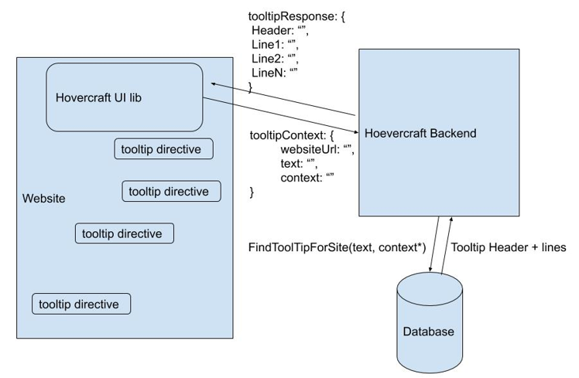
Flying tooltip on hover
BACKGROUND and INSTALLATION

Slide 6

Flying tooltip on hover
Examples of web-site with integrated tooltip plugin:
https://ospokolenko.wixsite.com/nonsense
https://hovercraft.azurewebsites.net/
Now, it’s time for the Demo …

Slide 7

Flying tooltip on hover
Any questions?
Maybe suggestions?
Or … comments?

Slide 8

Thank you for

