Slide 1
ON THE INFORMATION BOTTLENECK
THEORY OF DEEP LEARNING
A. M. Saxe, Y. Bansal, J. Dapello, M. Advani, A. Kolchinsky, B. D. Tracey, D. D. Cox
15 Feb. 2018

Slide 2
Agenda
1. Introduction
2. Compression and Neural Nonlinearities
3. Information Plane Dynamics in Deep Linear Networks
4. Compression in Batch Gradient Descent and SGD
5. Simultaneous Fitting and Compression
6. Discussion

Slide 3
Introduction
analyzes and responds to (Tishby & Zaslavsky, 2015; Shwartz-Ziv & Tishby, 2017)
Tishby proposed his theory can be used to compare different architectures
information bottleneck (IB) theory provides a fundamental bound on the amount of input compression and target output information that any representation can achieve (Tishby et al., 1999)

Slide 4
Introduction
“fitting” phase: mutual information between the hidden layers and both the input and output increases
“compression” phase : mutual information between the hidden layers and the input decreases
Hypothesize: - compression phase is responsible for the excellent generalization performance of deep networks - occurs due to the random diffusion-like behavior of stochastic gradient descent.

Slide 5
Introduction
Aim is to study these phenomena using a combination of analytical methods and simulation

Slide 6
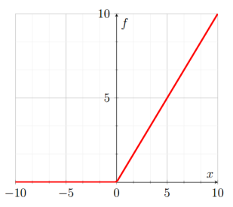
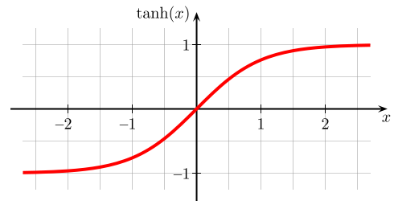
Compression and Neural Nonlinearities
tanh nonlinearity activation function: rectified linear activation function:

Slide 7
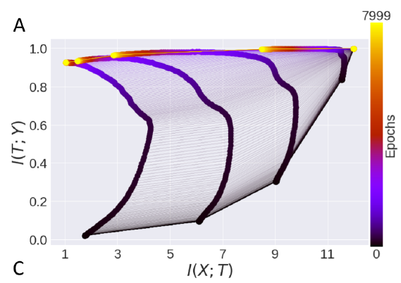
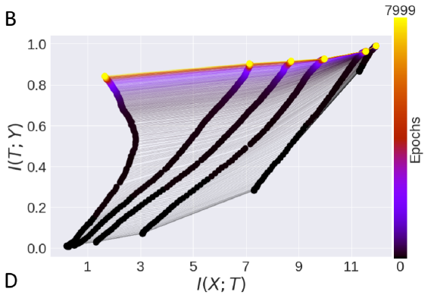
Compression and Neural Nonlinearities
Tanh nonlinearity activation function: Rectified Linear activation function:
compression no compression

Slide 8
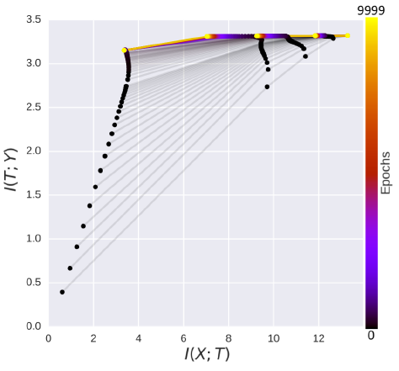
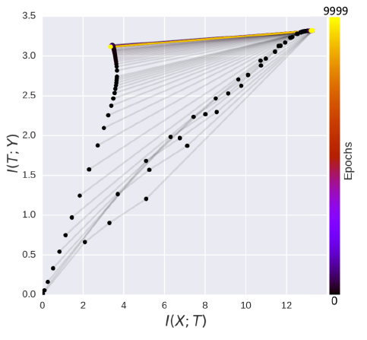
Compression and Neural Nonlinearities
Tanh trained on MNIST: ReLU trained on MNIST:
compression no compression
Notes:
The soft-sign activation function, a double-saturating nonlinearity that saturates more gently than tanh, shows modest compression.
The soft-plus activation function, a smoothed version of the ReLU, exhibits no compression. Hence double-saturating nonlinearities exhibit the compression effect while singlesaturating nonlinearities do not.

Slide 9
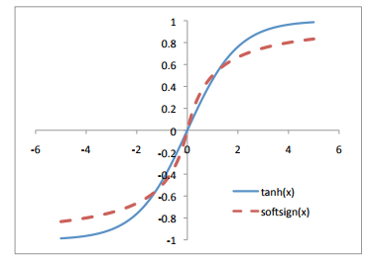
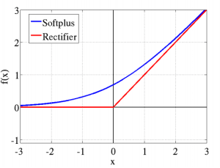
Compression and Neural Nonlinearities
Soft-sign activation function: Soft-plus activation function:
Notes:
The soft-sign activation function, a double-saturating nonlinearity that saturates more gently than tanh, shows modest compression.
The soft-plus activation function, a smoothed version of the ReLU, exhibits no compression. Hence double-saturating nonlinearities exhibit the compression effect while single saturating nonlinearities do not.

Slide 10
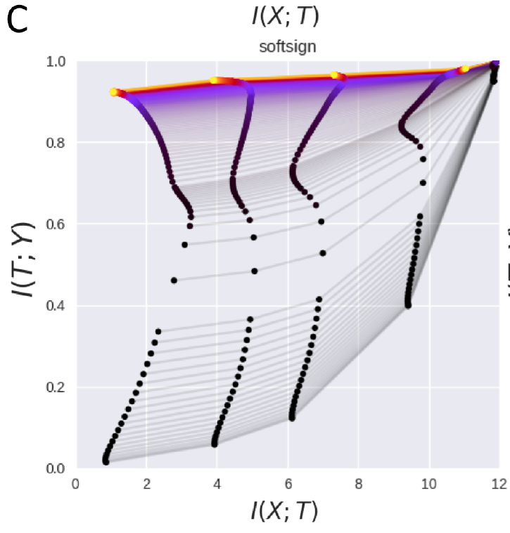
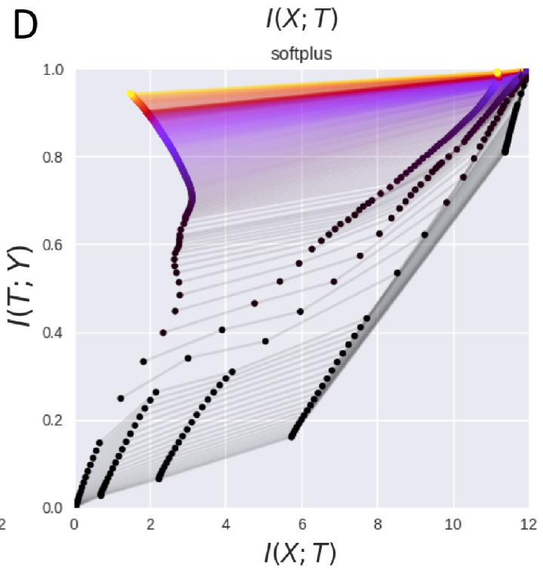
Compression and Neural Nonlinearities
Soft-sign activation function: Soft-plus activation function:
modest compression no compression
Notes:
The soft-sign activation function, a double-saturating nonlinearity that saturates more gently than tanh, shows modest compression.
The soft-plus activation function, a smoothed version of the ReLU, exhibits no compression. Hence double-saturating nonlinearities exhibit the compression effect while singlesaturating nonlinearities do not.

Slide 11
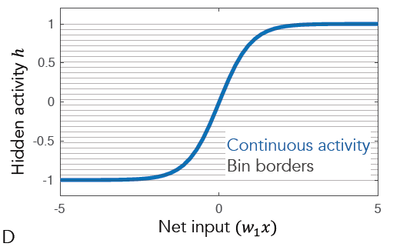
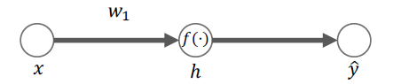
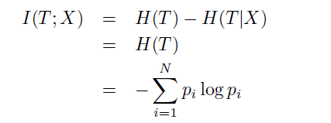

Compression and Neural Nonlinearities
Three Neuron Model:
Mutual Information:
since T is a deterministic function of X

Slide 12


Compression and Neural Nonlinearities
input X produces a hidden unit activity that lands in bin i, defined by lower and upper bin limits bi and bi+1:
for monotonic nonlinearities f() using the cumulative density of X:

Slide 13
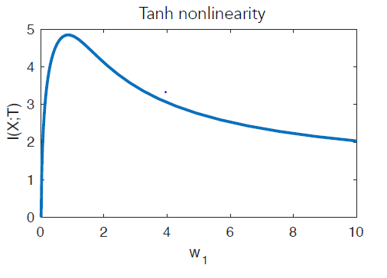
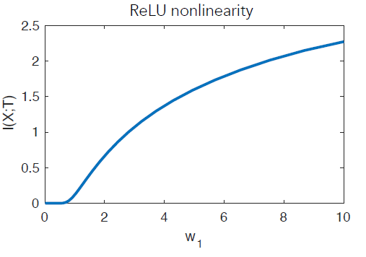
Compression and Neural Nonlinearities
mutual information as a function of weight

Slide 14

Compression and Neural Nonlinearities
binning procedure can be viewed as implicitly adding noise to the hidden layer activity:

Slide 15
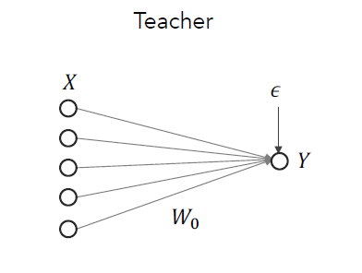
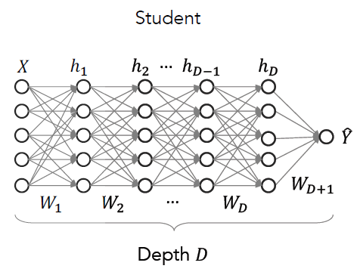
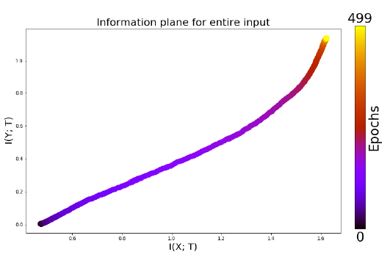
Information Plane Dynamics in Deep Linear Networks
generates a dataset by passing Gaussian inputs X through its weights and adding noise
A deep linear student network is trained on the dataset
no compression

Slide 16

Compression and Neural Nonlinearities
student network is then trained to minimize the mean squared error:
calculating the mutual information:

Slide 17
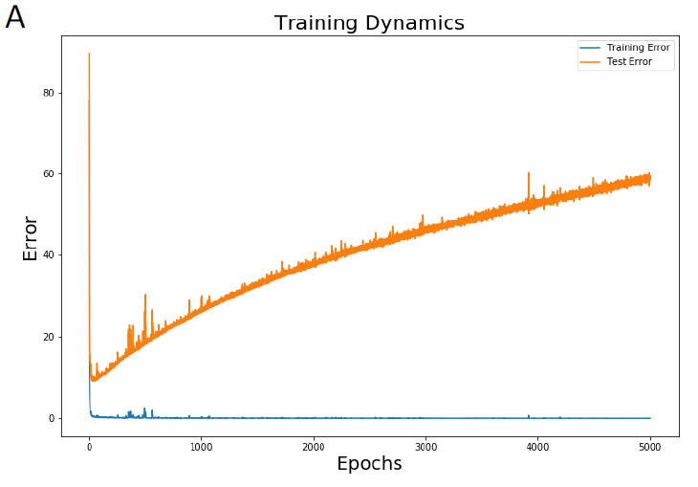
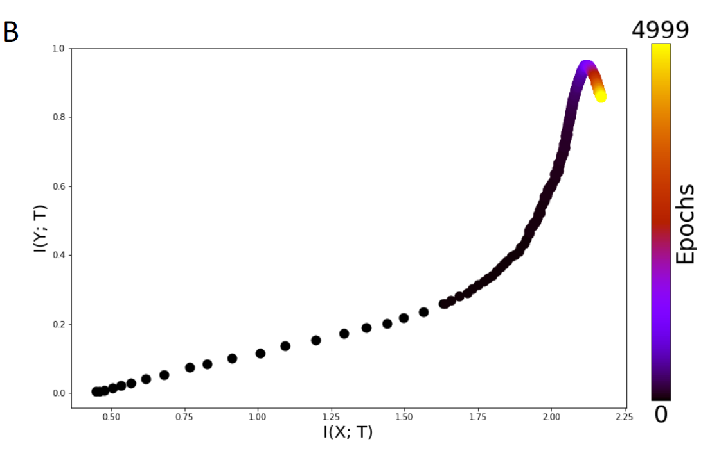
Information Plane Dynamics in Deep Linear Networks
No compression is observed
Average training and test mean square error for a deep linear network trained with SGD

Slide 18
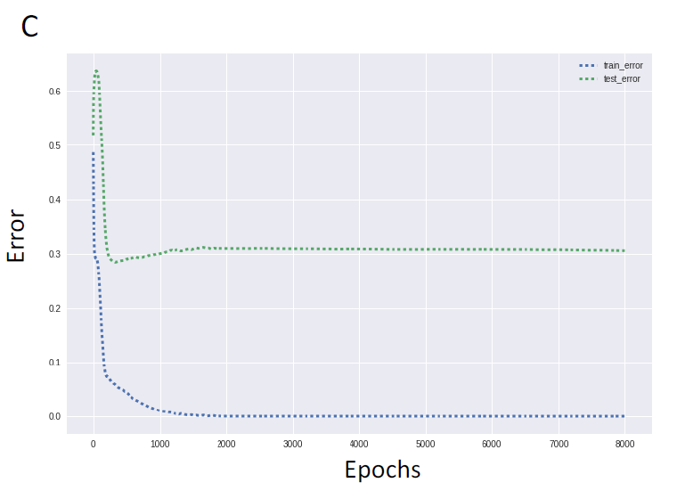
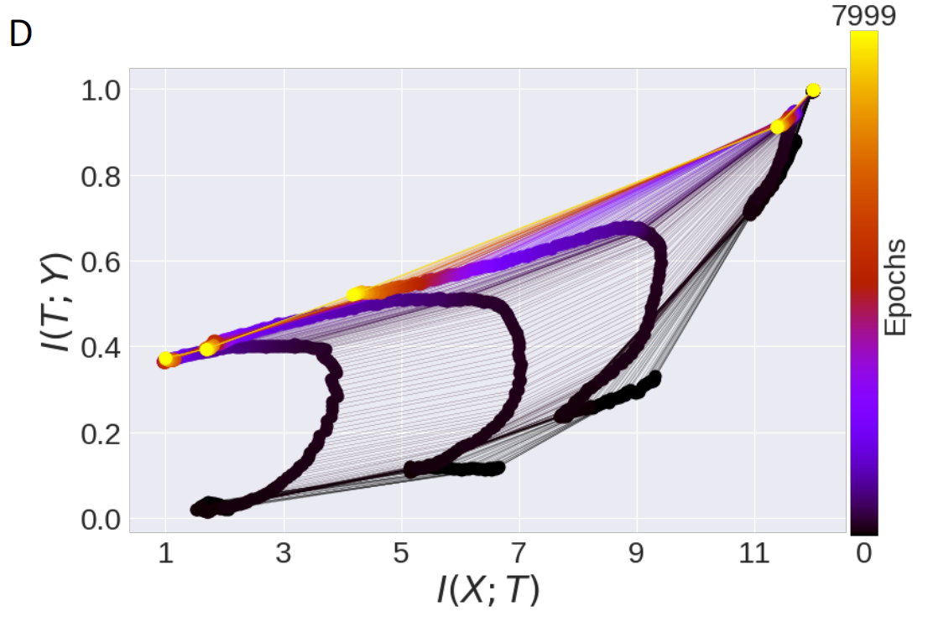
Information Plane Dynamics in Deep Linear Networks
Average train and test accuracy (% correct) for nonlinear tanh networks
Overfitting occurs despite continued compression

Slide 19
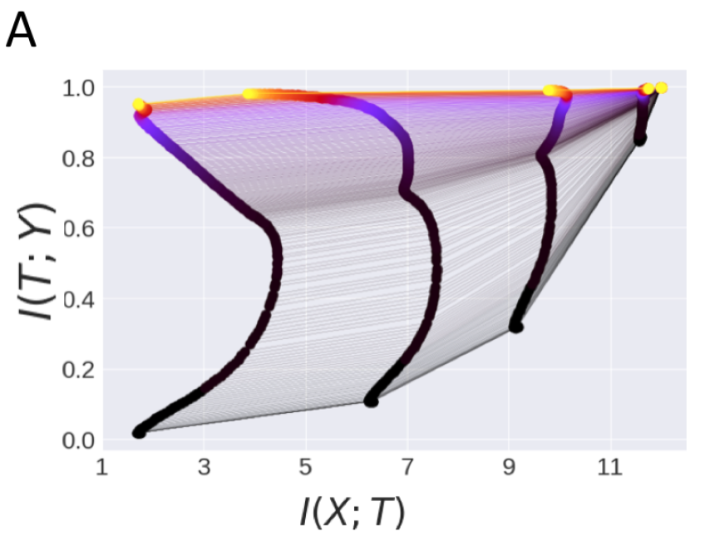
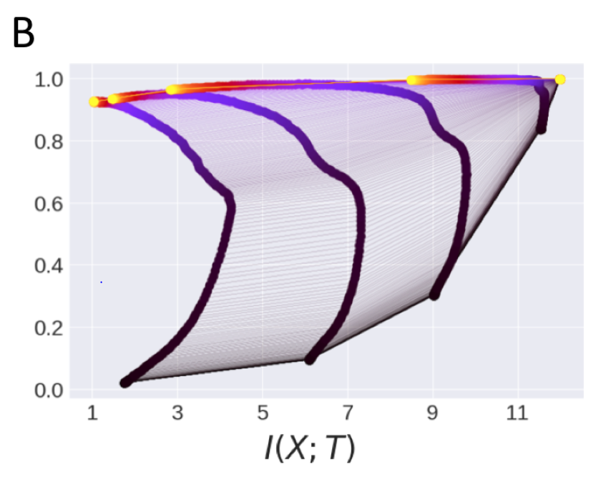
Information Plane Dynamics in Deep Linear Networks
tanh network trained with SGD
tanh network trained with BGD

Slide 20
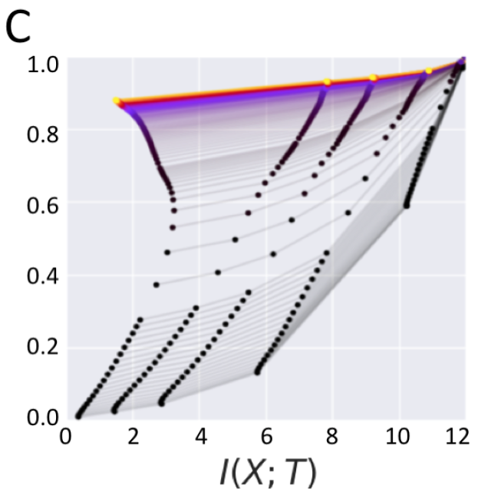
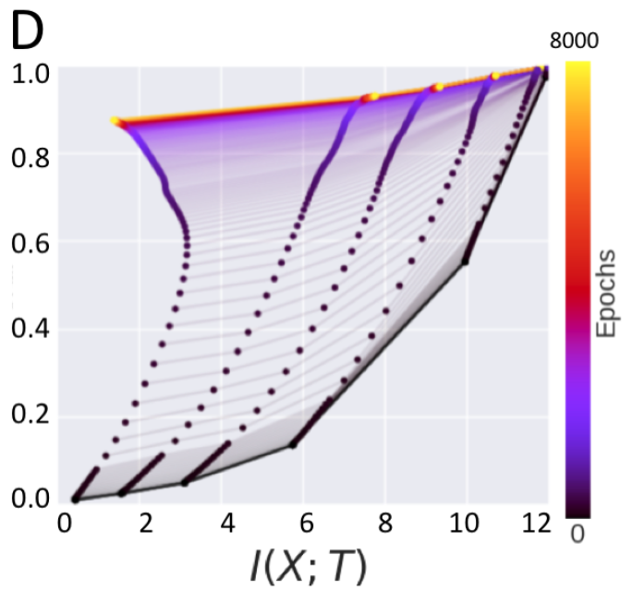
Information Plane Dynamics in Deep Linear Networks
ReLU network trained with SGD
ReLU network trained with BGD

Slide 21
Compression in Batch Gradient Descent and SGD
Stochastic gradient descent is responsible for the compression phase?
“drift” phase:
mean of the gradients over training samples is large relative to the standard deviation of the
gradients
“diffusion” phase:
the mean becomes smaller than the standard deviation
of the gradients

Slide 22
Compression in Batch Gradient Descent and SGD
Stochastic gradient descent is responsible for the compression phase?
-> Explanation does not hold up to either theoretical or empirical
theoretical:
There is no general reason that a given set of weights sampled from this distribution (i.e., the weight parameters found in one particular training run) will maximize H(XjT)
empirical:
- stochasticity of the SGD is not necessary for compression
- showed by training tanh and ReLU networks with SGD and BGD

Slide 23
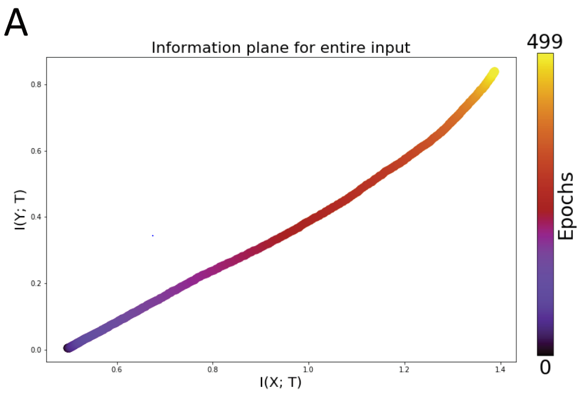
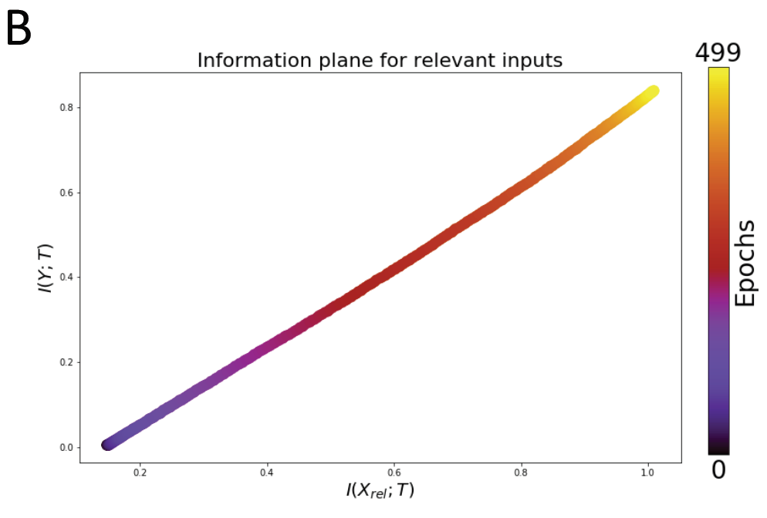
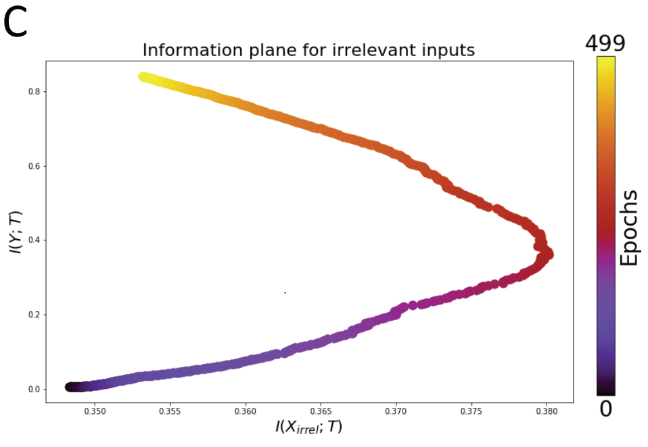
Simultaneous Fitting and Compression
For a large task-irrelevant subspace in the input, a linear network shows no overall compression
Information with the task-relevant subspace increases robustly over training
Information about the task-irrelevant subspace does compress over training

Slide 24
Discussion
compression dynamics in the information plane are not a general feature of deep networks
stochasticity in the training process does not contribute to compression
generalization performance may not clearly track information plane behavior (link between compression and generalization?)
link the information bottleneck principle with current practice in deep networks

Slide 25
Thank you for your attention!
Any questions?

