Slide 1
Strings
by Yaroslav Vendysh

Slide 2
Intro
In JavaScript, the textual data is stored as strings.
There is no separate type for a single character.
The internal format for strings is always UTF-16, it is not tied to the page encoding.

Slide 3
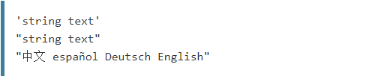
Syntax - string literals
Strings literals can be enclosed within either single quotes or double quotes:
Single and double quotes are essentially the same.

Slide 4

Syntax - string constructor
Strings can also be created using the String constructor:
thing - anything to be converted to a string

Slide 5
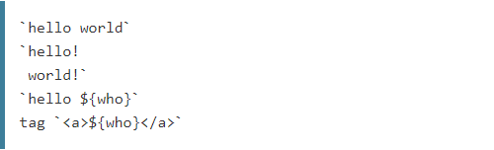
Syntax - template literals
Starting with ECMAScript 2015, string literals can be enclosed within backticks:

Slide 6
Escape notation
Besides regular characters, special characters can be encoded using escape notation.
Code | Result | Description
\' | ' | Single quote
\" | " | Double quote
\\ | \ | Backslash

Slide 7
Escape notation
Besides regular characters, special characters can be encoded using escape notation.
Code | Result
\b | Backspace
\f | Form Feed
\n | New Line
\r | Carriage Return
\t | Horizontal Tabulator
\v | Vertical Tabulator

Slide 8
Escape notation
Besides regular characters, special characters can be encoded using escape notation.
Code | Result
\XXX (where XXX is 1–3 octal digits; range of 0–377) | ISO-8859-1 character / Unicode code point between U+0000 and U+00FF
\uXXXX (where XXXX is 4 hex digits; range of 0x0000–0xFFFF) | UTF-16 code unit / Unicode code point between U+0000 and U+FFFF
\u{X} ... \u{XXXXXX} (where X…XXXXXX is 1–6 hex digits; range of 0x0–0x10FFFF) | UTF-32 code unit / Unicode code point between U+0000 and U+10FFFF
\xXX (where XX is 2 hex digits; range of 0x00–0xFF) | ISO-8859-1 character / Unicode code point between U+0000 and U+00FF

Slide 9

Escape notation – example using

Slide 10
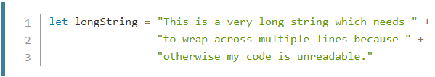
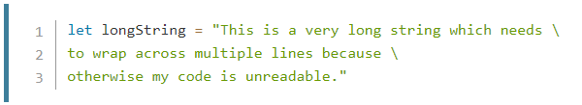
Long literal strings
Sometimes, your code will include strings which are very long.

Slide 11
Template literals – syntax
Template literals are string literals allowing embedded expressions.
You can use multi-line strings and string interpolation features with them.
They were called "template strings" in prior editions of the ES2015 specification.

Slide 12
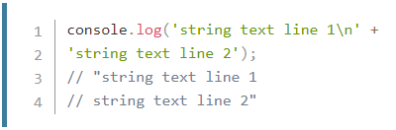
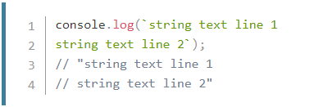
Template literals – multi-line strings
Before
After

Slide 13
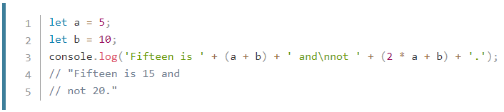
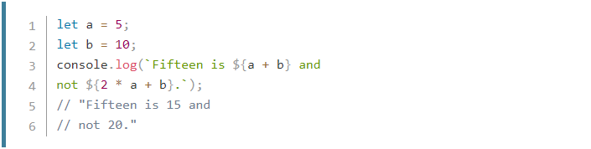
Template literals – expressions
Before
After

Slide 14
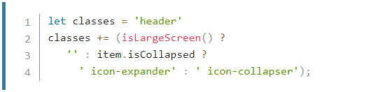

Template literals – nesting templates
Before
After

Slide 15
Template literals – tagged templates
A more advanced form of template literals are tagged templates.
Tags allow you to parse template literals with a function.
The first argument of a tag function contains an array of string values.
The remaining arguments are related to the expressions.
The tag function can then perform whatever operations on these arguments.

Slide 16
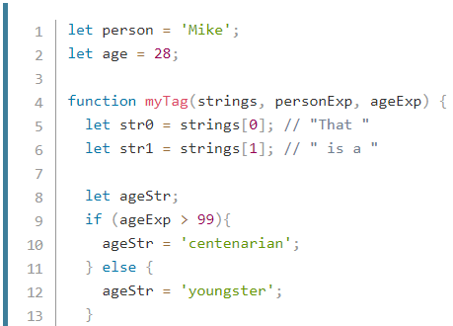
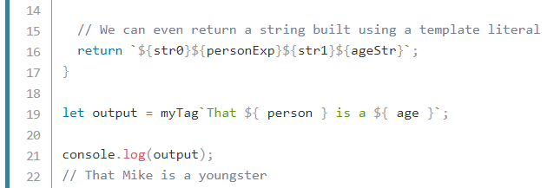
Template literals – tagged templates

Slide 17
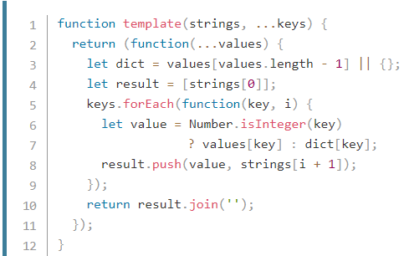
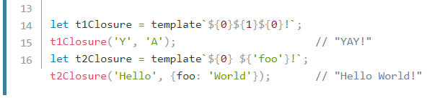
Template literals – tagged templates

Slide 18
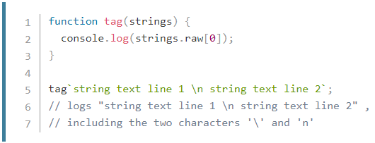
Template literals – raw strings
The special raw property, available on the first argument to the tag function, allows you to access the raw strings as they were entered, without processing escape sequences.

Slide 19
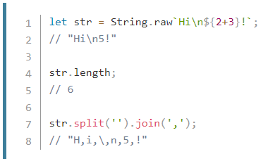
Template literals – raw strings
In addition, the String.raw() method exists to create raw strings - just like the default template function and string concatenation would create.

Slide 20
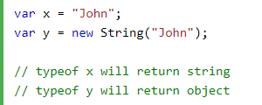
String object
Normally, JavaScript strings are primitive values, created from literal.
But strings can also be defined as objects with the keyword new.
Don't create strings as objects. It slows down execution speed.
The new keyword complicates the code. This can produce some unexpected results.

Slide 21



String object - unexpected results

Slide 22
Properties and methods in primitive?
Here’s the paradox faced by the creator of JavaScript:
There are many things one would want to do with a primitive like a string.
It would be great to access them as methods.
Primitives must be as fast and lightweight as possible.

Slide 23

Properties and methods in primitive?
The solution looks a little bit awkward, but here it is:
Primitives are still primitive. A single value, as desired.
The language allows access to methods and properties of strings.
In order for that to work, a special “object wrapper”.
It provides the extra functionality is created, and then is destroyed.

Slide 24

String length
The length property has the string length.
Note that \n is a single “special” character, so the length is indeed 3.

Slide 25
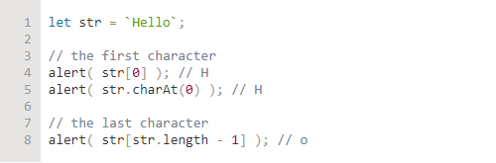
Accessing characters
To get a character at position pos, use square brackets or call the method str.charAt(pos).
The square brackets are a modern way of getting a character,
While charAt exists mostly for historical reasons.

Slide 26

Accessing characters
We can also iterate over characters using for..of:

Slide 27

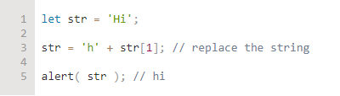
Strings are immutable
Strings can’t be changed in JavaScript. It is impossible to change a character.

Slide 28

Changing the case
Methods toLowerCase() and toUpperCase() change the case:

Slide 29
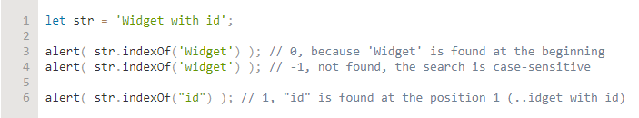
Searching for a substring - indexOf
The first method is str.indexOf(substr, pos).
It looks for the substr in str, starting from the given position pos.
And returns the position where the match was found or -1 if nothing can be found.

Slide 30

Searching for a substring - indexOf
The optional second parameter allows us to search starting from the given position.
For instance, the first occurrence of "id" is at position 1.
To look for the next occurrence, let’s start the search from position 2:

Slide 31
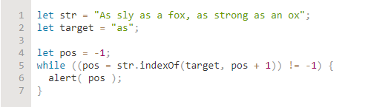
Searching for a substring - indexOf
If we’re interested in all occurrences, we can run indexOf in a loop.
Every new call is made with the position after the previous match:

Slide 32

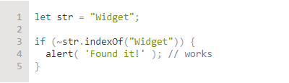
Searching for a substring - indexOf
One of the old tricks used here is the bitwise NOT ~ operator.
It converts the number to a 32-bit integer (removes the decimal part if exists)
And then it reverses all bits in its binary representation.
In practice, that means a simple thing: for 32-bit integers ~n equals -(n+1).

Slide 33
Searching for a substring - lastIndexOf
There is also a similar method str.lastIndexOf(substr, position).
This method searches from the end of a string to its beginning.
It would list the occurrences in the reverse order.

Slide 34

Searching for a substring - includes
The more modern method str.includes(substr, pos)
It returns true/false depending on whether str contains substr within.

Slide 35
Searching for a substring - includes
The optional second argument of str.includes is the position to start searching from:

Slide 36

Getting a substring - slice
str.slice(start [, end])
Returns the part of the string from start to (but not including) end.

Slide 37

Getting a substring - slice
If there is no second argument, then slice goes till the end of the string:
Negative values mean the position is counted from the string end:

Slide 38
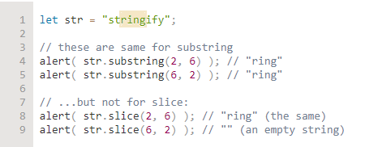
Getting a substring - substring
str.substring(start [, end])
Returns the part of the string between start and end.
This allows start to be greater than end. Negative arguments are not supported.

Slide 39
Getting a substring - substr
str.substr(start [, length])
Returns the part of the string from start, with the given length.
The first argument may be negative, to count from the end.

Slide 40
Getting a substring - comparing
Let’s recap these methods to avoid any confusion:
method | selects… | negatives
slice(start, end) | from start to end (not including end) | allows negatives
substring(start, end) | between start and end | negative values mean 0
substr(start, length) | from start get length characters | allows negative start

Slide 41


Comparing strings
Strings are compared character-by-character in alphabetical order.
Although, there are some oddities:
A lowercase letter is always greater than the uppercase:
Letters with diacritical marks are “out of order”:

Slide 42


Comparing strings
All strings are encoded using UTF-16. Each character has a corresponding numeric code.
There are special methods that allow to get the character for the code and back:
str.codePointAt(pos) - returns the code for the character at position pos
String.fromCodePoint(code) - creates a character by its numeric code

Slide 43
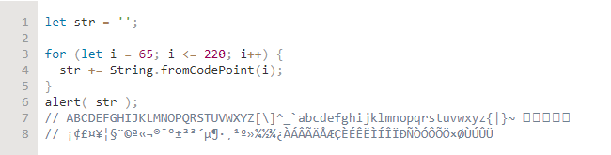
Comparing strings
Now let’s see the characters with codes 65..220 by making a string of them:

Slide 44
Comparing strings - correct comparisons
The “right” algorithm to do string comparisons is more complex than it may seem.
Alphabets are different for different languages, so browser needs to know it to compare.
The call str.localeCompare(str2) returns an integer indicating:
Returns a negative number if str is less than str2.
Returns a positive number if str is greater than str2.
Returns 0 if they are equivalent.

Slide 45
Another methods - unrelated to HTML
Method | Description
concat() | Combines the text of two (or more) strings and returns a new string.
match() | Used to match regular expression regexp against a string.
matchAll() | Returns an iterator of all regexp's matches.
padEnd() | Pads the current string from the end with a given string and returns a new string.
padStart() | Pads the current string from the start with a given string and returns a new string
repeat() | Returns a string consisting of the elements of the object repeated count times.
replace() | Used to replace occurrences of searchFor using replaceWith.

Slide 46
Another methods - unrelated to HTML
Method | Description
search() | Search for a match between a regular expression regexp and the calling string.
split() | Returns an array of strings populated by splitting the calling string.
toLocaleLowerCase() | The characters are converted to lowercase while respecting the current locale.
toLocaleUpperCase() | The characters are converted to uppercase while respecting the current locale.
toString() | Returns a string representing the specified object.
trim() | Trims whitespace from the beginning and end of the string.
trimStart()/trimLeft() | Trims whitespace from the beginning of the string.

Slide 47
Another methods - unrelated to HTML
Method | Description
trimEnd()/trimRight() | Trims whitespace from the end of the string.
valueOf() | Returns the primitive value of the specified object.
@@iterator() | Returns a new Iterator object that iterates over the code points of a String value.

Slide 48
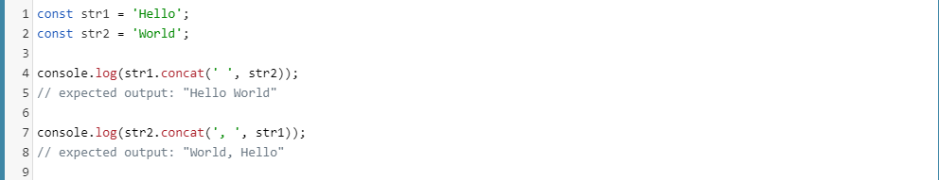
Another methods - unrelated to HTML
concat() - example

Slide 49
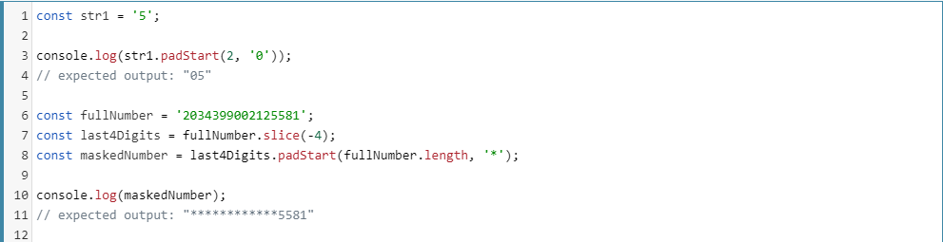
Another methods - unrelated to HTML
padStart() - example

Slide 50
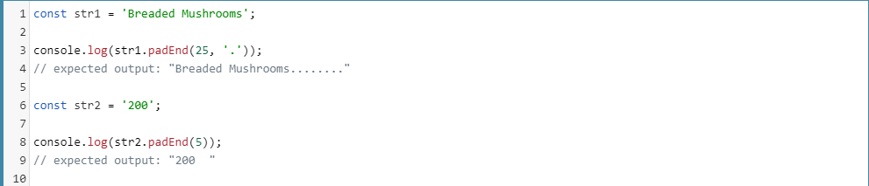
Another methods - unrelated to HTML
padEnd() - example

Slide 51
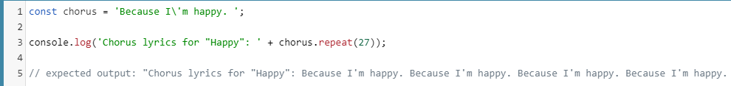
Another methods - unrelated to HTML
repeat() - example

Slide 52
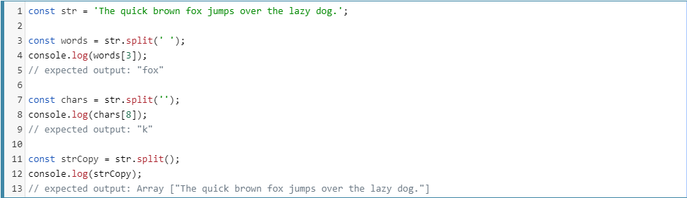
Another methods - unrelated to HTML
split() - example

Slide 53
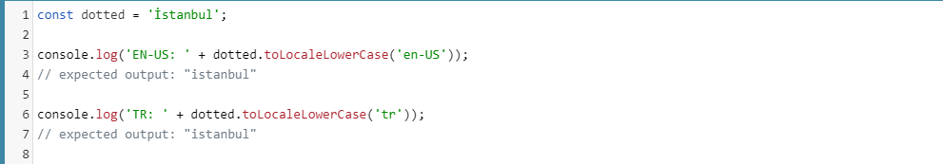
Another methods - unrelated to HTML
toLocaleLowerCase() - example

Slide 54
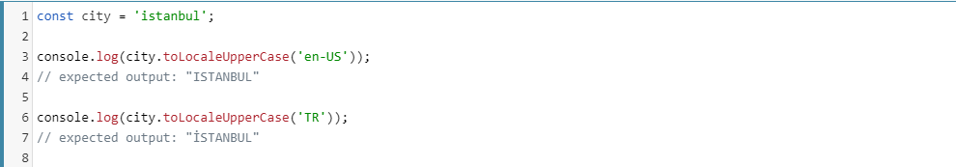
Another methods - unrelated to HTML
toLocaleUpperCase() - example

Slide 55
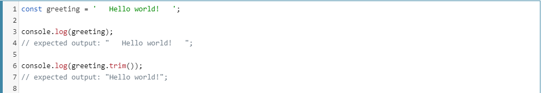
Another methods - unrelated to HTML
trim() - example

Slide 56
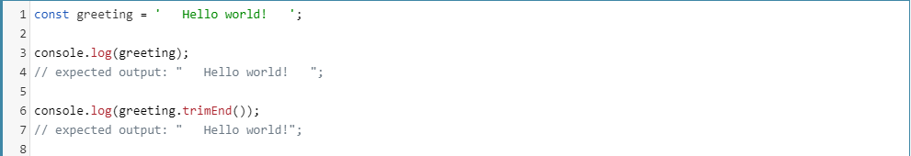
Another methods - unrelated to HTML
trimEnd() - example

Slide 57
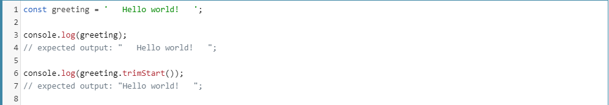
Another methods - unrelated to HTML
trimStart() - example

Slide 58
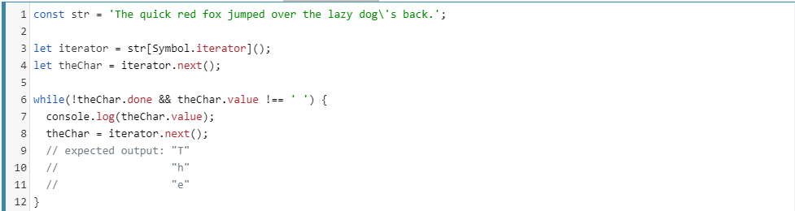
Another methods - unrelated to HTML
[@@iterator]() - example

Slide 59
Another methods - related to HTML
Method | HTML
anchor() | <a name="name">
big() | <big>
blink() | <blink>
bold() | <b>
fixed() | <tt>
fontcolor() | <font color="color">
fontsize() | <font size="size">
Notes:
Blink – текст мигає
Fixed – для введень з клавіатури, коду

Slide 60
Another methods - related to HTML
Method | HTML
italics() | <i>
link() | <a href="url">
small() | <small>
strike() | <strike>
sub() | <sub>
sup() | <sup>
Notes:
Strike – перекреслений текст
Sub – індекс знизу
Sup – індекс зверху

Slide 61

Bonus ☺ - surrogate pairs
All frequently used characters have 2-byte codes.
But 2 bytes only allow 65536 combinations and that’s not enough for every possible symbol.
So rare symbols are encoded with a pair of 2-byte characters called “a surrogate pair”.

Slide 62

Bonus ☺ - surrogate pairs
String.fromCodePoint and str.codePointAt - methods that deal with surrogate pairs right.
Before them, there were only String.fromCharCode and str.charCodeAt.
These methods are actually the same, but don’t work with surrogate pairs.

Slide 63


Bonus ☺ - diacritical marks
There are symbols that are composed of the base character with a mark above/under it.
For instance, the letter a can be the base character for: àáâäãåā.
Most common “composite” character have their own code in the UTF-16 table.
But not all of them, because there are too many possible combinations.
To support arbitrary compositions, UTF-16 allows us to use several unicode characters:

Slide 64
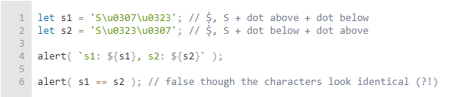
Bonus ☺ - diacritical marks
This provides great flexibility, but also an interesting problem:
characters visually look the same, but be represented with different unicode compositions.

Slide 65

Bonus ☺ - diacritical marks
To solve this, there exists a “unicode normalization” algorithm.
It brings each string to the single “normal” form.
It is implemented by str.normalize().

Slide 66
Useful links
https://developer.mozilla.org/en-US/docs/Web/JavaScript/Reference/Global_Objects/String
https://www.w3schools.com/js/js_string_methods.asp
https://www.sitepoint.com/15-javascript-string-functions/
https://javascript.info/string
https://www.tutorialspoint.com/javascript/javascript_strings_object.htm

Slide 67
Thank you for attention
by Yaroslav Vendysh

