Slide 1

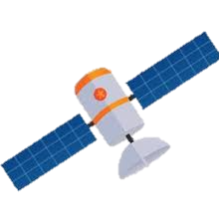
Orbit Debris and its Effect on Insolation
Jarod Aerts

Slide 2
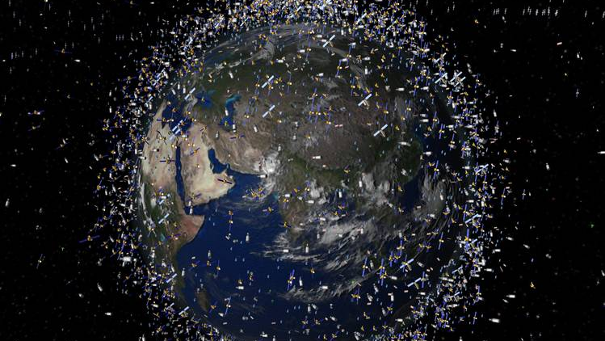
Question 1: Does orbital debris have a significant effect on insolation?
Question 2: If yes, could we use orbital reflectors to curb global warming?

Slide 3


What is orbital debris?
Broken Down Satellites
Rocket Second Stages
First Stage
Second Stage

Slide 4
How can this effect climate?
Orbital debris will block incoming solar radiation

Slide 5
How can we test it?
Map orbits of debris
Find total surface area in orbit
Calculate blocked sunlight

Slide 6
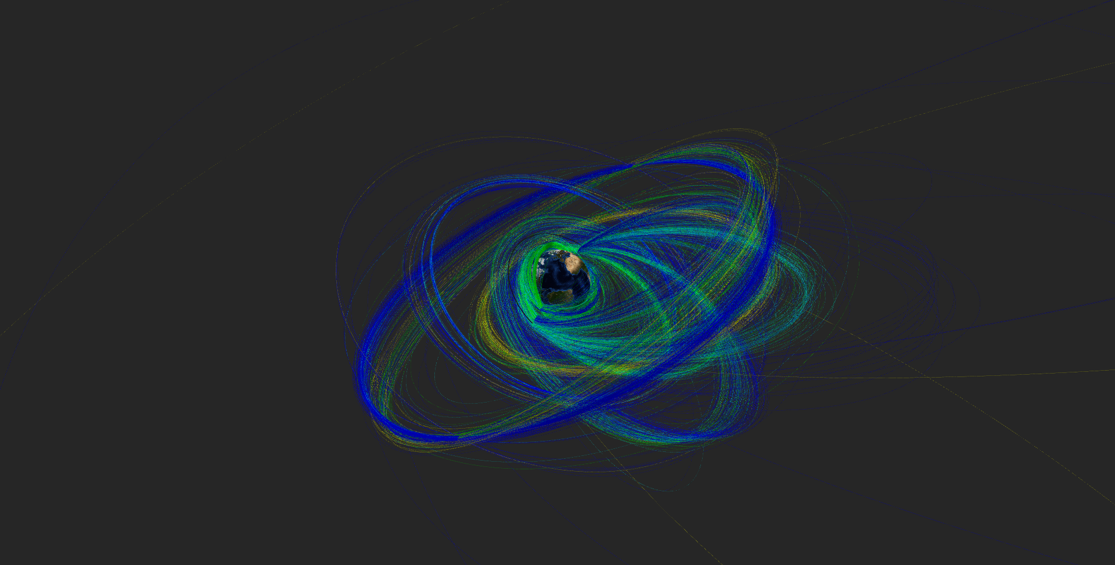
Orbits Plotted

Slide 8
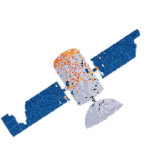
0.000000000052%
Total solar energy blocked

Slide 9
Conclusion
No significant effect on insolation
Orbital solar deflectors are not feasible.
13368 Tons put in orbit

