Slide 1

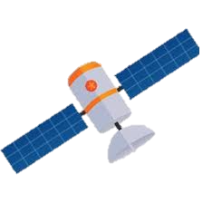
Orbit Space Debris and its Effect on Climate
Jarod Aerts

Slide 2


What is orbital debris?
Broken Down Satellites
Rocket Second Stages
First Stage
Second Stage

Slide 3
How can this effect climate?
Orbital debris will block incoming solar radiation

Slide 4
How can we test it?
Map orbits of debris
Find total surface area in orbit
Calculate blocked sunlight

Slide 5
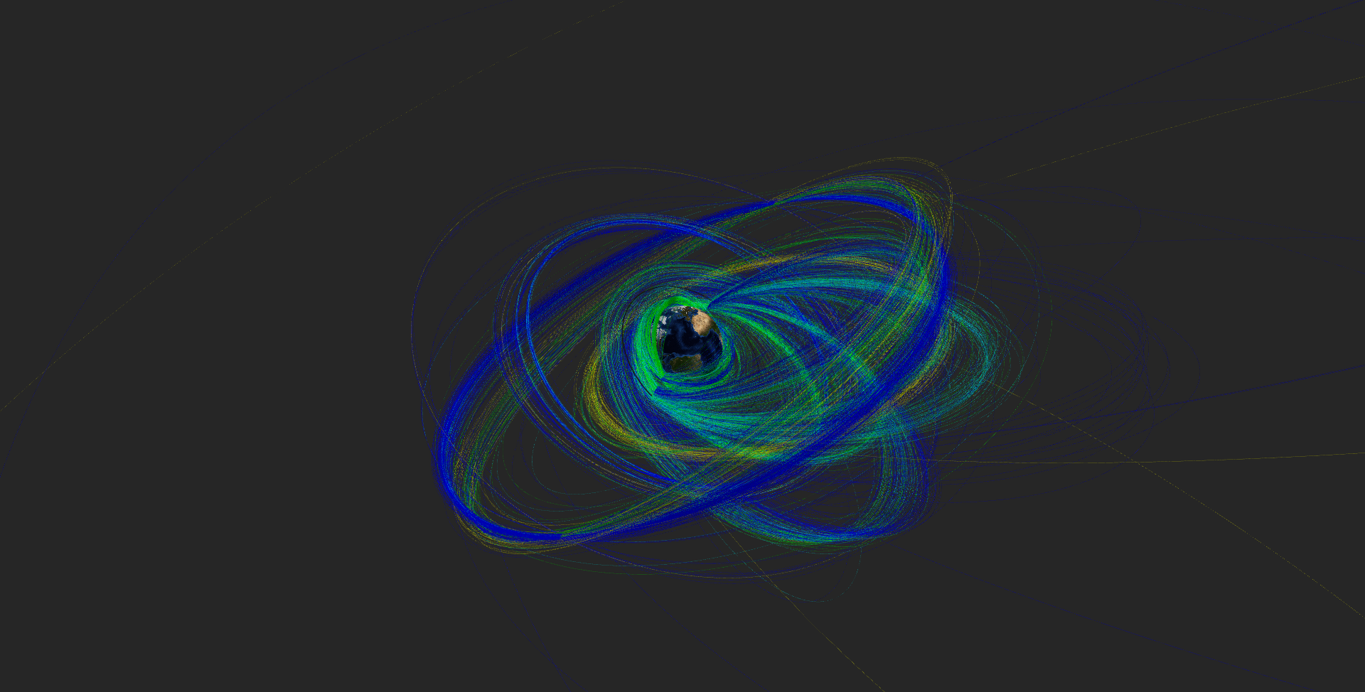
Orbits Plotted

Slide 7
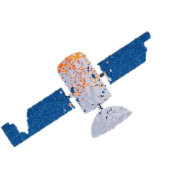
0.000000000052%
Total solar energy blocked

Slide 8
Conclusion
13368 Tons put in orbit
NO
Effects
on Insolation

