Slide 1

Y Wiki
An Open-Source App by Jarod Aerts

Slide 2


Slide 4
Y Wiki
An open source application to bring the knowledge of the internet to places where the internet doesn’t exist by utilizing the Wikipedia API.

Slide 5
Features
Search and download articles when internet is available
Download single articles
Download articles based on a topic
Browse and read downloaded articles offline

Slide 6
Demo

Slide 7
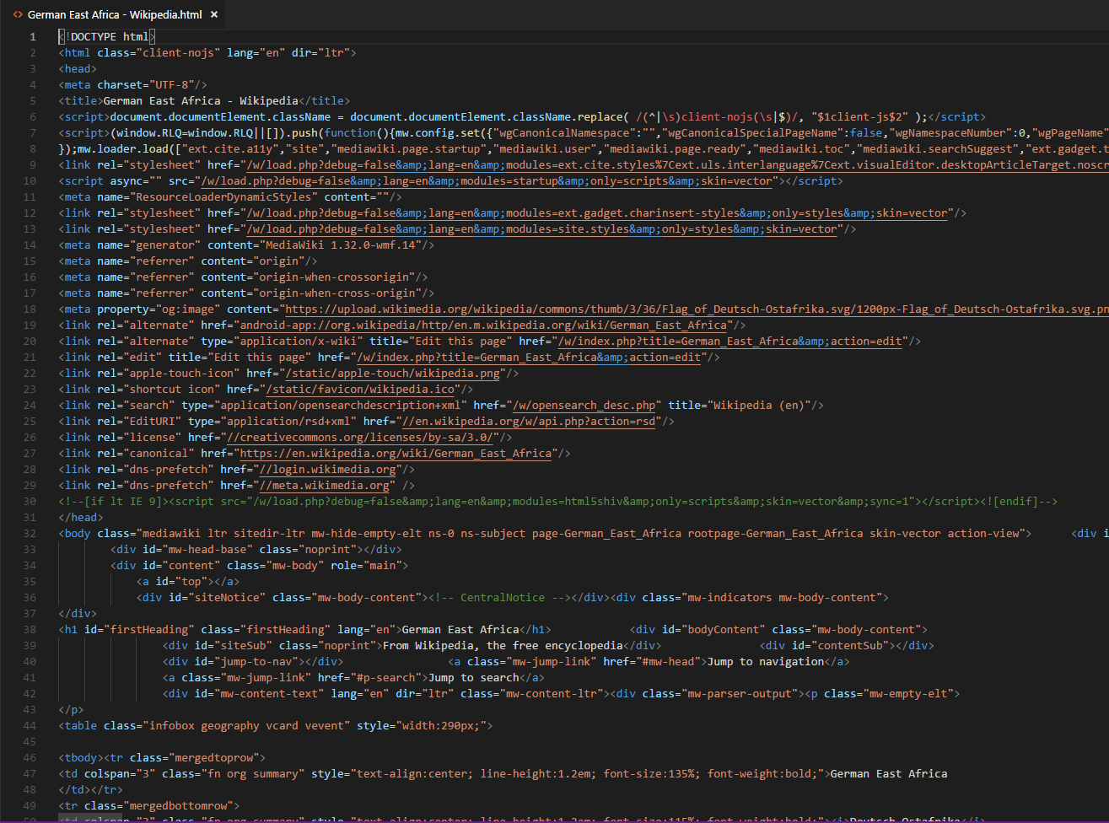
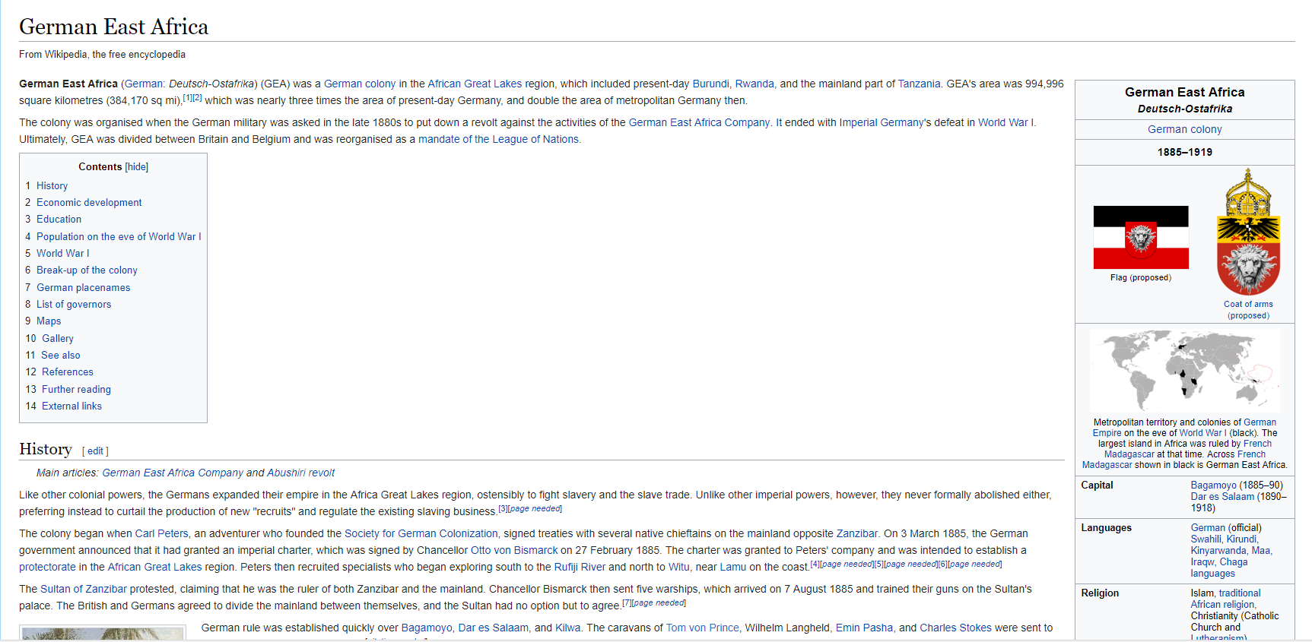
Some Issues…

Slide 8
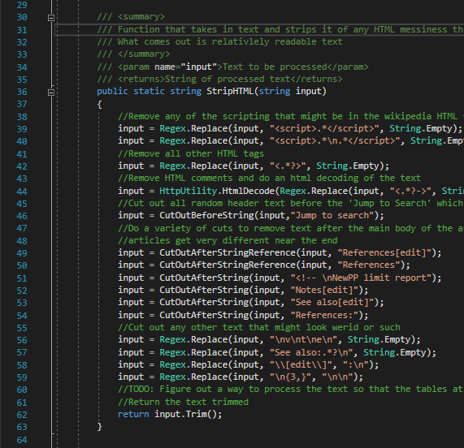

Slide 9


I want more than 10,000 articles at a time!
NO!

Slide 10
Questions?

