Slide 1
Predicting Ion Channels Opening
Jarod Carroll

Slide 2
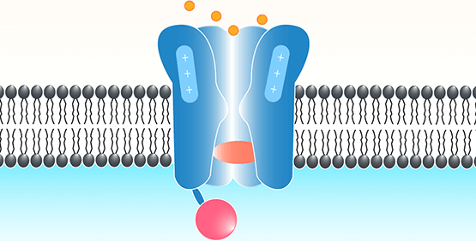
Goal and Why it’s important
Be able to predict the number of open channels from patch clamp data.
Allows for the study of ion channels.
Studying single channels is important in the study of channelopathies and other diseases.

Slide 3
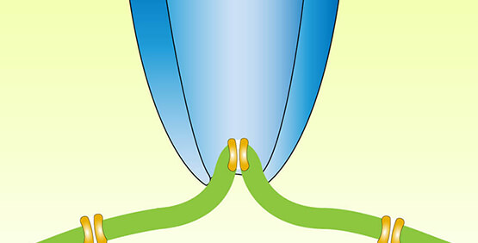
Patch Clamp
Allows for the capture and recording of a patch of the cell membrane.
Ideally this would get one or two channels but can get many channels.
Usually multiple channel data must be discarded. This is a huge time/labor waste

Slide 4
Process
Get the data
Process and transform it
Break the data into its different waveforms
Train a model
Transform the test data
Make predictions and get a score from Kaggle

Slide 5
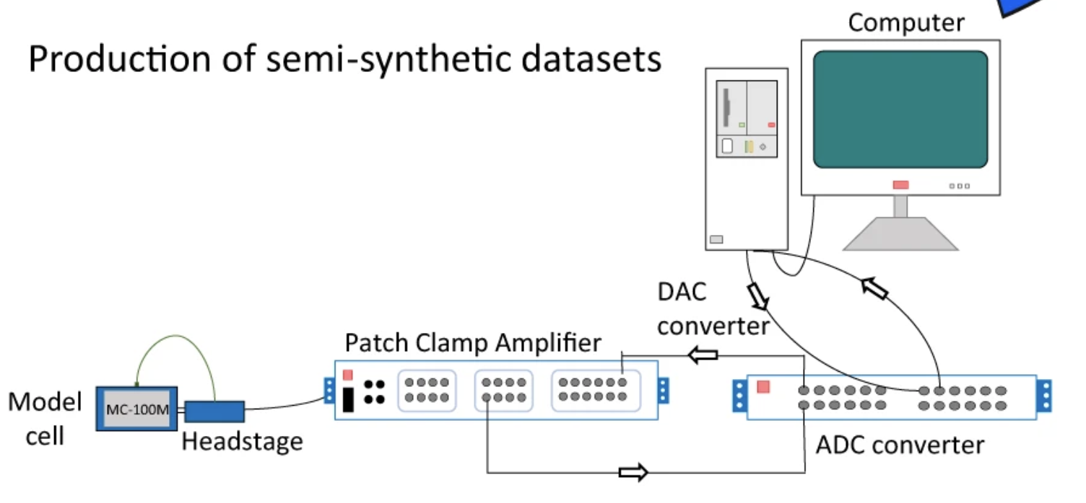
Where does the Data come from?
Kaggle competition by University of Liverpool.
Generated by a computer and played through normal patch clamp equipment.
Real world noise and drift added.
Indistinguishable from real data.
10 sets of 50 seconds of 10 kHz
data

Slide 6
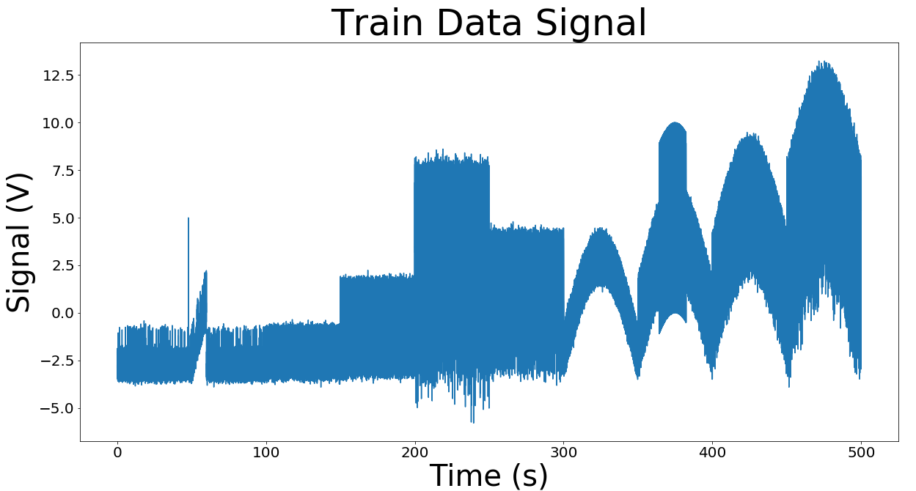
Inspecting the data

Slide 7
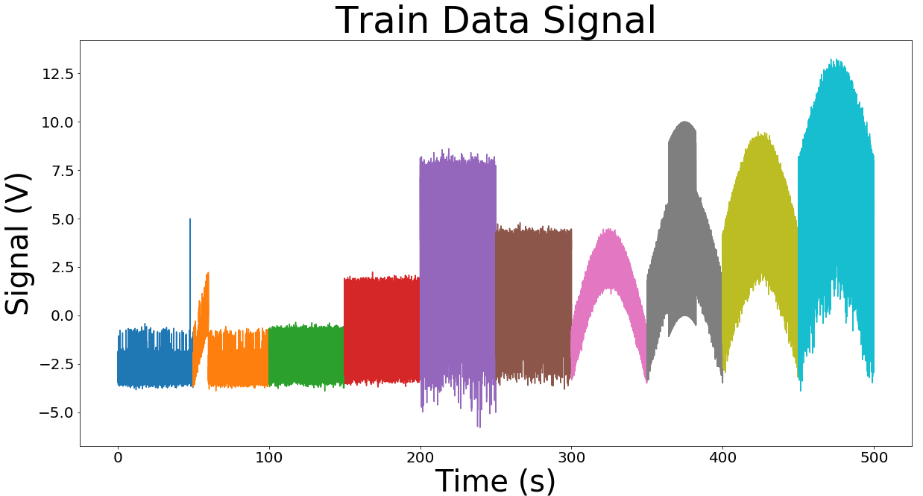
10 Sets of Data

Slide 8
Drift
Linear Drift
Parabolic Drifts

Slide 9
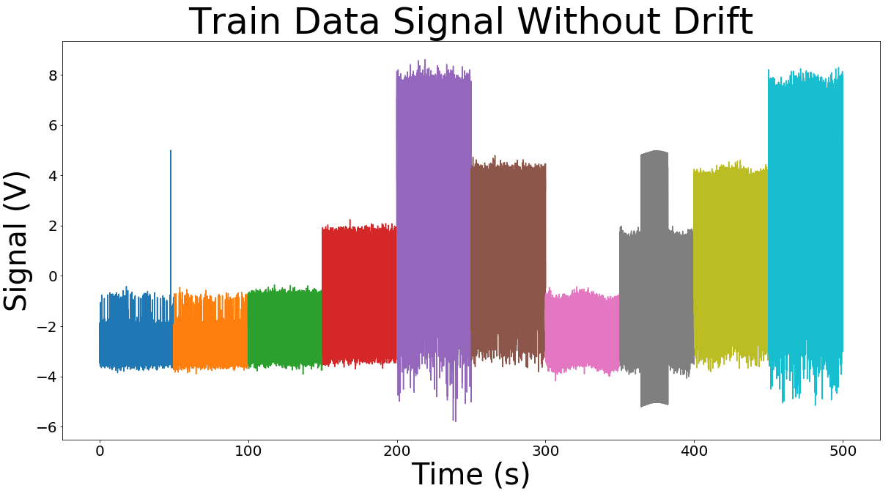
Remove Drifts with Functions

Slide 10
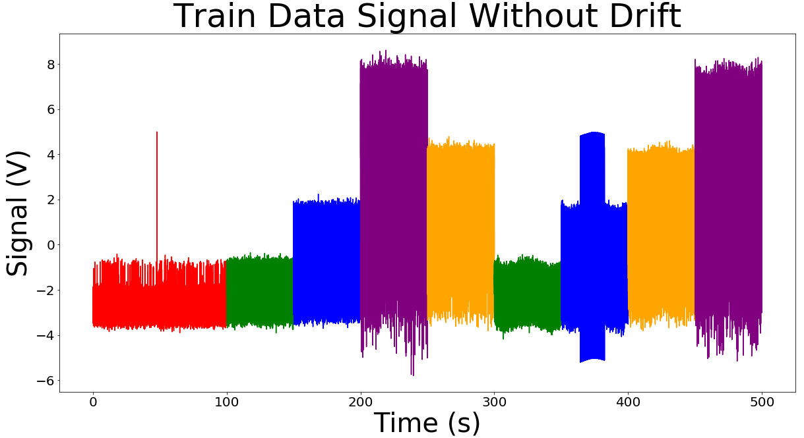
Different Waveforms

Slide 11
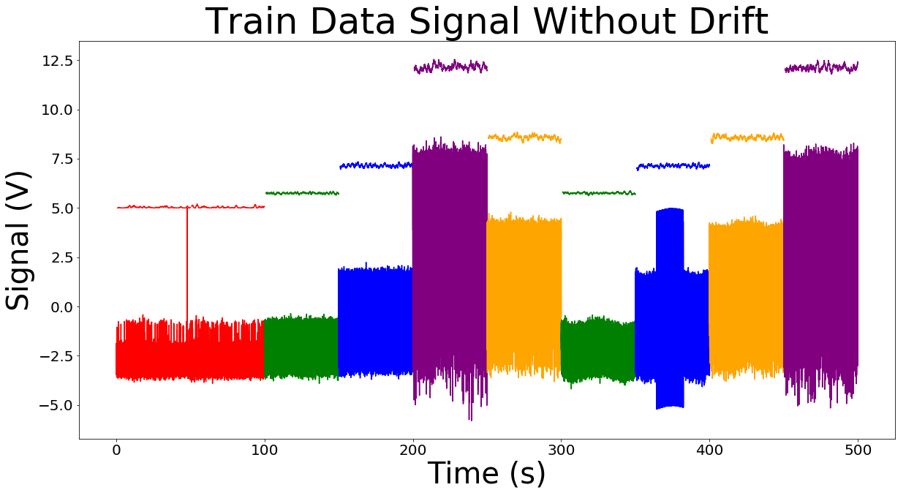
Different Waveforms
10
5
3
1f
1s

Slide 12
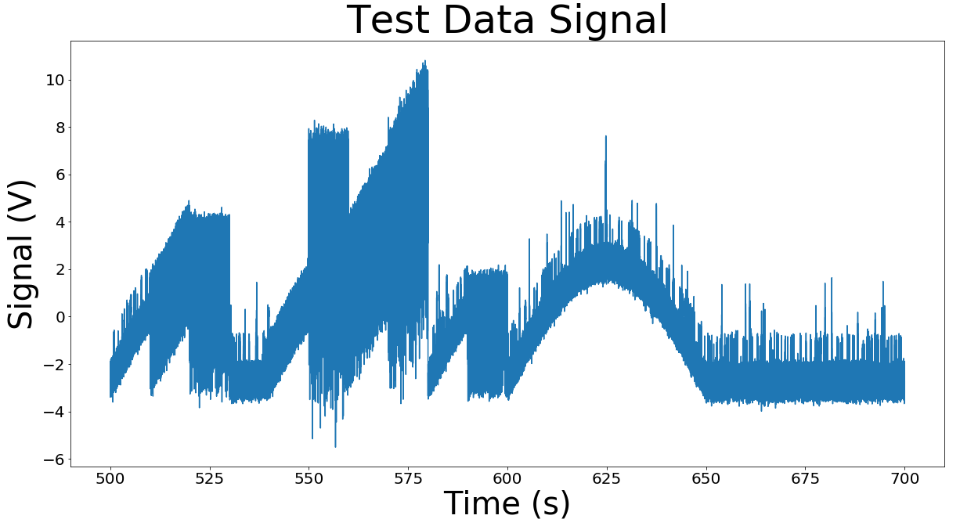
Test Data Drift

Slide 13
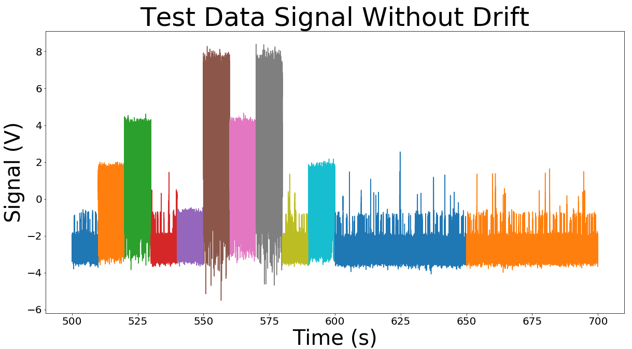
Test Data Drift

Slide 14
5 Models
Make a model for each waveform
Apply the the model that corresponds to the test waveform
Submit on Kaggle to get a macro F1 score
0.938
Dummy model that picks majority class 0.278

Slide 15
What Next?
Optimize the model more.
Think of new ways to feature engineer and to make models.
Try to get an F1 score above 0.940

Slide 16
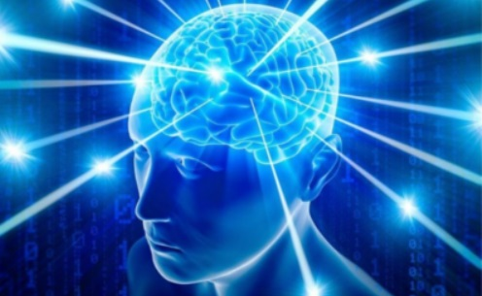
Thank you!
https://github.com/Jarodc33
www.linkedin.com/in/jarod-carroll-762a361a8

