Slide 1
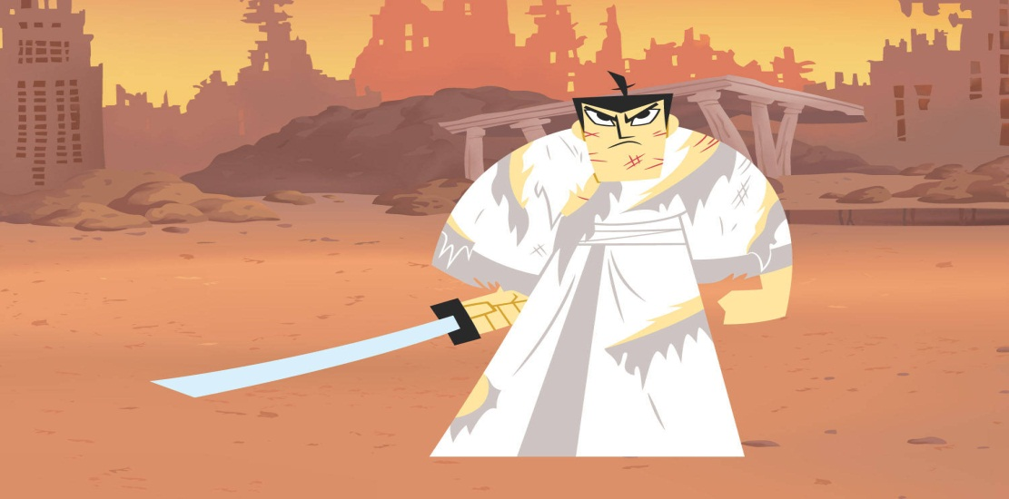
Online Shop (E-Shop)
Our Team, Demonstrate, Class Diagram, Source code, Commit logs
Team Samurai Jack
Telerik Software Academy
academy.telerik.com

Slide 2

Our Team
Samurai Jack :
Виктор Бахтев –
westi3m
Васил Василев –
vkv.1986
Митко Митев –
Mitko_Mitev
Ивайло Иванов –
Jarolim
Светлан Янев –
svetlan

Slide 3
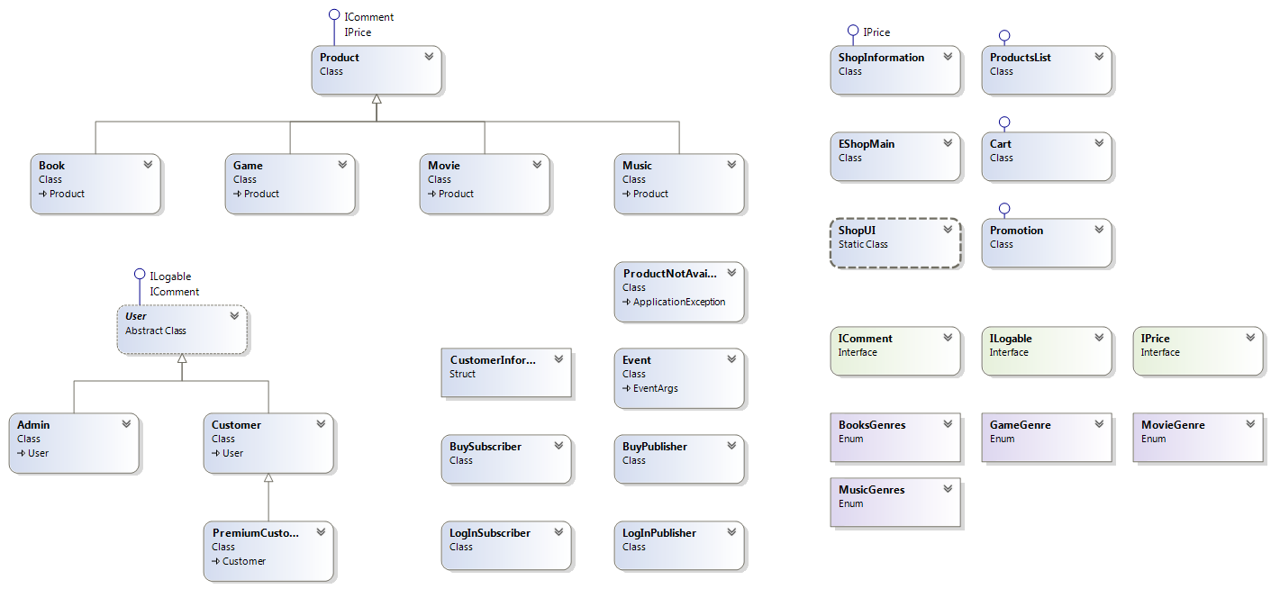
E-Shop
Class Diagram
Notes:
(c) 2006 National Academy for Software Development - http://academy.devbg.org*
3##

Slide 4

Demonstrate E-Shop
Live Demo
Notes:
(c) 2006 National Academy for Software Development - http://academy.devbg.org*
4##

Slide 5
Commit Logs
http://samuraijack.codeplex.com/SourceControl/list/changesets?ProjectName=samuraijack
http://samuraijack.codeplex.com/SourceControl/changeset/view/24906
http://samuraijack.codeplex.com/
Project files
Project info
5

Slide 6

Source code
Live Demo
Notes:
(c) 2006 National Academy for Software Development - http://academy.devbg.org*
6##

Slide 7

Thank You For Your Attention!
Questions?

