Slide 1
Light
Speed
Sara Alić-Ekinović
Timotej Kotlín
Samuel Lipovský

Slide 2


Vision
“We live in a world where we experience needless delays due to never-ending traffic jams. However, what if this could be avoided?”
- Founder of LightSpeed

Slide 3
Vision
Efficient routes
Multiple modes of transport
Precise route duration estimates

Slide 4

User Stories
Personal Budget Planning
user story
Disabled Access
user story
Carbon Emissions
user story
Filtering Transportation Types
user story
Connection Density Visual Data
user story
Seasonal Travel Information
user story

Slide 5
User Stories
Personal Budget Planning
user story
As a LightSpeed user.
I want to be able to check my daily/weekly/monthly money expenditure on the trips I have taken.
So that I would be able to make better choices when it comes to my budget.

Slide 6
User Stories
Disabled Access
user story
As a disabled LightSpeed user,
I want to filter for wheelchair accessible routes beforehand,
So that I am able to complete the journey without unnecessary re-routing.

Slide 7
User Stories
Connection Density Visual Data
user story
As a company that finds your data analysis quite helpful.
We want to have the option to see a visual map representation of the popularity of public transport connections throughout daily hours.
So that we can better visualize which connection causes troubles at set hours and make more optimal strengthening choices.

Slide 8
Use Cases
LightSpeed App
Route Search
Statistics & Analytics
Select Green Route
Analyse Seasonal Travel Patterns
Green User
View Travel Expenditure summary
Data Analyst
Filter Wheelchair Accessible Routes
«extends»
Filter Transportation Types
Personal Statistics
«extends»
«extends»
«extends»
«extends»
Search a Route to selected Destination
Check Emission Statistics
Disabled User
LightSpeed User

Slide 9
Use Cases

Slide 10
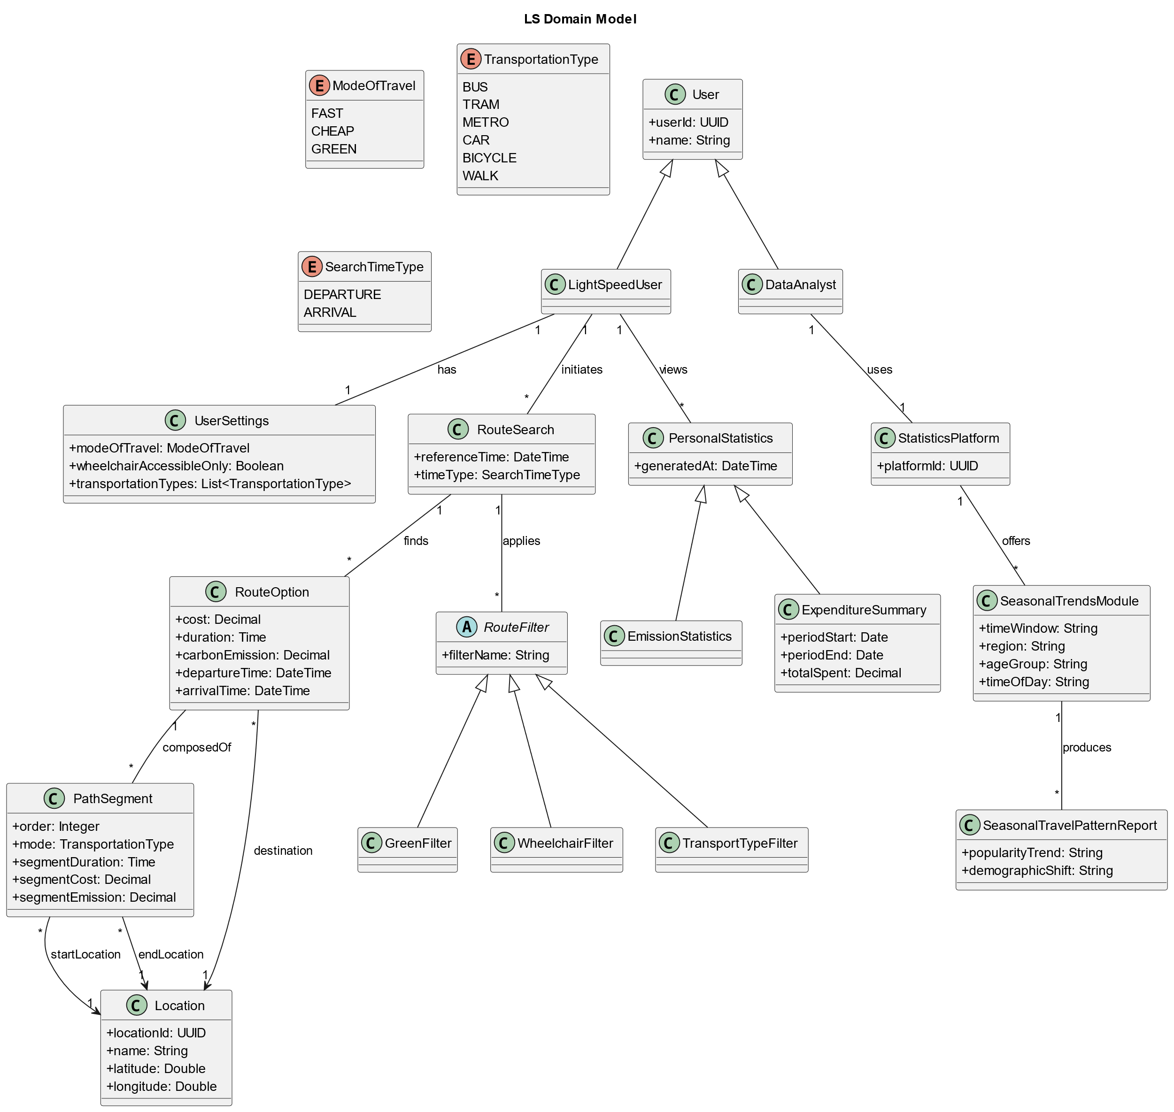
Domain Model

Slide 11
Thank you for
your attention

