Slide 1
Light
Speed
Sara Alić-Ekinović
Timotej Kotlín
Samuel Lipovský

Slide 2


Vision
“We live in a world where we experience needless delays due to never-ending traffic jams. However, what if this could be avoided?”
- Founder of LightSpeed

Slide 3
Vision
Efficient routes
Multiple modes of transport
Precise route duration estimates

Slide 4

User Stories
Personal Budget Planning
user story
Disabled Access
user story
Carbon Emissions
user story
Filtering Transportation Types
user story
Connection Density Visual Data
user story
Seasonal Travel Information
user story
Ease of Travel App
user story

Slide 5
User Stories
Ease of Travel App
user story
As someone who travels around Prague a lot.
I want a system that would encompass all the travel options in one App.
So that I can search for a place I want to get to and easily see all the possible travel options in one place and decide which combination suits me the best.

Slide 6
User Stories
Personal Budget Planning
user story
As a LightSpeed user.
I want to be able to check my daily/weekly/monthly money expenditure on the trips I have taken.
So that I would be able to make better choices when it comes to my budget.

Slide 7
User Stories
Connection Density Visual Data
user story
As a company that finds your data analysis quite helpful.
We want to have the option to see a visual map representation of the popularity of public transport connections throughout daily hours.
So that we can better visualize which connection causes troubles at set hours and make more optimal strengthening choices.

Slide 8

Use Cases
LightSpeed App
Route Search
Statistics & Analytics
Select Green Route
Analyse Seasonal Travel Patterns
Green User
View Travel Expenditure summary
Data Analyst
Filter Wheelchair Accessible Routes
«extends»
Filter Transportation Types
Personal Statistics
«extends»
«extends»
«extends»
«extends»
Search a Route to selected Destination
Check Emission Statistics
Disabled User
LightSpeed User

Slide 9
Use Cases
View Travel Expenditure Summary
use case
Actors: Regular LightSpeed User
Pre-conditions:
a. The user is has made his/her account in the LightSpeed application.
b. The user is logged into his/her account
c. Trip cost data has been recorded into the system (if any trips were made).
Basic flow:
1. The user navigates to the "Spending Summary" section.
2. The system displays options for viewing expenditure: Daily, Weekly and Monthly.
3. The user selects a desired time range.
4. The system displays: total money spent in selected time range, overview of most and least expensive trip/s taken.
Alternative flows:
4a. If the user has not taken any trips during the selected period, the system shows a message: "No trip data found for this period."
Post-conditions:
a. The user sees their trip-related spending in a chosen time frame.
b. The user has the option to make more budget-conscious decisions.

Slide 10
Use Cases
Searching a route to selected destination
use case
Actors: LightSpeed user that wants to get somewhere.
Pre-conditions:
a. The user has an account and is logged into the LightSpeed app.
b. The user is on the default search homepage of the LightSpeed app.
c. The user wants to get to a destination of his choosing.
Basic flow:
System prompts the user to select a starting point for their journey.
The user enters a starting point.
The system shows possible starting points, based on the user input, on a map.
The user selects the desired starting point option.
System prompts the user to select the destination for their journey.
The user enters the destination.
The system shows possible destinations, based on the user input, on a map.
The user selects the desired destination option.
The system takes the user to the route options page.
The user selects his preferences.
The system searches for a route from the selected starting point to the desired destination.
The system takes the user to the connections page, showing the user all possible connections with their respective overview, filtered by time of arrival to the desired destination.
The user selects his preferred route.
The system calculates the cost and prompts the user to select a payment option from a pop-up window.
The user selects the payment option best suited for him.
The system takes the user to the payment page.
The user fills in payment data and clicks pay.
The system takes the payment data and checks it.
The system makes the transaction.
The system takes the user to the Travel Overview page
Alternative flows:
2b. The user selects the current location options. 3b. The system acquires the current user location using GPS services and sets it as a starting point. (Skip to step 5) 6b. The user selects the current location options. 7b. The system acquires the current user location using GPS services and sets it as a destination. (Skip to step 9
Post-conditions:
a. The user is on the Travel Overview page, where he sees all information about the route to his destination.

Slide 11
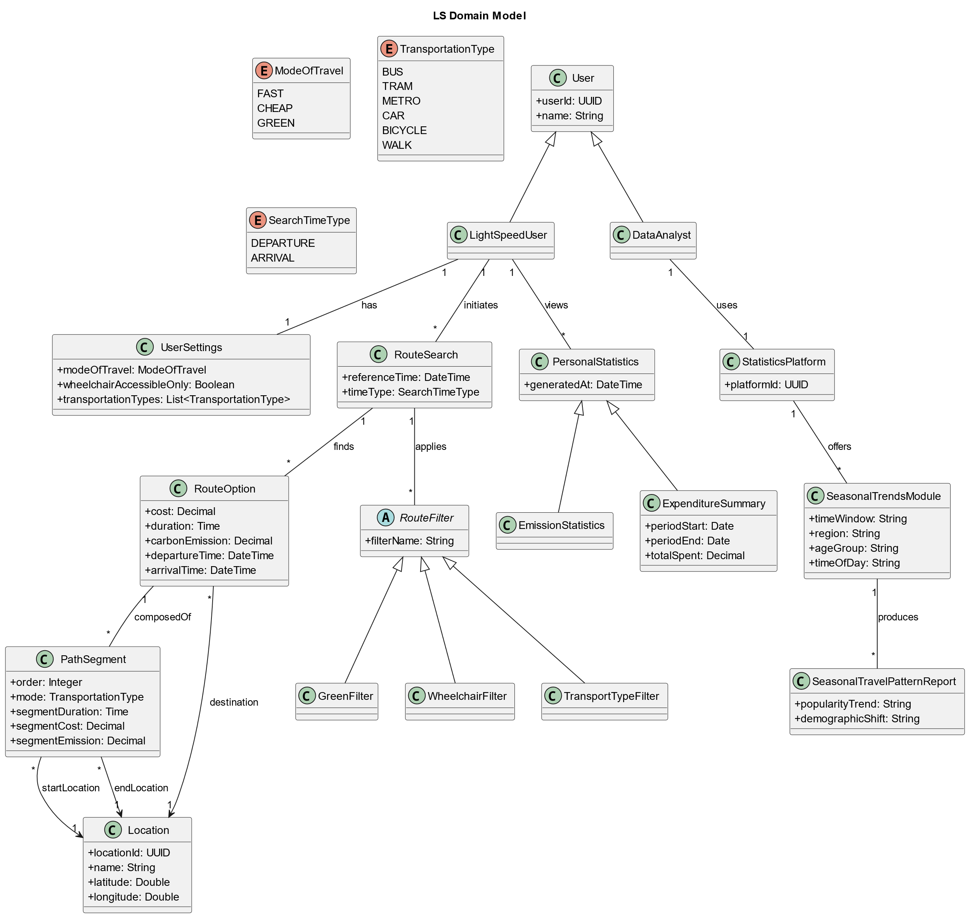


Domain Model

Slide 12
Thank you for
your attention

