Slide 1




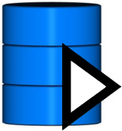
DASHBOARD
jQuery JSP
CLIENT
CLIENT
Query
Spring MVC
Hibernate
log4j
PLATFORM
Data update
Knowledge Inferencing
HermIT
Ontology cache
Access control
OWL API
Synchronization with database
Getting core ontology from URI
Session
Data state building
STORAGE
OWL/RDF
PostgreSQL
System flow

