Slide 1
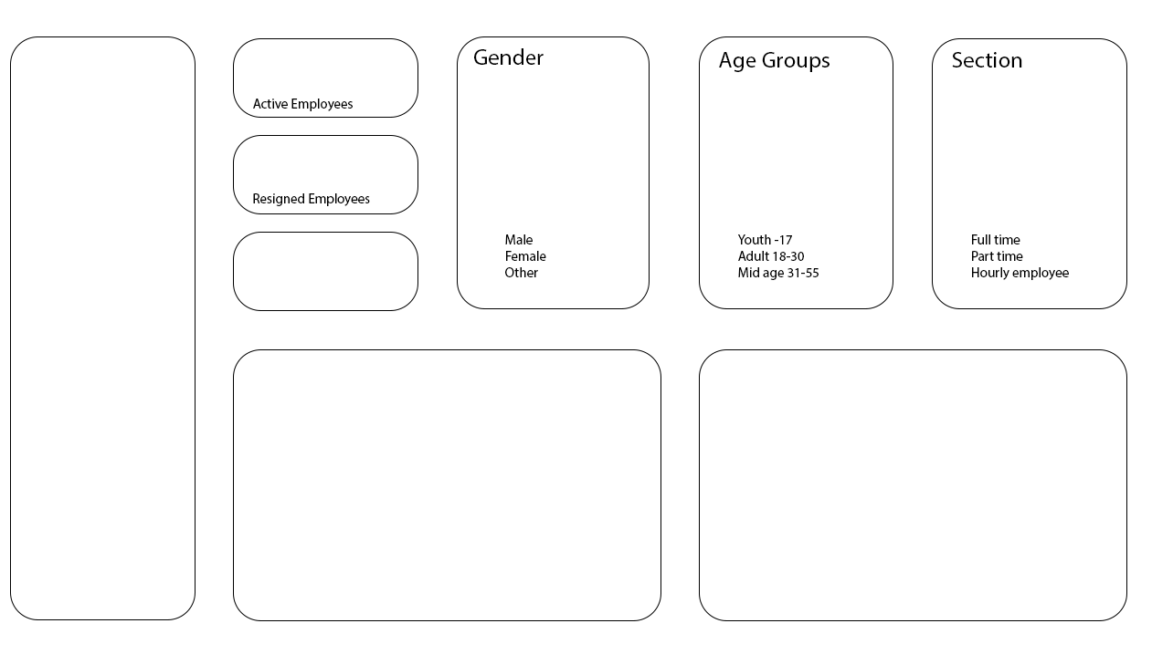








Revenue and Performance Analysis
Sales
Margin
QTD Sales
MTD Sales
Margin %
Sales Volume

Slide 2
Best Performing Product Group
Sales Insights
Sales
Margin
Margin %
Sales Volume

Slide 3
Worst Performing Product Group
Sales Insights
Sales
Margin
Margin %
Sales Volume

Slide 4
Technical Sales Data
Sales
Margin
WTD Sales
Margin %
Sales Volume

Slide 5



Gender
Age Group
Employment Type
Active Employees
Male Female
Other
Youth -17 Adult 18-30 Mid Age 31-55
Part Time Full Time Hourly
Leave Count
Employee Count Over Time by Gender
Annual Total Work Hours 2016

Slide 6
Gender
Age Group
Employment Type
Active Employees
Male Female
Other
Youth -17 Adult 18-30 Mid Age 31-55
Part Time Full Time Hourly
Leave Count
Salary by Lenght of Employment

Slide 7
Gender
Age Group
Employment Type
Active Employees
Male Female
Other
Youth -17 Adult 18-30 Mid Age 31-55
Part Time Full Time Hourly
Leave Count
Workforce Insights

Slide 8
Timeline
Campaign Revenue
Original Revenue
Campaign Margin
Revenue Difference
Revenue, Pricing & Margin Analysis
Campaign Revenue
Original Revenue
Campaign Margin

Slide 9
Best & Worst Performing Campaign by Margin
Campaign Revenue
Original Revenue
Campaign Margin
Revenue Difference
Campaign Analysis
Campaign K30 is considered the best-performing because it generated the highest profit margin. Profit is a crucial factor in evaluating campaign success, and K30's strong margin reflects its financial performance, ensuring sustained profitability and financial stability.

