Slide 1

Title : Online Shopping Application Using Hibernate FrameWork

Slide 2
Objective Of The Project :
Now a days Online shopping has become an integral part of modern life . Consumer now have the convenience of browsing & purchasing products from the comfort of their homes or office ,anytime and anywhere.
People can save their time & energy by purchasing products online with some discounts. The offers on the internet can be easily compared,& the buyer can buy the products according to their favorable conditions like price,qualiy etc..
The project aims to address this need by creating an innovative online shopping application that offers a seamless and enjoyable shopping experience for customers while providing efficient management tools for administrators.

Slide 3
Project Requirement:
Programming Language : Java
DataBase : SQL(RDBMS)
FrameWork : Hibernate

Slide 4
Entities:
User
Orders
Product
OrderDetail
Category
Review

Slide 5
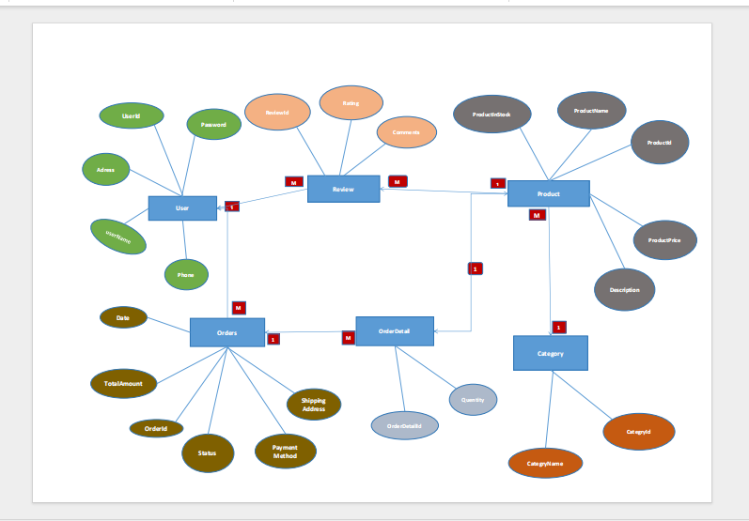

Slide 6


