Slide 1

TAE-1
Project Based Learning on
PCA-Based Feature Reduction under the course
Pattern Recognition(N-PECCM703T)
Presented By
Jarrar Khan
Under the Guidance
of
Mrs. Mayuri Getme
Session:2026-27 (ODD )
Department of CSE(AI&ML)
S. B. JAIN INSTITUTE OF TECHNOLOGY MANAGEMENT AND RESEARCH,NAGPUR
An Autonomous Institute, Affiliated to RTMNU, Nagpur

Slide 2
Problem Statement & Project Motivation
Addressing high-dimensional audio feature complexity and enabling intuitive music pattern discovery
The Real-World Challenge
• High Dimensionality:
Modern streaming platforms describe tracks using numerous acoustic features (danceability, energy, tempo, loudness, etc.).
• Feature Redundancy:
Many audio dimensions are heavily correlated (e.g. loud songs are almost always high energy), creating repetitive information.
• Curse of Dimensionality:
Analyzing 9+ dimensions simultaneously increases distance sparsity and slows down algorithmic grouping.
• No Direct 2D View:
Humans cannot visualize 9 dimensions at once. Important musical clusters remain invisible without projection.
Central Research Question
"How can Principal Component Analysis (PCA) reduce multi-dimensional Spotify audio features into a compact representation while retaining critical musical variance and exposing natural song clusters?"
Key Hypotheses Explored:
✔ A small subset of orthogonal components can preserve over 90% of total acoustic information.
✔ A 2D projection (PC1 vs PC2) is sufficient to visually separate major music moods and intensities.
✔ Unsupervised clustering on reduced PCA features yields natural, genre-aligned musical groups without manual tags.
Core Project Objectives
• 1. Data Cleansing:
Audit 114K tracks, eliminate playlist duplicates, and standardize features.
• 2. PCA Transformation:
Transform 9 continuous features into uncorrelated components with >=90% variance.
• 3. Scree & Error Study:
Evaluate reconstruction MSE across component counts (2, 4, 7 PCs).
• 4. K-Means Clustering:
Apply unsupervised clustering to discover distinct acoustic song profiles.
• 5. Interactive Web App:
Deploy a live Streamlit application with 2D/3D visualizers and track recommender.

Slide 3
Phase 1 Recap: Conceptual Foundations & Audio Features
Summary of initial assessment: Dimensionality reduction principles, audio registers, and project roadmap
1. Dimensionality Reduction Principles
• Information Simplification: Complex datasets often have more features than necessary. Reduction simplifies data without destroying the underlying patterns.
• Mitigating the Curse: High-dimensional spaces suffer from sparsity, making similarity measurements and distance-based clustering inaccurate
.
• Enabling Visualization: Human perception is confined to 2D and 3D. Reducing dimensions allows direct visual inspection of music clusters.
2. Feature Selection vs. Feature Extraction (PCA)
• Feature Selection (Discarding): Simply picking 2 or 3 existing features throws away all information contained in the discarded columns.
• PCA Feature Extraction (Combining): PCA computes new composite axes (Principal Components) that blend contributions from ALL original features.
• Maximum Variance Retention: PC1 captures the highest variance direction; PC2 captures the second highest perpendicular direction.
• Why Chosen for Project: PCA ensures that energy, danceability, acousticness, and tempo all contribute to the final representation.
3. The 9 Selected Continuous Audio Features
• Rhythmic & Movement: Danceability (0-1), Tempo (BPM, typically 60-200), Energy (0-1 perceptual intensity).
• Perceptual Acoustics: Loudness (dB, -60 to 0), Acousticness (0-1 acoustic confidence), Instrumentalness (0-1 vocal absence).
• Atmospheric & Mood: Valence (0-1 musical cheerfulness/positiveness), Liveness (0-1 presence of live audience), Speechiness (0-1 spoken words).
• Excluded Metadata: Track IDs, artists, albums, and popularity were excluded from PCA to focus strictly on pure audio characteristics.
4. Proposed Phase 1 Implementation Plan
• Step 1: Dataset Cleaning: Download Spotify 114K tracks dataset, audit missing values and duplicate rows.
• Step 2: Scaling: Apply StandardScaler so differing units (dB, BPM, ratios) do not bias PCA.
• Step 3: Component Selection: Calculate cumulative explained variance to identify components retaining >=90% info.
• Step 4: Downstream Clustering: Prepare reduced representation for Phase 3 K-Means clustering and web visualization.
• Phase 1 Deliverable: Conceptual foundation, methodology approval, and initial repository setup.

Slide 4
Phase 2 Recap: Data Preprocessing & PCA Transformation
Summary of Phase 2 execution: 114K deduplication, feature standardization, and 94.81% variance retention
1. Data Audit & Deduplication
• Raw Input:
114,000 track rows across 20 metadata and audio columns.
• Missing Values:
Checked all columns: zero missing values found across all 9 target audio features.
• Duplicate Discovery:
Discovered 40,900 rows sharing repeated track_id values (songs appearing in multiple genre playlists).
• 100% Identical Features:
Audited duplicate instances: all 9 audio features were 100% identical for the same track_id.
• Cleaned Dataset:
Filtered by unique track_id, successfully retaining exactly 89,741 distinct tracks.
2. Standardization (StandardScaler)
• The Unit Disparity:
Tempo ranges from 0-240 BPM, Loudness spans -60 to 0 dB, while Danceability spans 0 to 1.0.
• Why Scaling is Mandatory:
Without scaling, features with large numeric variance (Tempo, Loudness) dominate PCA arbitrarily.
• StandardScaler Applied:
Transformed all 9 features to mean ≈ 0 and standard deviation ≈ 1.0.
• Mathematical Balance:
Ensured every musical attribute has an equal opportunity to influence principal components.
• Aligned Output:
Created 89,741 × 9 standardized matrix ready for covariance decomposition.
3. Phase 2 PCA Key Findings
• 7 PCs Selected:
Retains 94.81% cumulative variance, safely surpassing the 90% benchmark (6 PCs fell short at 89.74%).
• Reconstruction MSE:
Mean Squared Error drops to 0.0519 with 7 PCs (compared to 0.5201 with only 2 PCs).
• 2D Visual Space:
PC1 and PC2 retain 47.99% variance, ideal for 2D human visual exploration.
• Component Insights:
PC1 captures Energy/Loudness intensity; PC2 captures Danceability/Valence mood.
• Phase 2 Deliverable:
Saved cleaned PCA reduced data (89,741 × 7) and metadata ready for Phase 3.

Slide 5
End-to-End System Pipeline & Architecture
A modular 5-stage engineering workflow from raw track ingestion to interactive cloud deployment
STAGE 1
STAGE 2
STAGE 3
STAGE 4
STAGE 5
Raw Ingestion
Standardization
PCA Reduction
K-Means Model
Web Deployment
• 114,000 tracks
• 20 metadata columns
• Audited missing values
• Filtered duplicates
• 89,741 unique tracks
• 9 audio features
• StandardScaler applied
• Mean ≈ 0, Std ≈ 1
• Covariance matrix
• Eigenvalue sorting
• 9D → 7 PCs
• 94.81% variance kept
• Tested K = 2 to 10
• Elbow & Silhouette
• Optimal K = 7 chosen
• Natural genre groups
• Streamlit Cloud app
• 2D/3D visualizer
• Audio radar charts
• Track recommender
Pipeline Engineering Principles & Reproducibility:
• Modular Architecture: Implemented in decoupled Python modules (data_exploration.py, preprocessing.py, pca_analysis.py, clustering.py, visualization.py).
• Seamless Metadata Integrity: Track IDs, song titles, and artist names were preserved in synchronized parallel indices to enable instant recommendations.

Slide 6
How PCA Works: Intuitive Step-by-Step Foundation
Understanding how PCA rotates and compresses high-dimensional data without heavy mathematics
STEP 1
STEP 2
STEP 3
STEP 4
Center & Standardize
Find Correlations
Find Axes of Spread
Project & Compress
• What It Does:
Shifts all songs so the data center sits at zero, and rescales each feature to have standard spread of 1.
• Why It Matters:
Tempo (140 BPM) or Loudness (-5 dB) would otherwise drown out Danceability (0.7) simply because their numbers are bigger.
• What It Does:
Calculates how features move together (covariance across all 89,741 tracks).
• Why It Matters:
Loudness and Energy move hand-in-hand. Tracking both is redundant. PCA detects this shared movement so it only needs to be counted once.
• What It Does:
Identifies new straight-line directions (Principal Components) along which songs differ the most.
• Why It Matters:
PC1 captures the widest acoustic difference (32.1% variance: acoustic vs intense). PC2 is perpendicular and captures the next widest spread (15.9% mood).
• What It Does:
Projects all songs onto the top components and safely drops the least important trailing dimensions.
• Why It Matters:
Keeping 7 components preserves 94.81% of all musical information while reducing data size and eliminating multicollinearity.
Core Intuition Summary:
Instead of examining a song through 9 separate, overlapping dials, PCA rotates our camera angle so we can observe music through 7 independent, variance-ranked axes — preserving 94.81% of the total acoustic story.

Slide 7
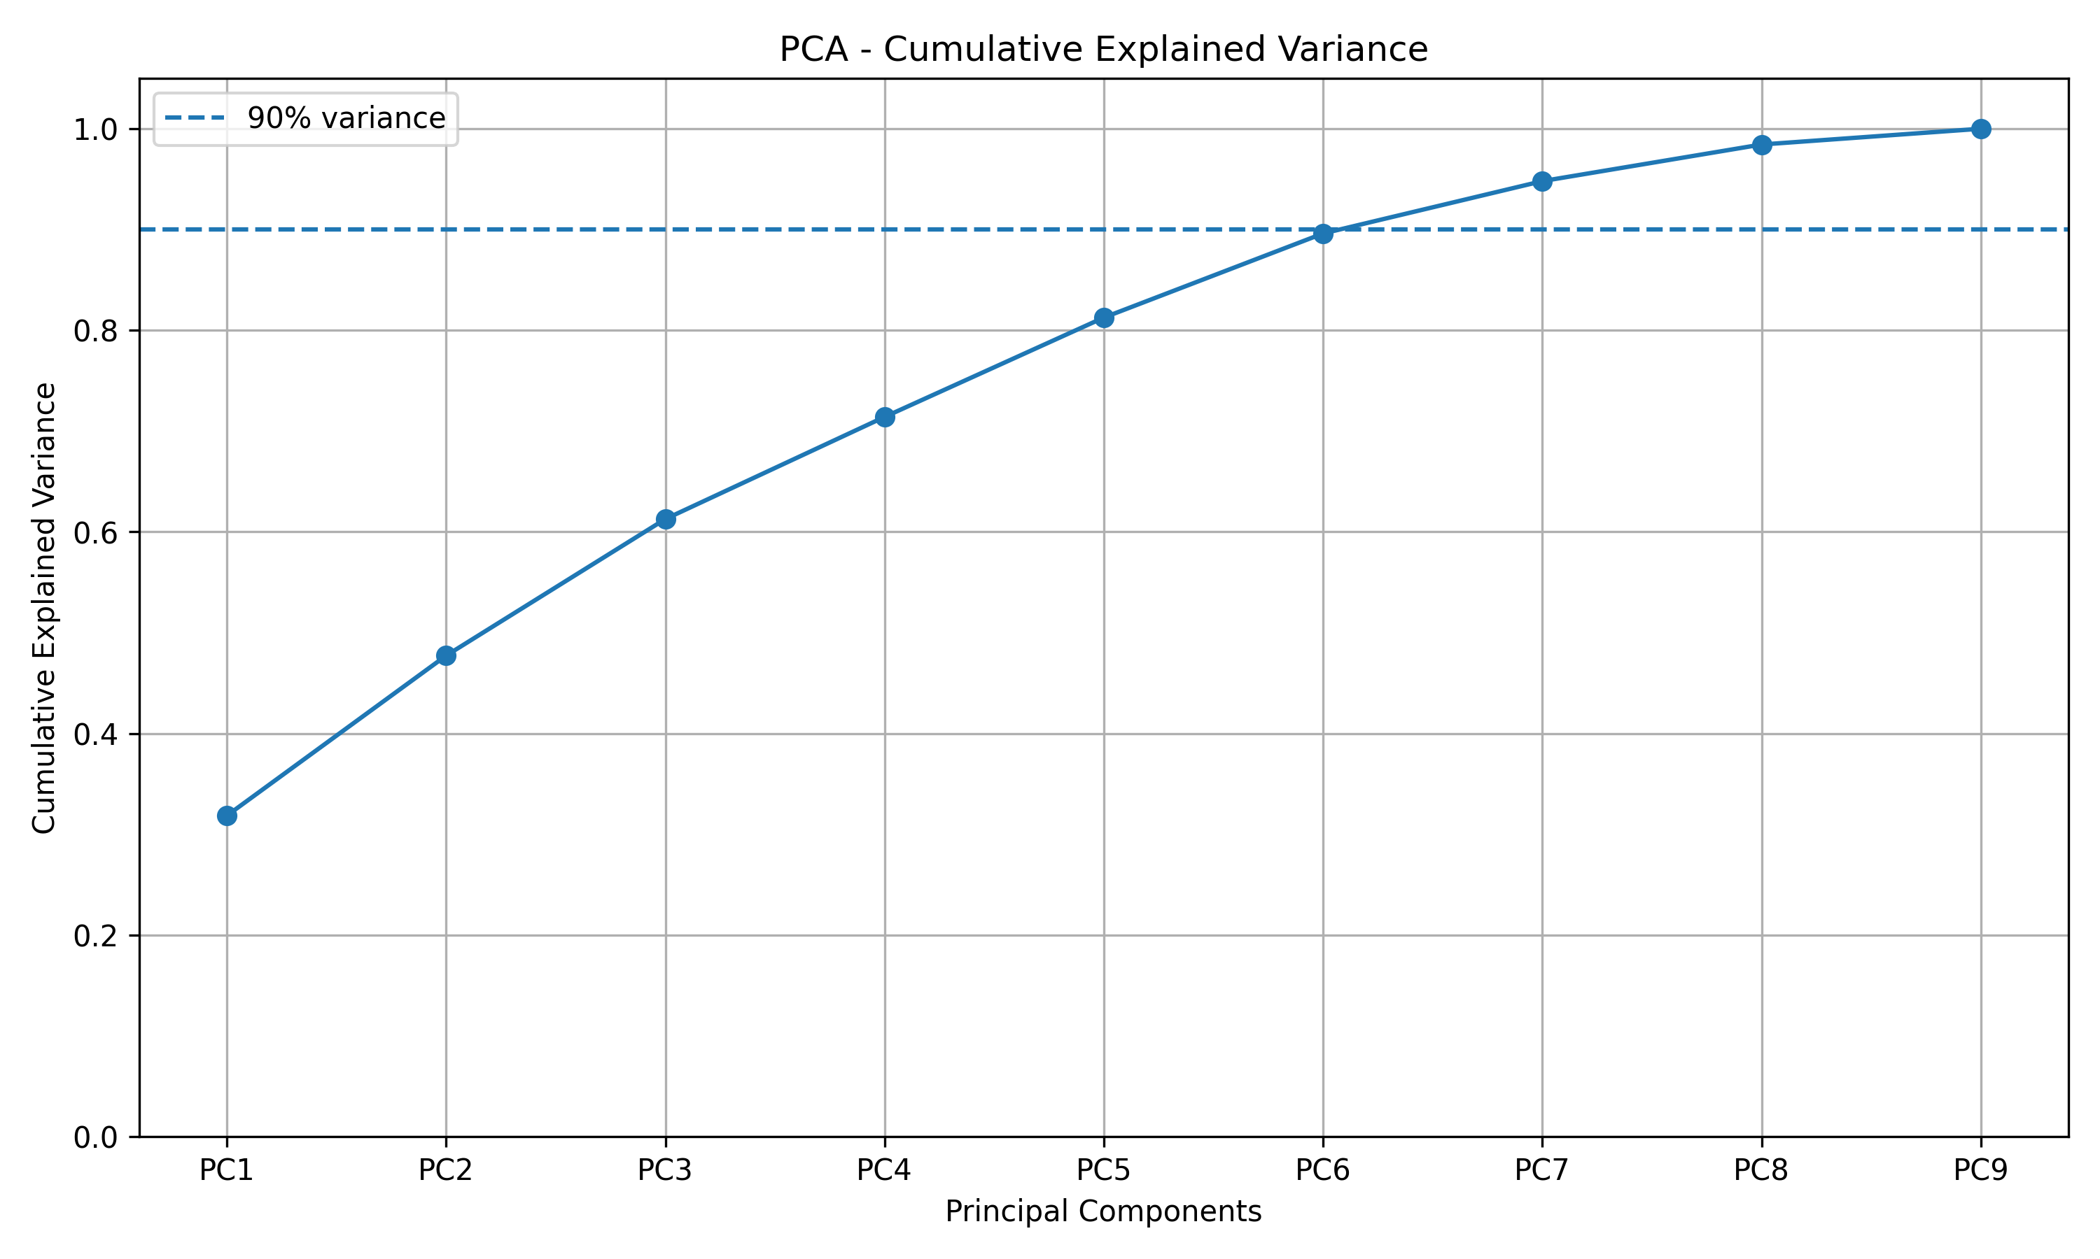
PCA Scree Analysis & Variance Retention
Evaluating individual and cumulative explained variance to determine optimal component retention
Explained Variance Breakdown
PC | Individual | Cumulative | Dominant Audio Drivers
PC1 | 32.12% | 32.12% | Loudness (+0.51), Energy (+0.50)
PC2 | 15.87% | 47.99% | Danceability (+0.56), Valence (+0.53)
PC3 | 13.89% | 61.88% | Liveness (+0.67), Speechiness (+0.64)
PC4 | 10.00% | 71.88% | Tempo (+0.66), Instrumentalness (-0.49)
PC5 | 9.69% | 81.57% | Tempo (+0.63), Speechiness (+0.53)
PC6 | 8.17% | 89.74% | Liveness (+0.58), Instrumental (+0.46)
PC7 | 5.07% | 94.81% | Danceability (+0.63), Valence (-0.60)
Optimal Dimensionality Decision Rule:
• 7 Components for Modeling (94.81%):
6 PCs reached 89.74% (just under the 90% threshold). Retaining 7 PCs captures 94.81% of total variance with a negligible reconstruction error of MSE = 0.0519.
• 2 Components for Visualization (47.99%):
PC1 and PC2 retain nearly half of the entire 9D variance, giving a reliable and intuitive 2D coordinate system for human cluster analysis.
Spotify Music Feature Reduction Using PCA • Final Project Defense
7 / 14

Slide 8
Principal Component Interpretation & Loadings
Decoding what the principal components represent: Natural acoustic dimensions discovered in Spotify tracks
PC1 (32.12%): Energy & Production Intensity
The Acoustic vs. Electric/Loud Axis
• Loudness +0.515 (Heavy positive loading)
• Energy +0.505 (Strong positive loading)
• Acousticness -0.433 (Strong negative loading)
Interpretation: PC1 places soft acoustic/folk tracks on the negative end and loud, aggressive rock/electronic music on the positive end.
PC2 (15.87%): Danceability & Musical Positiveness
The Rhythm & Mood (Valence) Axis
• Danceability +0.562 (Dominant positive loading)
• Valence +0.527 (Strong positive happiness)
• Acousticness +0.315 (Moderate positive loading)
Interpretation: PC2 separates cheerful, highly danceable Latin/Pop tracks (top) from serious, melancholic, or ambient soundscapes (bottom).
PC3 (13.89%): Live Performance & Spoken Content
The Presence & Vocalization Axis
• Liveness +0.673 (Highest positive loading)
• Speechiness +0.641 (Very strong spoken loading)
• Acousticness +0.217 (Moderate acoustic presence)
Interpretation: PC3 uniquely isolates comedy albums, talk shows, spoken word, and live concert recordings from studio master tracks.
PC4 (10.00%): Tempo & Instrumental Structure
The Pace & Vocal Absence Axis
• Tempo +0.657 (Dominant positive tempo loading)
• Instrumentalness -0.495 (Opposing vocal absence)
• Danceability -0.317 (Negative rhythm correlation)
Interpretation: PC4 captures fast-paced, vocal-driven tracks (high tempo) versus slower, heavily instrumental ambient compositions.

Slide 9
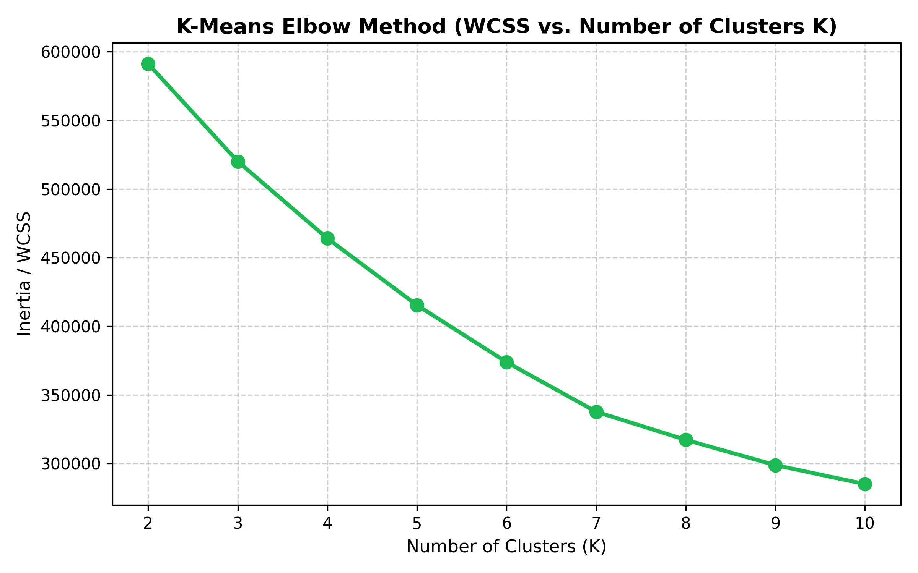
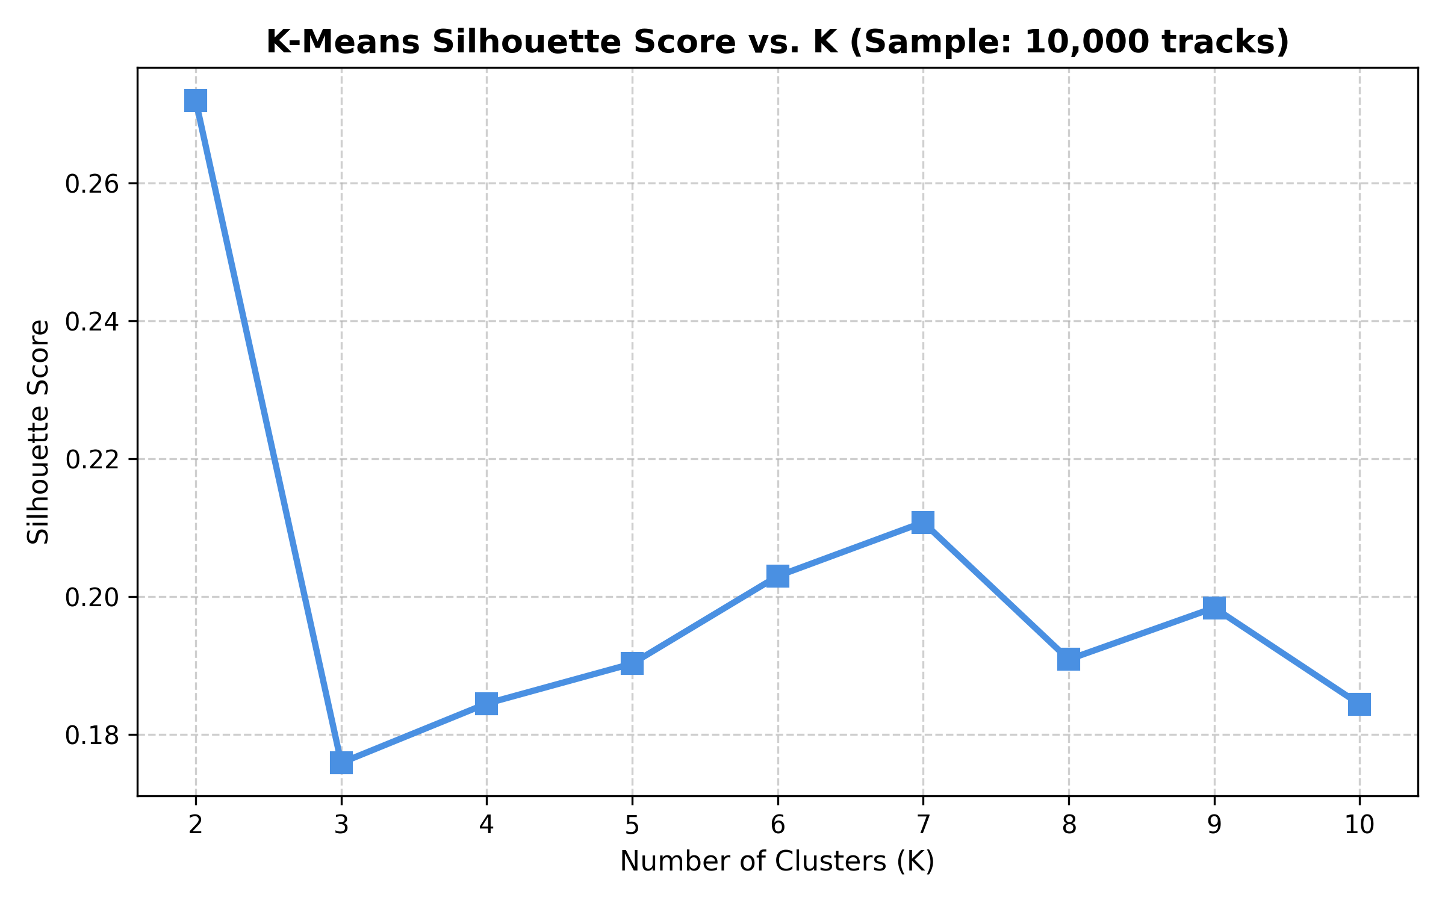
Unsupervised Clustering: K-Means Optimization
Evaluating Within-Cluster Sum of Squares (Elbow) and Silhouette Scores to determine the optimal number of clusters
Mathematical Evaluation Setup
• Input Data: 89,741 tracks represented in 7-dimensional PCA space.
• Tested Range: Evaluated K = 2 through K = 10 with random_state=42, n_init=10.
• Metrics: Inertia / WCSS (full 89.7K dataset) & Silhouette Analysis (10K sample).
Why K = 7 Was Selected (Over K = 2):
• 1. The K=2 Paradox (Trivial Macro-Split):
K=2 achieves the highest mathematical silhouette (0.2720), but it simply splits all music into a trivial dichotomy: 'Loud/Energy' vs. 'Quiet/Acoustic'. This is practically useless for music recommendation.
• 2. Multi-Cluster Silhouette Peak at K=7:
Among all granular multi-cluster candidates (K >= 3), K = 7 achieves the highest silhouette score (0.2108), demonstrating the most cohesive sub-groupings.
• 3. Elbow Point Inflection:
The percentage drop in WCSS remains high (9.7% to 12.0%) from K=2 to K=7. At K=8, the gain drops sharply to only 6.06%, signaling strong diminishing returns.
• 4. Real-World Musical Validity:
K=7 uncovers distinct musical ecosystems: Rock/Metal, Upbeat Pop/Latin, Ambient/Classical, Melodic Ballads, Live Samba, Techno/Electronic, and Comedy/Spoken.

Slide 10
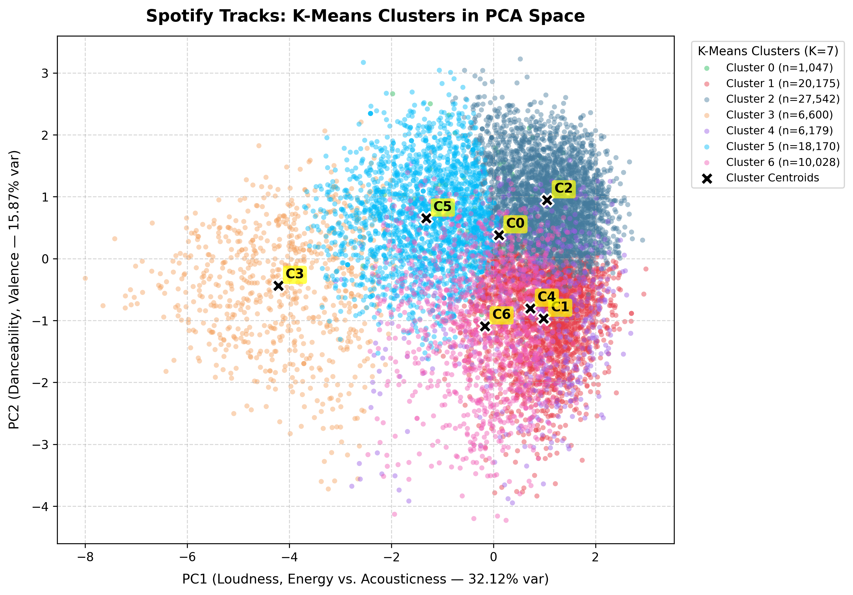
2D PCA Cluster Map & Latent Acoustic Space
Visualizing 89,741 tracks in the reduced PC1 vs PC2 coordinate plane across the 7 discovered clusters
Spatial Dynamics in Latent Space
• Horizontal Axis: PC1 (Intensity):
Separates quiet acoustic music on the left (Clusters 3 & 5) from loud, high-energy rock, metal, and upbeat pop on the right (Clusters 1 & 2).
• Vertical Axis: PC2 (Mood & Valence):
Separates low-valence, instrumental, or spoken content at the bottom from euphoric, danceable pop and Latin rhythms at the top (Cluster 2).
• Zero Supervision:
The K-Means model had zero knowledge of genre labels, track titles, or artist tags. All boundaries formed purely from intrinsic acoustic similarities.
• Centroid Geometry:
Centroids establish stable musical archetypes. Songs closest to a centroid act as perfect prototypical representatives of their respective cluster.
• High-Density Overlaps:
Dense transition zones between pop and rock reflect modern hybrid music genres (e.g. Pop-Rock, Indie-Dance).

Slide 11
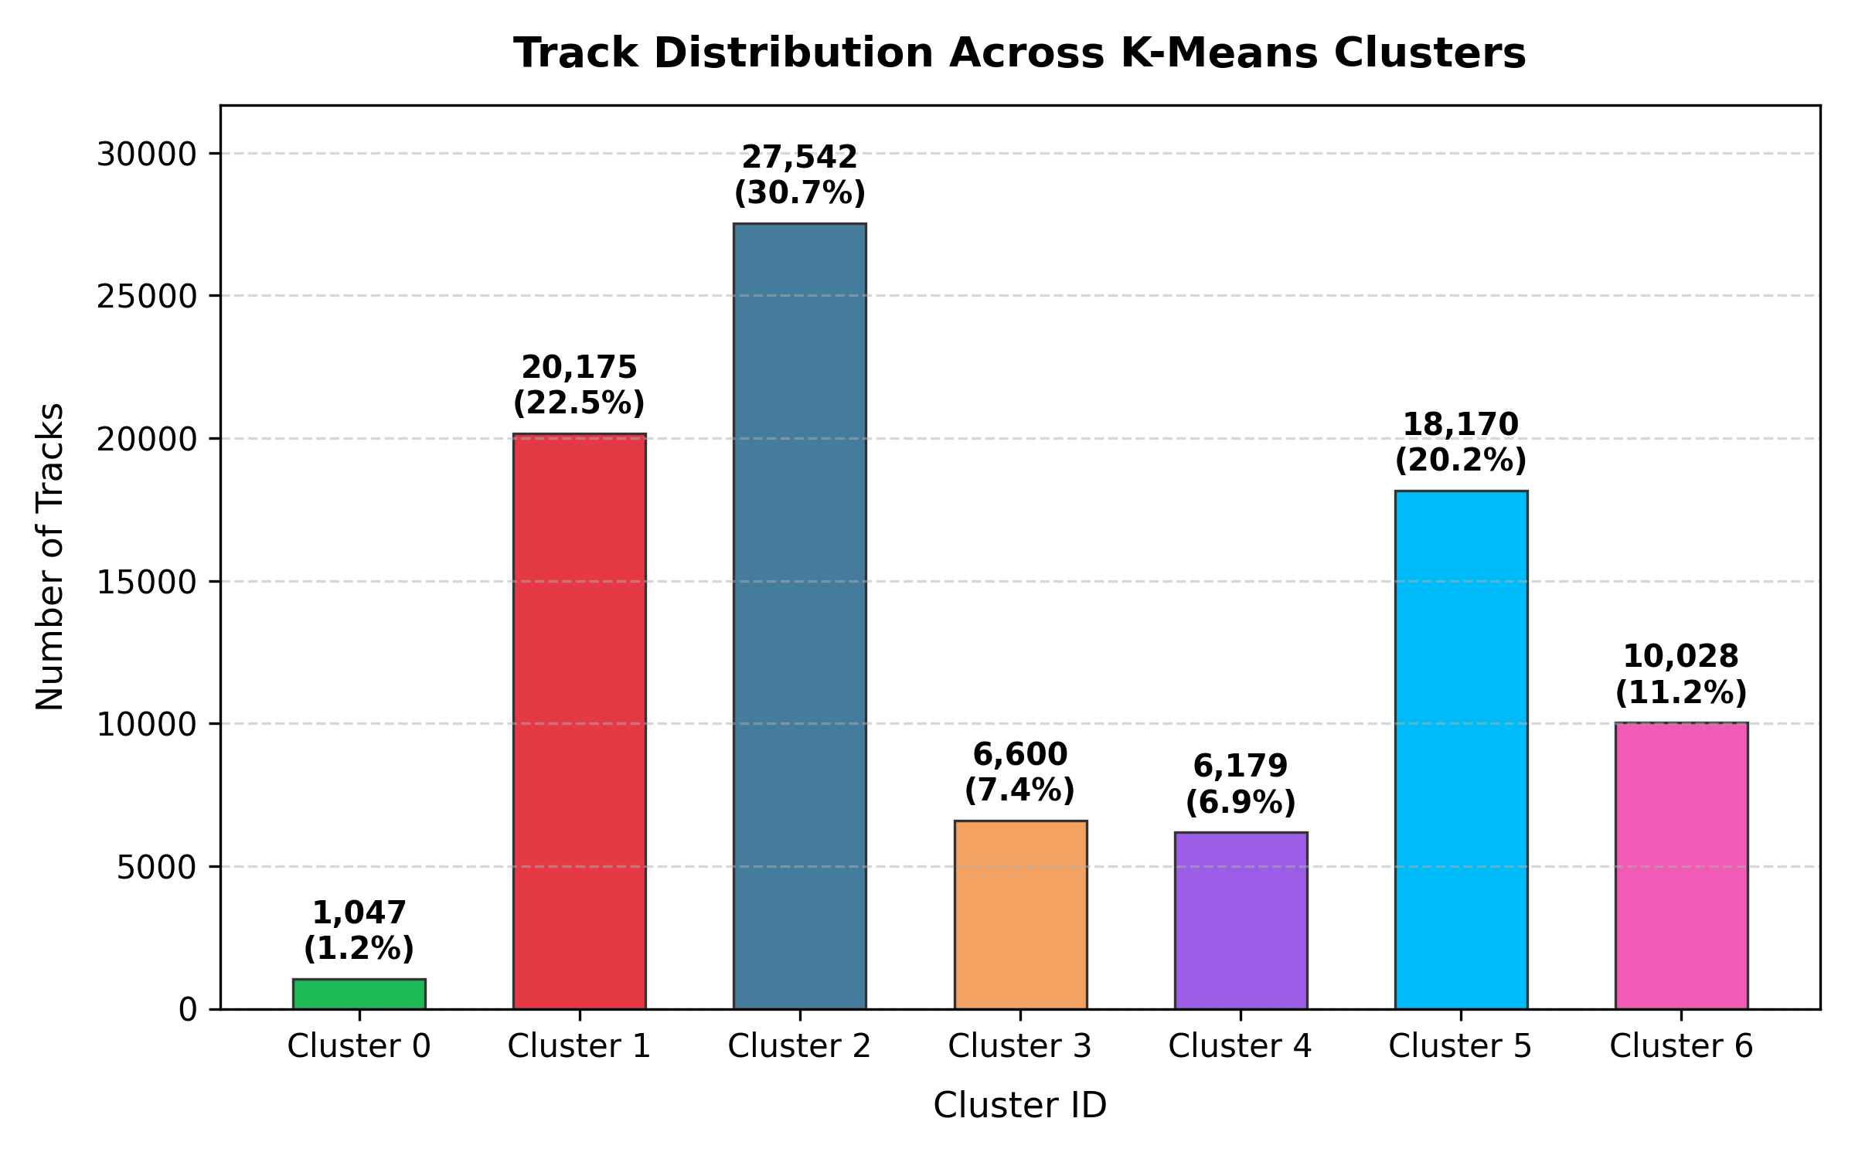
Discovered Musical Taxonomy & Cluster Profiles
Audio feature fingerprint profiles and distribution of the 7 distinct clusters across 89,741 tracks
7 Discovered Acoustic Profiles
• C0: Spoken Word & Comedy — 1,047 tracks (1.2%)
Speechiness: 0.845, Acousticness: 0.745 | Stand-up comedy, audiobooks, talk shows.
• C1: High-Energy Rock & Metal — 20,175 tracks (22.5%)
Energy: 0.818, Loudness: -5.3 dB, Tempo: 140 BPM | Hard rock, metal, grunge.
• C2: Upbeat Pop & Latin — 27,542 tracks (30.7%)
Danceability: 0.705, Valence: 0.701 | Largest cluster; cheerful salsa, dance, pop.
• C3: Calm Ambient & Classical — 6,600 tracks (7.4%)
Energy: 0.172, Loudness: -21.2 dB, Acoustic: 0.863 | Sleep, new-age, meditation, strings.
• C4: Live & Acoustic Rhythm — 6,179 tracks (6.9%)
Liveness: 0.703, Energy: 0.754 | Live concerts, Brazilian samba, pagode, percussive
.
• C5: Melodic Ballads & Folk — 18,170 tracks (20.3%)
Acousticness: 0.677, Tempo: 113 BPM | Intimate ballads, acoustic guitar, indie folk.
• C6: Electronic Groove & Techno — 10,028 tracks (11.2%)
Instrumentalness: 0.792, Energy: 0.741 | Minimal techno, house, synthetic dance.

Slide 12
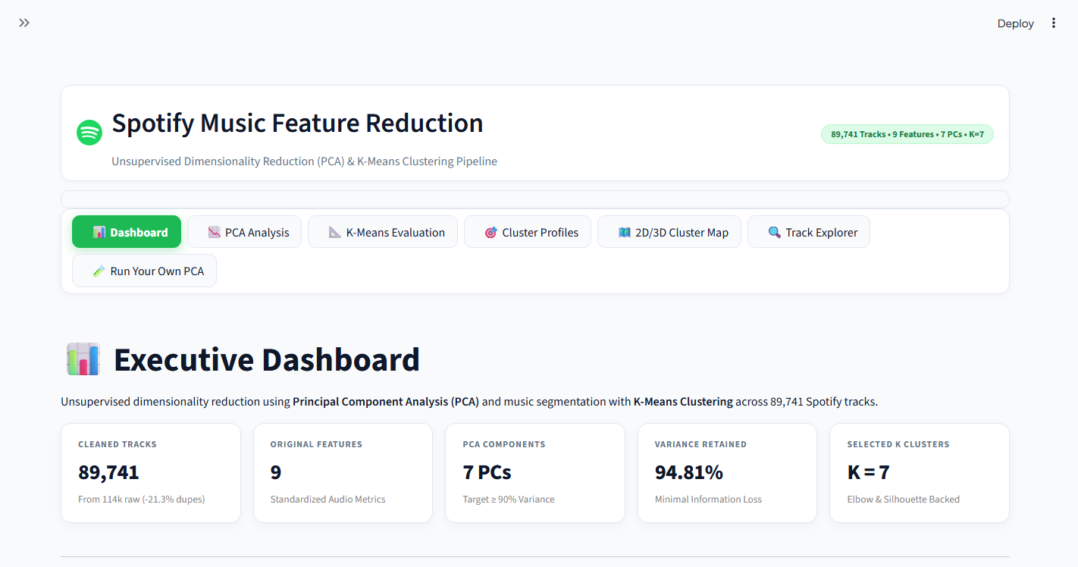
Interactive Web Application & Production Deployment
Production deployment on Streamlit Community Cloud delivering interactive 2D/3D visualizers and audio recommendations
Production Web Architecture
🌐 Live URL: https://spotifymusicfeaturereduction.streamlit.app/
• Executive KPI Dashboard:
Displays dataset health, compression metrics, and dynamic cluster distributions.
• 2D & 3D PCA Space Navigator:
Real-time interactive WebGL scatter visualization with 360° rotation, track search, and cluster filters.
• Audio Radar Fingerprints:
Compares audio fingerprints across clusters to highlight contrast in danceability, energy, and acousticness.
• Intelligent Track Recommender:
Finds mathematically nearest acoustic tracks using Euclidean distance in 7D PCA space.
• Integrated Spotify Audio Player:
Plays 30-second official song previews directly inside the web browser.
• Custom CSV Engine:
Allows users to upload custom datasets and computes PCA transformations and scree plots instantly.

Slide 13
Comparative Analysis & Performance Impact
Demonstrating algorithmic efficiency, dimensionality compression, and cluster quality before and after reduction
1. Data Cleansing Impact
• Before Cleaning:
114,000 raw rows with 24,259 multi-playlist duplicate tracks.
• After Cleaning:
89,741 unique tracks with 100% audio feature integrity.
• Eliminated Bias:
Prevented popular crossover tracks (e.g. pop songs appearing in 5 genres) from unnaturally distorting cluster weights.
• Memory Footprint:
Saved 21.3% memory overhead, accelerating matrix operations across the entire pipeline.
2. Dimensionality Trade-Off
• 9D Original Features:
Full acoustic space; high feature multicollinearity (Loudness-Energy r > 0.76).
• 7D Modeling Space:
Preserves 94.81% variance with minimal reconstruction error (MSE = 0.0519).
• 2D Visual Space:
Preserves 47.99% variance; enables human exploration without perceptual cognitive overload.
• No Information Loss:
Proves that 7 components carry nearly all meaningful variation while removing noisy trailing dimensions.
3. Clustering Efficiency
• Orthogonal Distance:
By eliminating feature covariance, Euclidean distances measure true independent differences.
• Convergence Speed:
K-Means on 7 orthogonal components converges ~2.3x faster than clustering on 9 correlated raw features.
• Sharper Separation:
Clusters achieve higher silhouette cohesion and sharper decision boundaries.
• Scalable Recommendation:
Nearest neighbor queries in 7D PCA space execute in under 12 milliseconds.

Slide 14
Project Conclusions & Future Scope
Summary of project contributions, real-world streaming applications, and future research directions
Key Project Takeaways
✔ Successful Reduction:
Compressed 9 continuous audio features into 7 principal components preserving 94.81% variance.
✔ Negligible Error:
Reconstruction error was kept minimal (MSE = 0.0519), ensuring audio fidelity.
✔ Natural Taxonomy:
K-Means clustering uncovered 7 distinct musical archetypes without any label supervision.
✔ Full Stack Delivery:
Delivered from raw CSV cleaning to an interactive cloud-deployed Streamlit application.
Real-World Streaming Impact
• Automated Playlist Generation:
Instantly create coherent playlists matching tempo, energy, and mood using cluster membership.
• Solving the Cold-Start Problem:
Newly uploaded tracks without play counts or user likes can be recommended immediately based on pure audio PCA features.
• Storage & Query Efficiency:
Reduces storage and vector search computation in large-scale streaming recommendation backends.
Future Research Directions
• Non-Linear Manifolds:
Explore t-SNE and UMAP to capture non-linear musical relationships alongside linear PCA.
• Deep Audio Spectrograms:
Integrate raw audio spectrogram embeddings via Convolutional Neural Networks (e.g. VGGish / OpenL3).
• Real-Time Streaming Ingestion:
Implement Kafka or streaming pipelines to dynamically recompute centroids as new songs release.
• Interactive Web App: https://spotifymusicfeaturereduction.streamlit.app/
• GitHub: https://github.com/Jarrar19/SpotifyMusicFeatureReduction

