Slide 1
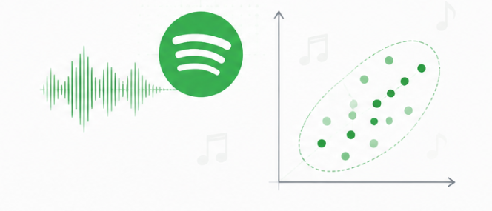
TAE-I
PROJECT BASED LEARNING
SPOTIFY MUSIC FEATURE REDUCTION
USING PRINCIPAL COMPONENT ANALYSIS (PCA)
Phase 2 — Data Preprocessing & PCA Analysis
9
Features
PCA
7
PCs
94.81% variance retained
Pattern Recognition (N-PECCM703T)
Presented By:
Jarrar Khan(CM23018)
Under the Guidance of
Mrs. Mayuri Getme

Slide 2
Phase 2: What We Needed to Achieve
Prepare reliable audio-feature data and reduce its dimensionality using PCA.
1
Explore
Understand rows, columns, missing values and duplicates.
2
Clean
Remove repeated track IDs while preserving useful metadata.
3
Standardize
Put the 9 selected audio features on a comparable scale.
4
Apply PCA
Find principal components and choose a compact representation.
5
Save
Export PCA data and analysis outputs for Phase 3.
KEY DESIGN CHOICE
9 audio features
Focus on measurable musical characteristics rather than IDs and metadata.
• PCA is used for dimensionality reduction, not for creating clusters.
• StandardScaler was applied before PCA because the audio features use different units and ranges.
• The final PCA representation is intended for later clustering and visualization.
PHASE 2 OUTPUT
89,741 × 7
Reduced data aligned with track metadata.
2

Slide 3
1. Dataset Exploration
Initial inspection established the structure and data-quality issues before preprocessing.
ROWS
114,000
tracks
COLUMNS
20
metadata + audio features
NUMERICAL
14
numeric columns available
DUPLICATE ROWS
450
exact duplicate rows
• Missing values were found in artists, album_name and track_name — one each.
• All 9 planned PCA audio features had no missing values.
• The raw data contained repeated track_id values, which required a track-level duplicate check.
Important finding
40,900 rows belonged to duplicated track_id values.
Across repeated track IDs, all 9 selected audio features were identical.
This supported track_id-level deduplication for the PCA dataset.
3

Slide 4
2. Cleaning: Track-Level Deduplication
Repeated track IDs were removed because they represented the same audio-feature vector.
BEFORE
114,000
raw rows
REMOVED
24,259
extra repeated track_id occurrences
AFTER
89,741
unique track IDs
• Deduplication key: track_id
• Kept the first occurrence of each track_id.
• Metadata was extracted in the same row order so it remains aligned with the PCA features.
• Why not remove by track_name + artists? A track can appear with different metadata or genre labels.
• For repeated track IDs, the selected audio features were 100% identical.
• This makes track_id the safer basis for this PCA preprocessing step.
Spotify Music Feature Reduction • Phase 2
4

Slide 5
3. Feature Selection & Standardization
Only the audio characteristics relevant to PCA were retained.
danceability
energy
loudness
EXCLUDED
IDs & metadata
track_id, artist, album, genre etc. are not PCA audio dimensions.
speechiness
acousticness
instrumentalness
liveness
valence
tempo
STANDARDIZATION
Mean ≈ 0
Each selected feature was transformed to a comparable scale using StandardScaler.
Why standardize?
The features have different scales — for example, tempo is measured in BPM while loudness is measured in dB. Standardization prevents scale differences from dominating PCA.
RESULT
9 standardized dimensions
Ready for PCA.
Spotify Music Feature Reduction • Phase 2
5

Slide 6
4. PCA Results: Choosing the Number of Components
The cumulative explained variance was used to choose a compact representation.
6 PCs
89.74%
just below the 90% target
7 PCs
94.81%
chosen for the final reduced representation
2 PCs
47.99%
useful for visualization, not the full information content
Spotify Music Feature Reduction • Phase 2
6

Slide 7
5. What the Principal Components Represent
Loadings show which original audio features contribute most strongly to each component.
Component
Strong loading 1
Strong loading 2
Strong loading 3
Variance
PC1
loudness (+0.515)
energy (+0.505)
acousticness (−0.433)
≈ 32.12%
PC2
danceability (+0.562)
valence (+0.527)
acousticness (+0.315)
≈ 15.87%
PC3
liveness (+0.673)
speechiness (+0.641)
acousticness (+0.217)
≈ 13.89%
PC4
tempo (+0.657)
instrumentalness (−0.495)
danceability (−0.317)
≈ 10.00%
PC1
Energy / intensity pattern
loudness & energy ↑, acousticness ↓
PC2
Danceability / mood pattern
danceability & valence dominate
PC3
Live / speech pattern
liveness & speechiness dominate
7

Slide 8
6. Validation, Outputs & Phase 2 Conclusion
The cleaned PCA pipeline is complete and ready for clustering and visualization.
6 PCs
89.74%
variance retained
7 PCs
94.81%
variance retained
7-PC MSE
0.0519
reconstruction error
2D VIEW
47.99%
PC1 + PC2 variance
• cleaned_selected_audio_features.csv
• cleaned_standardized_audio_features.csv
• cleaned_track_metadata.csv
• cleaned_pca_explained_variance.csv
• cleaned_pca_loadings.csv
• cleaned_pca_reconstruction_error.csv
• cleaned_pca_reduced_data.csv
Phase 2 conclusion
• The raw dataset was reduced from 114,000 to 89,741 unique track IDs.
• Nine audio features were standardized and transformed using PCA.
• Seven principal components retain 94.81% of the variance.
• The 7-PC representation is ready for Phase 3 clustering.
NEXT → Phase 3: K-Means clustering • choose K using evaluation metrics • PC1 vs PC2 visualization
Github :- https://github.com/Jarrar19/SpotifyMusicFeatureReduction
8

