Slide 1
Introduction Database checkpoint
which are MySQL, PostgreSQL and SQL SERVER
Jarray Intissar

Slide 2

MySQL
MySQL is a relational database management system (RDBMS) developed by Oracle that is based on structured query language (SQL). A database is a structured collection of data. It may be anything from a simple shopping list to a picture gallery or a place to hold the vast amounts of information in a corporate network.

Slide 3
Postgre SQL
PostgreSQL is an advanced, enterprise class open source relational database that supports both SQL (relational) and JSON (non-relational) querying. ... PostgreSQL is used as the primary data store or data warehouse for many web, mobile, geospatial, and analytics applications. The latest major version is PostgreSQL 12.

Slide 4
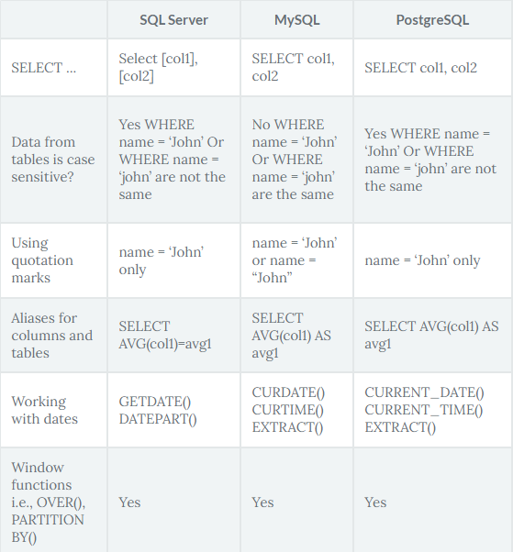
Comparaison between three relational RDBMS
PostMySQL, and SQL server use very similar syntax, with some notable differences highlighted below. Microsoft SQL Server has the greatest contrast in SQL syntax, as well as a wide variety of functions not available in other platforms. The table below highlights some examples of basic differences between SQL platforms.greSQL,

Slide 5
SQL Server
SQL Server is a database management system (DBMS) in SQL language incorporating, among other things, an RDBMS (relational DBMS ") developed and marketed by the Microsoft company. It works on Windows and Linux OS (since March 2016), but it is possible to launch it on Mac OS via Docker, because there is a version for download on the Microsoft website2.

Slide 6


