Slide 1
Example Hierarchy
A.)
B.)
C
8
X
Y
9
E
B
13
6
7
15
5
A
B
C
D
E
F
14
4
F
16
4
5
6
10
11
12
16
17
18
A
18
2
1
2
3
7
8
9
13
14
15
3
17
D
1
10
11
12

Slide 2
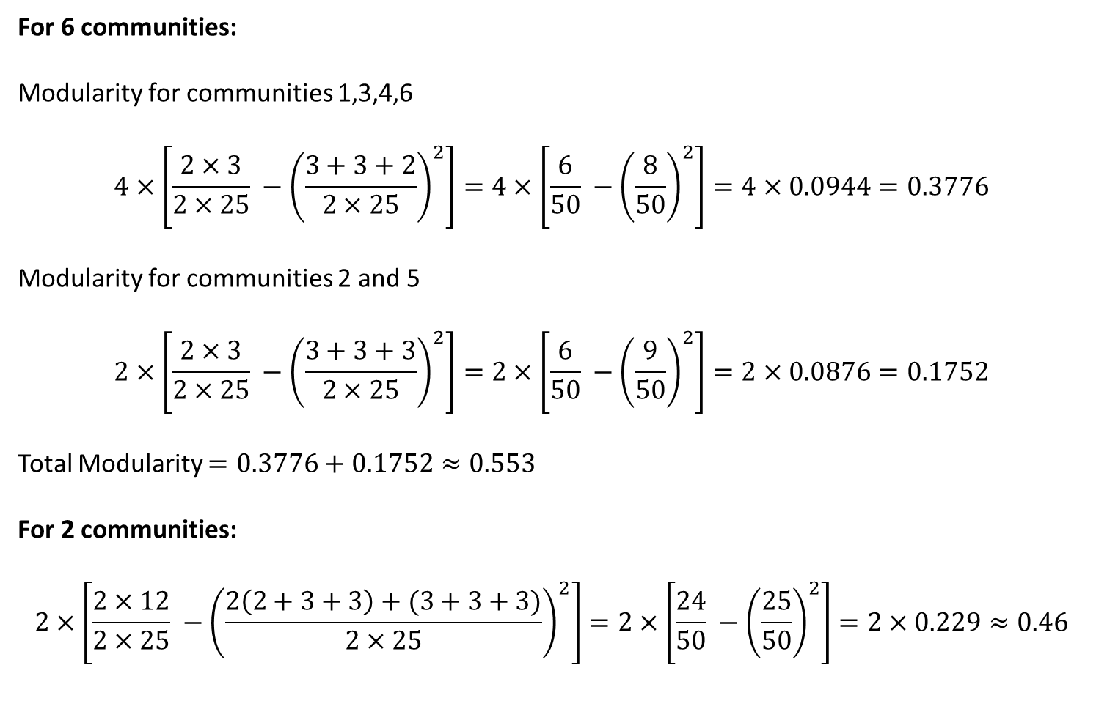
For 6 communities:
Modularity for communities 1,3,4,6
$$4×\left[\frac{2×3}{2×25} −{\left(\frac{3+3+2}{2×25}\right)}^{2}\right]=4×\left[\frac{6}{50} −{\left(\frac{8}{50}\right)}^{2}\right]=4×0.0944=0.3776$$
Modularity for communities 2 and 5
$$2×\left[\frac{2×3}{2×25} −{\left(\frac{3+3+3}{2×25}\right)}^{2}\right]=2×\left[\frac{6}{50} −{\left(\frac{9}{50}\right)}^{2}\right]=2×0.0876=0.1752$$
Total Modularity $=0.3776+0.1752≈0.553$
For 2 communities:
$$2×\left[\frac{2×12}{2×25} −{\left(\frac{2\left(2+3+3\right)+(3+3+3)}{2×25}\right)}^{2}\right]=2×\left[\frac{24}{50} −{\left(\frac{25}{50}\right)}^{2}\right]=2×0.229≈0.46$$

