Slide 1
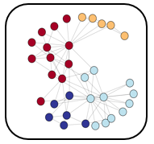
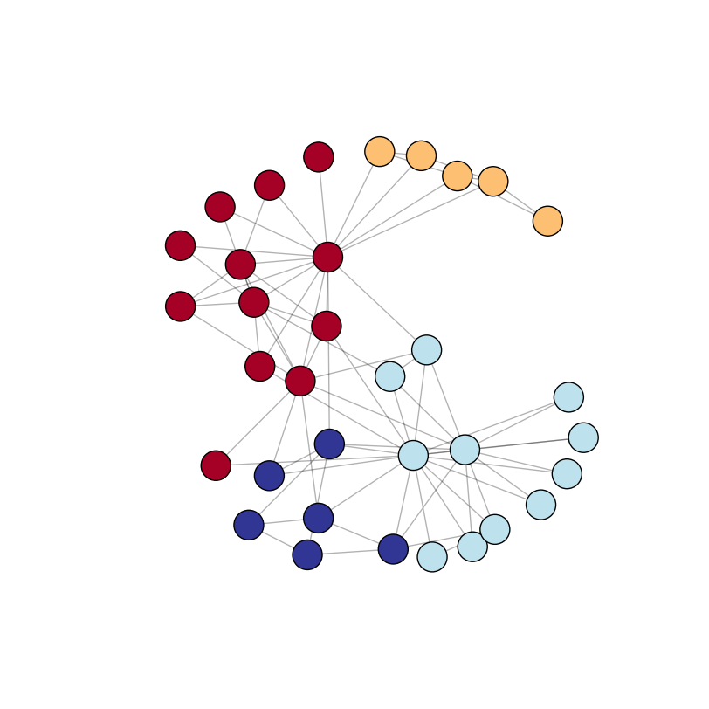
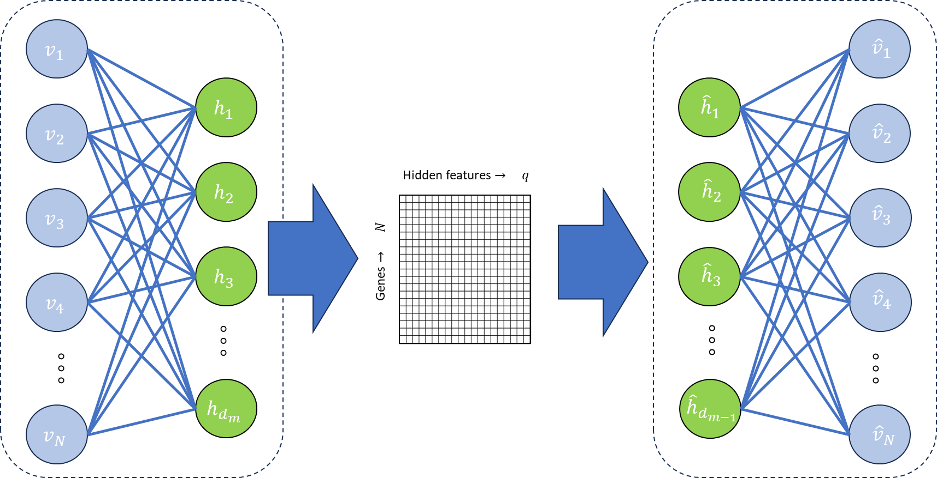

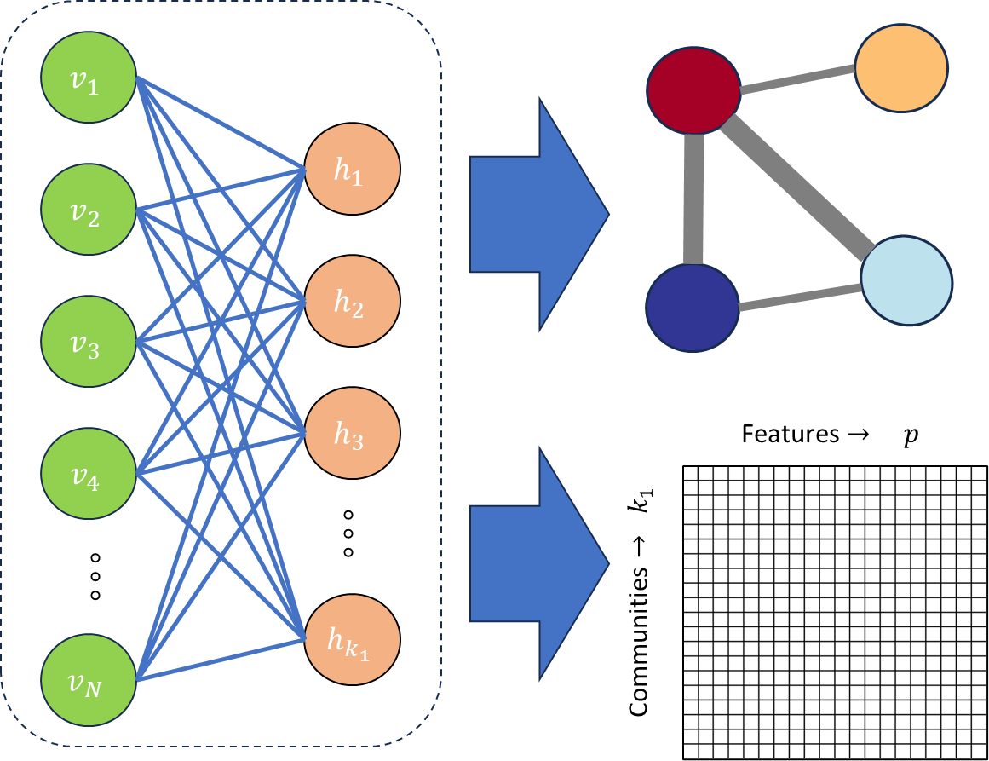
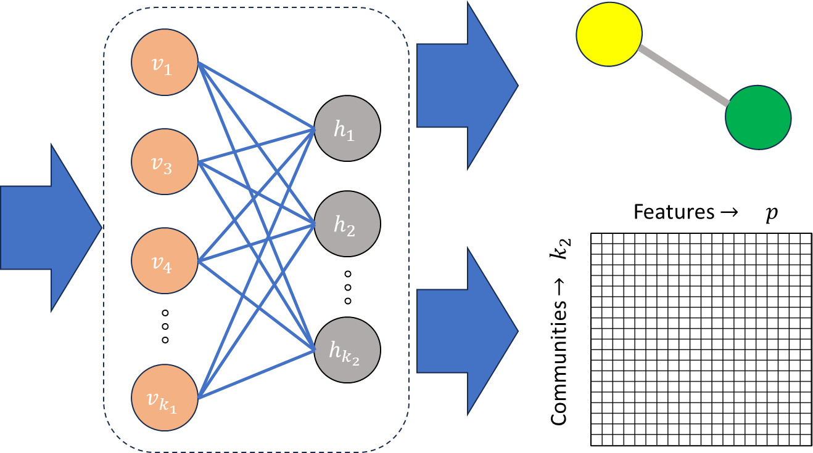
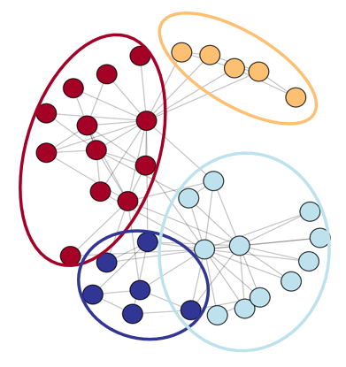
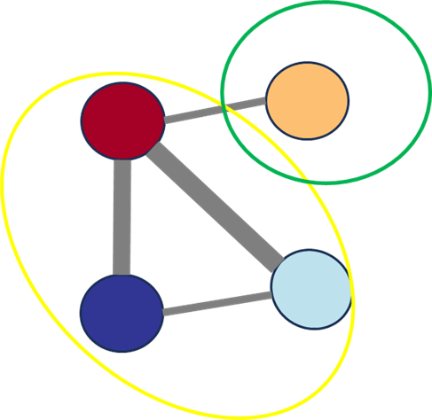








$$Graph Attention Autoencoder$$
E$ncoder$
D$ecoder$
Graph Adjacency Matrix
Graph Reconstruction
Features $→ p$
Features $→ p$
Genes $→ N$
Genes $→ N$
Latent Representations
Reconstructed
Node Attributes
Node Attribute Matrix
$$Hierarchical$$
$$Community$$
$$Detection$$

