Slide 1





















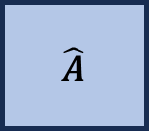



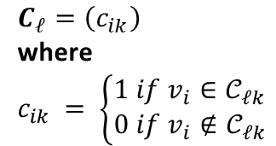






Encoder Module
Decoder Module
2-layer $ℓ=2$ example of HGGN
$${\hat{A}}_{0} ∈ ℝ^{N×N}$$
$${\hat{A}}_{0} ∈ ℝ^{N×N}$$
$$A$$
$$H_{1}∈ℝ^{N×d_{1}}$$
$$H_{1}∈ℝ^{N×d_{1}}$$
$$\hat{A}$$
$Z_{1}∈ ℝ^{N×d_{m}}$
$$E_{1}$$
$$Z$$
$$D_{m}$$
. . .
. . .
X
$$\hat{X}$$
$${\tilde{A}}^{(2)}∈ℝ^{k_{1}×k_{1}}$$
$$X∈ ℝ^{N×p}$$
$$X∈ ℝ^{N×p}$$
$${\tilde{X}}^{(2)}$$
$$soft\left(Z_{1}W_{1}\right)$$
$$W_{1}∈ ℝ^{d_{m}×k_{1}}$$
Linear
Classifier 2
Attributed Network: $ℊ_{0}(E, V, X)$
Linear
Classifier 1
$$E=\left\{\left(v_{i}, v_{j}\right)| 1<i, j<N;i≠j\right\}$$
$$V= \left\{v_{1},v_{2}, …, v_{N}\right\}$$
$$X=\left\{x_{1}, x_{2}, …;x_{N}\right\}$$
$$C_{2}$$
$$C_{1}$$
$${\tilde{X}}^{(1)}$$
$$soft\left({{\tilde{X}}^{(1)}W}_{2}\right)$$
$$W_{2}∈ℝ^{d_{m}×k_{2}}$$
$$g_{1}{\left(Z_{1}^{T}{⋅C}_{1}\right)}^{T}$$
$C_{ℓ}=\left(c_{ik}\right)$
where
$$c_{ik }= \left\{\begin{aligned}1 if v_{i}∈𝒞_{ℓk} \\ 0 if v_{i}∉𝒞_{ℓk}\end{aligned}\right.$$
$$C_{1}∈ ℝ^{N×k_{1}}$$
$$C_{2}∈ ℝ^{k_{1}×k_{2}}$$
$$\max_{k_{1}}\left(C_{1}\right)$$
$${\tilde{A}}^{(1)}∈ℝ^{k_{1}×k_{1}}$$
$$\max_{k_{2}}\left(C_{2}\right)$$
Node labels: $S_{1}$
Node labels: $S_{2}$

