Slide 1
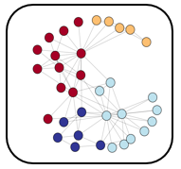
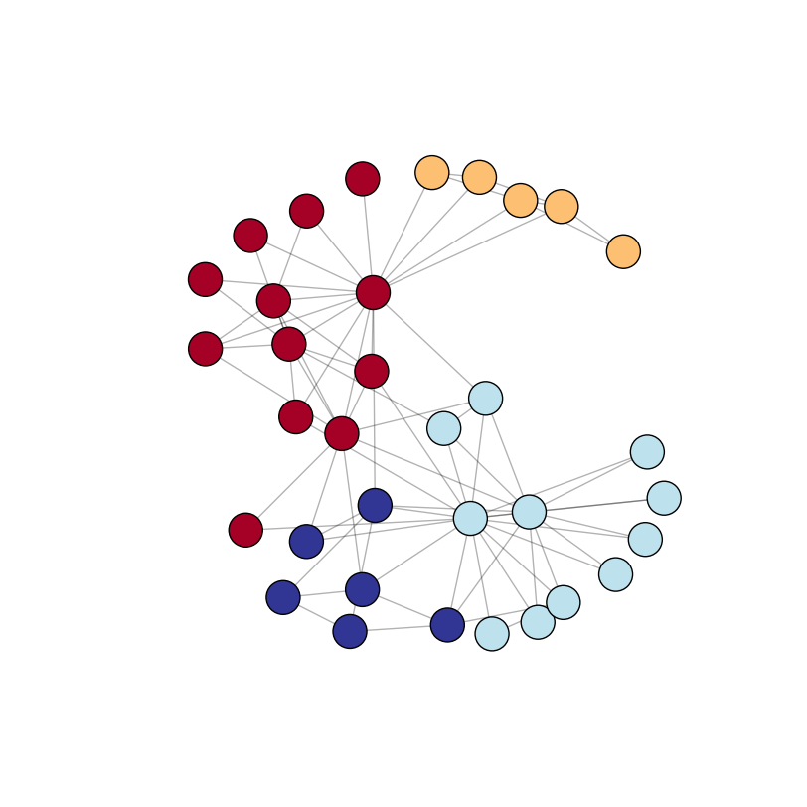
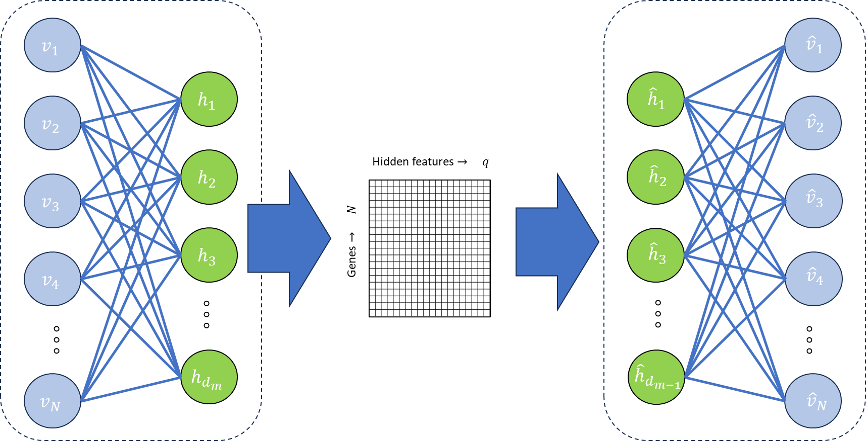

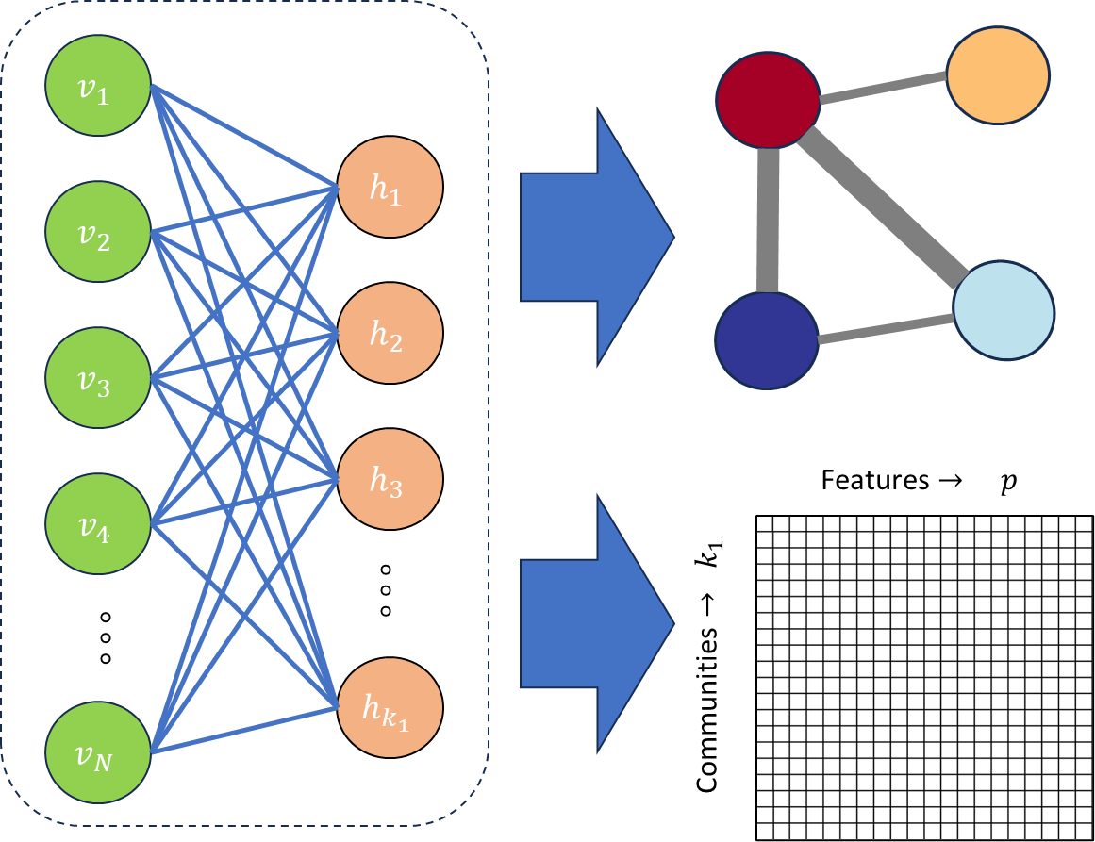
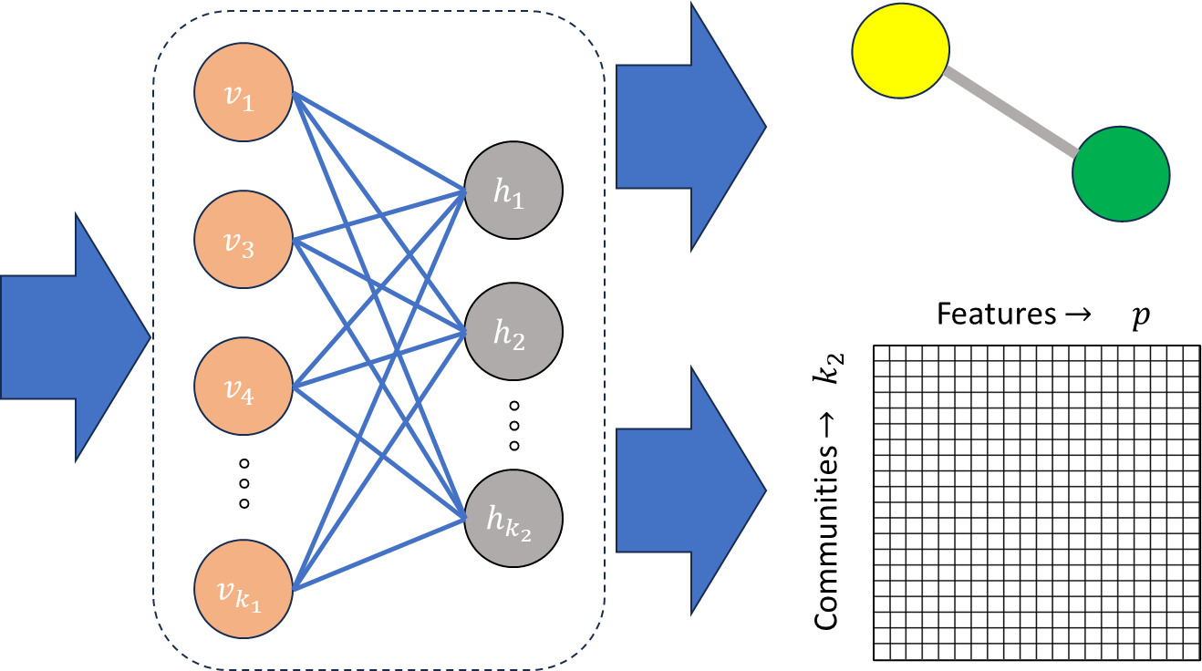
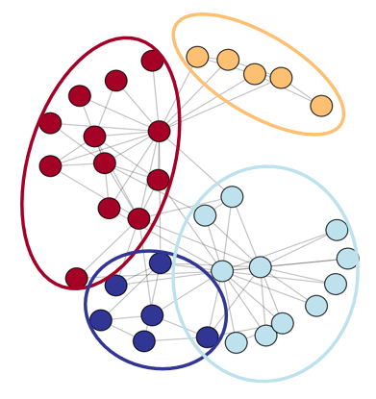
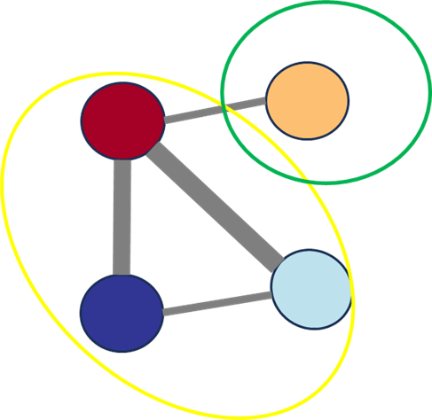




Features $→ p$
Features $→ p$
Genes $→ N$
Genes $→ N$

Slide 2
















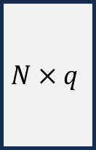






$$v_{1}$$
$${\hat{v}}_{1}$$
$$h_{1}$$
$$v_{2}$$
$${\hat{h}}_{1}$$
$${\hat{v}}_{2}$$
$$h_{2}$$
Hidden Attributes
$$v_{3}$$
$${\hat{h}}_{2}$$
$$N×q$$
$${\hat{v}}_{3}$$
Genes
$$h_{3}$$
$$v_{4}$$
$${\hat{h}}_{3}$$
$${\hat{v}}_{4}$$
$$° ° °$$
$$° ° °$$
$$° ° °$$
$$° ° °$$
$$h_{d_{m}}$$
$$v_{N}$$
$${\hat{h}}_{d_{m−1}}$$
$${\hat{v}}_{N}$$

Slide 3













$$v_{1}$$
$$h_{1}$$
$$v_{2}$$
$$h_{2}$$
$$v_{3}$$
$$h_{3}$$
$$v_{4}$$
Features $→ p$
$$° ° °$$
$$° ° °$$
$$h_{k_{1}}$$
Communities $→ k_{1}$
$$v_{N}$$

Slide 4


$$v_{1}$$
$$h_{1}$$
$$v_{2}$$
$$h_{2}$$
$$v_{3}$$
$$h_{3}$$
$$v_{4}$$
Features $→ p$
$$° ° °$$
$$° ° °$$
Communities $→ k_{1}$
$$h_{k_{1}}$$
$$v_{N}$$

Slide 5
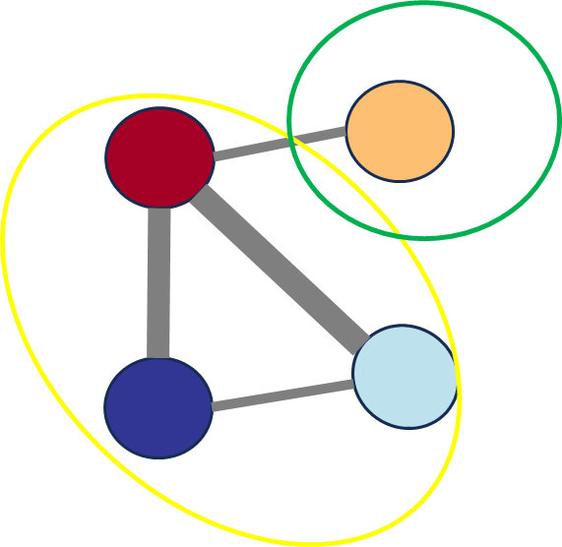

Slide 8











$$v_{1}$$
$$h_{1}$$
$$v_{3}$$
$$h_{2}$$
Features $→ p$
$$v_{4}$$
$$° ° °$$
$$° ° °$$
$$h_{k_{2}}$$
Communities $→ k_{2}$
$$v_{k_{1}}$$

Slide 9
