Slide 1
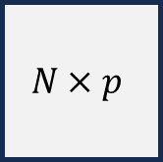
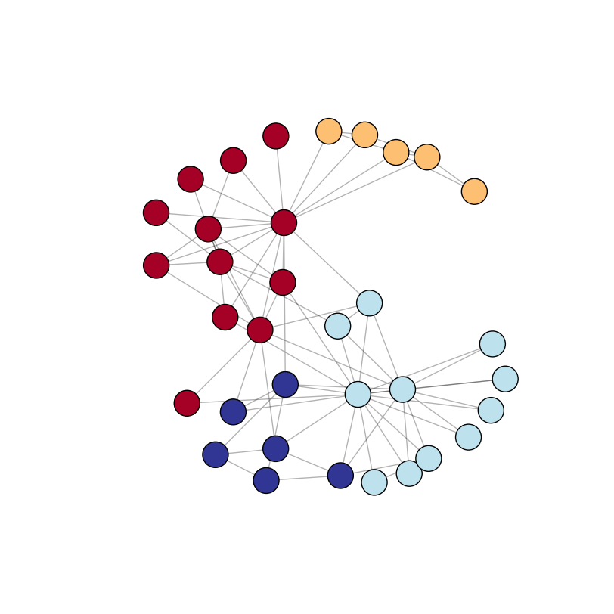
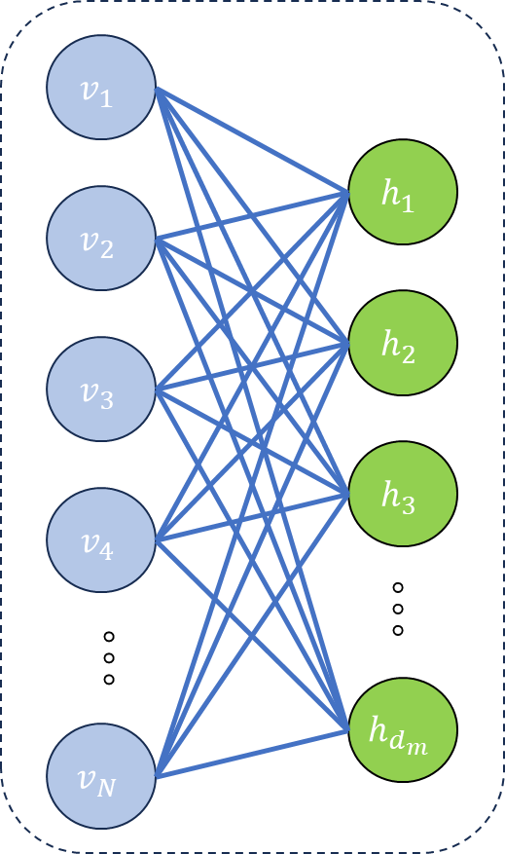
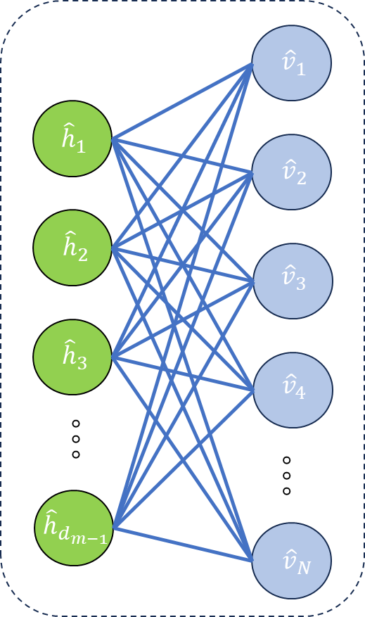

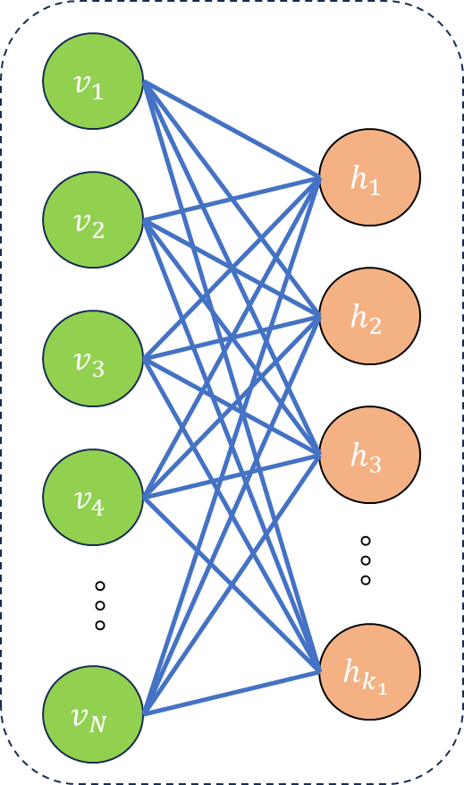
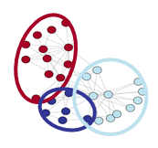
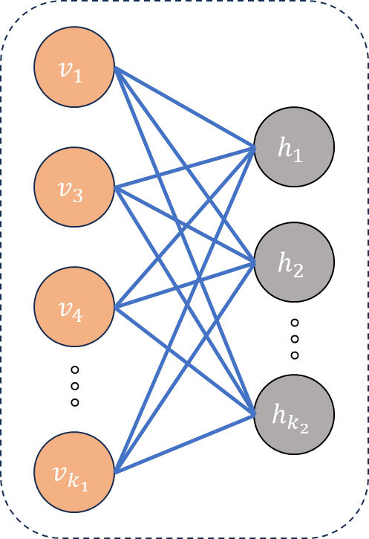
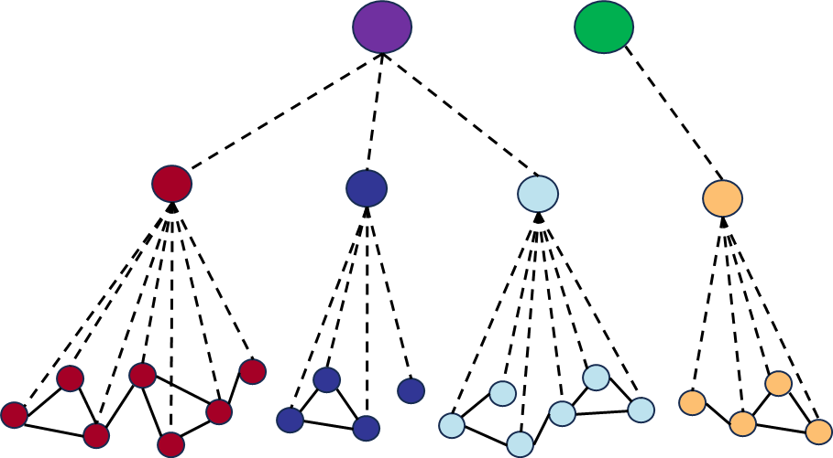
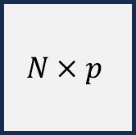
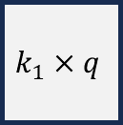


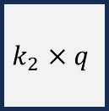
Graph Attention Autoencoder
Graph Reconstruction
Graph Adjacency Matrix
Hidden Attributes
Reconstructed Adjacency
$$N×q$$
Attributes
Genes
$$N×p$$
Attributes
$$N×p$$
Genes
Genes
Latent Representations
Reconstructed
Node Attributes
Node Attribute Matrix
Encoder
Decoder
Hierarchical Community Detection
Layer 1 Classifier
Layer 2 Classifier
Hidden
Attributes
$$N×q$$
Genes
Hidden Attributes
Hidden Attributes
Latent
Representations
$$k_{1}×q$$
$$k_{2}×q$$
communities
communities

