Slide 1
Lecture 6 Variance and standard deviation Cumulative distributions The normal distribution

Slide 2
Review
Percentiles
Range and IQR
The five number summary and boxplot

Slide 3
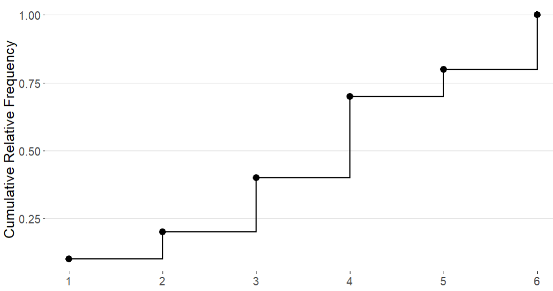
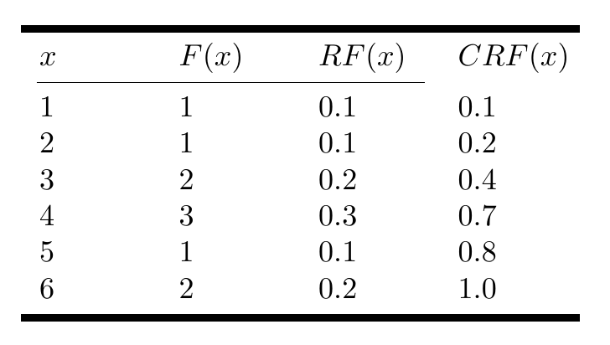
Cumulative Distributions
A cumulative distribution shows the relationship between the value of a variable and the cumulative relative frequency
We represent the cumulative distribution using a step function
Data = 1,2,3,3,4,4,4,5,6,6

Slide 4
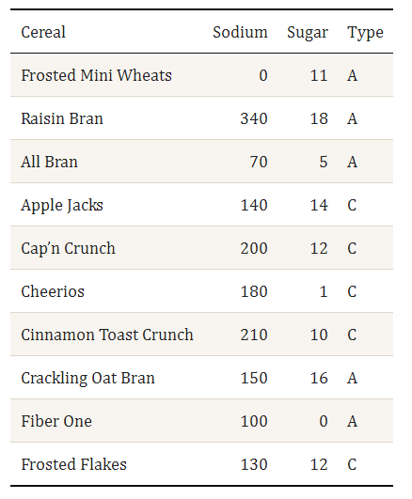
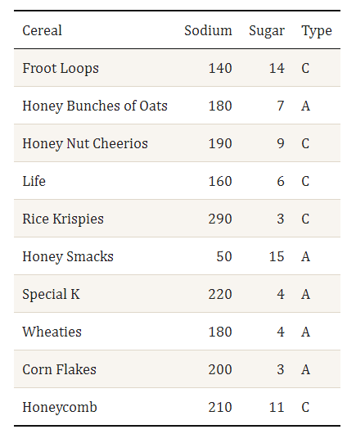

Slide 5
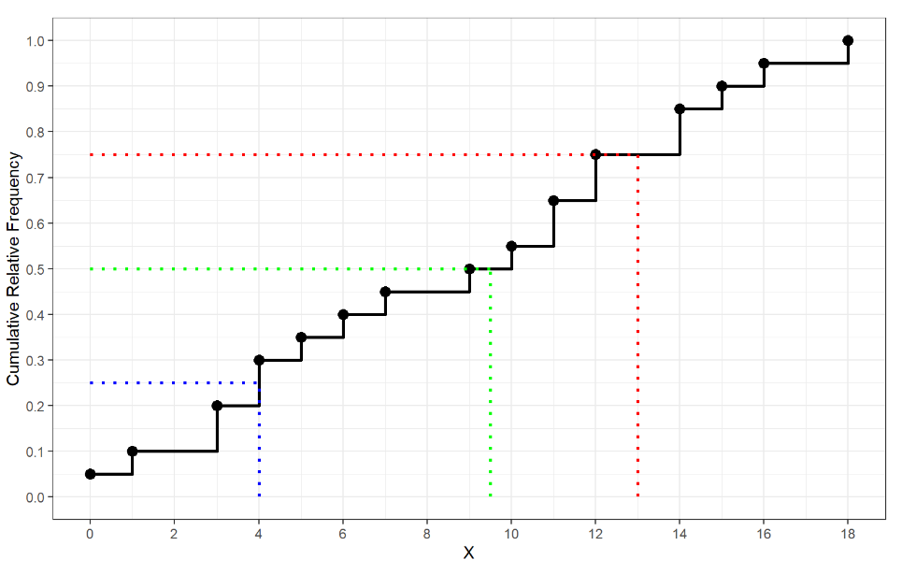

Finding Percentiles from Cumulative Distributions
lower half middle upper half
Data = 0, 1, 3, 3, 4, 4, 5, 6, 7, 9, 10,11,11,12,12,14,14,15,16,18
Q1 $= \frac{4+4}{2}=4$
Q2 $=\frac{9+10}{2}=9.5$
Q3 $= \frac{12+14}{2}=13$
What is the IQR?
IQR $=14 −4.5=9.5$

Slide 6
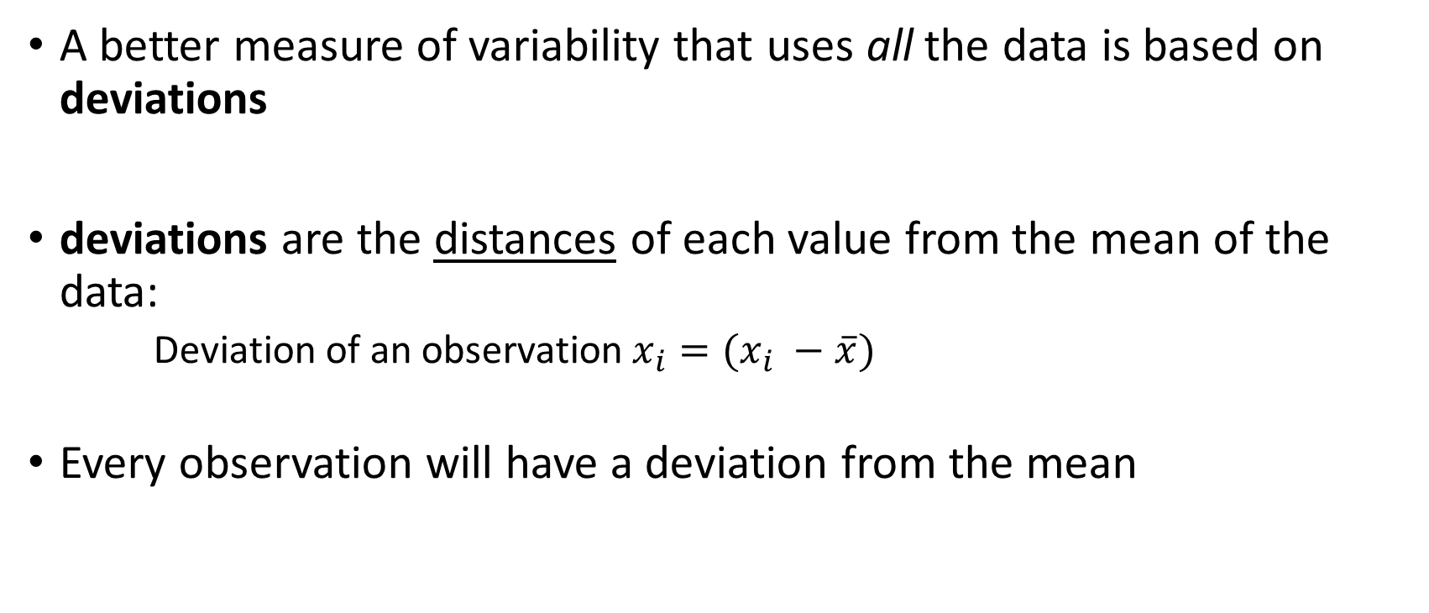
Measures of Spread: Deviation
A better measure of variability that uses all the data is based on deviations
deviations are the distances of each value from the mean of the data:
Deviation of an observation$x_{i}=(x_{i} −\overline{x})$
Every observation will have a deviation from the mean

Slide 7
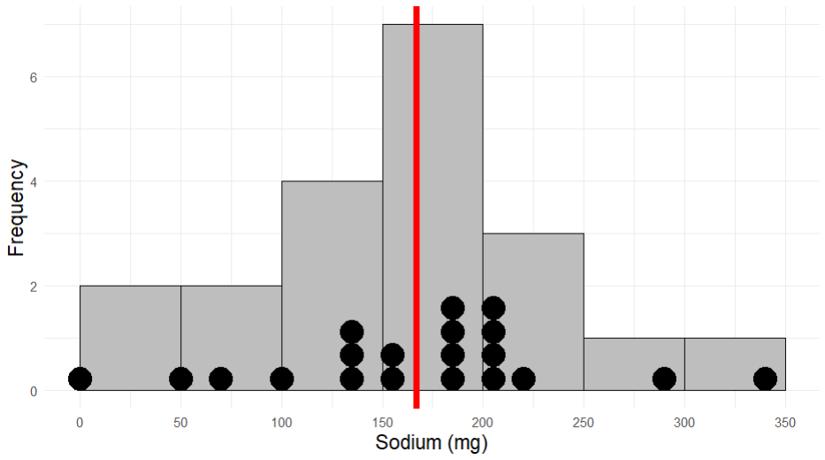


Frosted Mini Wheats = 0 (mg)
Mean = 167 (mg)
Rasin Bran = 340 (mg)
$$0 −167=−167$$
$$340 −167=173$$

Slide 8
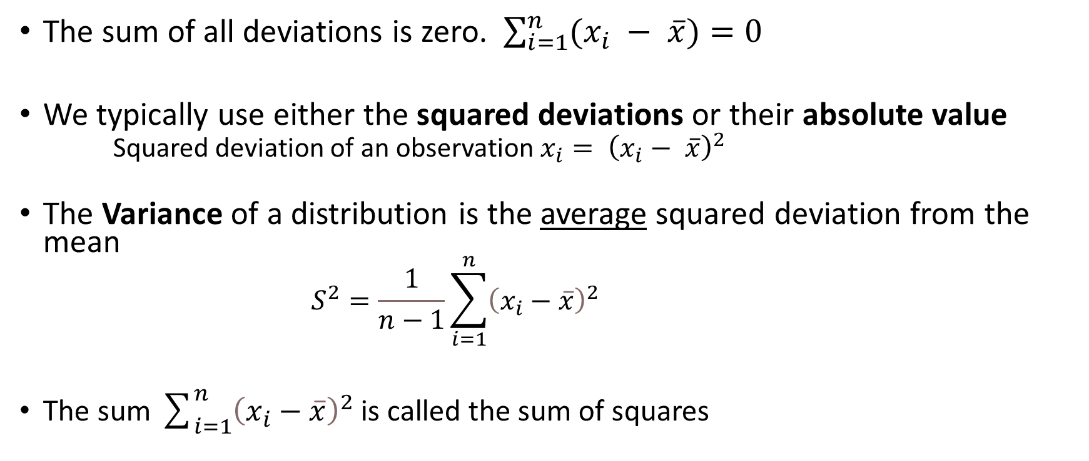
Measures of Spread: Variance
The sum of all deviations is zero. $\sum_{i=1}^{n}{(x_{i} − \overline{x})}=0$
We typically use either the squared deviations or their absolute value
Squared deviation of an observation $x_{i}= {\left(x_{i}− \overline{x}\right)}^{2}$
The Variance of a distribution is the average squared deviation from the mean
$$S^{2}=\frac{1}{n−1}\sum_{i=1}^{n}{{\left(x_{i}−\overline{x}\right)}^{2}}$$
The sum $\sum_{i=1}^{n}{{\left(x_{i}−\overline{x}\right)}^{2}}$ is called the sum of squares

Slide 9
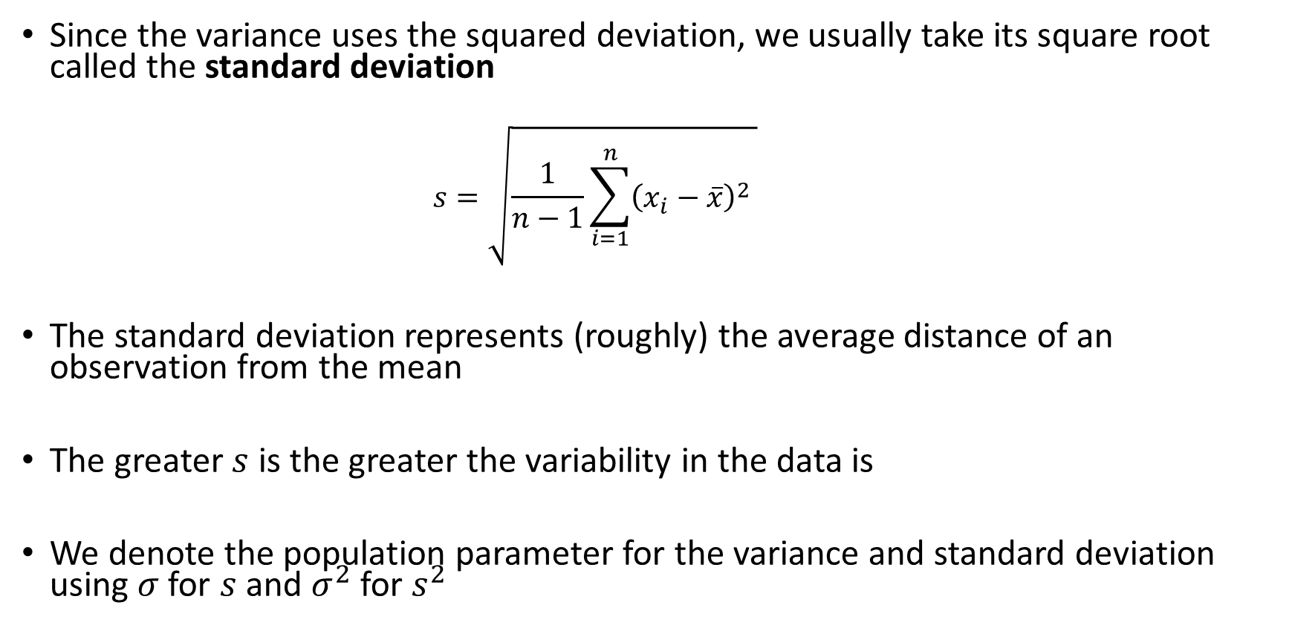
Measures of Spread: Standard Deviation
Since the variance uses the squared deviation, we usually take its square root called the standard deviation
$$s=\sqrt{\frac{1}{n−1}\sum_{i=1}^{n}{{\left(x_{i}−\overline{x}\right)}^{2}} }$$
The standard deviation represents (roughly) the average distance of an observation from the mean
The greater $s$ is the greater the variability in the data is
We denote the population parameter for the variance and standard deviation using $σ$ for $s$ and $σ^{2}$ for $s^{2}$

Slide 10

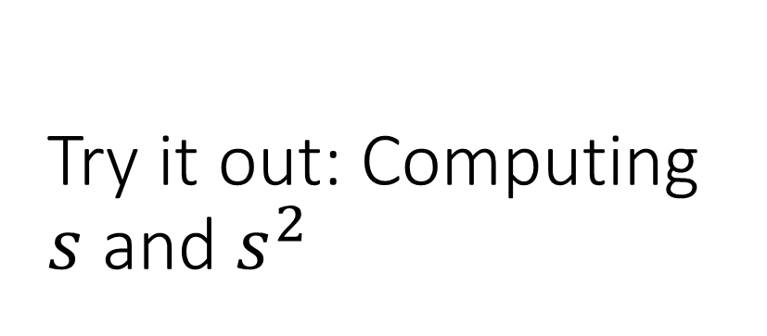
Try it out: Computing $s$ and $s^{2}$
Consider the following sample of 5 observations of the height of colleges students at the University of Idaho
Data = 61,62,62,68,75
Mean = 3.8
What if we observe another student who has a height of $x=92$ inches. How does including this observation change our estimate $s$

Slide 11
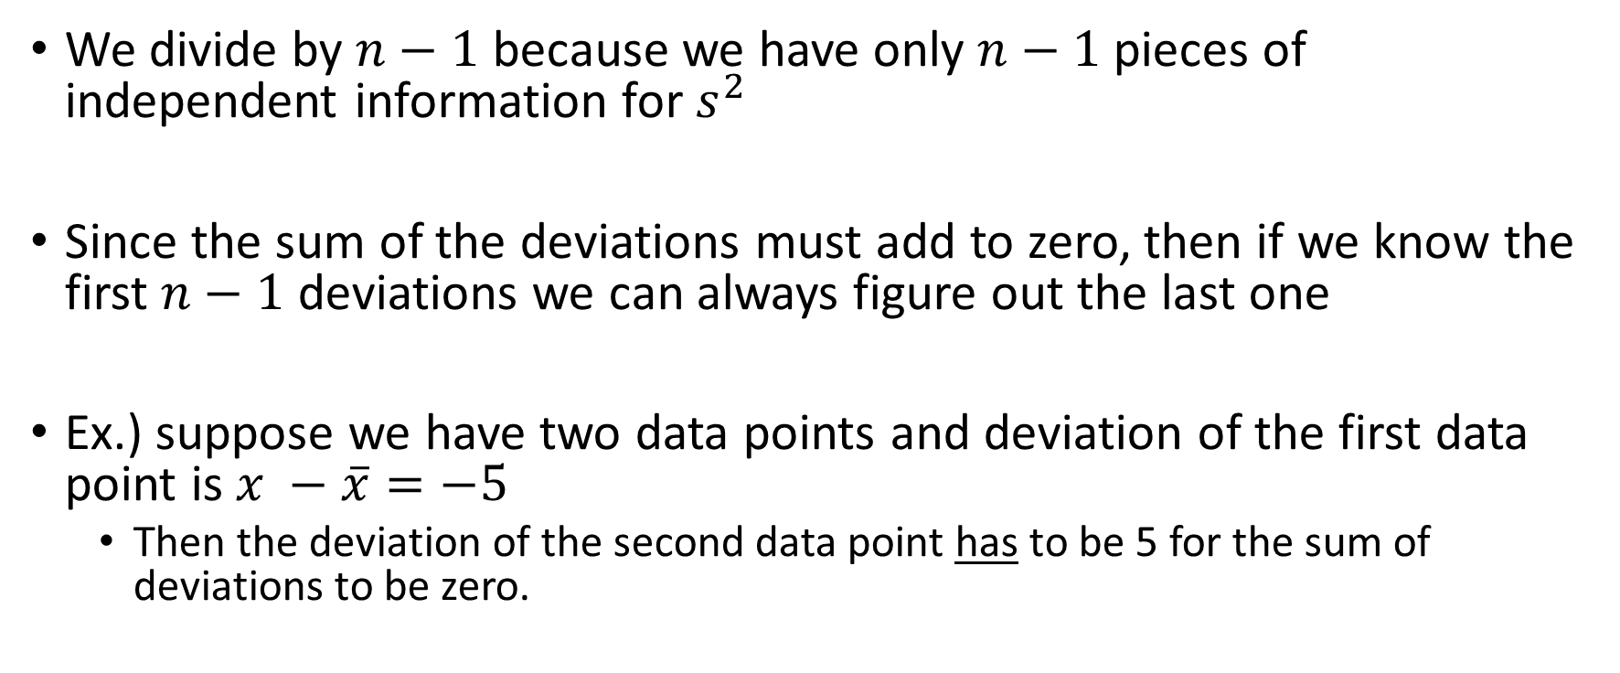

Why divide by $n−1$ ?
We divide by $n−1$ because we have only $n−1$pieces of independent information for $s^{2}$
Since the sum of the deviations must add to zero, then if we know the first $n−1$ deviations we can always figure out the last one
Ex.) suppose we have two data points and deviation of the first data point is $x −\overline{x}=−5$
Then the deviation of the second data point has to be 5 for the sum of deviations to be zero.

Slide 12
End of Material For Exam 1

Slide 13
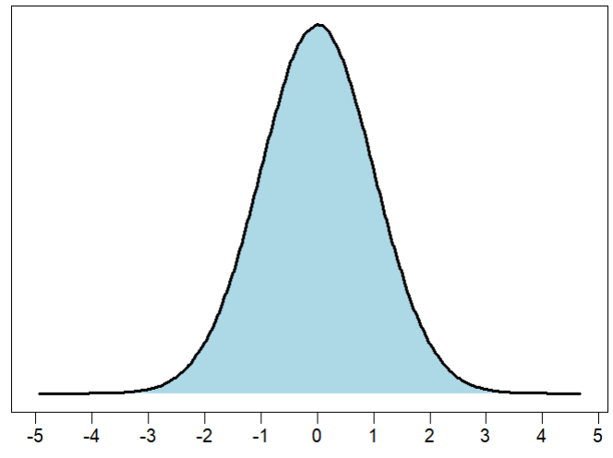
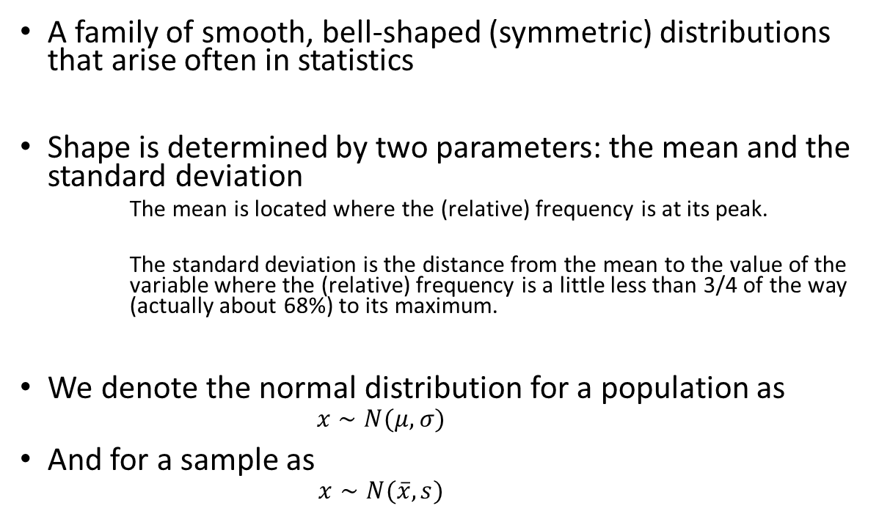
The Normal Distribution
A family of smooth, bell-shaped (symmetric) distributions that arise often in statistics
Shape is determined by two parameters: the mean and the standard deviation
The mean is located where the (relative) frequency is at its peak.
The standard deviation is the distance from the mean to the value of the variable where the (relative) frequency is a little less than 3/4 of the way (actually about 68%) to its maximum.
We denote the normal distribution for a population as
$$x∼N(μ, σ)$$
And for a sample as
$$x∼N(\overline{x}, s)$$

Slide 14
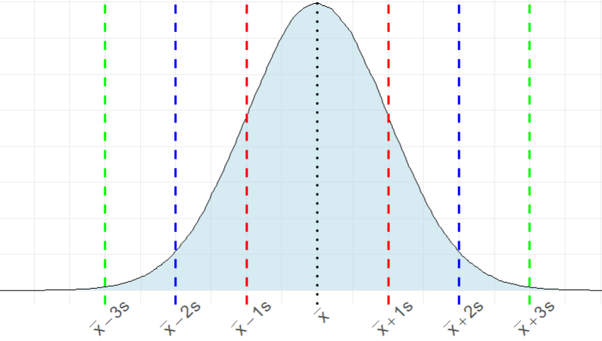
The Empirical Rule
About 99.7% of the data
About 95% of the data
About 68% of the data
2.35%
13.5%
34%
34%
13.5%
2.35%

Slide 15
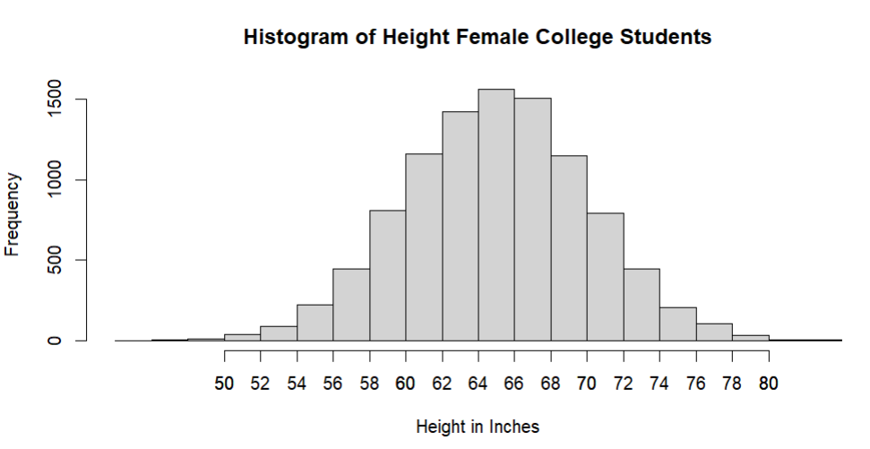
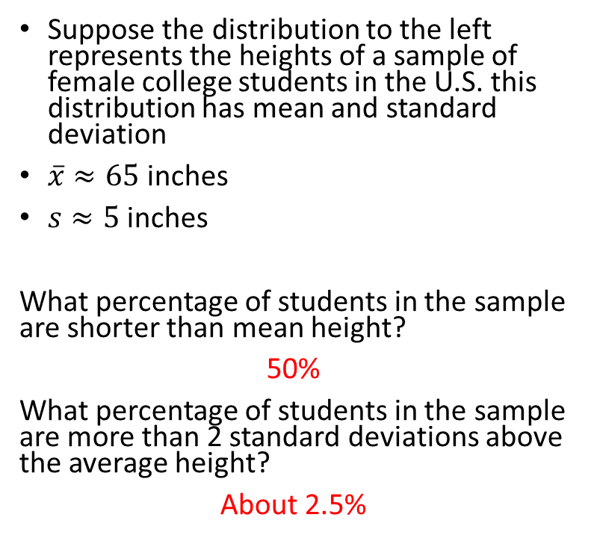
Practice
Suppose the distribution to the left represents the heights of a sample of female college students in the U.S. this distribution has mean and standard deviation
$\overline{x}≈65$ inches
$s≈5$ inches
What percentage of students in the sample are shorter than mean height?
50%
What percentage of students in the sample are more than 2 standard deviations above the average height?
About 2.5%
0.15%
2.35%
13.5%
34%

Slide 16
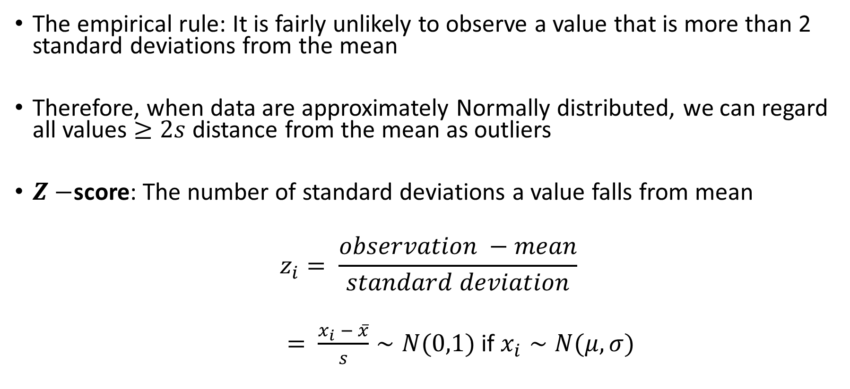
Identifying Outliers: Normal Distributions
The empirical rule: It is fairly unlikely to observe a value that is more than 2 standard deviations from the mean
Therefore, when data are approximately Normally distributed, we can regard all values $≥2s$ distance from the mean as outliers
$Z−$score: The number of standard deviations a value falls from mean
$$z_{i}= \frac{observation −mean}{standard deviation}$$
$= \frac{x_{i} − \overline{x}}{s}∼N(0,1)$ if $x_{i}∼N(μ, σ)$

Slide 17
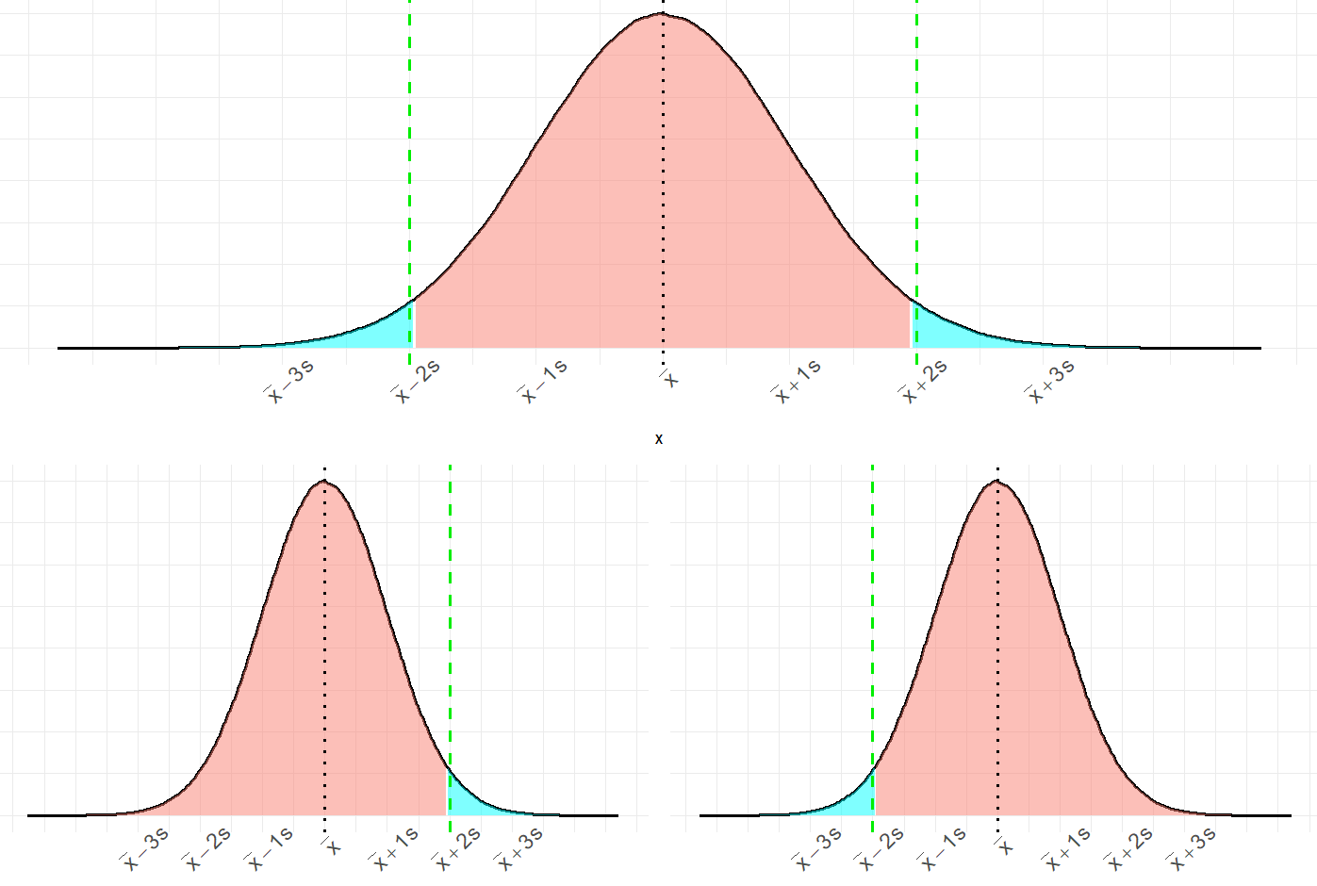
Outliers
Outliers
95%
2.5%
2.5%
Upper tail
Lower tail
97.5%
2.5%
2.5%
97.5%

Slide 18
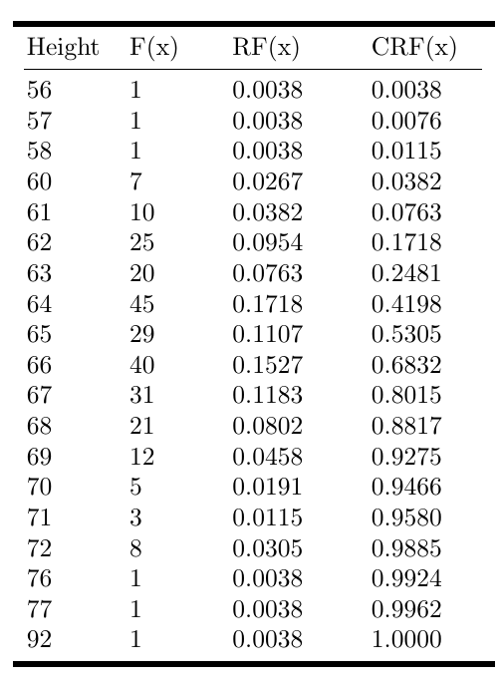
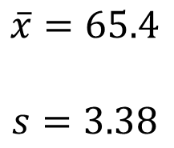
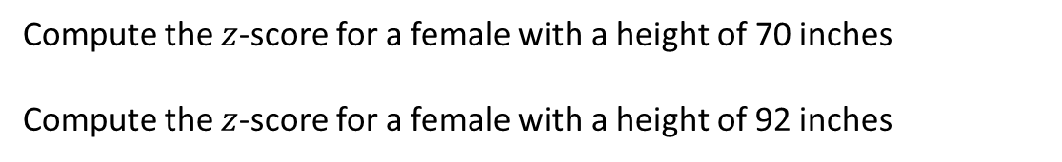
Try it out: Female College Student Heights
Compute the $z$-score for a female with a height of 70 inches
Compute the $z$-score for a female with a height of 92 inches
$$\overline{x}=65.4$$
$$s=3.38$$

Slide 19
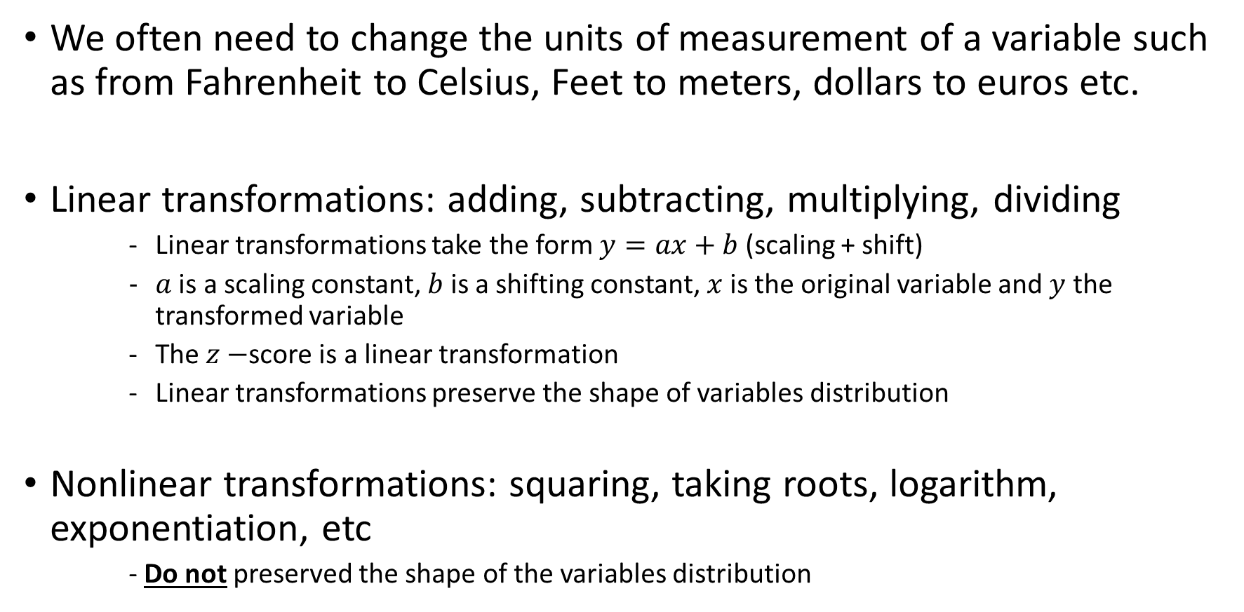
A Note About Transformations of Variables…
We often need to change the units of measurement of a variable such as from Fahrenheit to Celsius, Feet to meters, dollars to euros etc.
Linear transformations: adding, subtracting, multiplying, dividing
Linear transformations take the form $y=ax+b$ (scaling + shift)
$a$ is a scaling constant, $b$ is a shifting constant, $x$ is the original variable and $y$ the transformed variable
The $z−$score is a linear transformation
Linear transformations preserve the shape of variables distribution
Nonlinear transformations: squaring, taking roots, logarithm, exponentiation, etc
- Do not preserved the shape of the variables distribution

Slide 20
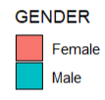
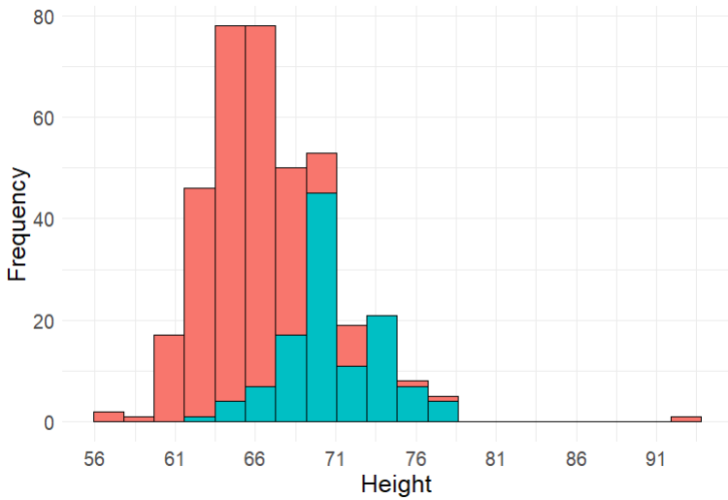
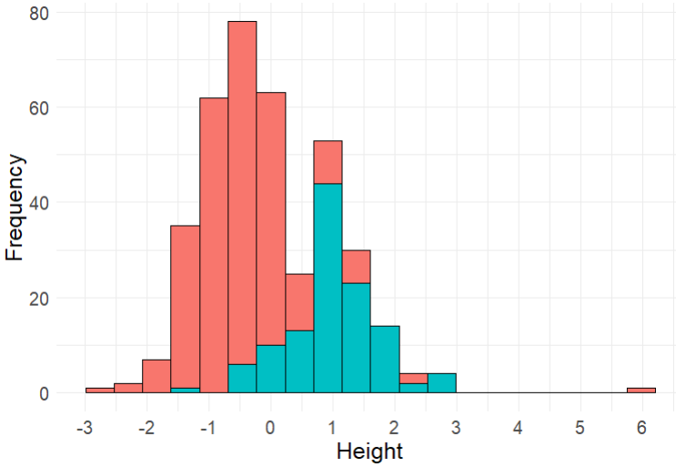
College Student Heights

Slide 21
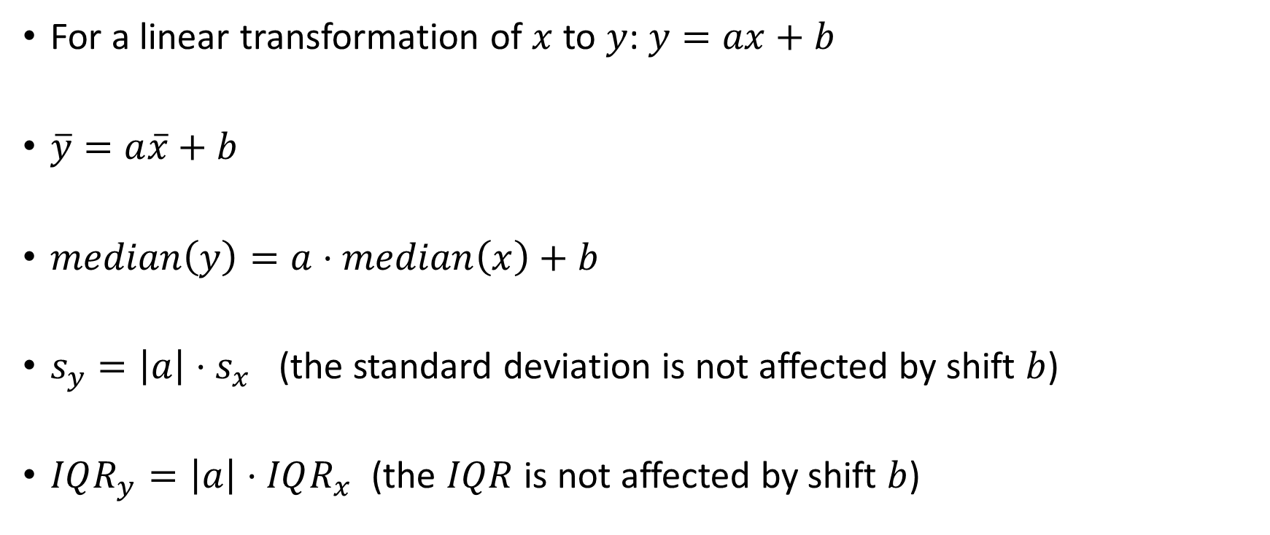
More properties of Linear Transformations
For a linear transformation of $x$ to $y$: $y=ax+b$
$\overline{y}=a\overline{x}+b$
$median\left(y\right)=a⋅median\left(x\right)+b$
$s_{y}=\left|a\right|{⋅s}_{x}$ (the standard deviation is not affected by shift $b$)
$IQR_{y}=\left|a\right|⋅IQR_{x}$ (the $IQR$ is not affected by shift $b$)

