Slide 1
STAT 251 Section 01 Final Exam Review!

Slide 2
Instructions
Class divided into 3 teams – teams will compete to win 5 bonus points on the final exam.
If you answer a question correctly you earn a piece of candy

Slide 3
Example:
Question: __________ is the probability of observing a value as or more extreme than the test statistic.
Answer: “What is p-value”

Slide 4
The Big Picture
Statistical Description
Probability Theory
Inferential Statistics
Sampling and Experiemental Design
Association and Linear Regression
$200
$200
$200
$200
$200
$200
$400
$400
$400
$400
$400
$400
$600
$600
$600
$600
$600
$600
$800
$800
$800
$800
$800
$800
$1000
$1000
$1000
$1000
$1000
$1000

Slide 5
A qualitative variable places observations into one or more categories while a quantitative variable consists of measurements represented by numerical values
CATEGORY 1 · $200

Slide 6
A parameter is a numerical characteristic of a population while a statistic is a numerical characteristic of a sample
CATEGORY 1 · $400

Slide 7
Inferential statistics concerns the use of a sample to make conclusions about a population
CATEGORY 1 · $600

Slide 8
A distribution of the observations of a variable gives (a) the values that occur and (b) how often each value occurs.
CATEGORY 1 · $800

Slide 9
We often cannot observe all members of a population. However, estimation allow us to approximate almost everything about populations using only samples.
CATEGORY 1 · $1000

Slide 10
The modal category is the most frequent category of a qualitative variable
CATEGORY 2 · $200

Slide 11
For normally distributed variables, the empirical rule states that 95% of the data falls within 2 standard deviations of the mean
CATEGORY 2 · $400

Slide 12
A frequency table is a tabular description of the distribution of a variable – it can be applied to either quantitative or qualitative variables
CATEGORY 2 · $600

Slide 13
The mean is the average of a distribution while the median is the middle value of a distribution
CATEGORY 2 · $800

Slide 14
A Z-score tells you the number of standard deviations a value falls from the mean
CATEGORY 2 · $1000

Slide 15
Probability is the measure of the likelihood of an event given as a number between 0 and 1
CATEGORY 3 · $200

Slide 16
The sample space of an experiment is the collection of all possible outcomes of an experiment
CATEGORY 3 · $400

Slide 17
A sampling distribution is the distribution of all possible values of an estimate
CATEGORY 3 · $600

Slide 18
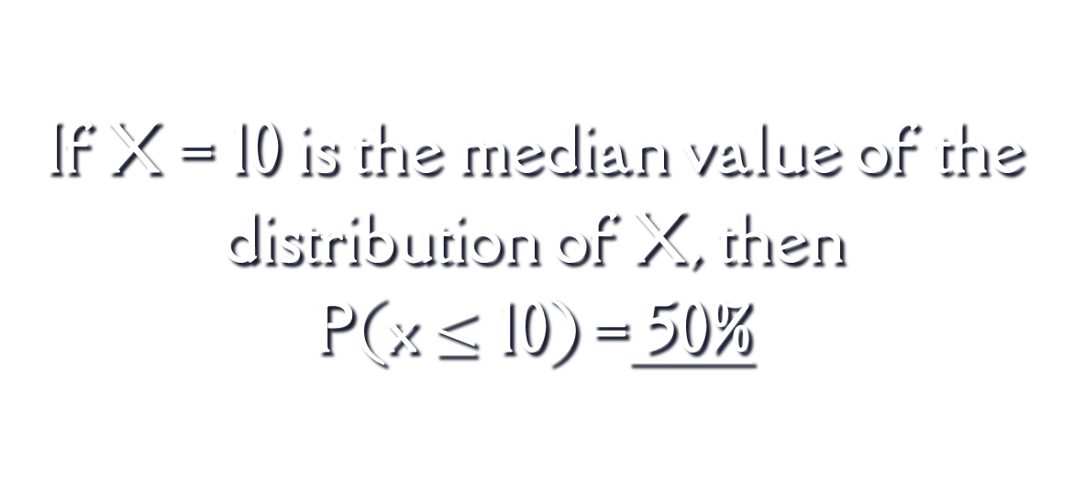
If X = 10 is the median value of the distribution of X, then P(x $≤$ 10) = 50%
CATEGORY 3 · $800

Slide 19
A random variable is a function that maps from the sample space of event to a set of values.
CATEGORY 3 · $1000

Slide 20
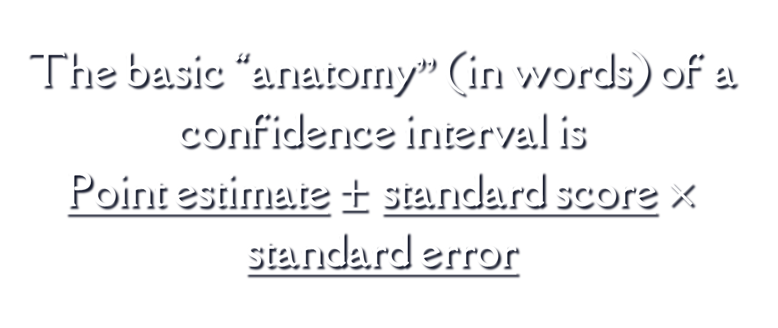
The basic “anatomy” (in words) of a confidence interval is Point estimate $±$ standard score $×$ standard error
CATEGORY 4 · $200

Slide 21
Interval estimation is the estimation of the value of a parameter with an interval of values
CATEGORY 4 · $400

Slide 22
The margin of error of an estimate measures how far we expect an estimate to fall from the true value of a population parameter
CATEGORY 4 · $600

Slide 23
The Central Limit Theorem states that as the sample size increases the shape of the sampling distribution of a sample mean will be approximately normal.
CATEGORY 4 · $800

Slide 24
Increasing the confidence level of a confidence interval increases the margin of error while increasing the sample size decreases the margin of error
CATEGORY 4 · $1000

Slide 25
In experimental studies, subjects are randomly assigned to treatment groups
CATEGORY 5 · $200

Slide 26
Simple random sampling is a type of sampling design where each subject in the sampling frame has an equal probability of being selected for the sample.
CATEGORY 5 · $400

Slide 27
A sample survey selects a sample of subjects from a population and collects data. It is a type of non-experimental study
CATEGORY 5 · $600

Slide 28
Non-response bias is the failure to observe some observational units that were intended to be observed
CATEGORY 5 · $800

Slide 29
Observational studies are prone to lurking variables - variables which are unknown to the researchers and have an association with both the response and explanatory variables
CATEGORY 5 · $1000

Slide 30
Two variables are said to be associated if values for one variable are more likely to occur with certain values of the other variable.
CATEGORY 6 · $200

Slide 31
Covariance is a measure of how much two random variables vary together
CATEGORY 6 · $400

Slide 32
The correlation coefficient is a unitless measure of the degree of linear relationship between two variables
CATEGORY 6 · $600

Slide 33
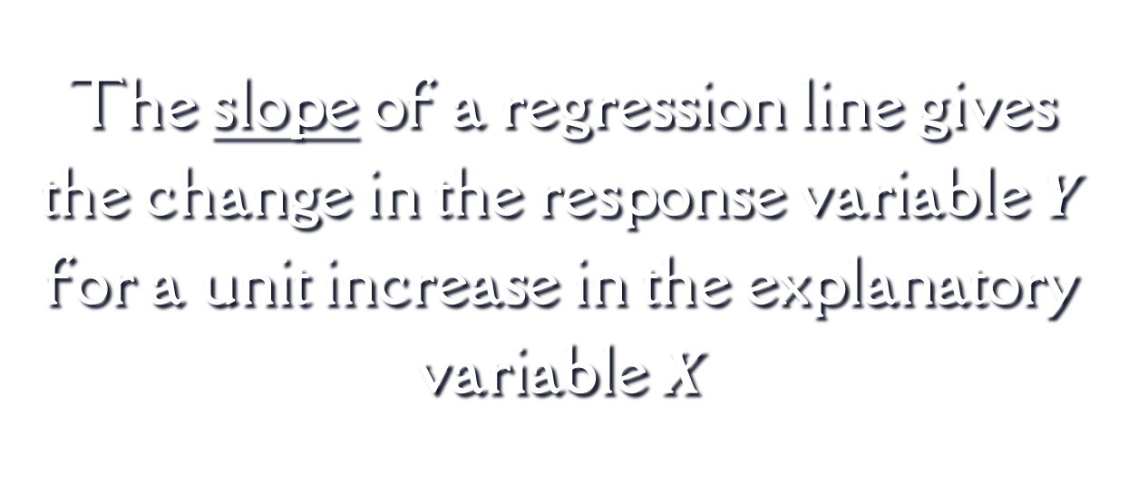
The slope of a regression line gives the change in the response variable $Y$ for a unit increase in the explanatory variable $X$
CATEGORY 6 · $800

Slide 34
The coefficient of determination compares the amount of variation of the regression model to the total variation in the dependent variable.
CATEGORY 6 · $1000

Slide 35
Winner!

Slide 36
Credits
Special thanks to all the people who made and released these awesome resources for free:
Presentation template by SlidesCarnival

Slide 37
Presentation design
This presentation uses the following typographies:
Titles: Bebas Neue
Body copy: Della Respira
Download for free at: https://www.fontsquirrel.com/fonts/bebas-neue https://www.1001fonts.com/della-respira-font.html
You don’t need to keep this slide in your presentation. It’s only here to serve you as a design guide if you need to create new slides or download the fonts to edit the presentation in PowerPoint®

Slide 38
MAP

Slide 39
GADGETS

Slide 40
SlidesCarnival icons are editable shapes. This means that you can:
Resize them without losing quality.
Change fill color and opacity.
Change line color, width and style.
Isn’t that nice? :) Examples:
Find more icons at slidescarnival.com/extra-free-resources-icons-and-maps

Slide 41
Diagrams and infographics

Slide 42
😉
You can also use any emoji as an icon! And of course it resizes without losing quality.
How? Follow Google instructions https://twitter.com/googledocs/status/730087240156643328
✋👆👉👍👤👦👧👨👩👪💃🏃💑❤😂😉😋😒😭👶😸🐟🍒🍔💣📌📖🔨🎃🎈🎨🏈🏰🌏🔌🔑 and many more...

Slide 43

Free templates for all your presentation needs
For PowerPoint and Google Slides
100% free for personal or commercial use
Ready to use, professional and customizable
Blow your audience away with attractive visuals

