Slide 1
Project Round 2!

Slide 2

Happy Baby Says It Best…

Slide 3
Your Challenge

Slide 4
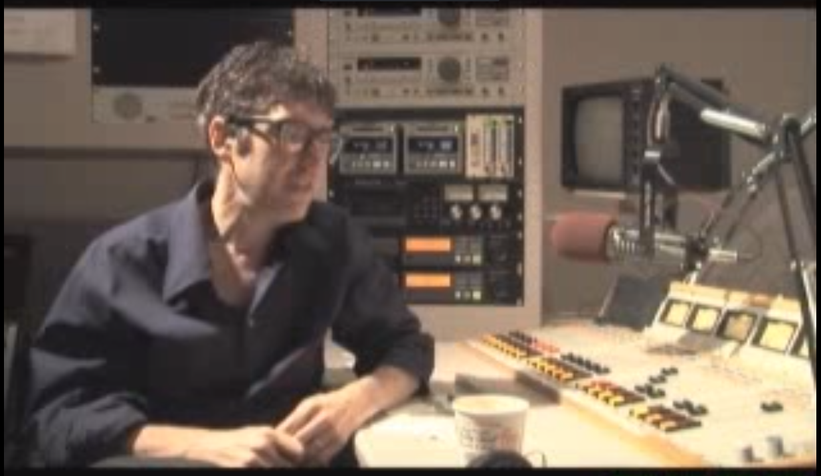
Ira Glass – On “Taste”
https://www.youtube.com/watch?v=X2wLP0izeJE

Slide 5
Your Challenge
At this point, you all have real skills.
It’s time to show it.

Slide 6
Your Challenge
Like seriously.
Be ambitious.

Slide 7
Teams

Slide 8
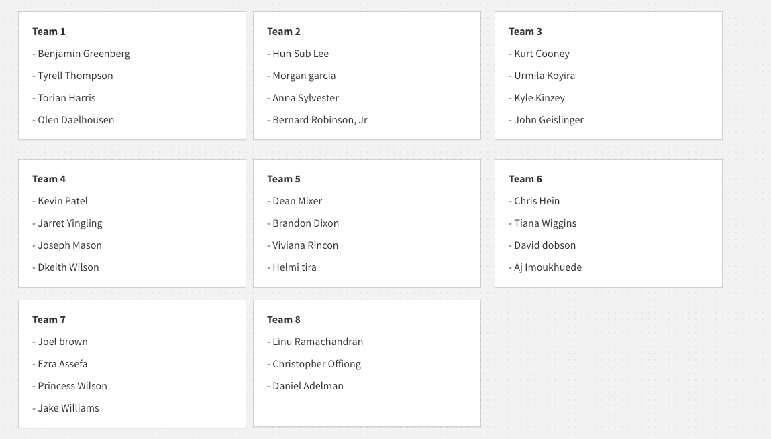
Group Teams

Slide 9
Project Task
To build a great project!

Slide 10
Coding Requirements
Must use a Node and Express Web Server
Must be backed by a MySQL Database with a Sequelize ORM
Must have both GET and POST routes for retrieving and adding new data
Must be deployed using Heroku (with Data)
Must utilize at least one new library, package, or technology that we haven’t discussed
Must have a polished frontend / UI
Must have folder structure that meets MVC Paradigm
Must meet good quality coding standards (indentation, scoping, naming)
Must protect API keys in node with environment variables

Slide 11
Coding – Nice To Haves
Utilize Handlebars for Server-Side Templating
Incorporate Authentication (JSON Web Tokens, Sessions, Etc.)
Use an existing public dataset to power the database
Create a migration strategy for sharing data across team members e.g. a seed/schema.sql file.

Slide 12
Presentation Requirement
You will also be responsible for preparing a 10 minute presentation.
This will be a formal presentation.
One in which you explain in detail:
Your overall application’s concept
The motivation for its development
Your design process
The technologies you used (and briefly how they work)
A demonstration of its functionality
Directions for future development
Treat the presentation seriously!
Talking intelligently about tech > doing tech sometimes.

Slide 13
Metrics

Slide 14
Metrics
Concept
Design
Functionality
Collaboration
Presentation

Slide 15
Questions

