Slide 1
AIoT Final Project:
Group 19
DATE: 2025/10/20

Slide 2
VitalGuard AI:
An AIoT Wearable for Real‑Time Health Insights & Alerts
1/4
What
A compact wearable + ESP32 edge‑AI system that continuously fuses multi‑sensor vitals (heart rate, respiration, temperature, activity, glucose, etc) to deliver personalized insights and trigger emergency alerts in real time.
Why (value & impact)
Relevance: Chronic disease & elder care need continuous, low‑cost monitoring outside clinics.
Social value: Earlier detection of anomalies and safer independent living; peace of mind for families/caregivers.
Utility: Actionable suggestions (hydration, rest, medication timing cues), trend tracking, and auto‑alert on falls/abnormal vitals.
Market potential: Remote Patient Monitoring (RPM), wellness wearables, campus safety, and corporate wellness pilots.

Slide 3
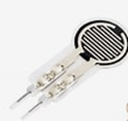


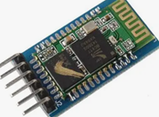
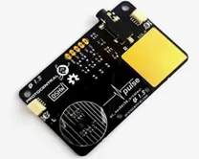
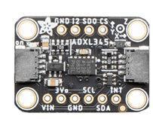
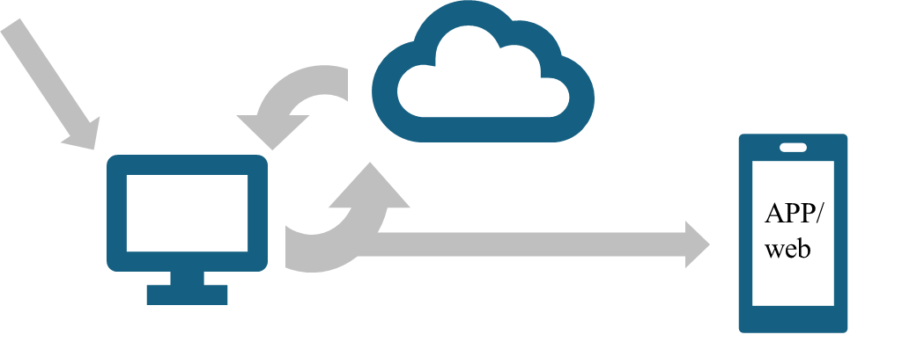
Integrated Sensors and Communication Modules
2/4
FSR402
•Fast response, compact.
•Pressure / force sensing.
TMP117
•Body / ambient temperature.
•±0.1°C accuracy, I²C interface.
MAX86150
•Heart rate, SpO₂, ECG.
•Integrated PPG+ECG, high SNR.
ADXL345
•Motion / posture / fall detection.
•3-axis, low power, high sensitivity.
Wi-Fi
•Cloud connectivity.
•High speed.
Bluetooth
•Short-range wireless link.
•Low energy, real-time data.

Slide 4
How It Works + Technical Components
3/4
Embedded Systems Components :
FSR402($7)
TMP117($17)
MAX86150($125)
ADXL345
Backend & Data Components:
Cloud Servers(GCP, AWS)
Socket
LLMs via API
Emergency notifications
Web UI & Mobile App
Workflow Pipeline:
Data from embedded systems will be sent to Cloud Servers(GCP, AWS)
A Socket will be used to facilitate data storage and data processing, which we plan to do with a Python script that will do feature extraction, normalization, etc.
An LLM will pull the processed data via an API, and do report generation.
For abnormal, serious detections, emergency notifications will be sent to the appropriate person(emergency contact, 911) immediately.
On the User End, the report from the LLM, and other key metrics from the embedded systems, will be available to them. There will be a Web UI for important information and notifications to be displayed & a Mobile App component for them to visualize and interact with their data.

Slide 5
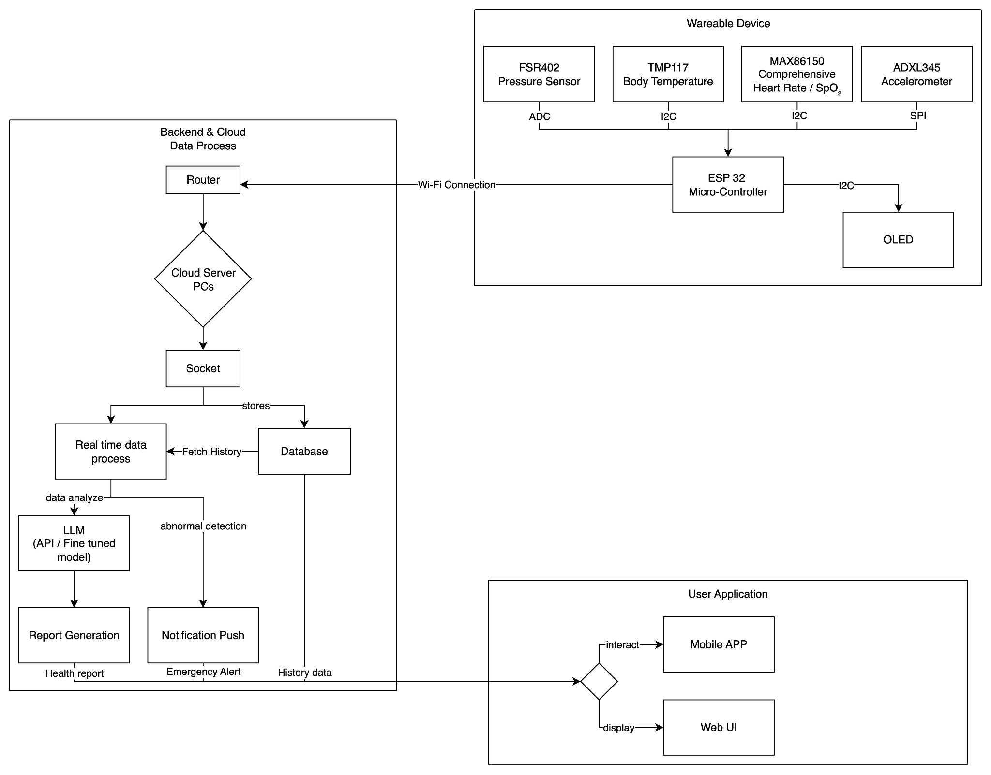
Block Diagram
4/4

Slide 6
Thank you for listening!

Slide 7
Hardware We Need
Pulse Oximeter Sensor($3)
Environment Humidity and Temperature Sensor($10)
Heart Rate Sensor($12)
Stress and Emotion Sensor[GSR Sensor]($11)

Slide 8
General Idea
Hardware: A kind of wearable that is able to track various different streams of data(including, but not limited to, heart rate, perspiration, etc.)
Software: 2 Components(AI and Not AI)
  Non AI component: Being able to automatically connect with other services(ie texting a loved one or emergency services if you fall, automatically syncing with temperature or weather outside, etc.)
  AI component: Being a kind of AI doctor? It should be able to that is able to take various inputs from the embedded sensors and generate outputs for the user, to improve their life or to make their body healthier.

