Slide 1
Programming & You
A presentation that I wish I had when I joined this lab
Jarrett Johnson
1/9/18
Zhang Lab

Slide 2
Outline
CPU architecture
Cache-friendly Data structures
Data Locality

Slide 3
Programming Languages
Java
C
C++
Python
Fortran
Etc…
Which language is the fastest?

Slide 4
Programming Languages
Java
C
C++
Python
Fortran
Etc…
NONE!
For the vast majority of programs, the speed is typically dictated by the algorithms and the data structures implemented by the programmer

Slide 5
CPU Architecture
MAIN MEMORY (RAM)
L3
CPU
L2
L1
16 – 32
Registers.
32 KB
64 byte
cache-line
4-5 cycle latency
256 KB
64 byte
cache-line
12 cycle latency
8 MB
64 byte
cache-line
36 cycle latency
16 GB
36 cycle latency +
57 ns
1 cycle ~ 300 picoseconds

Slide 6
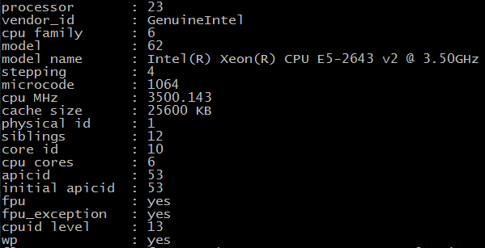
Our cluster nodes’ specs

Slide 7
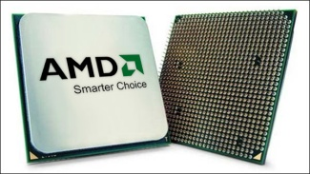
What does all of this mean?
L1
L2
RAM
Andreas Fredriksson – Insomnia Games

Slide 8
Cache-Friendly Data Structures
What is it?
  Data containers that store data contiguously in memory.
    Example:
      Cache-friendly: C-arrays and C++ vectors
      Cache-unfriendly: Linked Lists; Maps/Dictionaries
  Decreases the chances of a cache miss

Slide 9
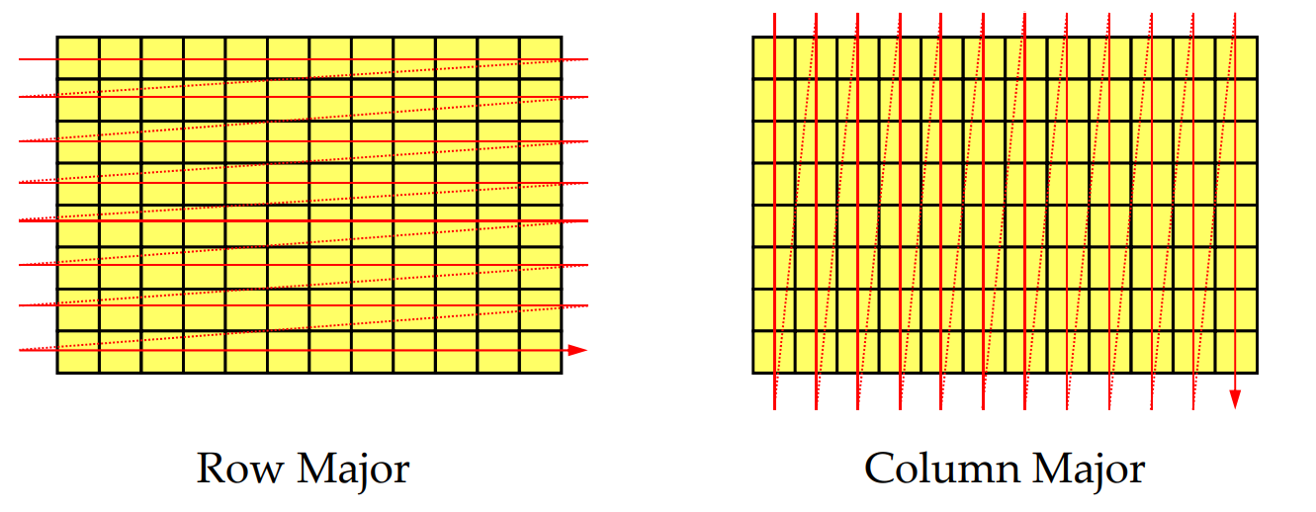
What is a cache-miss?
Scott Meyers 2014

Slide 10
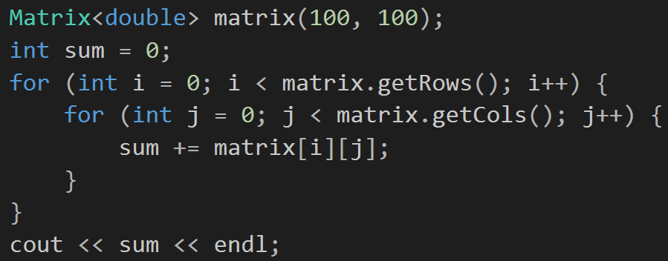
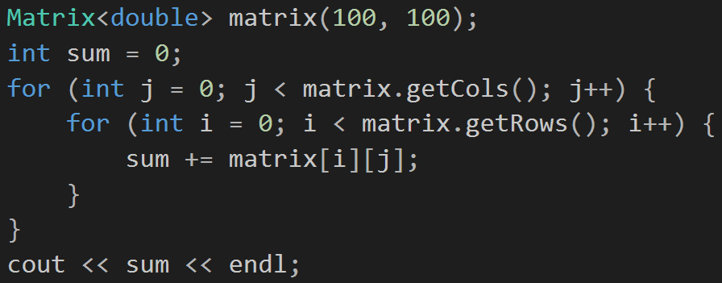
Know your data structures
Row Major Traversal
C/C++!
Column Major Traversal
Fortran!
Using correct traversal pattern for your data structures: ~3-5x speed (depends on the size of your matrix)
Scott Meyers 2014

Slide 11
Take-away
Use cache-friendly data structures (Use arrays)!
Try to avoid/limit searching through structures wherever/whenever possible.
Every language has (or at least should) have a data structure that is contiguous.
Use arrays!!!

Slide 12
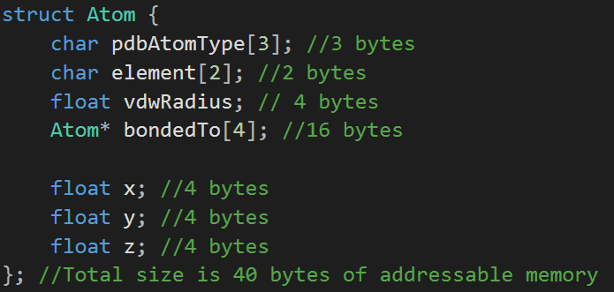
Data Locality
Working with the idea of cache-locality, if we’re optimizing for speed, we should pack our data that is optimal for our architecture not for our understanding.
Red: Atom’s X; Blue: Atom’s Y; Green: Atom’s Z
Atom 1
Atom 2
Atom 3
Atom 4
…

Slide 13
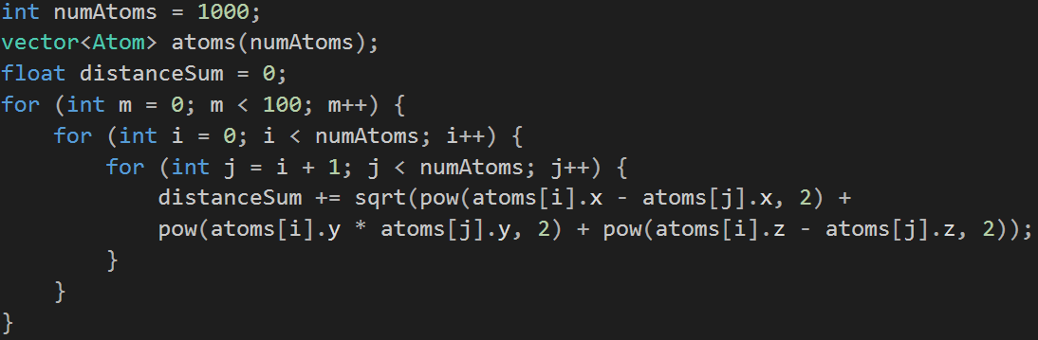
Distance Calculations Approach 1
Time spent on my i7 4770k cpu: 3 min and 1 sec.

Slide 14
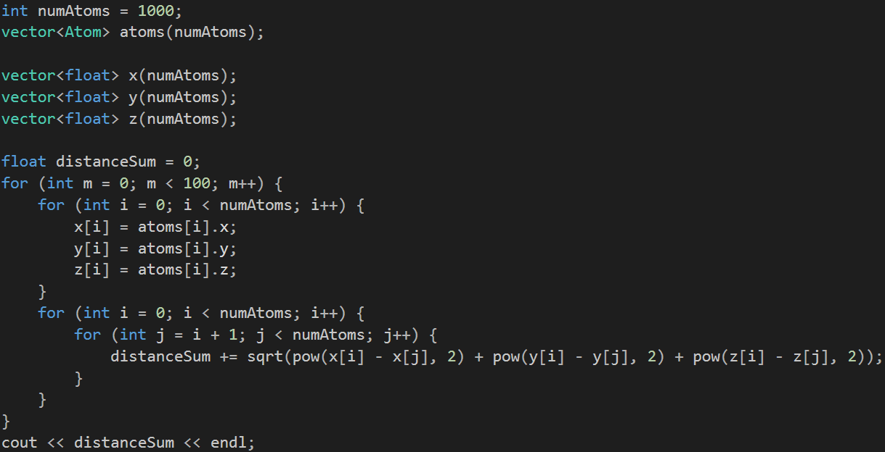
Distance Calculations Approach 2
New Approach creates 3 additional containers and performs N*3 copies every iteration
Time spent on my i7 4770k cpu: ???

Slide 16
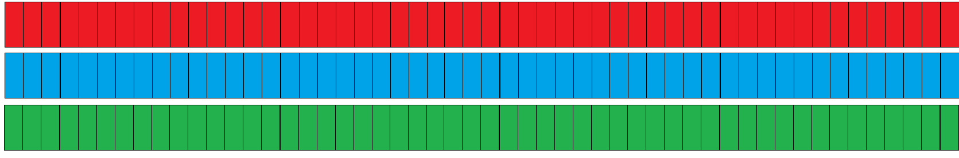
Revising our Data Locality
Atom 1
Atom 2
Atom 3
Atom 4
…
Red: Atom’s X; Blue: Atom’s Y; Green: Atom’s Z
Why?
We are packing the cache line with relevant data. Less opportunities for cache-misses.

Slide 17
Take-away
Use packed arrays!
Reason yourself as to why you have your data structured the way they are. Is it convenience for you? Are you thinking about your architecture?

Slide 18
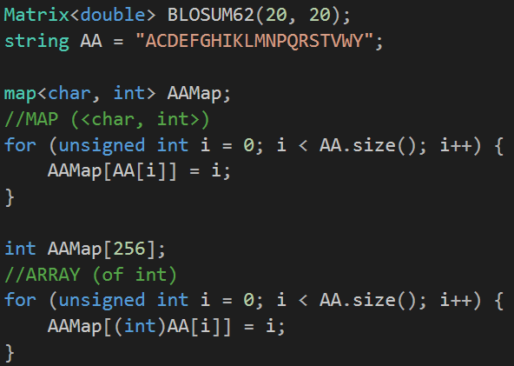
Cache-Friendly Data Structures
1)
2)

Slide 19
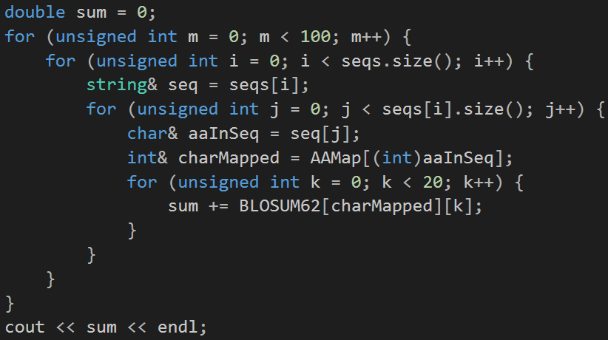
Cache-Friendly Data Structures
100 iterations
Pulls a seq from a list
Iterate through every amino acid in seq
Sum the blosum value of all amino acids vs the current amino acid.
Output sum

Slide 20
Cache-Friendly Data Structures

Slide 21
Take-away
Use arrays!
Try to avoid searching through structures wherever/whenever possible.
Every language has (or at least should) have a data structure that is contiguous.
Use arrays!!!

Slide 22
Rot Align Optimizations
Turn on optimizations (-O2)
Matrix revision
  Original: int** matrix;
  New: int* matrix;
Fragments represented as string pointers/references instead of a copy of a part of a string
QAVDILYAEETLRN
QAVDILYAEETLRN
VDILYA
All template fragments can now be pre-calculated and stored since it doesn’t consume much memory

Slide 24
Take-away
Use arrays

