Slide 1
Blackjack
Jarrod, Joe

Slide 2
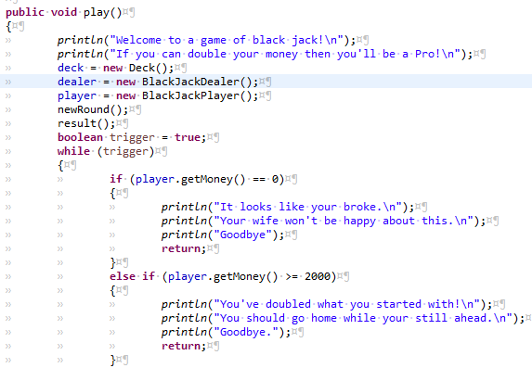
Beginning and Ending the Game

Slide 3
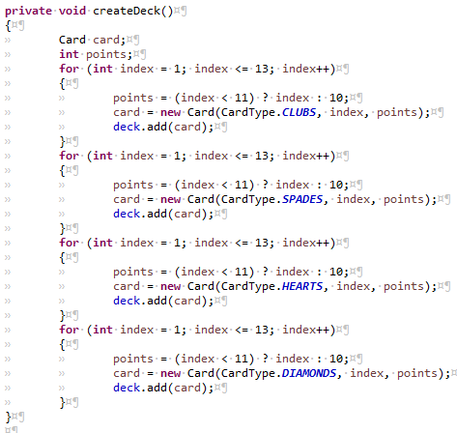
Building the Deck

Slide 4
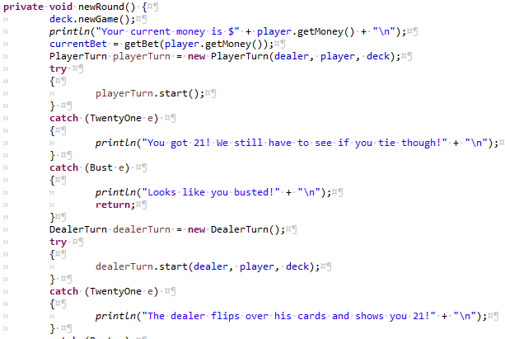
Starting a Round

Slide 5
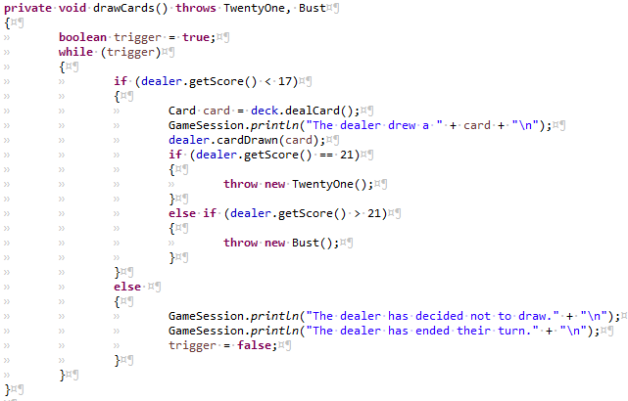
Dealer’s Turn

Slide 6
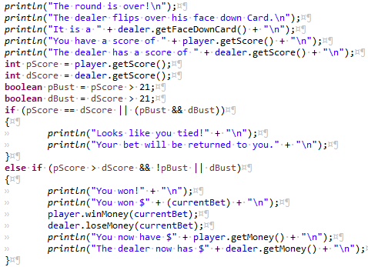
Tallying up the Score

Slide 7
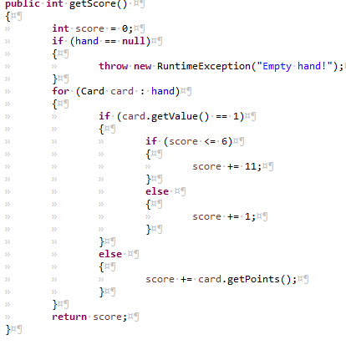
Getting the Score

Slide 8
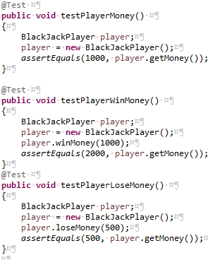
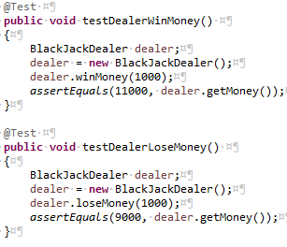
Test Cases

