Slide 1
Database, Client, Engine

Slide 2
What is a Relational Database?
Table
Rows, columns
Columns have names, data types
Each row is a single record
Operate on rows based on data in the columns
SELECT workbook_name FROM workbook WHERE
workbook_id = 1005;
Index
A way to find rows faster, based on content of one or more columns
table name
column name
which rows

Slide 3
Relations
When a row in one table is related to a row in another
Usually by equality, but not necessarily
Can find data from multiple tables based on relation
1 to N
1 to 1
N to 1
workbook_id, calculation_id are important columns to us – we look up almost everything by one or both of these

Slide 4
Relations
calculation
============== ========
calculation_id scene_id
1 1
2 1
3 2
============== ========
scene
======== ===============
scene_id characteristics
1 {}
2 {}
======== ===============
scene_element
======== ========== ========= ===============
scene_id element_id source_id source_arg_blob
1 1 1 {}
1 2 3 {"foo":"bar"}
2 1 1 {"foo":"baz"}
======== ========== ========= ===============
source
========= ===============
source_id characteristics
1 {"plugh":1}
{"plugh":77}
{ }
========= ===============

Slide 5

Obligatory Database Rant
You get data OUT of a database; you don’t put data IN to a database
Choose your tables and columns according to how you need to access them
If you start defining columns without knowing how you will use them, then
U R DOING IT RONG!

Slide 6
Choice of Database
Pandokia portable database interface
I don’t have time to take a shortcut; I’m in a hurry
No unnecessary complexity
wraps Python DBAPI 2.0 (not quite portable)
Sqlite (for developers)
MySQL (for production)
MS SQL Server (can talk to it later)

Slide 7
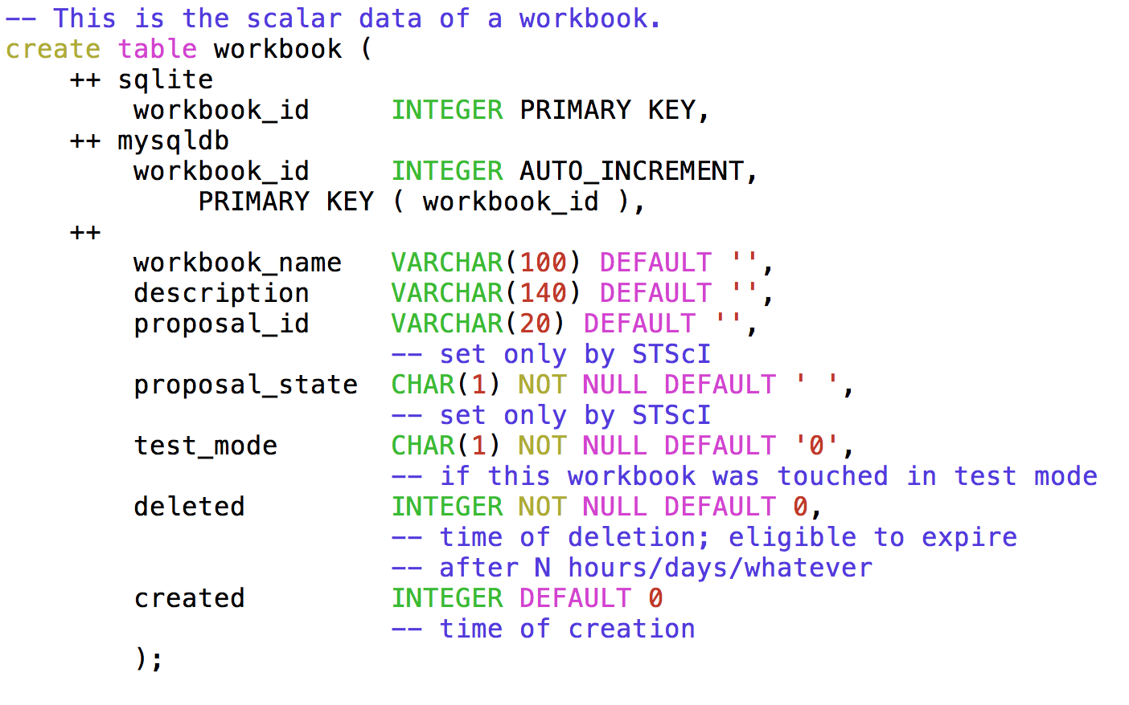
Sample Table
comment
pandokia extension
for portability
column type
column
name
color by vim

Slide 8
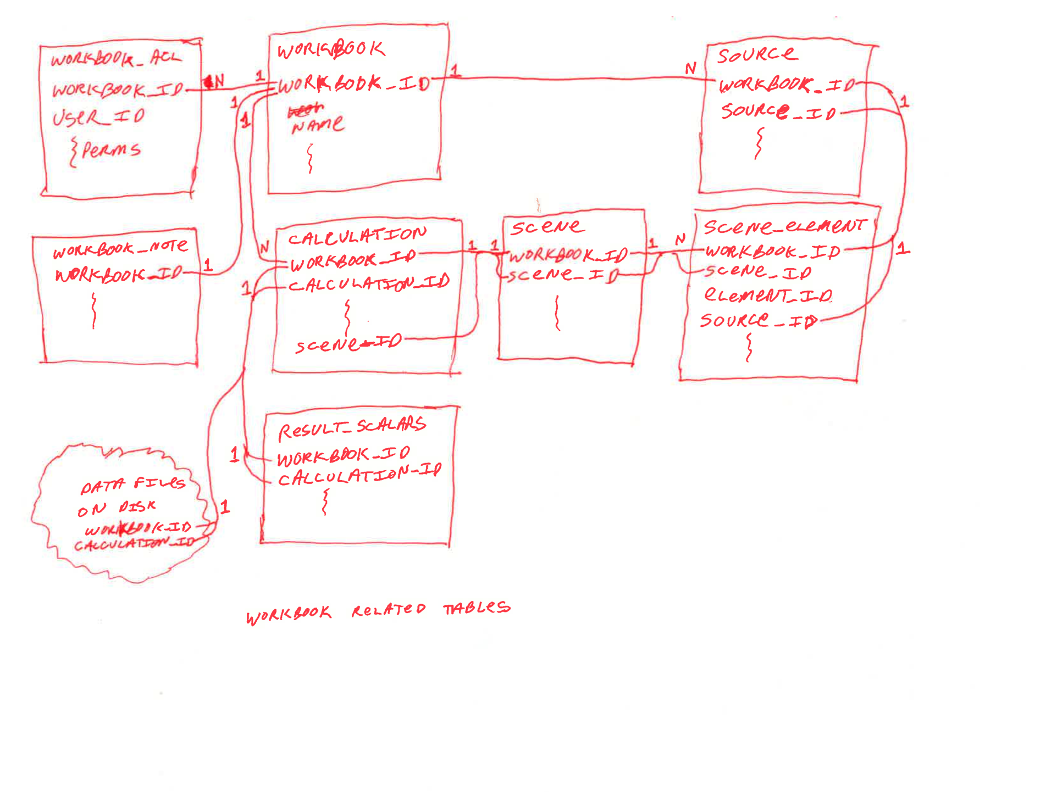
Relation Diagram of Pandeia
Tables are shown with only the columns that
are part of the relation.
Notice 1 to N / N to 1.

Slide 9
Finding data
Find a workbook by
workbook_id
Find a calculation by
workbook_id
calculation_id
Find a result by
workbook_id
calculation_id
Find a scene by
workbook_id
scene_id

Slide 10
Finding data - fancy
Find sources in a scene by
scene_element.workbook_id
scene_element.scene_id
Yields source_id, and then
source.workbook_id
source.source_id
SQL lessons later if you like

Slide 11
Why is it like this?
The scene_element table is how you do lists in SQL
scene table has a scene_id
many rows in scene_element table have that scene_id
those rows each identify a row in the source table

Slide 12
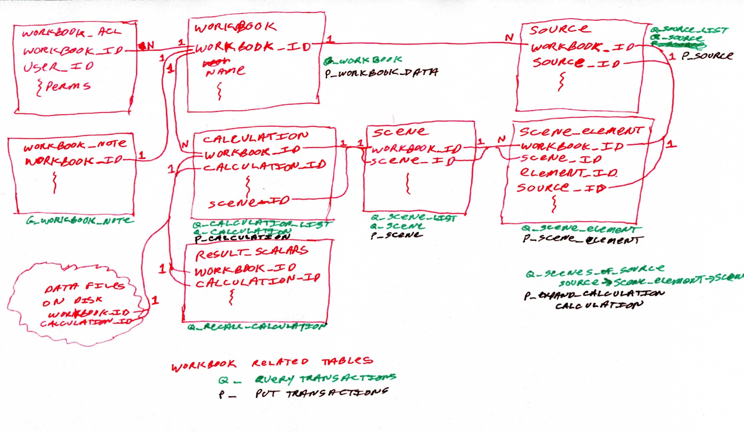
Mapping to Client
Client messages correspond directly to table rows.

Slide 13
Mapping to Server
Engine does not have same data model as rest of system
Single dict:
background
Is a string from the calculation table; more complex later
configuration
Is the instrument configuration, from calculation table
scene
Is a list of sources
Strategy
Is the strategy configuration, from calculation table

Slide 14
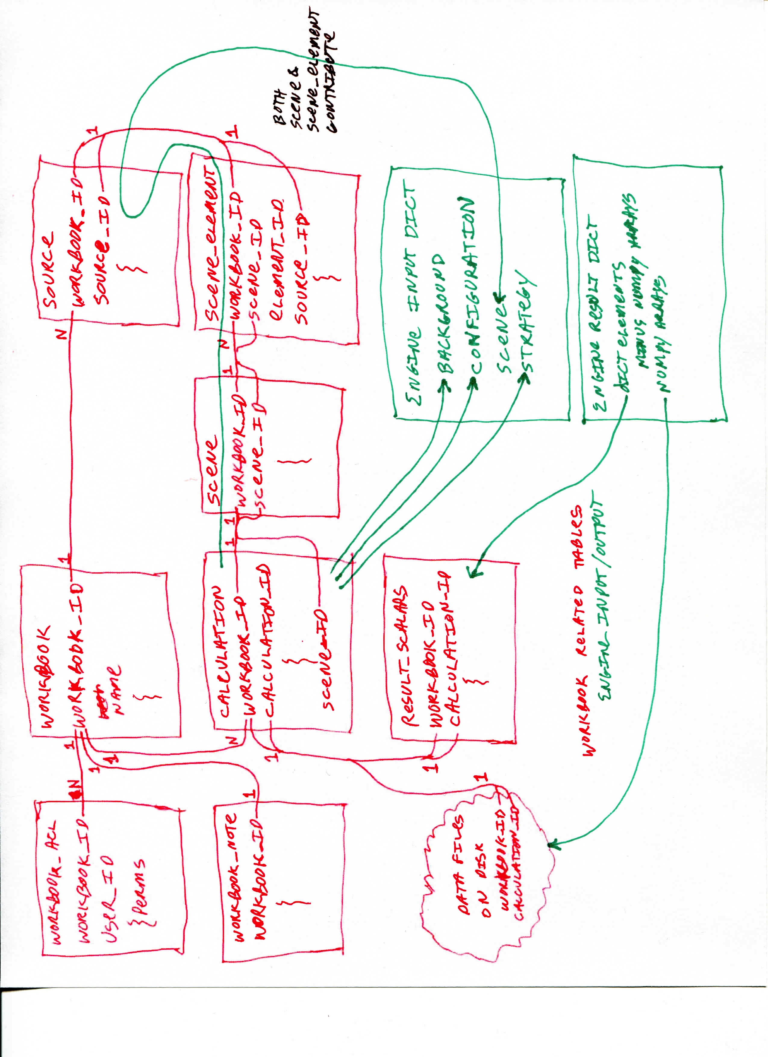
Mapping to Server
Calculation table has data for different parts of engine input dict.
Engine has only one scene, constructed from scene, scene_element, source tables.

Slide 15
json “blobs” to engine input
calculation.camera_config
x[‘configuration’]
calculation.strategy_args
x[‘strategy’]
scene.characteristics
nowhere
source.characteristics
x[‘scene’][n]
scene_element.source_arg_blob
x[‘scene’][n]

Slide 16
More Detail
pandeia/doc/api_overview/README.txt
Currently lists 12 files with more detail
Missing client->engine API
whatever is in the json blobs

Slide 17

Groundhog eating a Tomato

