Slide 1
JWST Coronagraphic Contrast Sensitivity Working Group Meeting
06/24/21
Agenda
Review of inputs, format, and assumptions
Implementing these in a coronagraphic sequence

Slide 2
Input files available at:
www.starkspace.com/shared/NIRCAM_OPDS.zip
www.starkspace.com/shared/MIRI_OPDS.zip
These are preliminary; an iteration is expected based on today’s meeting.
Each package contains a readme.txt file explaining format and units of files. OPD files are multi-extension fits, with “best case”, ”nominal”, and “requirement” scenarios given by 0 – 2 extensions, respectively. Dynamic terms are 100 x 100 x nt dimensions, where nt is the length of the time vector.
Orientation of all dynamic terms should be identical. I have not checked if this is the case for the OTE exit pupil WFE.
Dynamic terms calculated for 5 hours in steps of π/3 minutes. GTO coronagraph sequences typically take 1-6 hours depending on target, filters, masks, rolls, etc.

Slide 3
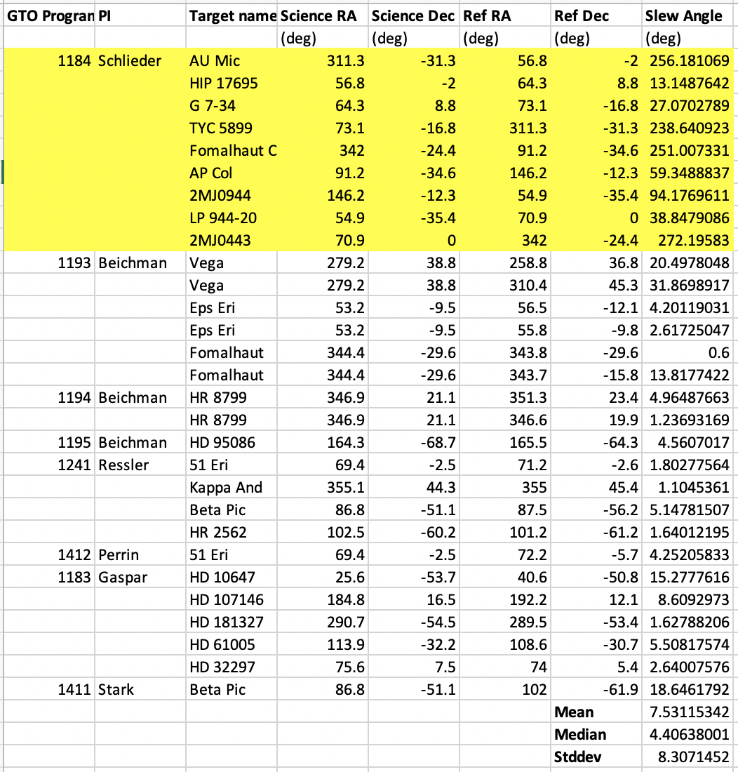
Estimating Typical Slew Size
Pueyo & Hines report the typical slew from the SODRM is ~3 deg
Evaluating the slew from coronagraphic GTO programs (at right) suggests a mean slew of ~8 deg
When implementing the impact of the slew on WFE, we basically assume it is all pitch
Currently adopting 3 deg for ”best case” scenario and 10 deg for “nominal” scenario. This is conservative. Could revise downward.

Slide 4
Amplitude Assumptions
Mode | NIRCam | MIRI
Target Acq | 2D Gaussian [5, 7, 10 mas] per axis 1σ Ref: Peiman & Mario G | 2D Gaussian [5, 7, 10 mas] per axis 1σ Ref: Hines / Lajoie et al. (2016)
Pupil shear | N/A | [0%, 2%, 4%] Ref: Cavarroc et al. (2008)
LOS Jitter | 2D Gaussian [2.5,3.8, 5.8 mas] per axis 1σ Ref: Peiman | 2D Gaussian [2.5,3.8,5.8 mas] per axis 1σ Ref: Peiman
IEC Oscillations | OPD vs time (sinusoidal), fixed DT=0.25 C, scale by MUF [MUF=1,MUF=1.7,MUF=2.8] Ref: Joe Howard | OPD vs time (sinusoidal), fixed DT=0.25 C, scale by MUF [MUF=1,MUF=1.7,MUF=2.8] Ref: Joe Howard
Frill/close-out | OPD vs time (exponential decay), fixed time constant [small slew (3 deg) no MUF, typical (10 deg) slew no MUF, requirement] Ref: Joe Howard, Hines & Pueyo | OPD vs time (exponential decay), fixed time constant [small slew (3 deg) no MUF, typical (10 deg) slew no MUF, requirement] Ref: Joe Howard, Hines & Pueyo
Thermal drift | OPD vs time (exponential decay), fixed time constant [small slew (3 deg) no MUF, typical (10 deg) slew no MUF, requirement] Ref: Joe Howard, Hines & Pueyo | OPD vs time (exponential decay), fixed time constant [small slew (3 deg) no MUF, typical (10 deg) slew no MUF, requirement] Ref: Joe Howard, Hines & Pueyo
Deployed dynamics | OPD vs time (segment-level randomization) [TBD w/ Joe] Ref: Joe Howard | OPD vs time (segment-level randomization) [TBD w/ Joe] Ref: Joe Howard
Magnitudes of effects span from “best” to “requirement” in 3 values: [Best, Likely/Midpoint, Requirement]
Best = best case scenario with no MUF
Requirement = requirement is usually the worst case scenario (worst case slew w/ MUF)
Likely/midpoint = expected performance when possible, midpoint used when there is insufficient information
Yellow highlight indicates TBR
Pink highlight indicates value I made up
No highlight indicates it was recommended/checked with the reference(s) indicated
Still waiting on these, but amplitude is small

Slide 5
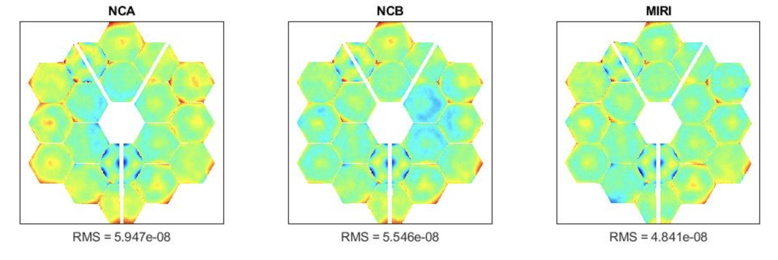
Static WFE
1024x1024 Post-WFSC Static WFE at OTE exit pupil
Joe Howard
These are nominal WFE errors w/out jitter or stability included

Slide 6
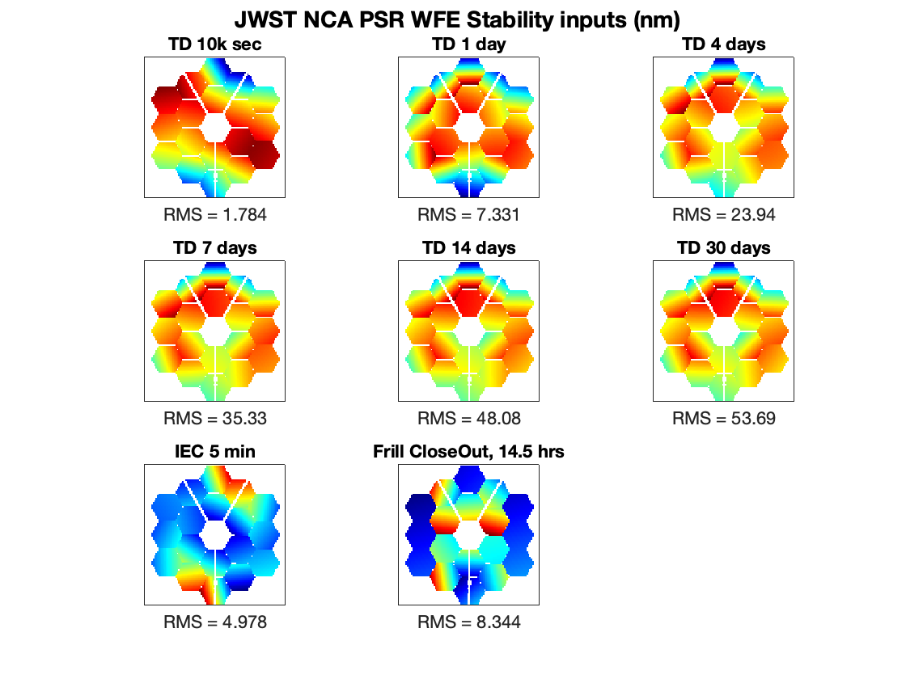
Dynamic WFE Terms
IEC Oscillations
Frill/Close-Out
Thermal Relaxation (alignment + figure drift)
Deployed Dynamics
TBD
Joe Howard

Slide 7
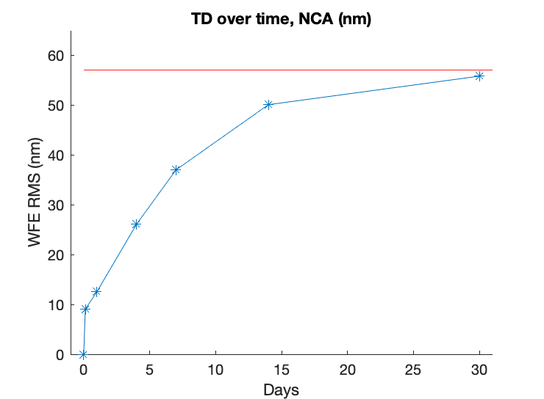
Thermal Relaxation
3D data cube provided is interpolated over this small range
Thermal Relaxation (alignment + figure drift)

Slide 8
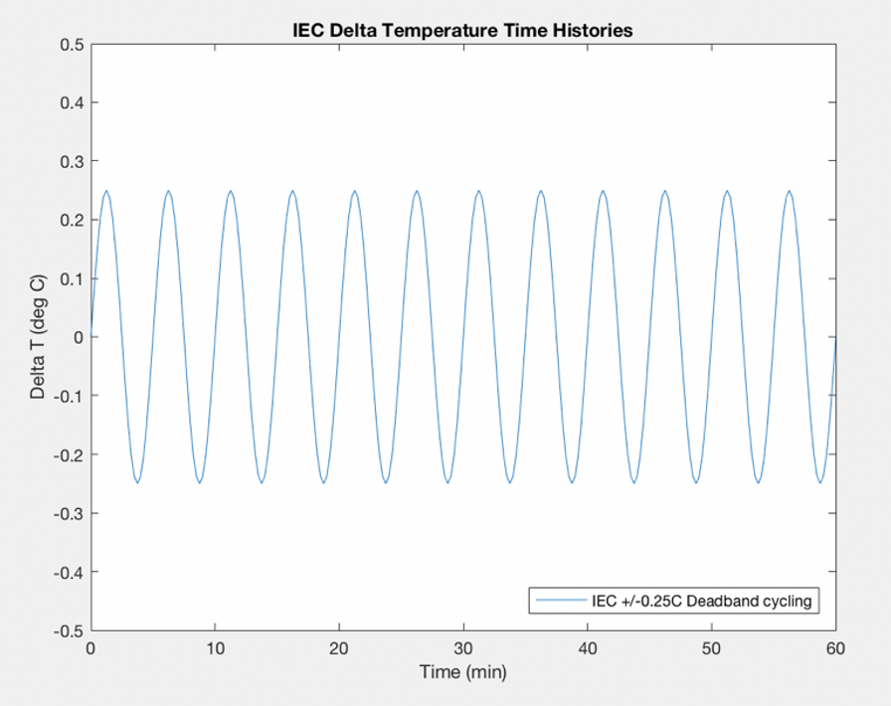
IEC Oscillations
WFE(t) = WFE(t=0) * cos(A * t)
Where A = 2π/T
And T = 5 min
cosine adopted for this study such that the amplitude is given by the first frame

Slide 9
Frill/CO
WFE(t) = WFE_0 * (exp(b*t) - 1)
Where b = -1/T
And T = 9 hours

Slide 10
Target Acq
1000 draws of a 2D Gaussian of the magnitude decided upon for each scenario
For each simulation of a coronagraph sequence comprised of N observations, select the next N values
LOS Jitter
1000 draws of a 2D Gaussian of the magnitude decided upon for each scenario
No correspondence to time vector – discussion of implementation

Slide 11
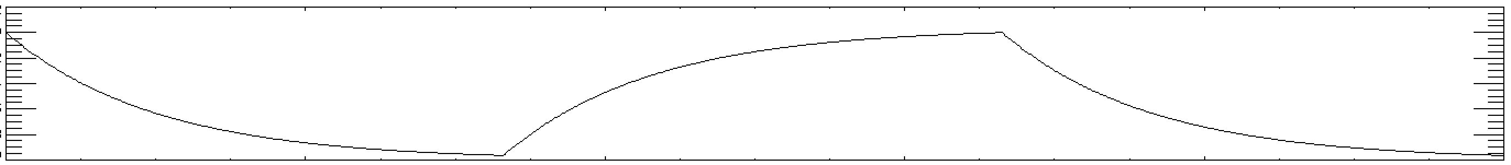
Implementing as a Coronagraphic Sequence
Science Roll1
Science Roll2
Reference
Slew
Exposure
Other filters
Slew
Exposure
Other filters
Slew
Exposure
Other filters
Targ Acq
Draw 1
Draw 2
Draw 3
LOS jitter
Swap the sign
Thermal
Swap the sign
Frill/CO
IEC

Slide 12
Implementing as a Coronagraphic Sequence
Science roll1, science roll2, reference vs Science roll1, reference, science roll2
Exposure times and budgeting for multiple filters
Slew angles
initial vs reference slew—keep them the same and adjust both with the “scenario”?
slew between rolls—always 5 deg?
Slew times (constant vs consistent with assumed slew angle magnitude)
Swapping sign of thermal and frill/CO WFE maps when slew occurs
Correlate LOS jitter draws w/ time? Current time sampling would provide 300 total draws over 5 hour time vector. This would change the # of samples if we change anything about the exposure time.

