Slide 1
JWST Coronagraphic Contrast Sensitivity Working Group Meeting
05/13/21
Agenda
Brief summary of last meeting & follow-up
Amplitudes of three scenarios per mode
OPD maps from Joe Howard

Slide 2
1. Brief summary of last meeting & follow-up
Discussed TA
MIRI:
Dean: for MIRI, circular Gaussian is sufficient with σ=5-10 mas per axis
NIRCam:
Follow-up needed for NIRCam
E-mail chain with Julien, Peiman, John S, and Mario G. Two-step TA process expected to achieve σ=5 mas best case scenario, 7 mas likely
Pupil shear
NIRCam:
Marshall: NIRCam tolerant to 4% shear and has sufficient control range to correct for it. Should drop entirely for NIRCam
MIRI:
George: Look at past analysis for MIRI
Cavarroc et al. examined values from 0-4%
Marshall: look at Randal Telfer’s e-mail
Randal indicates 0.2% shear change possible in MIMF

Slide 3
Magnitudes of effects span from “best” to “requirement” in 3 values: [Best, Likely/Midpoint, Requirement]
Best = best case scenario (e.g., no slew) with no MUF
Requirement = requirement is usually the worst case scenario (worst case slew w/ MUF)
Likely/midpoint = expected performance when possible, midpoint used when there is insufficient information
Yellow highlight indicates TBR
Pink highlight indicates value I made up
No highlight indicates it was recommended/checked with the reference(s) indicated
Mode | NIRCam | MIRI
Target Acq | 2D Gaussian [5, 7, 10 mas] per axis 1σ Ref: Peiman & Mario G | 2D Gaussian [5, 7, 10 mas] per axis 1σ Ref: Hines / Lajoie et al. (2016)
Pupil shear | N/A | [0%, 2%, 4%] Ref: Cavarroc et al. (2008)
LOS Jitter | 2D Gaussian [2.5,3.8, 5.8 mas] per axis 1σ Ref: Peiman | 2D Gaussian [2.5,3.8,5.8 mas] per axis 1σ Ref: Peiman
IEC Oscillations | OPD vs time (sinusoidal), fixed DT=0.25 C, scale by MUF [MUF=1,MUF=1.7,MUF=2.8] Ref: Joe Howard | OPD vs time (sinusoidal), fixed DT=0.25 C, scale by MUF [MUF=1,MUF=1.7,MUF=2.8] Ref: Joe Howard
Frill/close-out | OPD vs time (exponential decay), fixed time constant [no slew no MUF, typical (10 deg) slew no MUF, requirement] Ref: Joe Howard | OPD vs time (exponential decay), fixed time constant [no slew no MUF, typical (10 deg) slew no MUF, requirement] Ref: Joe Howard
Thermal drift | OPD vs time (exponential decay), fixed time constant [no slew no MUF, typical (10 deg) slew no MUF, requirement] Ref: Joe Howard | OPD vs time (exponential decay), fixed time constant [no slew no MUF, typical (10 deg) slew no MUF, requirement] Ref: Joe Howard
Deployed dynamics | OPD vs time (segment-level randomization) [TBD w/ Joe] Ref: Joe Howard | OPD vs time (segment-level randomization) [TBD w/ Joe] Ref: Joe Howard
Suggestion from meeting: change Frill/CO and TD amplitudes to [3 deg slew no MUF, 10 deg slew no MUF, requirement]

Slide 4
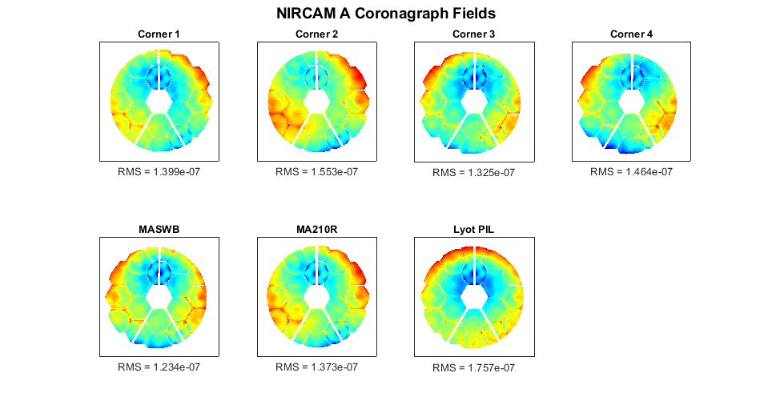
3. OPD Maps
1024x1024 Post-WFSC Static WFE Maps

Slide 5
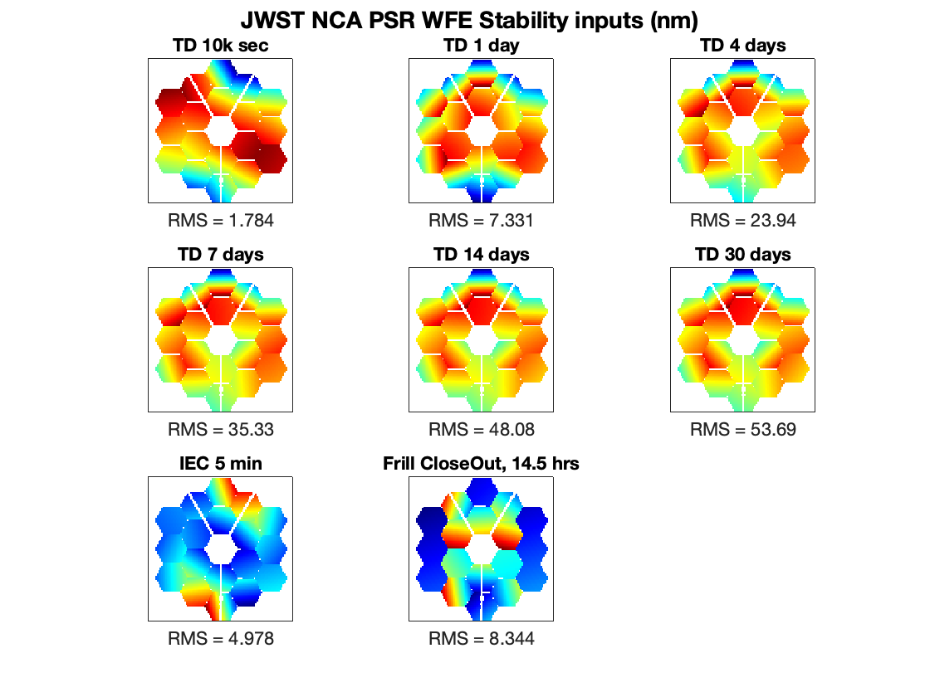
3. OPD Maps
IEC Oscillations
Frill/Close-Out
Thermal Drift (alignment + figure drift)
Deployed Dynamics
TBD

Slide 6
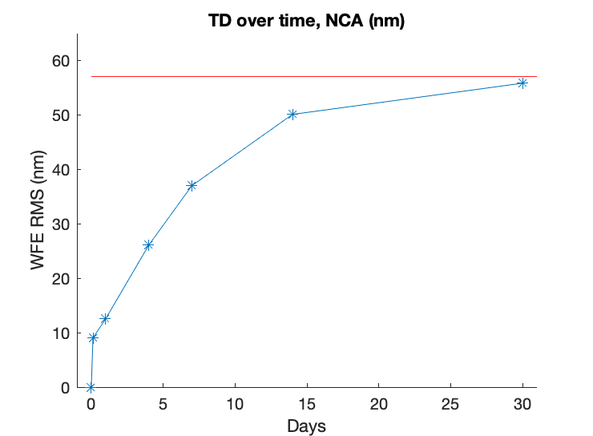
3. OPD Maps
Thermal Drift (alignment + figure drift)

Slide 7
3. OPD Maps
Formatting questions
Current resolution is 100x100
is interpolation sufficient, or do we need to wait for Joe to regenerate at 1024x1024?
Interpolation method to avoid edge artifacts; 1024 = flat to flat?
Time resolution:
Preference for 3D data cube, or 2D map w/ analytic time prescription?
Amplitude:
Preference for separate data cubes or scaling factors

Slide 8
3. OPD Maps
Forming a coronagraphic sequence
Adopt a pupil shear value
Assume post-WFSC starting point?
Slew to science target – adopt an assumed slew magnitude (best, nominal, worst)
Adopt a TA precision value from Gaussian dist.
Resolve time series during observation
Include TD during observation based on slew magnitude, interpolate
Include Frill/CO based on slew magnitude, interpolate
Include IEC + DD
Include LOS Jitter
Slew to reference target – adopt an assumed slew magnitude (best, nominal, worst)
Adopt a TA precision value from Gaussian dist.
Resolve time series during observation
Include TD during observation based on slew magnitude, interpolate
Include Frill/CO based on slew magnitude, interpolate
Include IEC + DD
Include LOS Jitter

