Slide 1
Containers @ AWS
ECR,ECS,EKS,Fargate,AppRunner

Slide 2
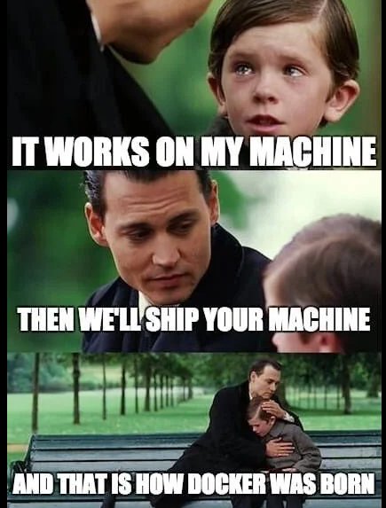
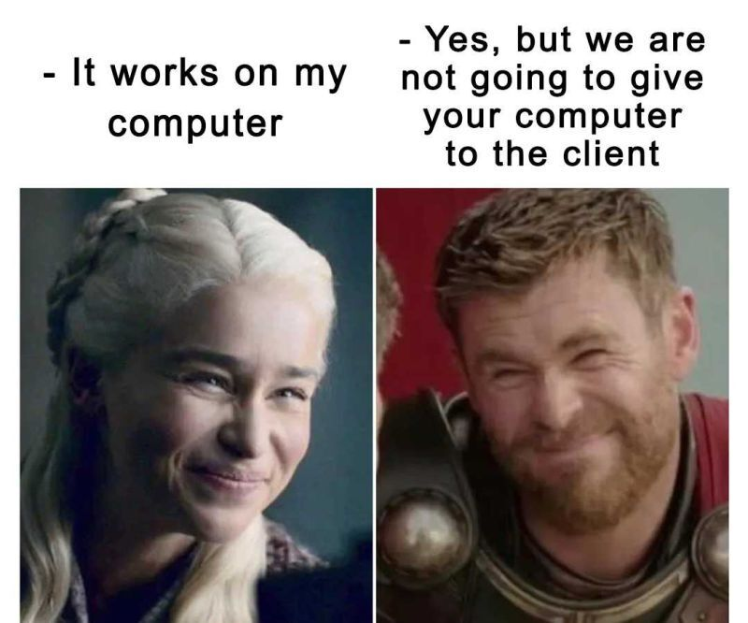
Problem? Solution!
Containers @ AWS
Notes:
Popisat ake problemy mozu byt medzi developerom a customerom
- software zavistlosti (potrebne kniznice, verzie)
- nastavenia prostredia (premenne)
- celkova velkost produktu ktora sa dava k zakaznikovi

Slide 3
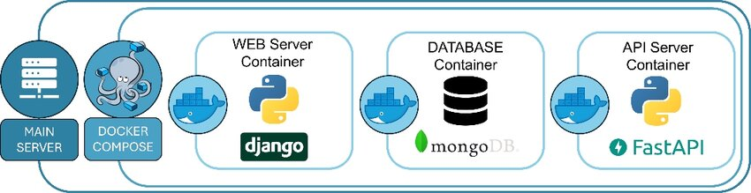
Čo je docker? docker container?
Containers @ AWS
Software development platform
Container = "balík" obsahujuci všetko potrebné pre beh aplikácie (nezalezi na OS)
Menej problémov s kompatibilitou
Ľahšie udržiavanie a deployment
1 Server = X docker containers (Backend, Frontend, DB, všetko dokopy?)
Notes:
Container – zahrna iba potrebne veci, povoluje rychlu iteraciu, scaling, zmeny
Problem moze byt v podobe exploitov so zameranim na utek z kontajnerov/vm
VMky – zahrnaju vsetko vratane guest operating system a balastu okolo
Priklad – windows movie maker / video editor

Slide 4
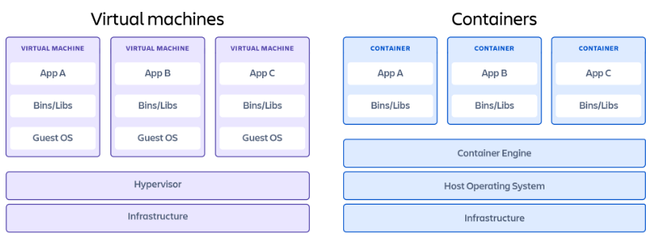
Virtual machines vs containers
Containers @ AWS
Notes:
Container – zahrna iba potrebne veci, povoluje rychlu iteraciu, scaling, zmeny
Problem moze byt v podobe exploitov so zameranim na utek z kontajnerov/vm
VMky – zahrnaju vsetko vratane guest operating system a balastu okolo
Priklad – windows movie maker / video editor

Slide 5
Ako vytvoriť docker image a spustiť ako container?
Containers @ AWS

Slide 6

Ako vytvoriť docker image – príklad app.py (python3 + flask)
Containers @ AWS
from flask import Flask app = Flask(__name__) @app.route('/') def hello_world(): return 'Hello, Docker!'

Slide 7
Ako vytvoriť docker image – Dockerfile
Containers @ AWS
# Filename: Dockerfile
FROM python:3.8-slim-buster WORKDIR /app COPY requirements.txt requirements.txt RUN pip3 install -r requirements.txt COPY app.py
CMD [ "python3", "-m" , "flask", "run", "--host=0.0.0.0"]
#base/parent image
#default location for next commands
#copy requirements.txt
#install packages in requirements.txt
#copy app.py
#command to start our app

Slide 8
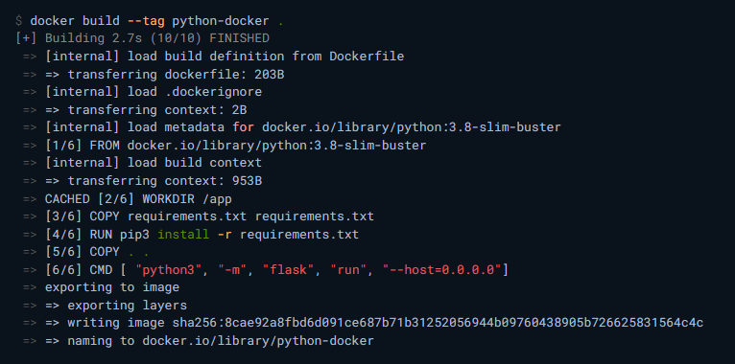
Ako vytvoriť docker image - build fáza
Containers @ AWS

Slide 9

Ako vytvoriť docker image – lokálny docker image
Containers @ AWS

Slide 10

Ako vytvoriť docker image – štart lokálneho docker image
Containers @ AWS
docker run –-publish <HOST_PORT>:<CONTAINER_PORT> container-name
HOST_PORT: Číslo portu na vašom hostiteľskom počítači, na ktorom chcete prijímať prevádzku.
CONTAINER_PORT: Číslo portu v kontajneri, ktorý čaká na pripojenia, na ktorom by mali byť publishnuté služby. (default pre flask je 5000)

Slide 11

Ako vytvoriť docker image – validácia lokálneho docker image
Containers @ AWS

Slide 12
Ako vytvoriť docker image – ako/kde uložiť naše obrazy
Containers @ AWS
Úložiska pre image:
AWS ECR
Dockerhub
Prístup:
Verejný
Súkromny (napr.: iba v ramci účtu, firmy, okruh účtov,...)

Slide 13
Ako vytvoriť docker image – docker push (AWS ECR)
Containers @ AWS
V AWS ECR je potrebne vytvorit repozitar pre images pred samotnym ulozenim
aws ecr get-login-password --region region | docker login --username AWS --password-stdin aws_account_id.dkr.ecr.region.amazonaws.com
docker tag e9ae3c220b23 aws_account_id.dkr.ecr.region.amazonaws.com/my-repository:tag (docker tag IMAGE_ID ARN_MY_REPO)
docker push aws_account_id.dkr.ecr.region.amazonaws.com/my-repository:tag

Slide 14
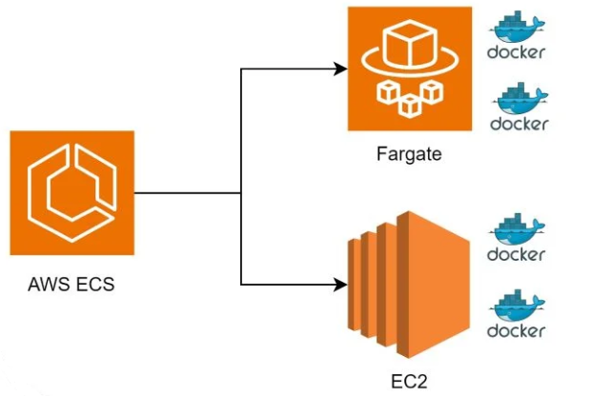
Ako spustiť container
Containers @ AWS
AWS managed infra
You manage infra

Slide 15

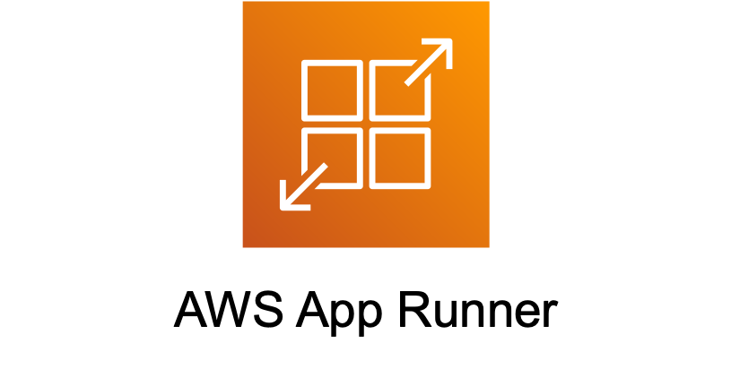
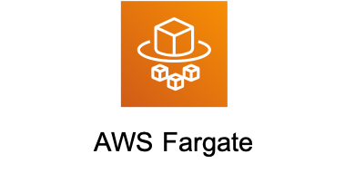
Ako spustiť container – kedy ktorú službu vyuziť
Containers @ AWS
AWS managed infra
You manage infra
Model | Serverless | Virtual Machines (IaaS) - EC2
Management | Low (AWS managed) | High (User managed)
Scaling | Automatic & Fast | Auto Scaling Groups
Cost Structure | Pay per Task (vCPU/RAM) | Pay per Instance Type
Best For | Agility, Spiky apps | Control, Steady state

Slide 16
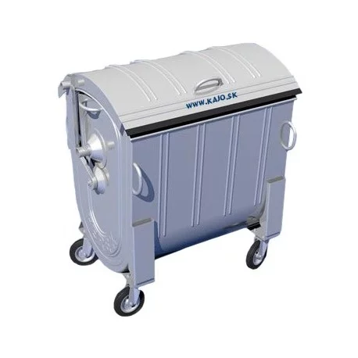
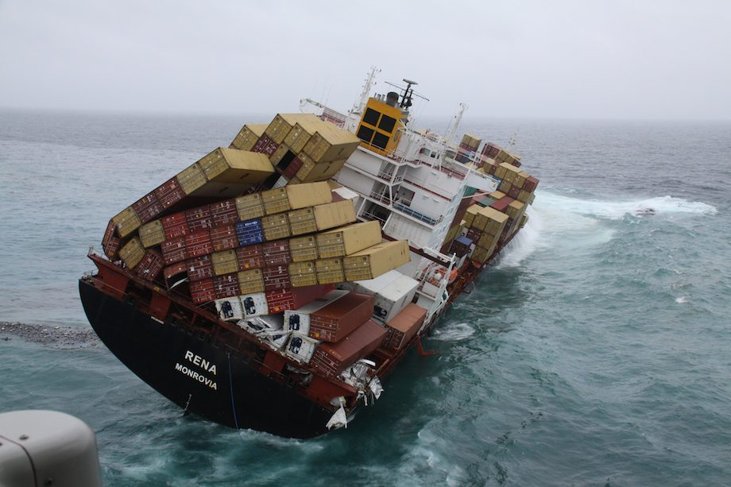
Ako spustiť container – single vs multi-container
Containers @ AWS
VS

Slide 17
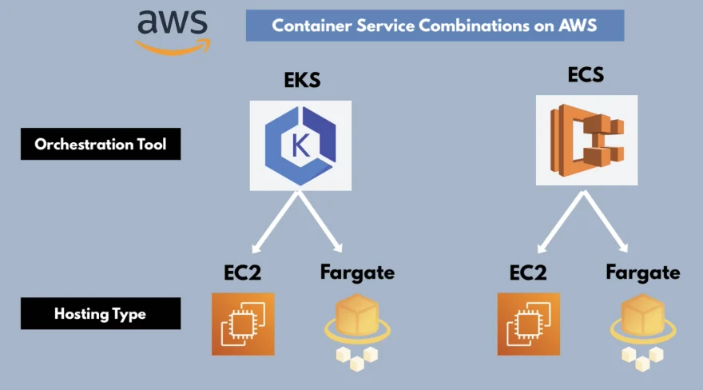
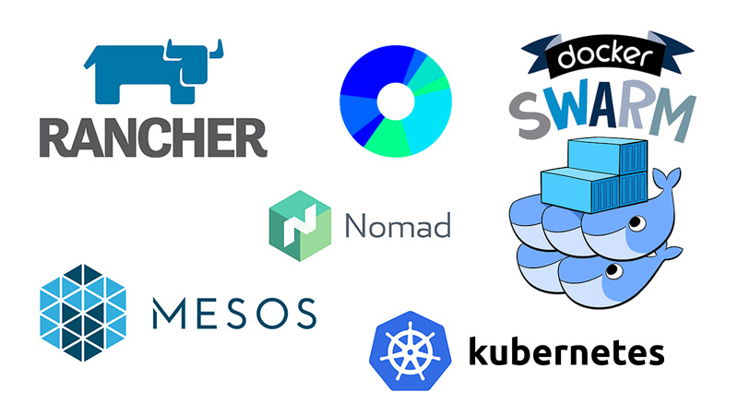
Ako spustiť container – Orchestrators
Containers @ AWS
Container orchestration is the automation of much of the operational effort required to run containerized workloads and services.
This includes a wide range of things software teams need to manage a
container’s lifecycle, including provisioning
deployment
scaling (up and down)
networking, load balancing and more.

Slide 18


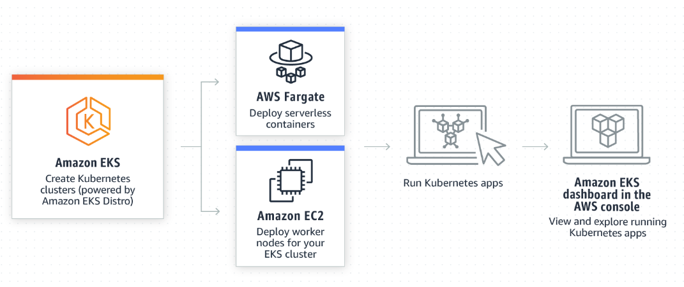
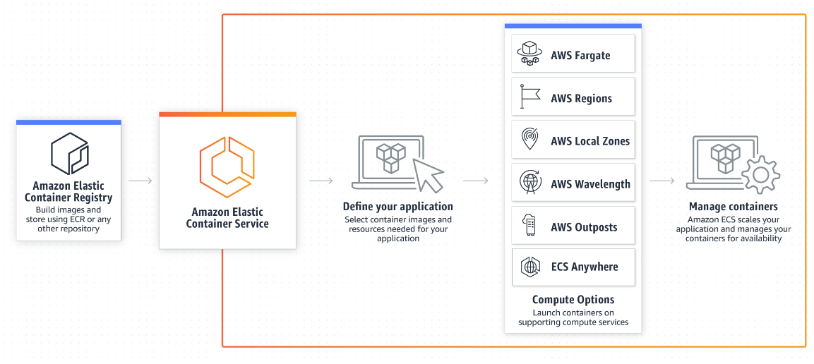
Ako spustiť container – Orchestration
Containers @ AWS

Slide 19
Ako spustiť container – ECS vs EKS
Containers @ AWS
Kubernetes in AWS
Helm charts
Používa pods/replica sets/namespaces
Typy:
Serverless – Fargate
Server - EC2
AWS Docker engine
Pouziva service/task/daemon
Typy:
Serverless – Fargate
Server - EC2

Slide 20
Ako spustiť container – spôsoby deploymentu na ECS/EKS
Containers @ AWS
In Place: ECS replaces old tasks with new ones, minor outage between replacement (only DEV).
Rolling Deployment (ECS Default): The standard method where ECS replaces old tasks with new ones based on configured minimum/maximum healthy percentages.
Blue/Green Deployment (CodeDeploy): Uses AWS CodeDeploy to create a new, parallel environment (Green) alongside the old one (Blue). This allows for validation, canary testing, and traffic shifting before switching, providing zero downtime.
External Deployment: Allows users to control the deployment using TaskSets to integrate with custom or third-party deployment systems.

Slide 21
Ako spustiť container – tasks/services na ECS
Containers @ AWS
Task definition - ako spustiť docker container(y) (image, porty, mem+cpu, network)
IAM Task Role – task preberá túto rolu aby mal prístup k iným AWS službám
Service definition – koľko taskov, v akom móde:
Škálovacie metódy
Target tracking – napr. CPU vyťaženosť, dĺžka SQS queue, custom parameter (počet užívateľov,…)
Step scaling – podľa hodnoty danej metriky pridávame/odoberáme tasky (agresívnejší scaling)
Scheduled – vopred definujeme kedy a koľko taskov (v noci menej taskov ako cez deň)
Service módy:
Daemon – beží na každej ec2 (napr. monitoring, logging)
Replica – samostatný task (môže ich bežať viac naraz)

Slide 22
Ako spustiť container – AWS managed – App Runner vs Fargate
Containers @ AWS
Service Category | Fully managed PaaS (Platform-as-a-Service) | Serverless Container Compute
Complexity | Very Low (Zero infrastructure management) | Moderate (Requires ECS/EKS knowledge)
Deployment | Direct from GitHub or Container Registry | Container Image (via ECS/EKS Task Definition)
Networking | Automated (Load Balancer & SSL included) | Manual configuration (VPC, ALB, Subnets)
Scaling | Auto-scales based on concurrent requests | Auto-scales based on CPU/RAM metrics
Pricing Model | Provisioned instances (CPU pauses when idle) | Pay-as-you-go for vCPU/RAM resources
Use Case | Rapidly deploying Web Apps and APIs | Microservices, batch jobs, complex architectures

