Slide 1
S3, Tagging, CloudTrail
22.3.2023
S3 bucket, concepts of tagging, cloudtrail
Ing. Viliam Čillík
Ing. Maroš Pekár
vcillik@ohpen.com mpekar@ohpen.com

Slide 2




Today, it's about...
S3, Tagging, CloudTrail
S3
Tagging
ClaudTrail

Slide 3

S3 Simple Storage Service Regionally provisioned object storage service Globally unique Can be accessed anywhere No limit to the amount of data stored
S3, Tagging, CloudTrail

Slide 4


S3 Key-value store Object = key, value, version ID, metadata, subresources By default – objects are private Bucket policies Object ACL Global view but it is regional
S3, Tagging, CloudTrail

Slide 5

Versioning - protects objects from accidental overwrites and deletes
S3, Tagging, CloudTrail
​ Action​ | Versioning Enabled​ | Versioning Disabled/​ Versioning Suspended​
Upload object with​ the same Key​ ​ | Creates a new object with a different version ID. Both are retrievable by version ID.​ | Overwrites the original object, and previous object is no longer retrievable.​
Delete​ | Adds a Delete marker, but the object is still retrievable by version ID.​ | Deletes the object, and it is no longer retrievable.​

Slide 6
S3, Tagging, CloudTrail
S3 – Object Storage Classes
General purpose
Amazon S3 Standard
Infrequent access
Amazon S3 Standard-Infrequent Access (S3 Standard-IA)
Amazon S3 One Zone-Infrequent Access (S3 One Zone-IA)
Archive
Amazon S3 Glacier
Intelligent tiering
Amazon S3 Intelligent-Tiering
Amazon S3 – Glacier Deep Archive

Slide 7






S3 Glacier
S3, Tagging, CloudTrail
Extremely low-cost data archiving
Long-term backup
Retrieval by request
Can configure lifecycle archiving of Amazon S3 content to Amazon S3 Glacier
On-premises server
Amazon Simple Storage Service (S3)
Instance
Archive via AWS CLI
Use lifecycle rules
Archive via API
or…
Amazon S3 Glacier
Archive retrieval options
Expedited: 1-5 minutes
Standard: 3-5 hours
Bulk: 5-12 hours

Slide 9

Tagging
S3, Tagging, CloudTrail
Tag
Key-value pair that can be attached to an AWS resource
Allows to identify and categorize resources
Tag keys and values are case-sensitive
Some tags are build-in and cannot be removed (For example: aws:cloudformation:<stack-name>)
Limits

Slide 10


S3, Tagging, CloudTrail
Best practices for tagging:
Create business-relevant tag groupings to organize resources along technical, business, and security dimensions.
Always use more tags instead of using too few tags.
Use meaningful names for both tag keys and values.
Always use a standardized, case-sensitive format for tags, and implement it consistently across all resource types.
Implement automated tools to help manage resource tags. For example, use the Resource Groups Tagging API.

Slide 12

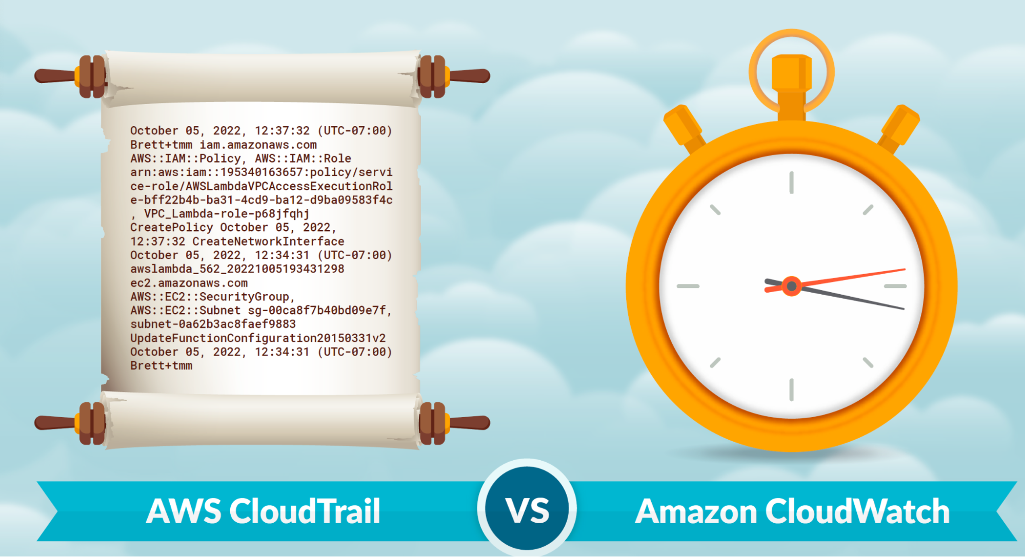
CloudTrail
S3, Tagging, CloudTrail
Logs, continuously monitors and retains account activity related to actions across AWS infrastructure
Records API calls for most AWS services
Automatically pushes logs to S3 after it is configured
Will not track events within EC2 instances
Helps to answer questions:
Who terminated specific instance?
Who changed SG configuration?
What activities were denied due to lack of permissions?

