Slide 1

Classiﬁcation and Feature Relevance Determination for Imbalanced Astronomical Data
Jarvin Mutatiina
SUPERVISORS
Asst. Prof. Dr Kerstin Bunte Prof. Michael Biehl Mohammad Mohammadi, MSc Teymoor Saifollahi, MSc

Slide 2
Introduction

Slide 3
Introduction
Data Science in Astronomy is becoming more popular with increasingly complex and vast amounts of data available.
Common conventional astronomical method of analysis is Photometric selection[Stetson, 2013]
ML techniques have been previously explored e.g. SVM, KNN,Random Forest, Artiﬁcial Neural Networks etc.
1

Slide 4
Introduction
Need to explore more sophisticated and robust methods of adaptive distance metric variants of Learning Vector Quantization(LVQ). Why?
Distance metric is adapted to the target data as opposed to commonly used Euclidean distance.
Very intuitive and highly interpretable with the output feature relevance.
Scalable because of the prototype class representation.
2

Slide 5
Research contribution/Objective
Application of state of the art adaptive distance metric LVQ variants to imbalanced astronomical data.
Handling of class imbalance and overlap with pre-processing techniques
Feature relevance determination and relation to astronomical expert knowledge.
3

Slide 6
Data Deﬁnition

Slide 7
Data Deﬁnition
Data is extracted from images from different points of observations through optical ﬁlters u, g, r, i, J, K using a Source Extractor
(SExtractor)[Bertin and Arnouts, 1996]. There are 3 classes;
Class 1 - Background galaxies
Class 2 - Ultra-compact galaxies(UCDs) and Globular clusters (GCs). Minority class of interest.
Class 3 - Foreground stars.

Slide 8
Data Deﬁnition
There are 21 features;
Proxies of the Angular size i.e Full-width-half-maximum -
fwhm∗g, fwhm∗r, fwhm∗i, fwhm∗u, fwhm∗j, fwhm∗k
Compactness of the objects - dg0, di0, di0
Color indices - ug, ur, ui, uj, uk, gr, gi, gj, gk, ri, rj, rk, ij, ik, jk
Class 1 | Class 2 | Class 3 |  | Total
data1 2003 data2 ²⁸²⁶ 2083 | 163 512 387 | 4121 4399 2806 |  | 6287 7737 5276

Slide 9
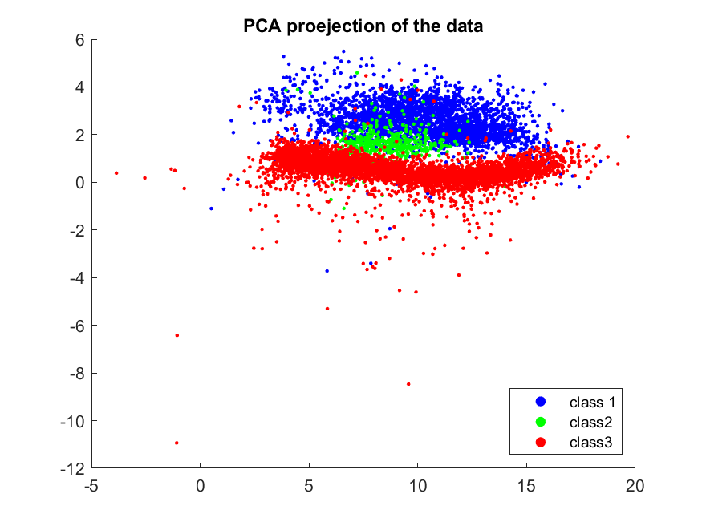
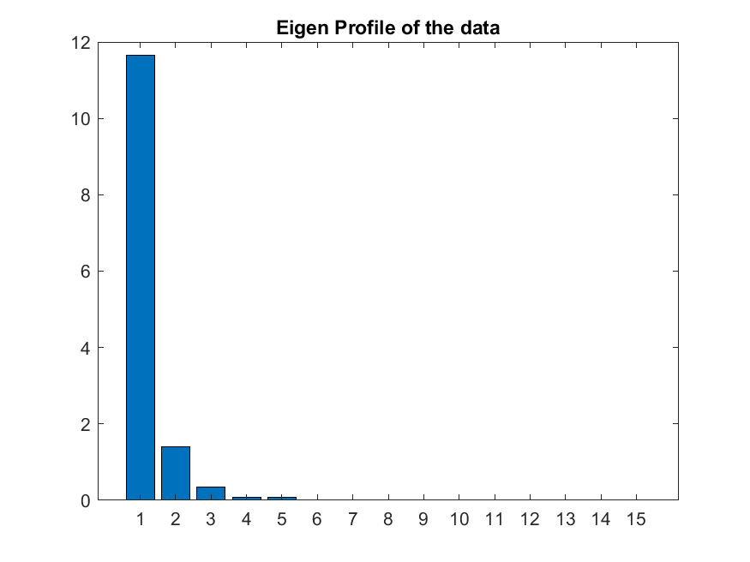
Data Structure/ Projection
(a)
(b)
Figure 1: (a) PCA-projection of the data2. It shows the imbalance and overlap between the classes. (b) The eigen proﬁle gives a hint that there are 2-3 more signiﬁcant directions of the data.

Slide 10
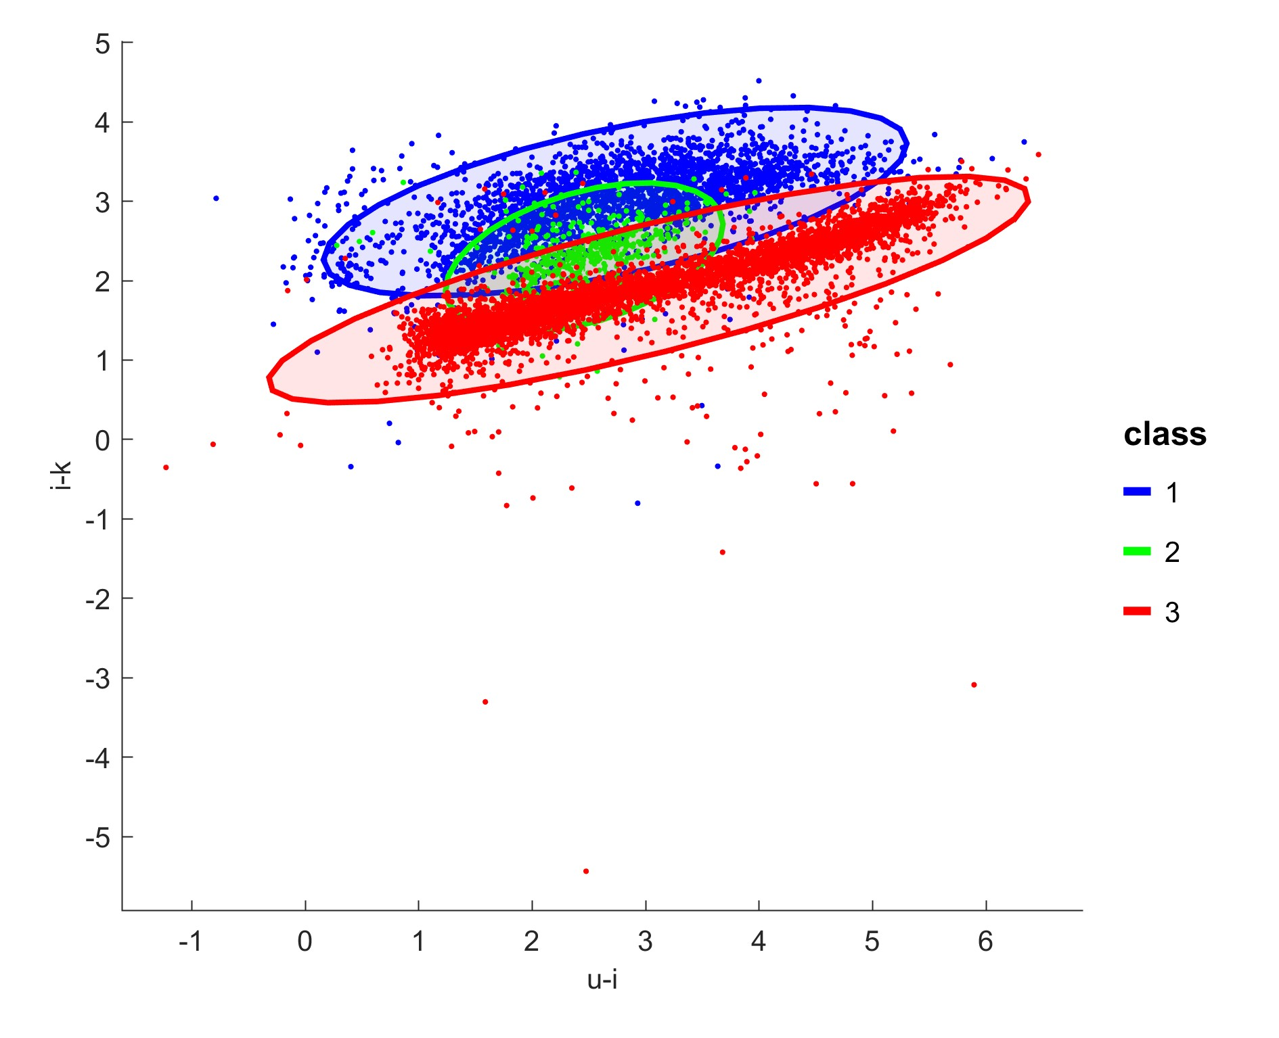
Photometric Selection
Is traditionally used by astronomers on basis of a color-color diagram. The color indices ui- age of the object and ik - metallicity are most instrumental according to Munoz et. al[Munoz et al., 2013].
Figure 2: Color-color diagram showing photometry-based selection with the ui and ik colors. Based on the position of novel data points, a class can be assigned according to its position

Slide 11
Methods

Slide 12
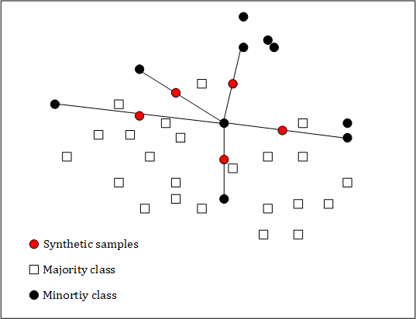
Data Pre-processing
Appropriate pre-processing is crucial for this research
Z-score Transformation
Synthetic Minority Over-Sampling (SMOTE)[Chawla et al., 2002]
Figure 3
Borderline-SMOTE[Han et al., 2005]
8

Slide 13
Learning Vector Quantization -LVQ
Is a prototype based ML method based on similarity measure introduced by Kohonen[Kohonen, 1997].
For data ξ_{i} of n examples and corresponding y_{i} labels. Prototypes ω^{j}
with labels c(ω^{j}) are iteratively updated as below;

 j
j
if y_{i} = c(ω^{j})
otherwise
ω + η · (ξ − ω )
j
i
ω :=
(1)

j j
ω − η · (ξ − ω )
i
ξ ← c(ω^{j}) where arg min d(ξ, ω^{j})
(2)
for
ξ
Sato and Yamada[Sato and Yamada, 1995] introduce a boundary optimization in Generalised LVQ(GLVQ). The cost function is deﬁned as;
cost function
∑
n
J
K
d(ξ , ω )
− d(ξ , ω )
E = Φ(µ ) where µ =
i i
(3)
i i
d(ξ_{i}, ω^{J}) + d(ξ_{i}, ω^{K})
i
•
µ_{i} ∈ [−1, 1] shows the conﬁdence of the classiﬁcation.
9

Slide 14
Relevance learning
Optimize similarity measure by adapting to target dataset.
N
∑
λ
2
d (ξ, ω) = λ (ξ
− ω )
(4)
i i
i
i=1
Weight factors λ_{i} as known as relevances are iteratively updated for each learning step[Bojer et al., 2001].
Is a substitute to general Euclidean distance and increases classiﬁcation performance.
Generalized Relevance LVQ(GRLVQ)[Hammer and Villmann, 2002] combines both concepts of relevance learning and a cost function as in equations 3 and 4.
10

Slide 15
Adaptive Distance Metrics
Global Metric Tensors
A global full transformation matrix is deﬁned to be adapted by stochastic gradient descent for each learning step.
Generalized Matrix
LVQ(GMLVQ)[Schneider et al., 2009b, Schneider et al., 2009a] implements this metric.
d^{Λ}(ξ, ω) = (ξ − ω)^{T}Λ(ξ − ω) (5) where Λ is full N × N matrix that represents the correlations between the
feature dimensions. It is derivable to Euclidean distance in a transformed space as shown below;
Λ = Ω^{T}Ω
d^{Λ}(ξ, ω) = (ξ − ω)^{T}Ω^{T}Ω(ξ − ω)
d^{Λ}(ξ, ω) = [Ω^{T}(ξ − ω)]²
The diagonal of Λ corresponds to the relevance values of the feature dimensions.
(6)
11

Slide 16
Adaptive Distance Metrics
Local Metric Tensors
Learn the localized dissimilarities w.r.t to the distinct class prototypes. Deﬁne non-linear decision boundaries with the local transformation matrix.
Localized GMLVQ(LGMLVQ)[Schneider et al., 2009b]- direct extension of GMLVQ.
d^{Λj} (ξ, ω^{j}) = (ξ − ω^{j})^{T}Λ^{j}(ξ − ω^{j}) (7)
where Λ^{j} = Ω^{jT}Ω^{j} and j is a given prototype.
∑
_{Λ}j _{Λ}k
n
_{µ}i
d −
d
i
J
K
E = Φ(µ ) where
=
(8)
LGMLVQ local
local
j
k
Λ
Λ
d + d
i J K
Λ
j k
Λ i
where d and d are the distances of the points ξ from the closest correct
J K
and incorrect prototypes respectively.
12

Slide 17
Adaptive Distance Metrics
Local Metric Tensors
Localized Limited Rank Matrix LVQ(LLiRAM)[Bunte et al., 2012, Bunte, 2011]
Transform data to a low dimensional representation within the algorithm. The distance metric is deﬁned as;
j
Ψ j j T T jT j
j
d (ξ, ω ) = (ξ − ω ) Ω Ψ Ψ Ω(ξ
− ω )
(9)
j
where Ω is a rectangular M × N matrix of the global linear dimensionality reduction and Ψ^{j} is the local dissimilarity in the transformed space for each prototype ω^{j}.
13

Slide 18
Experiments and Discussion

Slide 19
Experimental Setup
Baseline Setup - Without resampling techniques
10-fold cross validation with a 90/10 class-wise split, Z-score transformation, 1 prototype per class, regularization set to 0.00001.
Resampled setup
Involves resampling techniques of SMOTE or Borderline-SMOTE aǒter Z-score transformation with the 10-cross validation folds.

Slide 20
Experimental Setup BV1 - data1
GMLVQ
LGMLVQ2
LGMLVQ3
Precision 2
Speciﬁcity 2
TPR 1
TPR 2
TPR 3
Avg training error Avg test error
0 ± 0
0.586 ± 0.505
0.754 ± 0.402
1 ± 0
0.9997 ± 0.0007
0.999 ± 0.0012
0.989 ± 0.0058
0.99 ± 0.0071
0.99 ± 0.0075
0 ± 0
0.431 ± 0.3903
0.544 ± 0.311
0.997 ± 0.0028
0.997 ± 0.0030
0.997 ± 0.0028
0.031 ± 0.00037
0.0202 ± 0.0093
0.016 ± 0.0079
0.0312 ± 0.00262 0.0198 ± 0.0113 0.017 ± 0.0067
Table 1: BV1 results showing precision and speciﬁcity of the minority class, TPR 1,2 and 3 represent the True Positive Rate/recall of the corresponding classes 1, 2 and 3, average training and test error all with corresponding standard deviation. These results are for the methods GMLVQ, LGMLVQ2 i.e. with rank 2 and LGMLVQ3 i.e with rank 3 for experimental setup BV1.

Slide 21
Experimental Setup RV1
GMLVQ
LGMLVQ2
LGMLVQ3
LLiRaM
Precision 2
Speciﬁcity 2
TPR 1
TPR 2
TPR 3
Avg training error Avg test error
0.451 ± 0.108
0.698 ± 0.0213
0.706 ± 0.092
0.52 ± 0.071
0.968 ± 0.013
0.989 ± 0.0011
0.989 ± 0.0048
0.9775 ± 0.007
0.949 ± 0.019
0.987 ± 0.001
0.986 ± 0.0069
0.9595 ± 0.016
0.913 ± 0.060
0.934 ± 0.0079
0.938 ± 0.059
0.9 ± 0.0672
0.973 ± 0.012
0.985 ± 0.0015
0.984 ± 0.0063
0.981 ± 0.006
0.037 ± 0.005
0.016 ± 0.0013
0.0155 ± 0.001
0.0422 ± 0.002
0.037 ± 0.12 0.017 ± 0.0065 0.0167 ± 0.006 0.0282 ± 0.007
Table 2: RV1 results for the methods GMLVQ, LGMLVQ2 with rank 2 , LGMLVQ3 with rank 3 and LLiRaM for experimental setup RV1. The data in these experiments is all resampled based on SMOTE.

Slide 22
Experimental Setup BV2 - data2
LGMLVQ2
LGMLVQ3
Precision 2
Speciﬁcity 2
TPR 1
TPR 2
TPR 3
Avg training error Avg test error
0.9544 ± 0.0234
0.9611 ± 0.0283
0.9972 ± 0.0015
0.9976 ± 0.0017
0.9826 ± 0.0059
0.9833 ± 0.0058
0.8176 ± 0.0515
0.8157 ± 0.0508
0.9902 ± 0.0042
0.9904 ± 0.0041
0.0232 ± 0.001
0.023 ± 0.00058
0.02396 ± 0.005 0.0237 ± 0.0049
Table 3: BV2 results showing precision and speciﬁcity of the minority class, TPR 1,2 and 3 represent the True Positive Rate/recall of the corresponding classes 1, 2 and 3, average training and test error all with corresponding standard deviation. These results are for the methods LGMLVQ2 with rank 2 and LGMLVQ3 i.e. with rank 3 for experimental setup BV2.

Slide 23
Experimental Setup RV2
LGMLVQ 2
LGMLVQ3
LGMLVQ2 -BL
Precision 2
Speciﬁcity 2
TPR 1
TPR 2
TPR 3
Avg training error Avg test error
0.8362 ± 0.0461
0.8449 ± 0.0456
0.697 ± 0.0631
0.9868 ± 0.0043
0.9877 ± 0.0043
0.97 ± 0.0097
0.967 ± 0.0098
0.9674 ± 0.0093
0.922 ± 0.0264
0.939 ± 0.0457
0.9392 ± 0.0457
0.949 ± 0.0482
0.9818 ± 0.0043
0.9825 ± 0.0043
0.98 ± 0.0056
0.0261 ± 0.001
0.02593 ± 0.001
0.043 ± 0.007
0.0264 ± 0.0067 0.0259 ± 0.0067 0.0435 ± 0.008
Table 4: RV2 results are for the methods LGMLVQ2 with rank 2 , LGMLVQ3 with rank 3 and LGMLVQ2 -BL for experimental setup RV1. LGMLVQ2-BL is resampled using Borderline-SMOTE technique and the rest by SMOTE

Slide 24
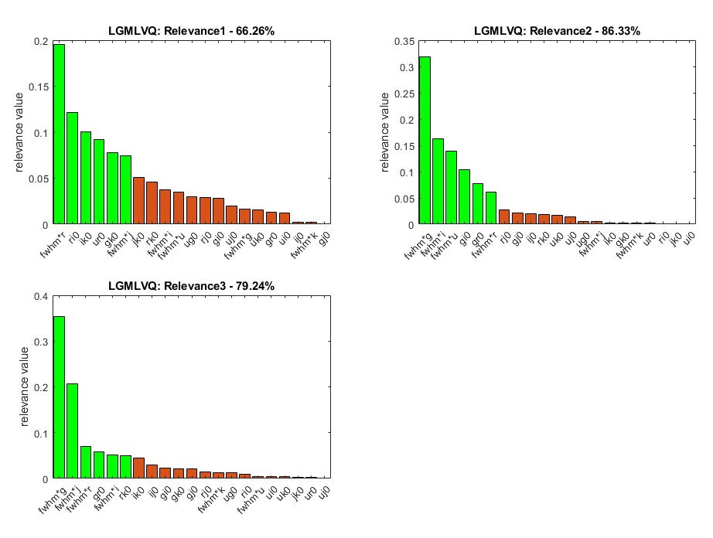
Experimental Setup RV2- -LGMLVQ2
Figure 4: Top 6 class-wise relevant features in the normalized proﬁle for LGMLVQ2 with the features’ corresponding percentage of contribution

Slide 25
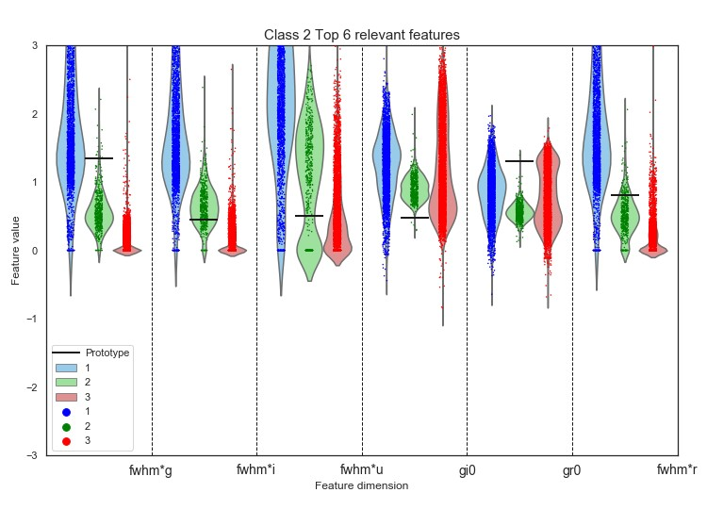
Experimental Setup RV2 -LGMLVQ2
Figure 5: Further illustration of the Top 6 relevant features’ prototype positions relative to the feature value distribution
20

Slide 26
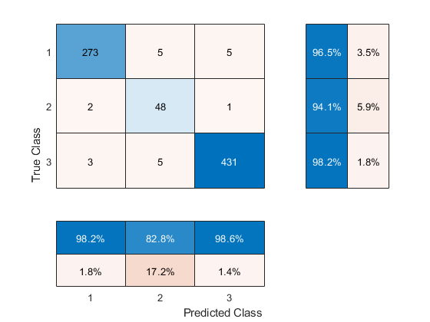
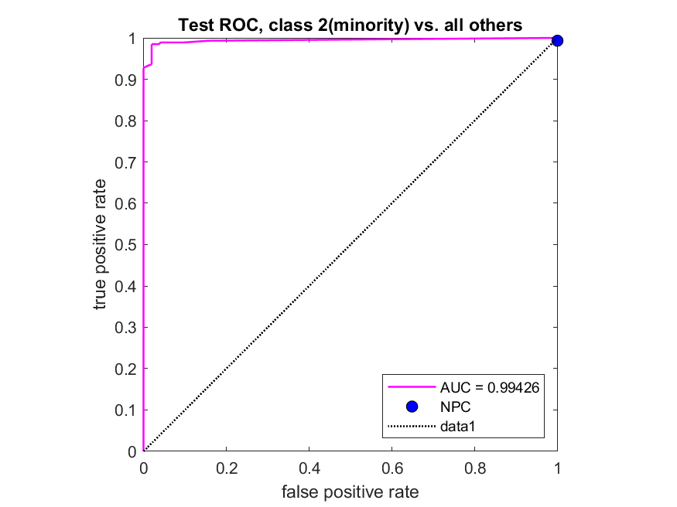
Experimental Setup RV2 -LGMLVQ2
(a) (b)
Figure 6: (a) is the test confusion matrix for the model LGMLVQ2 in RV2 (b) shows the corresponding ROC curve of minority class 2 vs all the other classes and the corresponding AUROC value of 0.99387
21

Slide 27
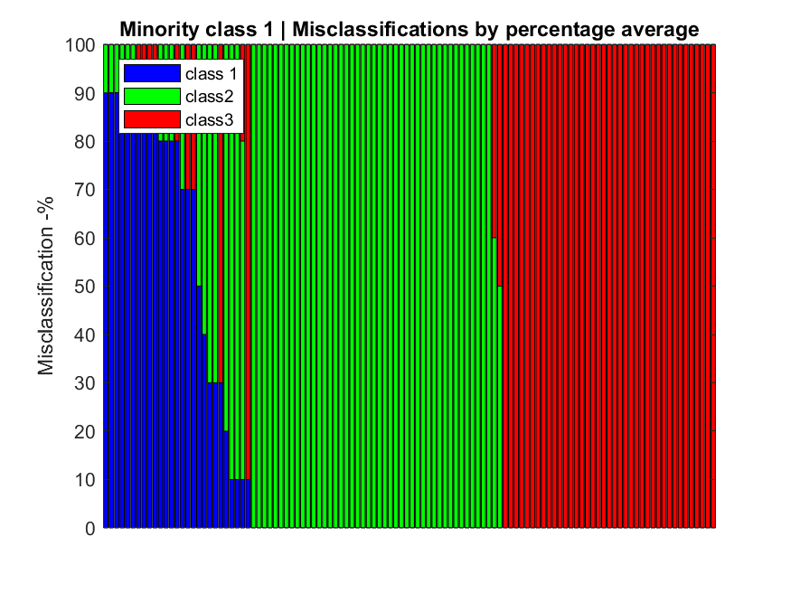
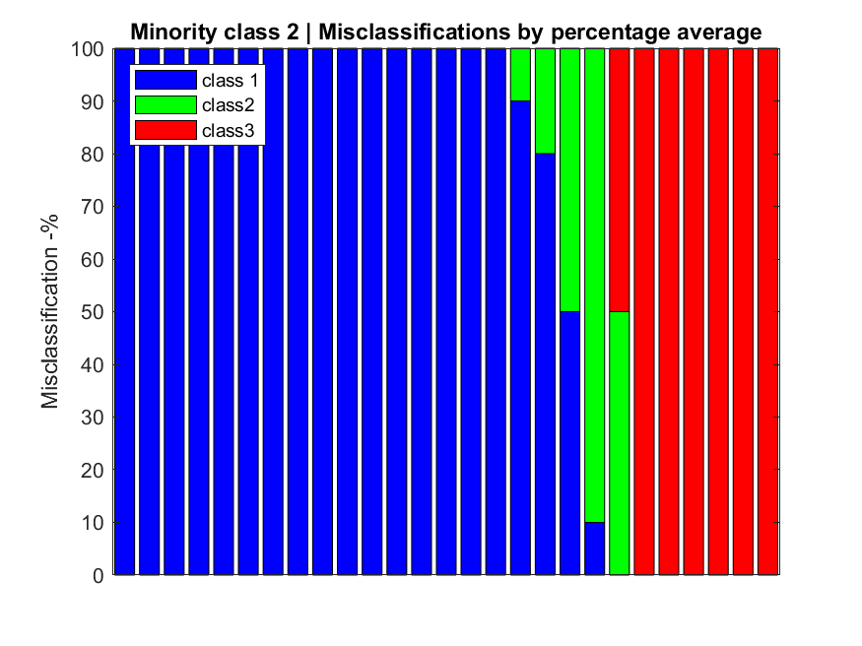
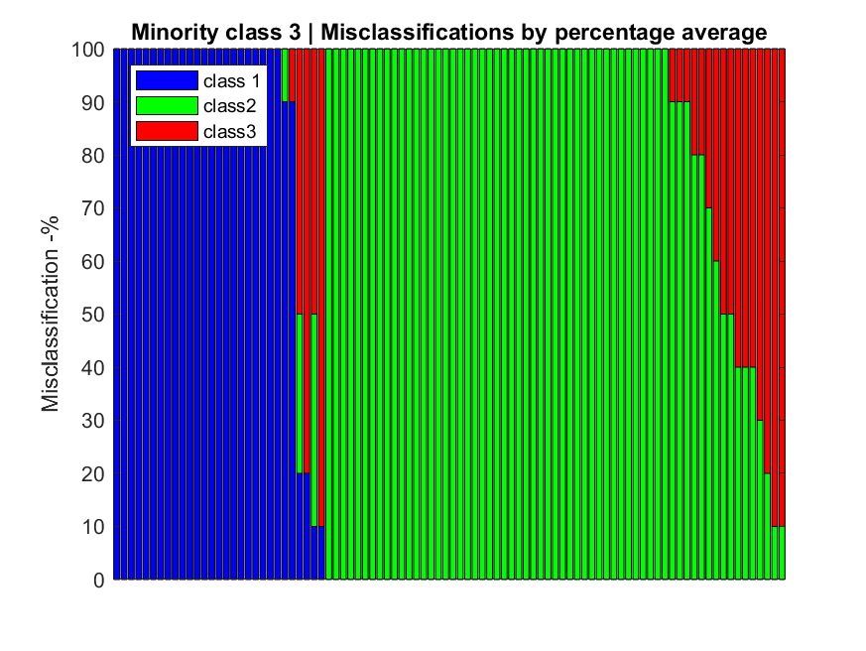
Experimental Setup RV2 -LGMLVQ2
(a) (b) (c)
Figure 7: Misclassiﬁcation rates for the wrongly classiﬁed examples in each class representing which classes there are misclassiﬁed for. (a) 64 of the 125 misclassiﬁed class 1 examples are oǒten identiﬁed as class 2. (b) 20 of the 27 class 2 examples are oǒten classiﬁed as class 1. (c) 66 of the 92 class 3 examples are classiﬁed as class 2
22

Slide 28
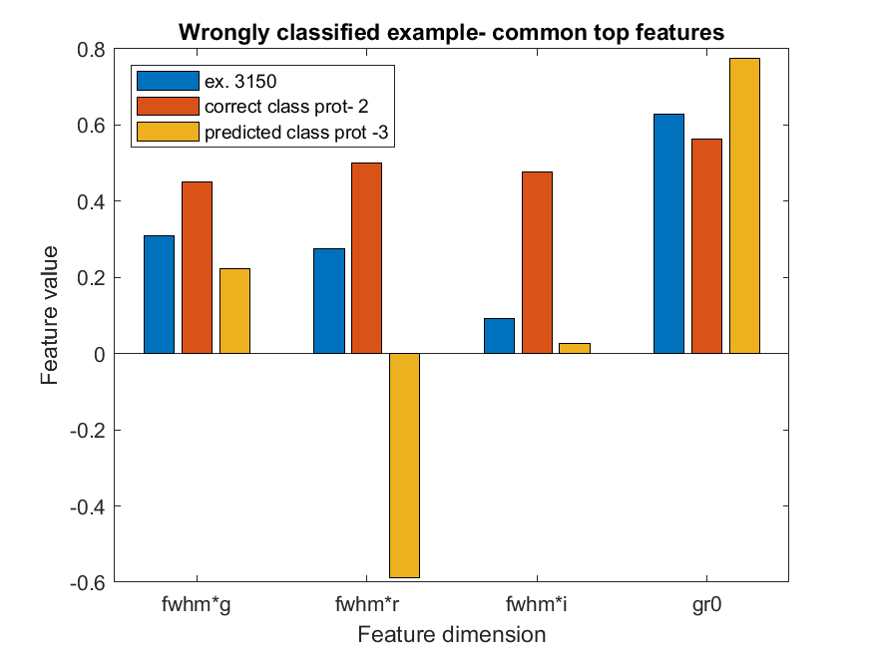
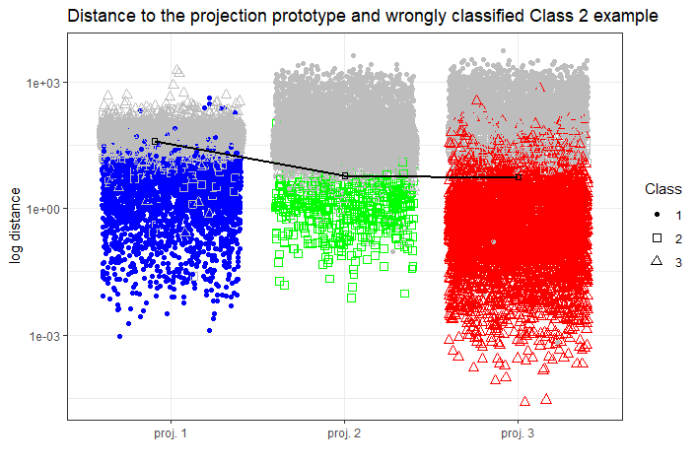
Wrongly classiﬁed example -LGMLVQ2
(b)
Figure 8: 100% Wrongly classiﬁed example from the minority class 2. (a) Common top feature positions of the examples relative to the closest correct and wrong prototypes
distances to the projection prototype and arc representation of the same example relative to the other observations in each class.
23

Slide 29
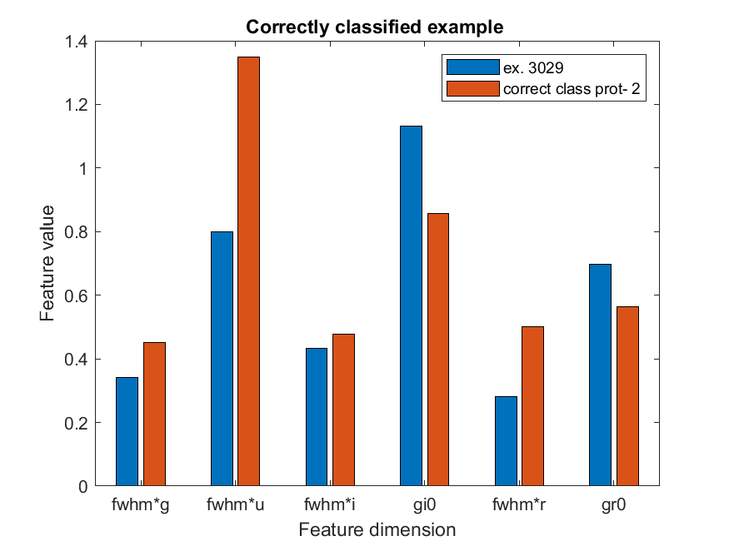
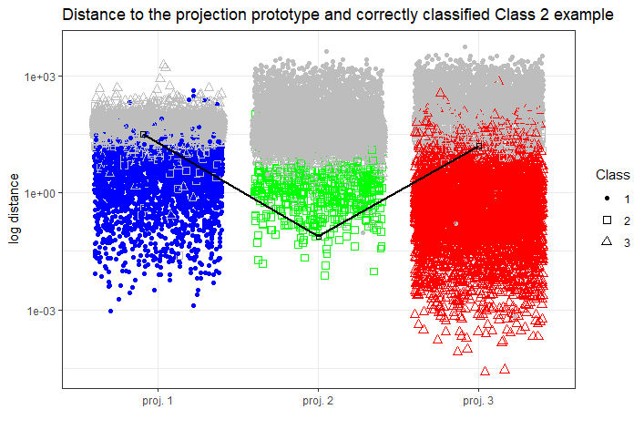
Correctly classiﬁed example -LGMLVQ2
(a) (b)
Figure 9: 100% Correctly classiﬁed example from the minority class 2. (a) Top 6 feature positions of the examples relative to the closest correct prototype (b) arc representation for same example in distance to projection prototype.
24

Slide 30
Summary of discussion
Angular size features - fwhm∗g, fwhm∗i, fwhm∗u are predominantly important for the minority class than expected.
Sizes are expected to be used to discriminate class 1 from class 2 and 3.
Class 2 objects are faint hence measurements can be larger than actual size. This introduces a bias in the data.
Astronomically more relevant features of ui- age of object and ik - metallicity do not vie well for the minority class. Observations in the u and K ﬁlters are hard and have a lower signal to noise ratio. Also other color indices like gi, gr, rk etc. partially carry the information.
Appropriate pre-processing is crucial for this research
The class boundaries are evidently non-linear and local metric tensor method of LGMLVQ is appropriate for this data
25

Slide 31
Future Work
Possible Future work
Use trained models on novel observation to aid further research into the Ultra-compact Dwarf galaxies(UCDs) and Globular Clusters.
More work on preliminary feature selection to address the disparity from astronomical expectations.
Explore missing value imputation techniques to cater for information loss
Angle LVQ[Bunte et al., 2016] that deﬁnes angular based similarity and minimises within-class variation.
26

Slide 32
Questions?
26

Slide 33
References i
Bertin, E. and Arnouts, S. (1996).
Sextractor: Soǒtware for source extraction.
Astronomy and Astrophysics Supplement Series, 117(2):393–404.
Bojer, T., Hammer, B., Schunk, D., and von Toschanowitz, K. T. (2001).
Relevance determination in learning vector quantization.
In PROC. OF EUROPEAN SYMPOSIUM ON ARTIFICIAL NEURAL NETWORKS.
Bunte, K. (2011).
Adaptive dissimilarity measures, dimension reduction and visualization.
PhD thesis.

Slide 34
References ii
Bunte, K., Baranowski, E. S., Arlt, W., and Tino, P. (2016).
Relevance learning vector quantization in variable dimensional spaces. In Hammer, B., Martinetz, T., and Villmann, T., editors, New Challenges in Neural Computation (NC²), Workshop of the GI-Fachgruppe Neuronale Netze and the German Neural Networks Society in connection to GCPR 2016, pages 20–23, Hannover, Germany.
Bunte, K., Schneider, P., Hammer, B., Schleif, F.-M., Villmann, T., and Biehl, M. (2012).
Limited rank matrix learning, discriminative dimension reduction and visualization.
Neural Networks, 26:159 – 173.
Chawla, N. V., Bowyer, K. W., Hall, L. O., and Kegelmeyer, W. P. (2002).
Smote: Synthetic minority over-sampling technique.
J. Artif. Int. Res., 16(1):321–357.

Slide 35
References iii
Hammer, B. and Villmann, T. (2002).
Generalized relevance learning vector quantization.
Neural Networks, 15(8):1059 – 1068.
Han, H., Wang, W.-Y., and Mao, B.-H. (2005).
Borderline-smote: A new over-sampling method in imbalanced data sets learning.
In Huang, D.-S., Zhang, X.-P., and Huang, G.-B., editors, Advances in Intelligent Computing, pages 878–887, Berlin, Heidelberg. Springer Berlin Heidelberg.
Kohonen, T. (1997).
Learning Vector Quantization, pages 175–189.
Springer Berlin Heidelberg, Berlin, Heidelberg.

Slide 36
References iv
Munoz, R. P., Puzia, T. H., Lançon, A., Peng, E. W., Cote, P., Ferrarese, L.,
Blakeslee, J. P., Mei, S., Cuillandre, J.-C., Hudelot, P., et al. (2013).
The next generation virgo cluster survey-infrared (ngvs-ir). i. a new near-ultraviolet, optical, and near-infrared globular cluster selection tool.
The Astrophysical Journal Supplement Series, 210(1):4.
Sato, A. and Yamada, K. (1995).
Generalized learning vector quantization.
In Proceedings of the 8th International Conference on Neural Information Processing Systems, NIPS’95, page 423–429, Cambridge, MA, USA. MIT Press.
Schneider, P., Biehl, M., and Hammer, B. (2009a).
Adaptive relevance matrices in learning vector quantization.
Neural Comput., 21(12):3532–3561.

Slide 37
References v
Schneider, P., Biehl, M., and Hammer, B. (2009b).
Distance learning in discriminative vector quantization.
Neural Computation, 21(10):2942–2969.
Stetson, P. B. (2013).
Astronomical Photometry, pages 1–34.
Springer Netherlands, Dordrecht.

