Slide 1

Hashing- based approximate nearest neighbor search
Locality Sensitive Hashing [LSH]
Vs.
Locality Preserving hashing [LPH]
Jarvin Mutatiina
Chriss Santi
Notes:
Hello. My name is Jarvin. This is Chriss. Today, we shall be talking about Hashing based approximate nearest neighbor search.
Are you amazed at how fast the Google search engine is? With billions and billions of documents on the web, it is able to zero down to relevant results in just milliseconds. How is it able to find documents that are most relevant or similar to your search?
We are going to explore two techniques used to optimize similarity search.

Slide 2
Overview
Nearest Neighbor search
Hashing
Locality Sensitive Hashing
Locality Preserving Hashing
Discussion

Slide 3
Nearest Neighbor Search [NNS]
1
Definition and concept
Notes:
To start off our discussion,let us make ourselves familiar with topic. Following the example of an internet search, finding web pages that are most similar to your query/search relies on the concept of NNS. And you wonder what is nearest neighbor seach?

Slide 4
NNS - Definition
Definition
Nearest neighbor search is finding the closest / most similar point to a query in a given dataset.
Similarity is determined by distance metrics.
Notes:
NNS is finding points in a specific set that are most similar to a given query . It can also be looked at in terms of the K nearest neighbors, which returns the K nearest elements in regards to a given query as we can see in the illustration here.
Similarity can be based on semantic, textual or feature similarity and these can be measured with various metrics like euclidean and hamming distance

Slide 5
Hashing
2
Map data to compact key values
Notes:
Chriss : From hashing till LSH

Slide 6
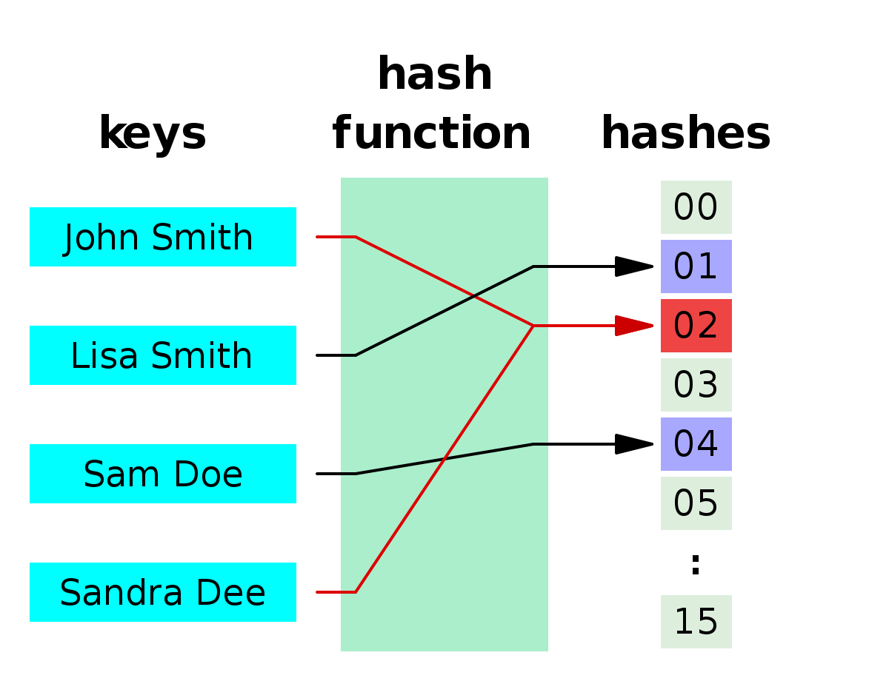
Hashing
Definition?
Map data of arbitrary size onto fixed sized code/value.
source: google
Generic Hashing
Notes:
Hashing takes data an return a small and unique code.
This particularity of the Hash functions make it interesting as we use it in cryptography to authenticate documents.
Finding a duplicate of a document becomes easier…However our goal is to find similar data.
The algorithms we’re talking about, LSH and LPH rely on the same principle of hashing that is dimensionality reduction.

Slide 7
Locality Sensitive Hashing [LSH]
3
Data dependent hashing
Notes:
Chriss

Slide 8
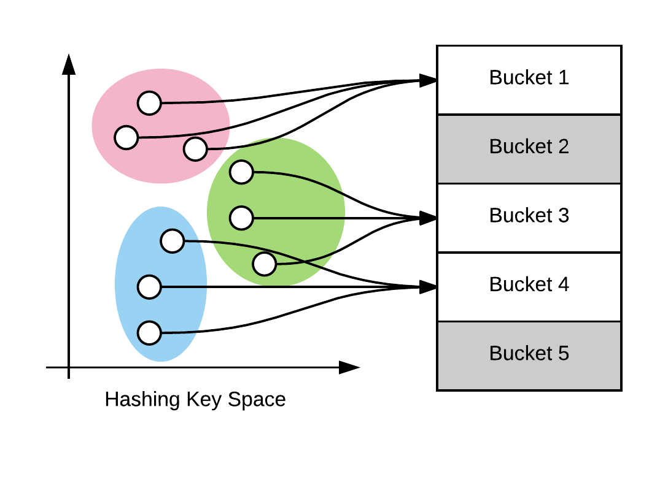
LSH
What is LSH?
LSH maximizes the probability of collision for objects that are similar as compared to those that are far apart.
source: google
Locality Sensitive Hashing
Notes:
collision refers to mapping multiple hash codes to the same bucket.
How many of you have already hear about LSH ?
Didn’t expect too much ;)
To put it simple, LSH is a nns technique which rely on the principle of maximizing the probability of objects which are close
As opposed to generic hashing that avoids collision, LSH relies on this phenomenon to aid the nearest neighbor search.
Therefore, given a query, LSH has the ability to approximate similar data points based on the bucket of the query. There can be constraints to this technique as the hashing is conducted randomly.

Slide 9
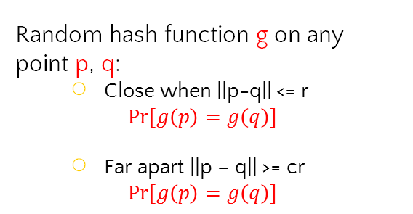


LSH
Random hash function g on any point p, q:
Close when ||p-q|| <= r
$$Pr⁡[g\left(p\right)=g\left(q\right)]$$
Far apart ||p – q|| >= cr
$$Pr⁡[g\left(p\right)=g\left(q\right)]$$
$$p$$
Use several hash tables
$$1$$
$$Pr⁡[g\left(p\right)=g\left(q\right)]$$
$$1$$
$$dist(p,q)$$
Notes:
Now let me explain to you Locality Sensitive Hashing
Let’s consider this yellow blob which is our space, and we have our points inside.
So LSH will try to partion this space in a way that
If the point p anq q are close, the probability of their hash code being same is high, otherwise low
However we don’t always have a collision, as you can see with this graph, the probability of collision decrease as the distance between the point increase.
To tackle this issue, we run several times the hasing part, by using different hashing functions.
In the hamming space, the choice of the hash functions is pretty simple, we just use random hash function.
At the end we get many hash tables, and from them, we decide of the similarity between the points by comparing how many times the collide during the steps above.

Slide 10
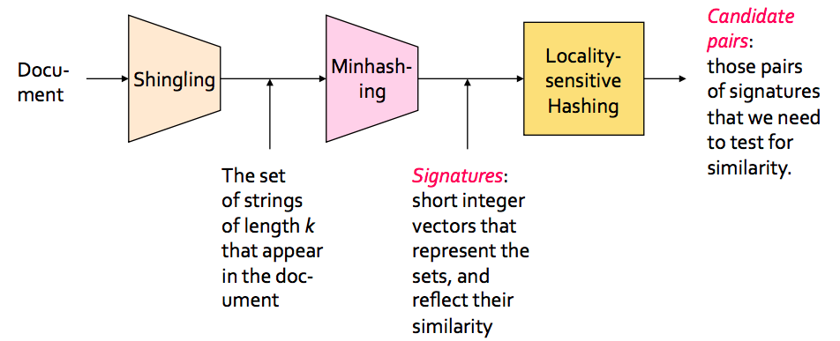
LSH IMPLEMENTATION
source: google
Notes:
Case study for text or document.
Shingling generates large sets of groupings of the data
abstract these large sets with compact representation.
Given a threshold t we compare the minhash and conclude similarity
Here we have an example of how to use LSH on documents
First we shingle each document–
Then we pass these shingles to the Minash algorithm, which gives the hash of the documents
Then we built an hash table and select the pairs of potential similar…And repeat the process from Minashing
At the end we output the pair of data which collide the most.

Slide 11
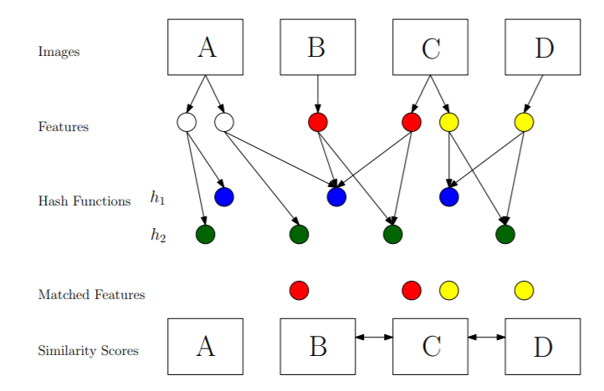
VisualRank – LSH with Images
Notes:
LSH with images is similar as with texts…instead of shingling, we just extract the images features which we pass then to the hashing function.
Hey Jarvin, what makes LPH different from LSH ?

Slide 12
Locality Preserving Hashing [LPH]
4
Data dependent hashing
Notes:
LPH is data dependent. Data dependency in such a way that when hashing the original data, the technique keeps the neighborhood structure of this data I.e. the after hashing the most similar data will still maintain that arrangement as hashed

Slide 13
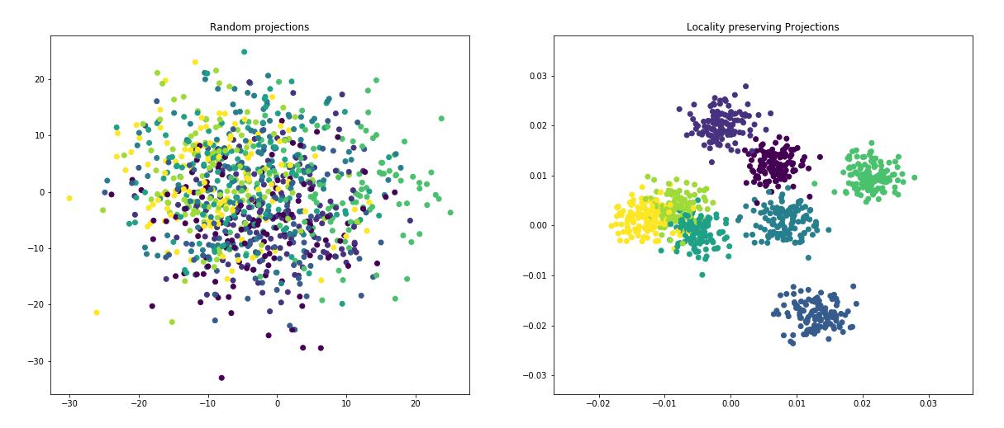
LPH
What is LPH?
LPH that preserves the neighborhood structure during hashing.
Locality Preserving Hashing
Notes:
LPH is based on the concept of LPproj as shown in the illustration. We see similar data, color coded, grouped together as opposed to the randomness in the random projections. Intuitively, this makes its grouping much more accurate in terms of

Slide 14
LSH Vs. LPH
LSH
Data independence -random Hashing
Faster query time
LPH
Data dependence
More Accurate
Trade –off between Query time and accuracy requirement of an application.
Notes:
With these hashing techniques, both techniques reduce the search space by we notice a trade-off between Fast query time that arises from the randomness of the hashing of queries in LSH and a higher accuracy for LPH because hashes have the same similarity structure as the original data.

Slide 15
DISCUSSION
5
Experiments and results
Notes:
Let's look at some results!

Slide 16
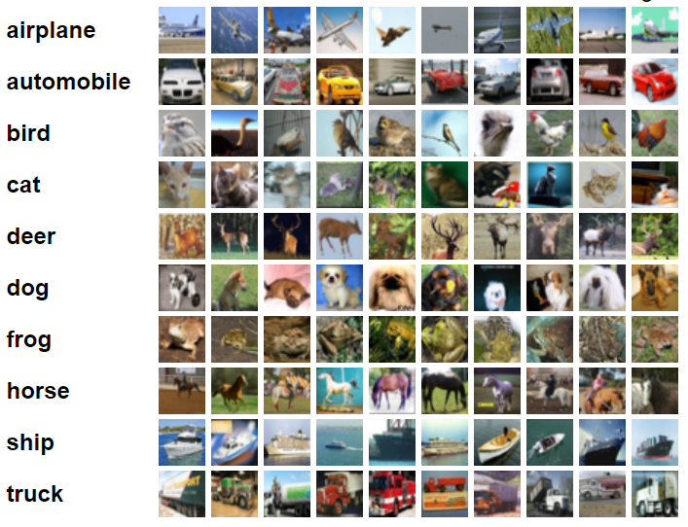
Experimental Setup
Results based on research by Yi-Hsuan Tsai and Ming –Hsuan Yang.
Datasets
CIFAR-10 – 10 classes. Training set – 200 random images per class
CIFAR-100 – 100 classes of images. Training set – 20 images per class.
Notes:
These results are adopted from Yi-Hsuan Tsai and MIng Hsuan Yang research from 2014. It is conducted on two image datasets -CIFAR-10 dataset consists of 60000 32x32 colour images in 10 classes, with 6000 images per class and CIFAR-100 that is relatively bigger with 100 classes of images

Slide 17
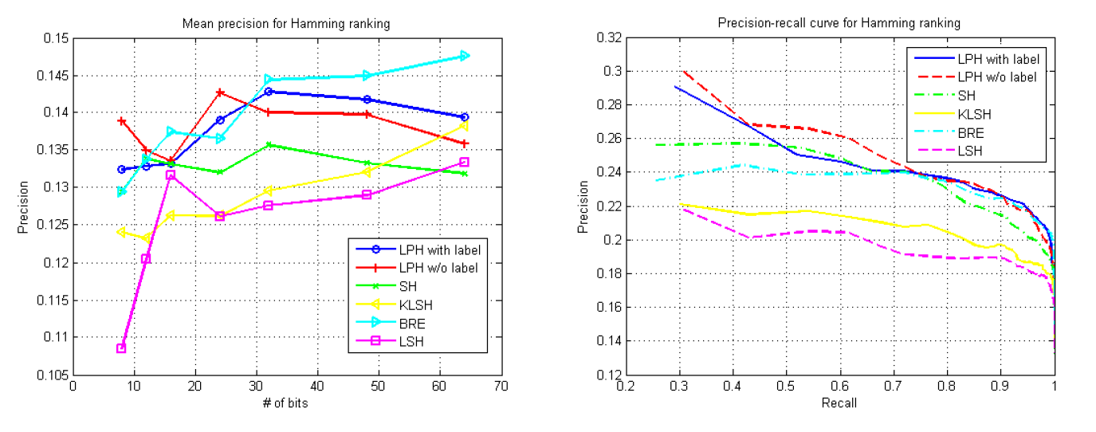
Results – CIFAR-10
Notes:
These results are based on accuracy measures of precision and recall for finding 100 nearest neighbors. And also number of bits in the hash code. As shown the graphs, we can see that LPH performs considerly better than LSH – In pink and blue.
The labels are used to adjust the data distribution and estimate the eigenfunctions
LPH w/o labels performs similarly as LPH with labels meaning that the labels do not provide any additional information.

Slide 18
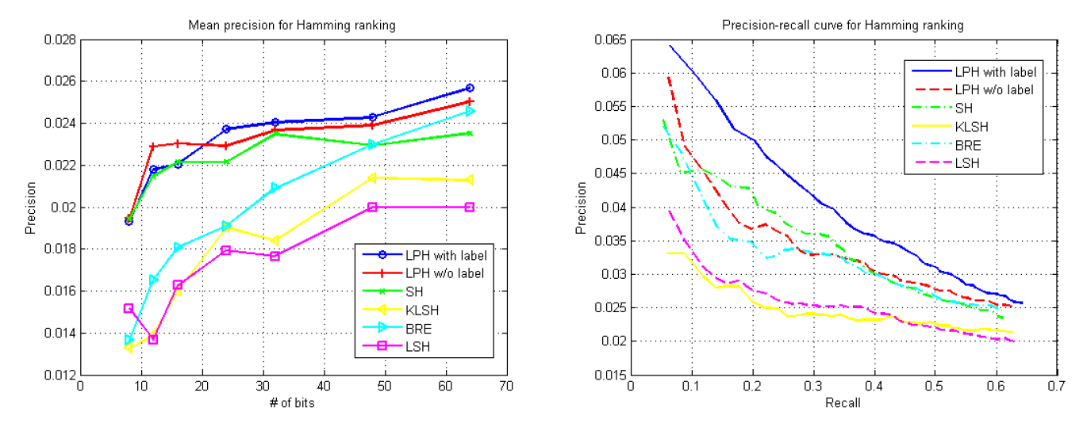
Results – CIFAR-100
Notes:
This is alittle variant with a larger dataset. LPH with labels works for larger datasets has more object classes and the label similarity
is likely to play a more important role.

Slide 19



Applications
Page Rank
Fake Driving
Image Filtering
Notes:
In real world applications, LSH is widely used.
We have google with ranking,
Uber uses LSH to quickly detect fraudulents drivings,
Another most use case is Pinterest which uses LSH, to filter images by similarity.
Such algorithms are also generally use as baselines for Machine learning algorithms such as KNN.
Not a lot of research exists with LPH, despite it being a more accurate technique.
Future research would be on optimising LPH to be as fast the LSH technique to much better approximate results

Slide 20

Questions?

