Slide 1
T_{E}X
Retweet Popularity Prediction
Jarvis · 22. Juni 2018
SE · ECNU

Slide 2
Overview
T_{E}X
Problem Definition
Model Definition 3.Coding 4.Comparison 5.Conclusion

Slide 3
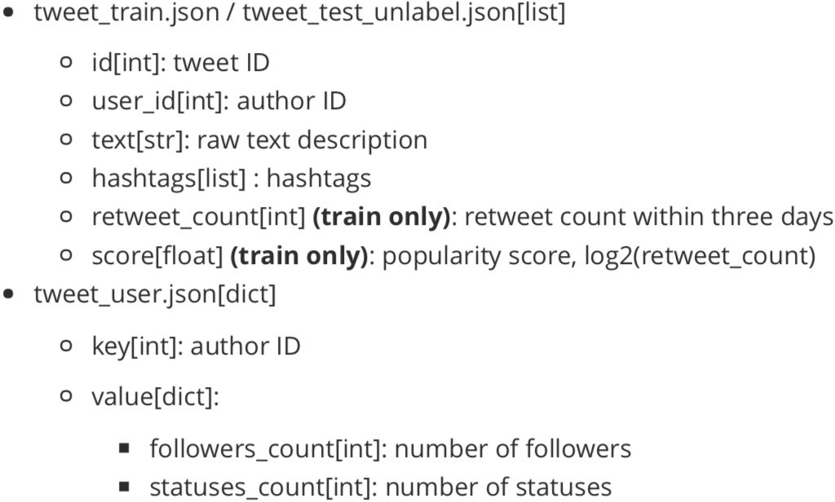
Problem Definition
T_{E}X
DataSet Showing

Slide 4
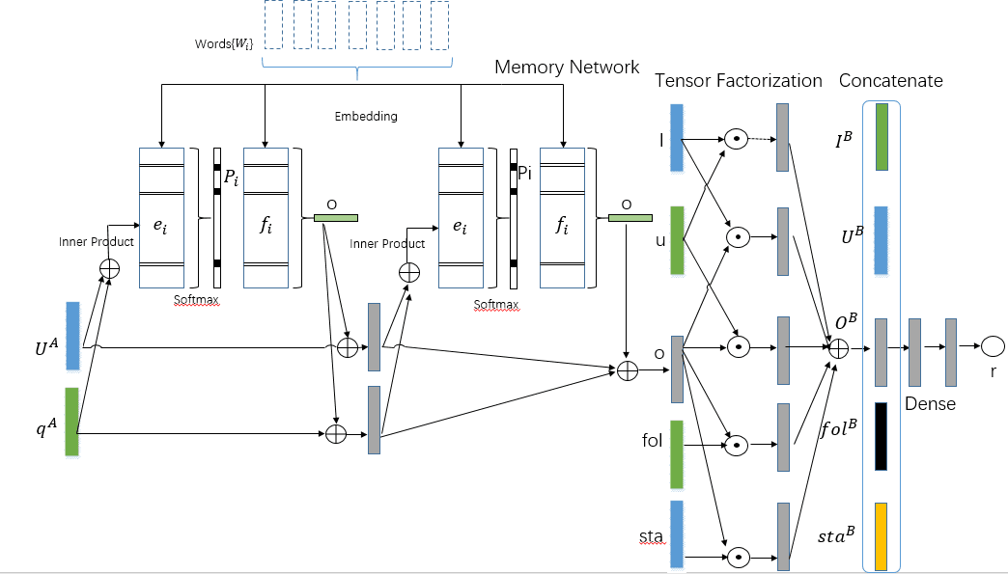
Model Definition
T_{E}X

Slide 5
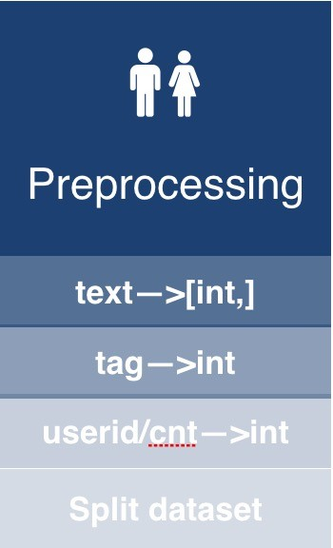
Coding
T_{E}X
5

Slide 6
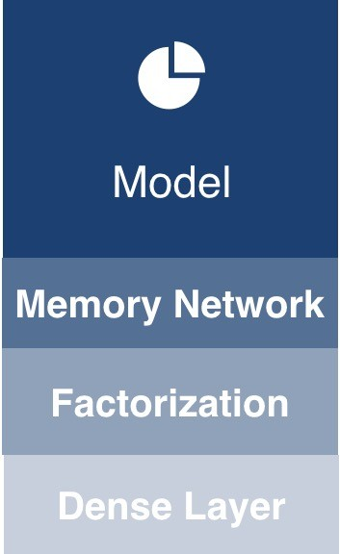
Coding
T_{E}X
− − − − − >
5

Slide 7
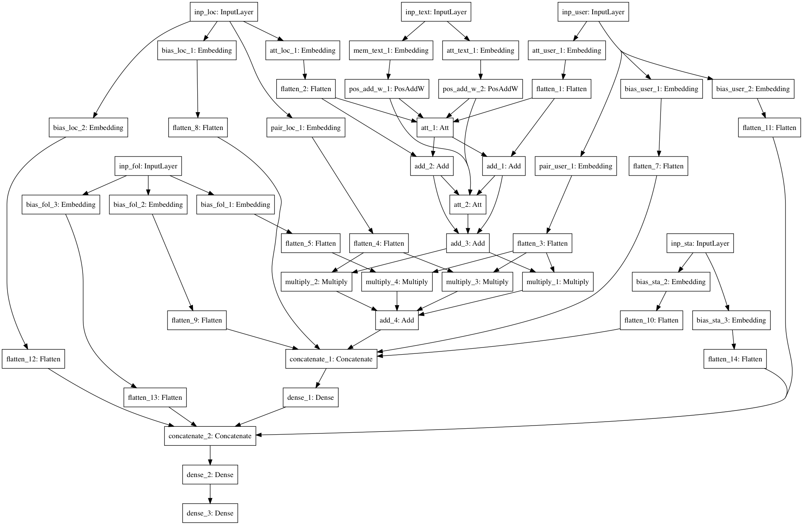
Coding
T_{E}X
− − − − − >
final model view
5

Slide 8
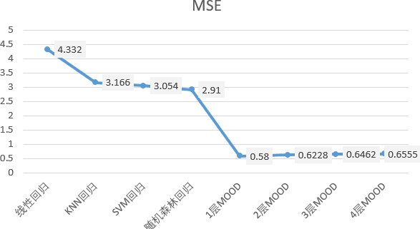
Comparison
T_{E}X
6

Slide 9
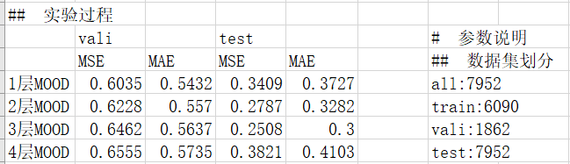
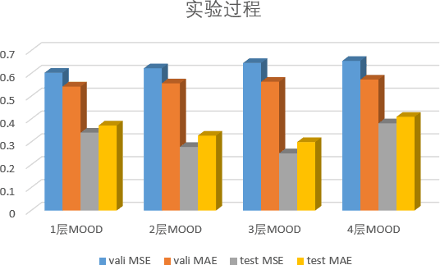
Comparison
T_{E}X
6

Slide 10
Conclusion
T_{E}X
Memory Network can acquire effective representations for text .
Factorization Tensor can help joints features.
MOOD merges the above 2 and gets great result in the ques. 4.Params in MOOD has a great influence to the result.
7

Slide 11

Conclusion
T_{E}X
7

