Slide 1
10. Extending Tractability
finding small vertex covers
solving NP-hard problems on trees
circular arc coverings
vertex cover in bipartite graphs

Slide 2
Coping with NP-completeness
Q. Suppose I need to solve an NP-complete problem. What should I do?
A. Theory says you're unlikely to find poly-time algorithm.
Must sacrifice one of three desired features.
Solve problem to optimality.
Solve problem in polynomial time.
Solve arbitrary instances of the problem.
This lecture. Solve some special cases of NP-complete problems.

Slide 3
10. Extending Tractability
finding small vertex covers
solving NP-hard problems on trees
circular arc coverings
vertex cover in bipartite graphs

Slide 4
Vertex cover
Given a graph G = (V, E) and an integer k, is there a subset of vertices S ⊆ V such that | S | ≤ k, and for each edge (u, v) either u ∈ S or v ∈ S or both?
1
6
2
7
3
8
4
9
5
10
S = { 3, 6, 7, 10 } is a vertex cover of size k = 4

Slide 5
Finding small vertex covers
Q. VertexCover is NP-complete. But what if k is small?
Brute force. O(k n^{k+1}).
Try all C(n, k) = O(n^{k}) subsets of size k.
Takes O(k n) time to check whether a subset is a vertex cover.
Goal. Limit exponential dependency on k, say to O(2^{k} k n).
Ex. n = 1,000, k = 10.
Brute. k n^{k+1} = 10³⁴ ⇒ infeasible.
Better. 2^{k} k n = 10⁷ ⇒ feasible.
Remark. If k is a constant, then the algorithm is poly-time; if k is a small constant, then it's also practical.

Slide 6
Finding small vertex covers
Claim. Let (u, v) be an edge of G. G has a vertex cover of size ≤ k iff at least one of G − { u } and G − { v } has a vertex cover of size ≤ k − 1.
Pf. ⇒
Suppose G has a vertex cover S of size ≤ k.
S contains either u or v (or both). Assume it contains u.
S − { u } is a vertex cover of G − { u }.
Pf. ⇐
Suppose S is a vertex cover of G − { u } of size ≤ k − 1.
Then S ∪ { u } is a vertex cover of G. ▪
Claim. If G has a vertex cover of size k, it has ≤ k (n − 1) edges.
Pf. Each vertex covers at most n − 1 edges. ▪
delete v and all incident edges

Slide 7
Finding small vertex covers: algorithm
Claim. The following algorithm determines if G has a vertex cover of size ≤ k in O(2^{k} kn) time.
Pf.
Correctness follows from previous two claims.
There are ≤ 2^{k+1} nodes in the recursion tree; each invocation takes O(kn) time. ▪
Vertex-Cover(G, k) {
if (G contains no edges) return true
if (G contains ≥ kn edges) return false
let (u, v) be any edge of G
a = Vertex-Cover(G - {u}, k-1)
b = Vertex-Cover(G - {v}, k-1)
return a or b
}

Slide 8

Finding small vertex covers: recursion tree
k
k-1
k-1
k-2
k-2
k-2
k-2
k - i
0
0
0
0
0
0
0
0

Slide 9
10. Extending Tractability
finding small vertex covers
solving NP-hard problems on trees
circular arc coverings
vertex cover in bipartite graphs

Slide 10
Independent set on trees
Independent set on trees. Given a tree, find a maximum cardinality subset of nodes such that no two share an edge.
Fact. A tree on at least two nodes has at least two leaf nodes.
Key observation. If v is a leaf, there exists a maximum size independent set containing v.
Pf. (exchange argument)
Consider a max cardinality independent set S.
If v ∈ S, we're done.
If u ∉ S and v ∉ S, then S ∪ { v } is independent ⇒ S not maximum.
If u ∈ S and v ∉ S, then S ∪ { v } − { u } is independent. ▪
degree = 1
u
v

Slide 11
Independent set on trees: greedy algorithm
Theorem. The following greedy algorithm finds a maximum cardinality independent set in forests (and hence trees).
Pf. Correctness follows from the previous key observation. ▪
Remark. Can implement in O(n) time by considering nodes in postorder.
Independent-Set-In-A-Forest(F) {
S ← φ
while (F has at least one edge) {
Let e = (u, v) be an edge such that v is a leaf
Add v to S
Delete from F nodes u and v, and all edges
incident to them.
}
return S
}

Slide 12

Weighted independent set on trees
Weighted independent set on trees. Given a tree and node weights w_{v} > 0, find an independent set S that maximizes Σ_{v∈S} w_{v}.
Observation. If (u, v) is an edge such that v is a leaf node, then either OPT includes u or OPT includes all leaf nodes incident to u.
Dynamic programming solution. Root tree at some node, say r.
OPT_{in} (u) = max weight independent set of subtree rooted at u, containing u.
OPT_{out} (u) = max weight independent set of subtree rooted at u, not containing u.
r
u
v
w
x
children(u) = { v, w, x }

Slide 13
Weighted independent set on trees: dynamic programming algorithm
Theorem. The dynamic programming algorithm finds a maximum weighted independent set in a tree in O(n) time.
can also find
independent set itself
(not just value)
Weighted-Independent-Set-In-A-Tree(T) {
Root the tree at a node r
foreach (node u of T in postorder) {
if (u is a leaf) {
M_{in} [u] = w_{u}
M_{out}[u] = 0
}
else {
M_{in} [u] = w_{u} + Σ_{v∈children(u)} M_{out}[v]
M_{out}[u] = Σ_{v∈children(u)} max(M_{in}[v], M_{out}[v])
}
}
return max(M_{in}[r], M_{out}[r])
}
ensures a node is visited
after all its children
Notes:
Takes O(n) time since we visit nodes in postorder and examine each edge exactly once.

Slide 14
Context
Independent set on trees. This structured special case is tractable because we can find a node that breaks the communication among the
subproblems in different subtrees.
Graphs of bounded tree width. Elegant generalization of trees that:
Captures a rich class of graphs that arise in practice.
Enables decomposition into independent pieces.
u
see Chapter 10.4
(but proceed with caution)

Slide 15
10. Extending Tractability
finding small vertex covers
solving NP-hard problems on trees
circular arc coverings
vertex cover in bipartite graphs

Slide 16
Wavelength-division multiplexing
Wavelength-division multiplexing (WDM). Allows m communication streams (arcs) to share a portion of a fiber optic cable, provided they are transmitted using different wavelengths.
Ring topology. Special case is when network is a cycle on n nodes.
Bad news. NP-complete, even on rings.
Brute force. Can determine if k colors suffice in O(k^{m}) time by trying all k-colorings.
Goal. O(f (k)) ⋅ poly(m, n) on rings.
c
b
a
1
4
2
e
f
d
3
n = 4, m = 6
{ c, d }, { b, f }, { a, e }

Slide 17
Review: interval coloring
Interval coloring. Greedy algorithm finds coloring such that number of colors equals depth of schedule.
Circular arc coloring.
Weak duality: number of colors ≥ depth.
Strong duality does not hold.
maximum number of streams at one location
c
d
f
j
b
g
i
a
e
h
max depth = 2 min colors = 3

Slide 18
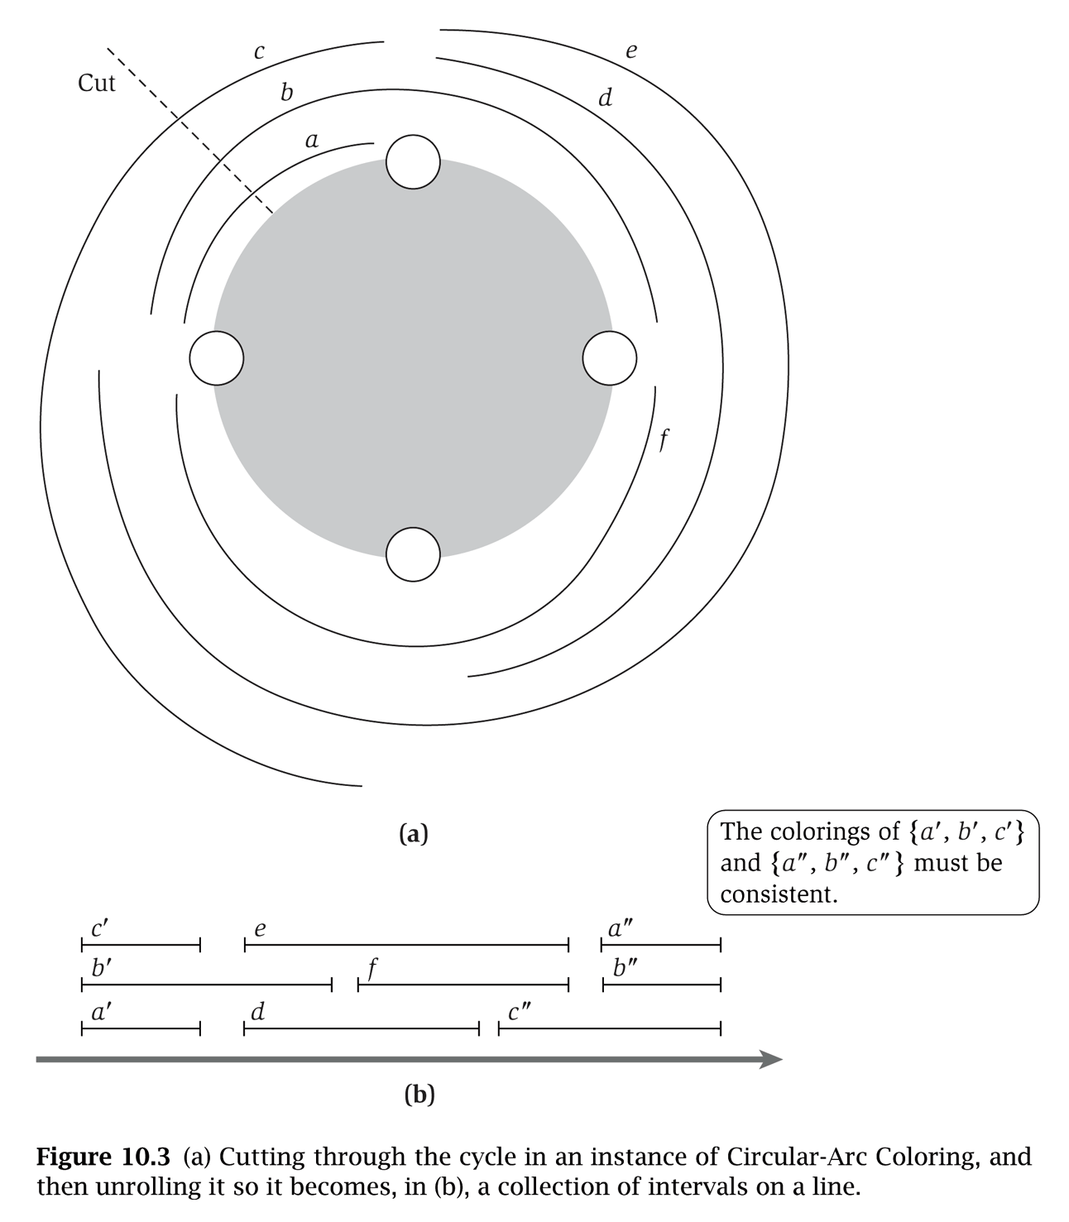
(Almost) transforming circular arc coloring to interval coloring
Circular arc coloring. Given a set of n arcs with depth d ≤ k, can the arcs be colored with k colors?
Equivalent problem. Cut the network between nodes v₁ and v_{n}. The arcs can be colored with k colors iff the intervals can be colored with k colors in such a way that "sliced" arcs have the same color.
v₁
colors of a', b', and c' must correspond to colors of a", b", and c"
v₀
v₄
v₂
v₀
v₁
v₂
v₃
v₄
v₀
v₃

Slide 19
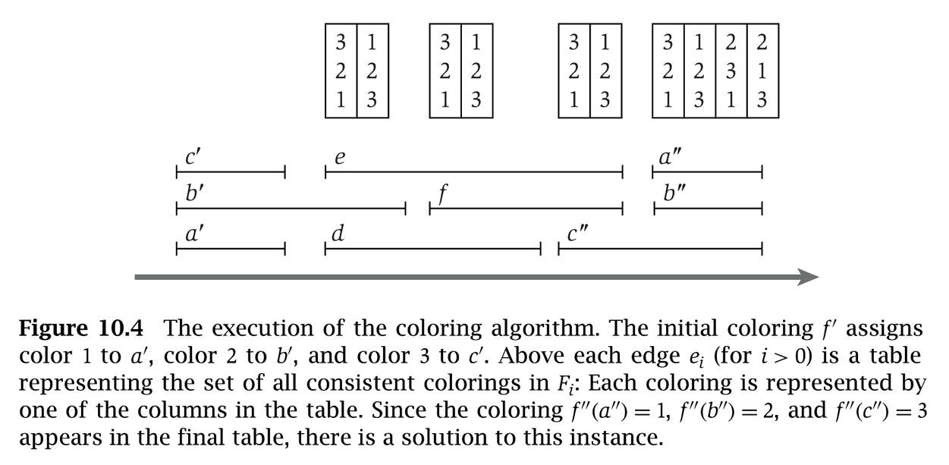
Circular arc coloring: dynamic programming algorithm
Dynamic programming algorithm.
Assign distinct color to each interval which begins at cut node v₀.
At each node v_{i}, some intervals may finish, and others may begin.
Enumerate all k-colorings of the intervals through v_{i} that are consistent with the colorings of the intervals through v_{i–1}.
The arcs are k-colorable iff some coloring of intervals ending at cut node v₀ is consistent with original coloring of the same intervals.
yes
c'
3
e
3
1
e
3
1
e
3
1
a"
3
2
1
2
b'
2
b'
2
2
f
2
2
f
2
2
b"
2
3
2
1
a'
1
d
1
3
d
1
3
c"
1
3
c"
1
1
3
3
v₀
v₁
v₂
v₃
v₄
v₀

Slide 20
Circular arc coloring: running time
Running time. O(k! ⋅ n).
The algorithm has n phases.
Bottleneck in each phase is enumerating all consistent colorings.
There are at most k intervals through v_{i}, so there are at most k! colorings to consider.
Remark. This algorithm is practical for small values of k (say k = 10) even if the number of nodes n (or paths) is large.

Slide 21
10. Extending Tractability
finding small vertex covers
solving NP-hard problems on trees
circular arc coverings
vertex cover in bipartite graphs

Slide 22
Vertex cover
Given a graph G = (V, E) and an integer k, is there a subset of vertices S ⊆ V such that | S | ≤ k, and for each edge (u, v) either u ∈ S or v ∈ S or both?
1
1'
2
2'
3
3'
4
4'
5
5'
vertex cover S = { 3, 4, 5, 1', 2' }

Slide 23
Vertex cover and matching
Weak duality. Let M be a matching, and let S be a vertex cover. Then, | M | ≤ | S |.
Pf. Each vertex can cover at most one edge in any matching.
1
1'
2
2'
3
3'
4
4'
5
5'
matching M: 1-1', 2-2', 3-4', 4-5'

Slide 24
Vertex cover in bipartite graphs: König-Egerváry Theorem
Theorem. [König-Egerváry] In a bipartite graph, the max cardinality of a matching is equal to the min cardinality of a vertex cover.
1
1'
2
2'
3
3'
4
4'
5
5'
matching M: 1-1', 2-2', 3-4', 4-5'
vertex cover S = { 3, 4, 5, 1', 2' }

Slide 25
Proof of König-Egerváry theorem
Theorem. [König-Egerváry] In a bipartite graph, the max cardinality of a matching is equal to the min cardinality of a vertex cover.
Suffices to find matching M and cover S such that | M | = | S |.
Formulate max flow problem as for bipartite matching.
Let M be max cardinality matching and let (A, B) be min cut.
1
∞
1'
1
2
2'
1
s
3
3'
t
4
4'
5
5'
L
R

Slide 26
Proof of König-Egerváry theorem
Theorem. [König-Egerváry] In a bipartite graph, the max cardinality of a matching is equal to the min cardinality of a vertex cover.
Suffices to find matching M and cover S such that | M | = | S |.
Formulate max flow problem as for bipartite matching.
Let M be max cardinality matching and let (A, B) be min cut.
Define L_{A} = L ∩ A, L_{B} = L ∩ B , R_{A} = R ∩ A, R_{B} = R ∩ B.
Claim 1. S = L_{B} ∪ R_{A} is a vertex cover.
consider (u, v) ∈ E
u ∈ L_{A}, v ∈ R_{B} impossible since infinite capacity
thus, either u ∈ L_{B} or v ∈ R_{A} or both
Claim 2. | M | = | S |.
max-flow min-cut theorem ⇒ | M | = cap(A, B)
only edges of form (s, u) or (v, t) contribute to cap(A, B)
| M | = cap(A, B) = | L_{B} | + | R_{A} | = | S |. ▪

Slide 27
1
1
∞
G'
∞
A
1'
LA = {2, 4, 5} LB = {1, 3} RA = {2', 5'} N(LA) = {2', 5'}
∞
2'
2
1
s
3'
4
1
3
4'
5
5'
1
t

