Slide 1
11. Approximation Algorithms
load balancing
center selection
pricing method: vertex cover
LP rounding: vertex cover
generalized load balancing
knapsack problem

Slide 2
Coping with NP-completeness
Q. Suppose I need to solve an NP-hard problem. What should I do?
A. Sacrifice one of three desired features.
Solve arbitrary instances of the problem.
Solve problem to optimality.
Solve problem in polynomial time.
ρ-approximation algorithm.
Guaranteed to run in poly-time.
Guaranteed to solve arbitrary instance of the problem
Guaranteed to find solution within ratio ρ of true optimum.
Challenge. Need to prove a solution's value is close to optimum, without even knowing what optimum value is
Notes:
Prove P = NP.

Slide 3
11. Approximation Algorithms
load balancing
center selection
pricing method: vertex cover
LP rounding: vertex cover
generalized load balancing
knapsack problem

Slide 4
Load balancing
Input. m identical machines; n jobs, job j has processing time t_{j}.
Job j must run contiguously on one machine.
A machine can process at most one job at a time.
Def. Let J(i) be the subset of jobs assigned to machine i. The load of machine i is L_{i} = Σ_{j ∈ J(i)} t_{j}.
Def. The makespan is the maximum load on any machine L = max_{i} L_{i}.
Load balancing. Assign each job to a machine to minimize makespan.
machine 1
a
d
Machine 1
f
b
c
Machine 2
machine 2
e
g
0
L1
L2
time

Slide 5
Load balancing on 2 machines is NP-hard
Claim. Load balancing is hard even if only 2 machines.
Pf. Number-Partitioning ≤ _{P} Load-Balance.
NP-complete by Exercise 8.26
a
b
c
d
e
f
g
length of job f
machine 1
a
d
Machine 1
f
yes
b
c
Machine 2
machine 2
e
g
0
L
time

Slide 6

Load balancing: list scheduling
List-scheduling algorithm.
Consider n jobs in some fixed order.
Assign job j to machine whose load is smallest so far.
Implementation. O(n log m) using a priority queue.
List-Scheduling(m, n, t₁,t₂,…,t_{n}) {
for i = 1 to m {
L_{i} ← 0
J(i) ← ∅
}
for j = 1 to n {
i = argmin_{k} L_{k}
J(i) ← J(i) ∪ {j}
L_{i} ← L_{i} + t_{j}
}
return J(1), …, J(m)
}
load on machine i
jobs assigned to machine i
machine i has smallest load
assign job j to machine i
update load of machine i
Notes:
Remark. This is an "online" algorithm.

Slide 7
Load balancing: list scheduling analysis
Theorem. [Graham 1966] Greedy algorithm is a 2-approximation.
First worst-case analysis of an approximation algorithm.
Need to compare resulting solution with optimal makespan L*.
Lemma 1. The optimal makespan L* ≥ max_{j} t_{j}.
Pf. Some machine must process the most time-consuming job. ▪
Lemma 2. The optimal makespan
Pf.
The total processing time is Σ_{j} t_{j} .
One of m machines must do at least a 1 / m fraction of total work. ▪
Notes:
Need to compare greedy solution with optimal makespan. Need good lower bounds on the optimal value.
Lower bound too weak in following case: one job is extremely long relative to sum of all processing times. If sufficiently extreme, optimal solution will place long job on a machine all by itself and it will be last to finish. In this case, greedy will do well, but first lower bound will not establish this.

Slide 8
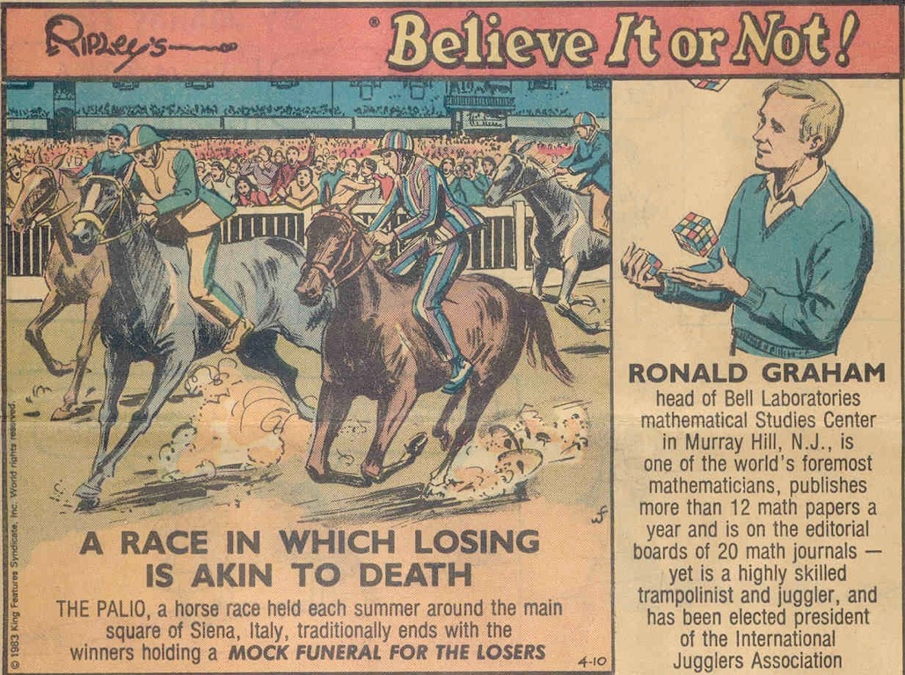
Believe it or not

Slide 9
Load balancing: list scheduling analysis
Theorem. Greedy algorithm is a 2-approximation.
Pf. Consider load L_{i} of bottleneck machine i.
Let j be last job scheduled on machine i.
When job j assigned to machine i, i had smallest load. Its load before assignment is L_{i} – t_{j} ⇒ L_{i} – t_{j} ≤ L_{k} for all 1 ≤ k ≤ m.
blue jobs scheduled before j
machine i
j
0
Li - tj
L = Li
time

Slide 10


Load balancing: list scheduling analysis
Theorem. Greedy algorithm is a 2-approximation.
Pf. Consider load L_{i} of bottleneck machine i.
Let j be last job scheduled on machine i.
When job j assigned to machine i, i had smallest load. Its load before assignment is L_{i} – t_{j} ⇒ L_{i} – t_{j} ≤ L_{k} for all 1 ≤ k ≤ m.
Sum inequalities over all k and divide by m:
Now ▪
Lemma 2
Lemma 1

Slide 11
Load balancing: list scheduling analysis
Q. Is our analysis tight?
A. Essentially yes.
Ex: m machines, m (m – 1) jobs length 1 jobs, one job of length m.
list scheduling makespan = 19
machine 2 idle
machine 3 idle
machine 4 idle
m = 10
machine 5 idle
machine 6 idle
machine 7 idle
machine 8 idle
machine 9 idle
machine 10 idle
0
9
19

Slide 12
Load balancing: list scheduling analysis
Q. Is our analysis tight?
A. Essentially yes.
Ex: m machines, m (m – 1) jobs length 1 jobs, one job of length m.
optimal makespan = 10
m = 10
0
9
10
19

Slide 13
Load balancing: LPT rule
Longest processing time (LPT). Sort n jobs in descending order of processing time, and then run list scheduling algorithm.
LPT-List-Scheduling(m, n, t₁,t₂,…,t_{n}) {
Sort jobs so that t₁ ≥ t₂ ≥ … ≥ t_{n}
for i = 1 to m {
L_{i} ← 0
J(i) ← ∅
}
for j = 1 to n {
i = argmin_{k} L_{k}
J(i) ← J(i) ∪ {j}
L_{i} ← L_{i} + t_{j}
}
return J(1), …, J(m)
}
load on machine i
jobs assigned to machine i
machine i has smallest load
assign job j to machine i
update load of machine i

Slide 14

Load balancing: LPT rule
Observation. If at most m jobs, then list-scheduling is optimal.
Pf. Each job put on its own machine. ▪
Lemma 3. If there are more than m jobs, L* ≥ 2 t_{m+1} .
Pf.
Consider first m+1 jobs t₁, …, t_{m+1}.
Since the t_{i}'s are in descending order, each takes at least t_{m+1} time.
There are m + 1 jobs and m machines, so by pigeonhole principle, at least one machine gets two jobs. ▪
Theorem. LPT rule is a 3/2-approximation algorithm.
Pf. Same basic approach as for list scheduling.
▪
Lemma 3 ( by observation, can assume number of jobs > m )
Notes:
j = last job scheduled on bottleneck machine.

Slide 15
Load Balancing: LPT rule
Q. Is our 3/2 analysis tight?
A. No.
Theorem. [Graham 1969] LPT rule is a 4/3-approximation.
Pf. More sophisticated analysis of same algorithm.
Q. Is Graham's 4/3 analysis tight?
A. Essentially yes.
Ex: m machines, n = 2m + 1 jobs, 2 jobs of length m, m + 1, …, 2m – 1 and one more job of length m.
Notes:
Best known: PTAS, 4/3-analysis not too hard

Slide 16
11. Approximation Algorithms
load balancing
center selection
pricing method: vertex cover
LP rounding: vertex cover
generalized load balancing
knapsack problem

Slide 17
Center selection problem
Input. Set of n sites s₁, …, s_{n} and an integer k > 0.
Center selection problem. Select set of k centers C so that maximum distance r(C) from a site to nearest center is minimized.
k = 4 centers
r(C)
center
site

Slide 18
Center selection problem
Input. Set of n sites s₁, …, s_{n} and an integer k > 0.
Center selection problem. Select set of k centers C so that maximum distance r(C) from a site to nearest center is minimized.
Notation.
dist(x, y) = distance between sites x and y.
dist(s_{i}, C) = min _{c ∈ C} dist(s_{i}, c) = distance from s_{i} to closest center.
r(C) = max_{i} dist(s_{i}, C) = smallest covering radius.
Goal. Find set of centers C that minimizes r(C), subject to | C | = k.
Distance function properties.
dist(x, x) = 0 [ identity ]
dist(x, y) = dist(y, x) [ symmetry ]
dist(x, y) ≤ dist(x, z) + dist(z, y) [ triangle inequality ]
Notes:
Note: if we don't assume weights satisfy the triangle inequality (or put some other restriction on the distances) the problem cannot be approximated
within any computable factor

Slide 19
Center selection example
Ex: each site is a point in the plane, a center can be any point in the plane, dist(x, y) = Euclidean distance.
Remark: search can be infinite!
k = 4 centers
r(C)
center
site

Slide 20
Greedy algorithm: a false start
Greedy algorithm. Put the first center at the best possible location for a single center, and then keep adding centers so as to reduce the covering radius each time by as much as possible.
Remark: arbitrarily bad!
k = 2 centers
greedy center 1
center
site

Slide 21
Center selection: greedy algorithm
Repeatedly choose next center to be site farthest from any existing center.
Property. Upon termination, all centers in C are pairwise at least r(C) apart.
Pf. By construction of algorithm.
Greedy-Center-Selection (k, n, s1, s2, … , sn)
________________________________________________________________________________________________________________________________________________________________________________________________________________________________________________________________________________________________________________________________________________________________________________________________________________________________________________________________________________________________________________________________________________________________________________________________________________________________________________________________________________________________________________________________________________________________________________________________________________________________________________________________________________________________________________________________________________________________________________________________________________________________________________________________________________________________________________________________________________________________________
C ← ∅.
Repeat k times
Select a site si with maximum distance dist(si, C).
C ← C ∪ si.
Return C.
________________________________________________________________________________________________________________________________________________________________________________________________________________________________________________________________________________________________________________________________________________________________________________________________________________________________________________________________________________________________________________________________________________________________________________________________________________________________________________________________________________________________________________________________________________________________________________________________________________________________________________________________________________________________________________________________________________________________________________________________________________________________________________________________________________________________________________________________________________________________________
site farthest
from any center
Notes:
Note: in first iteration, can choose any site s

Slide 22
Center selection: analysis of greedy algorithm
Lemma. Let C* be an optimal set of centers. Then r(C) ≤ 2r(C*).
Pf. [by contradiction] Assume r(C*) < ½ r(C).
For each site c_{i} ∈ C, consider ball of radius ½ r(C) around it.
Exactly one c_{i}* in each ball; let c_{i} be the site paired with c_{i}*.
Consider any site s and its closest center c_{i}* ∈ C*.
dist(s, C) ≤ dist(s, c_{i}) ≤ dist(s, c_{i}*) + dist(c_{i}*, c_{i}) ≤ 2r(C*).
Thus, r(C) ≤ 2r(C*). ▪
Δ-inequality
≤ r(C*) since c_{i}* is closest center
½ r(C)
½ r(C)
c_{i}
½ r(C)
C*
c_{i}*
site
s
Notes:
Why at least one c* in each ball around c? If not, then c would not be within 1/2 r(C) > r(C*) of any center in C* (contradicting the assumption).
Why at most one c* in each ball around c? The balls are disjoint, each ball contains at least one c*, and |C| = |C*|.

Slide 23
Center selection
Lemma. Let C* be an optimal set of centers. Then r(C) ≤ 2r (C*).
Theorem. Greedy algorithm is a 2-approximation for center selection problem.
Remark. Greedy algorithm always places centers at sites, but is still within a factor of 2 of best solution that is allowed to place centers anywhere.
Question. Is there hope of a 3/2-approximation? 4/3?
e.g., points in the plane

Slide 24
Dominating set reduces to center selection
Theorem. Unless P = NP, there no ρ-approximation for center selection problem for any ρ < 2.
Pf. We show how we could use a (2 – ε) approximation algorithm for Center-Selection selection to solve Dominating-Set in poly-time.
Let G = (V, E), k be an instance of Dominating-Set.
Construct instance G' of Center-Selection with sites V and distances
dist(u, v) = 1 if (u, v) ∈ E
dist(u, v) = 2 if (u, v) ∉ E
Note that G' satisfies the triangle inequality.
G has dominating set of size k iff there exists k centers C* with r(C*) = 1.
Thus, if G has a dominating set of size k, a (2 – ε)-approximation algorithm for Center-Selection would find a solution C* with r(C*) = 1 since it cannot use any edge of distance 2. ▪

Slide 25
11. Approximation Algorithms
load balancing
center selection
pricing method: vertex cover
LP rounding: vertex cover
generalized load balancing
knapsack problem

Slide 26
Weighted vertex cover
Definition. Given a graph G = (V, E), a vertex cover is a set S ⊆ V such that each edge in E has at least one end in S.
Weighted vertex cover. Given a graph G with vertex weights, find a vertex cover of minimum weight.
2
4
2
4
2
9
2
9
weight = 2 + 2 + 4
weight = 11

Slide 27

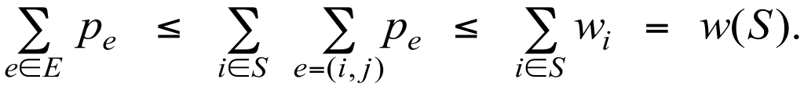
Pricing method
Pricing method. Each edge must be covered by some vertex. Edge e = (i, j) pays price pe ≥ 0 to use both vertex i and j.
Fairness. Edges incident to vertex i should pay ≤ wi in total.
Fairness lemma. For any vertex cover S and any fair prices pe : ∑e pe ≤ w(S).
Pf. ▪
2
4
2
9
each edge e covered by at least one node in S
sum fairness inequalities for each node in S

Slide 28
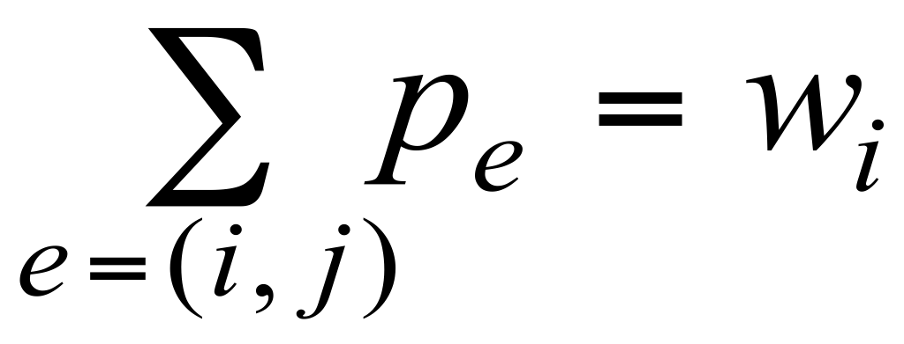
Pricing method
Set prices and find vertex cover simultaneously.
Weighted-Vertex-Cover (G, w)
__________________________________________________________________________________________________________________________________________________________________________________________________________________________________________________________________________________________________________________________________________________________________________________________________________________________________________________________________________________________________________________________________________________________________________________________________________________________________________________________________________________________________________________________________________________________________________________________________________________________________________________________________________________________________________________________________________________________________________________________________________________________________________________________________________________________________________________________________________________________________________________________________________________________________________________________________________________________________________________________________________
S ← ∅.
Foreach e ∈ E
pe ← 0.
While (there exists an edge (i, j) such that neither i nor j is tight)
Select such an edge e = (i, j).
Increase pe as much as possible until i or j tight. S ← set of all tight nodes.
Return S.
__________________________________________________________________________________________________________________________________________________________________________________________________________________________________________________________________________________________________________________________________________________________________________________________________________________________________________________________________________________________________________________________________________________________________________________________________________________________________________________________________________________________________________________________________________________________________________________________________________________________________________________________________________________________________________________________________________________________________________________________________________________________________________________________________________________________________________________________________________________________________________________________________________________________________________________________________________________________________________________________________________

Slide 29
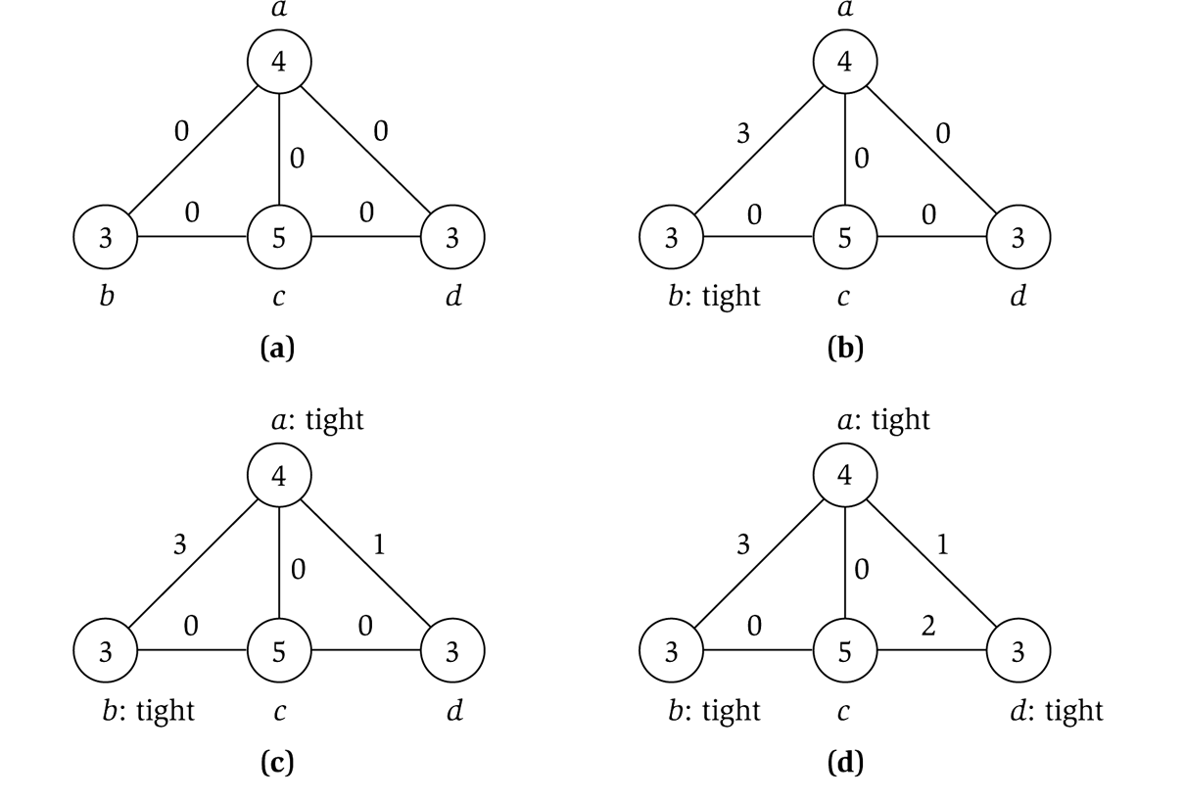
Pricing method example
price of edge a-b
vertex weight

Slide 30
Pricing method: analysis
Theorem. Pricing method is a 2-approximation for Weighted-Vertex-Cover.
Pf.
Algorithm terminates since at least one new node becomes tight after each iteration of while loop.
Let S = set of all tight nodes upon termination of algorithm. S is a vertex cover: if some edge (i, j) is uncovered, then neither i nor j is tight. But then while loop would not terminate.
Let S* be optimal vertex cover. We show w(S) ≤ 2 w(S*).
all nodes in S are tight
S ⊆ V, prices ≥ 0
each edge counted twice
fairness lemma

Slide 31
11. Approximation Algorithms
load balancing
center selection
pricing method: vertex cover
LP rounding: vertex cover
generalized load balancing
knapsack problem

Slide 32
Weighted vertex cover
Given a graph G = (V, E) with vertex weights w_{i} ≥ 0, find a min weight subset of vertices S ⊆ V such that every edge is incident to at least one vertex in S.
10
9
6
16
10
7
6
9
3
23
33
7
32
10
total weight = 6 + 23 + 7 + 9 + 10 = 55
Notes:
min weight vertex cover may not be a min cardinality vertex cover

Slide 33

Weighted vertex cover: IP formulation
Given a graph G = (V, E) with vertex weights w_{i} ≥ 0, find a min weight subset of vertices S ⊆ V such that every edge is incident to at least one vertex in S.
Integer programming formulation.
Model inclusion of each vertex i using a 0/1 variable x_{i}. Vertex covers in 1–1 correspondence with 0/1 assignments: S = { i ∈ V : x_{i} = 1}.
Objective function: minimize Σ_{i} w_{i} x_{i}.
Must take either vertex i or j (or both): x_{i} + x_{j} ≥ 1.

Slide 34

Weighted vertex cover: IP formulation
Weighted vertex cover. Integer programming formulation.
Observation. If x* is optimal solution to (ILP), then S = { i ∈ V : x_{i}* = 1} is a min weight vertex cover.

Slide 35


Integer programming
Given integers a_{ij}, b_{i}, and c_{j}, find integers x_{j} that satisfy:
Observation. Vertex cover formulation proves that Integer-Programming is an NP-hard search problem.
Notes:
NP-hard even if all coefficients are 0/1 and at most two variables per inequality.
Also known to be NP-complete when the integers need not be 0/1, but proving that requires some numerical analysis to argue that if there exists a feasible solution, then there exists one that is not too large.

Slide 36
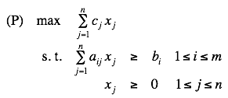

Linear programming
Given integers a_{ij}, b_{i}, and c_{j}, find real numbers x_{j} that satisfy:
Linear. No x², xy, arccos(x), x(1 – x), etc.
Simplex algorithm. [Dantzig 1947] Can solve LP in practice.
Ellipsoid algorithm. [Khachian 1979] Can solve LP in poly-time.
Notes:
Solving simultaneous linear equations (Ax = b) can be accomplished using Gaussian elimination. LP is a generalization with inequalities instead of equalities.
Note: simple transformations to handle >= inequalities, unrestricted variables, or min objective

Slide 37
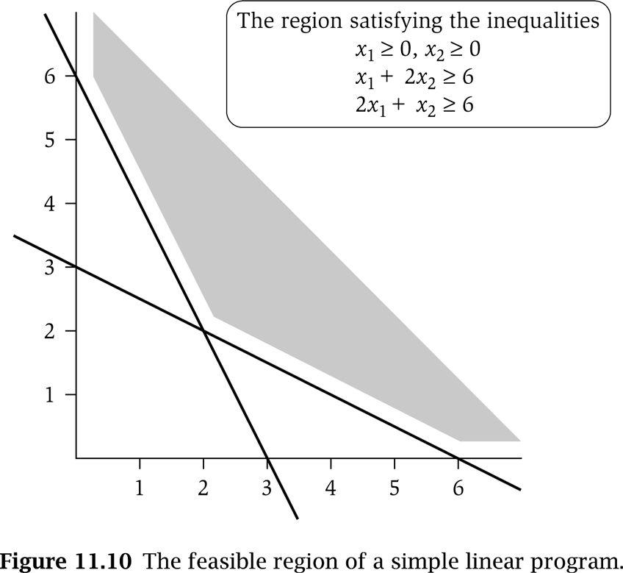
LP feasible region
LP geometry in 2D.
x₁ = 0
x₂ = 0
x₁ + 2x₂ = 6
2x₁ + x₂ = 6

Slide 38

Weighted vertex cover: LP relaxation
Linear programming relaxation.
Observation. Optimal value of (LP) is ≤ optimal value of (ILP). Pf. LP has fewer constraints.
Note. LP is not equivalent to vertex cover.
Q. How can solving LP help us find a small vertex cover?
A. Solve LP and round fractional values.
½
½
½
Notes:
LP relaxation is a useful lower bound for designing approximation algorithms.

Slide 39

Weighted vertex cover: LP rounding algorithm
Lemma. If x* is optimal solution to (LP), then S = { i ∈ V : x_{i}* ≥ ½} is a vertex cover whose weight is at most twice the min possible weight.
Pf. [S is a vertex cover]
Consider an edge (i, j) ∈ E.
Since x_{i}* + x_{j}* ≥ 1, either x_{i}* ≥ ½ or x_{j}* ≥ ½ ⇒ (i, j) covered.
Pf. [S has desired cost]
Let S* be optimal vertex cover. Then
Theorem. The rounding algorithm is a 2-approximation algorithm.
Pf. Lemma + fact that LP can be solved in poly-time.
LP is a relaxation
xi* ≥ ½

Slide 40
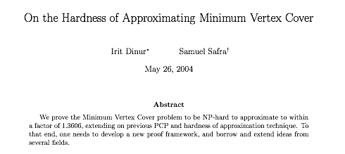
Weighted vertex cover inapproximability
Theorem. [Dinur-Safra 2004] If P ≠ NP, then no ρ-approximation for Weighted-Vertex-Cover for any ρ < 1.3606 (even if all weights are 1).
Open research problem. Close the gap.
Notes:
NP-hard even on 3-regular planar graphs with unit weights.
10 √5 – 21 = 1.3506

Slide 41
11. Approximation Algorithms
load balancing
center selection
pricing method: vertex cover
LP rounding: vertex cover
generalized load balancing
knapsack problem

Slide 42
Generalized load balancing
Input. Set of m machines M; set of n jobs J.
Job j ∈ J must run contiguously on an authorized machine in M_{j} ⊆ M.
Job j ∈ J has processing time t_{j}.
Each machine can process at most one job at a time.
Def. Let J(i) be the subset of jobs assigned to machine i. The load of machine i is L_{i} = Σ_{j ∈ J(i)} t_{j}.
Def. The makespan is the maximum load on any machine = max_{i} L_{i}.
Generalized load balancing. Assign each job to an authorized machine to minimize makespan.

Slide 43
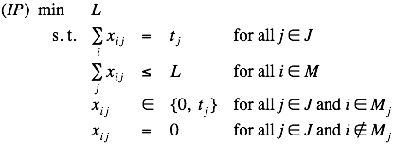
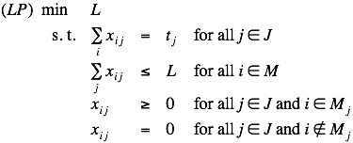
Generalized load balancing: integer linear program and relaxation
ILP formulation. x_{ij} = time machine i spends processing job j.
LP relaxation.

Slide 44
Generalized load balancing: lower bounds
Lemma 1. The optimal makespan L* ≥ max_{j} t_{j}.
Pf. Some machine must process the most time-consuming job. ▪
Lemma 2. Let L be optimal value to the LP. Then, optimal makespan L* ≥ L.
Pf. LP has fewer constraints than IP formulation. ▪

Slide 45
Generalized load balancing: structure of LP solution
Lemma 3. Let x be solution to LP. Let G(x) be the graph with an edge between machine i and job j if x_{ij} > 0. Then G(x) is acyclic.
Pf. (deferred)
can transform x into another LP solution where G(x) is acyclic if LP solver doesn't return such an x
x_{ij} > 0
G(x) acyclic
G(x) cyclic
job
machine
Notes:
LP solver will return such an x since any extreme point satisfies desired condition

Slide 46
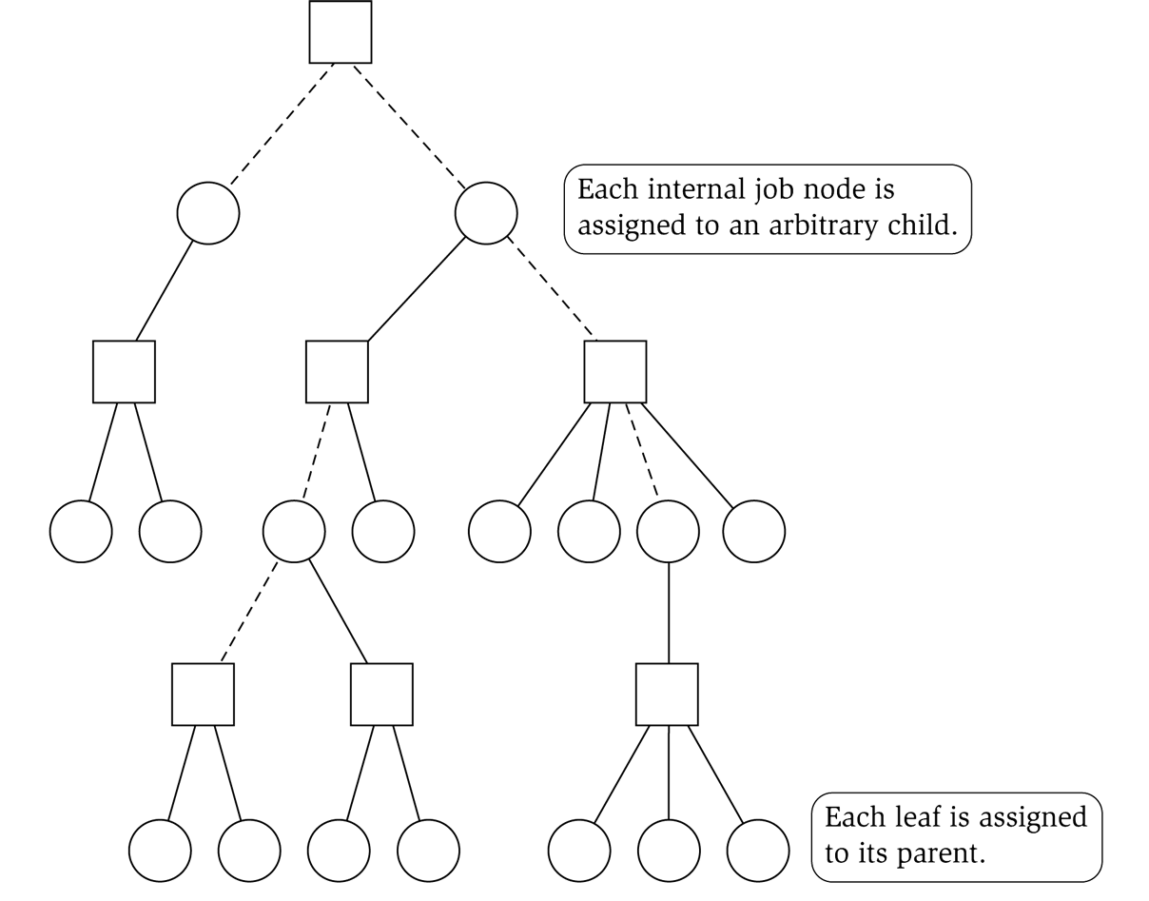
Generalized load balancing: rounding
Rounded solution. Find LP solution x where G(x) is a forest. Root forest G(x) at some arbitrary machine node r.
If job j is a leaf node, assign j to its parent machine i.
If job j is not a leaf node, assign j to any one of its children.
Lemma 4. Rounded solution only assigns jobs to authorized machines.
Pf. If job j is assigned to machine i, then x_{ij} > 0. LP solution can only assign positive value to authorized machines. ▪
job
machine

Slide 47
Generalized load balancing: analysis
Lemma 5. If job j is a leaf node and machine i = parent(j), then x_{ij} = t_{j}.
Pf.
Since i is a leaf, x_{ij} = 0 for all j ≠ parent(i).
LP constraint guarantees Σ_{i} x_{ij} = t_{j}. ▪
Lemma 6. At most one non-leaf job is assigned to a machine.
Pf. The only possible non-leaf job assigned to machine i is parent(i). ▪
job
machine

Slide 48

Generalized load balancing: analysis
Theorem. Rounded solution is a 2-approximation.
Pf.
Let J(i) be the jobs assigned to machine i.
By Lemma 6, the load L_{i} on machine i has two components:
leaf nodes:
parent:
Thus, the overall load L_{i} ≤ 2 L*. ▪
Lemma 5
LP
Lemma 2 (LP is a relaxation)
optimal value of LP
Lemma 1

Slide 49
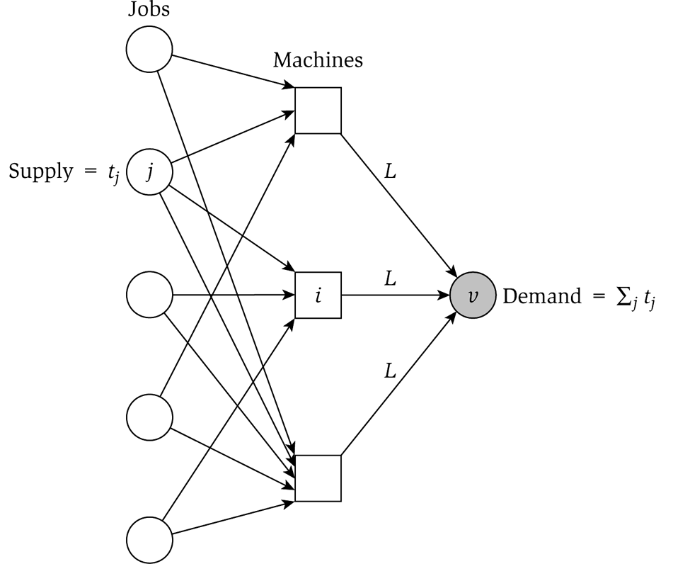
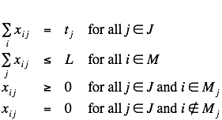
Generalized load balancing: flow formulation
Flow formulation of LP.
Observation. Solution to feasible flow problem with value L are in 1-to-1 correspondence with LP solutions of value L.
∞

Slide 50
Generalized load balancing: structure of solution
Lemma 3. Let (x, L) be solution to LP. Let G(x) be the graph with an edge from machine i to job j if x_{ij} > 0. We can find another solution (x', L) such that G(x') is acyclic.
Pf. Let C be a cycle in G(x).
Augment flow along the cycle C.
At least one edge from C is removed (and none are added).
Repeat until G(x') is acyclic. ▪
flow conservation maintained
augment flow
along cycle C
3
3
3
3
6
6
2
3
4
2
4
1
1
5
5
4
3
4
4
G(x)
G(x')

Slide 51
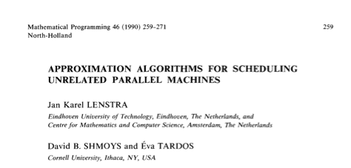
Conclusions
Running time. The bottleneck operation in our 2-approximation is solving one LP with m n + 1 variables.
Remark. Can solve LP using flow techniques on a graph with m + n + 1 nodes: given L, find feasible flow if it exists. Binary search to find L*.
Extensions: unrelated parallel machines. [Lenstra-Shmoys-Tardos 1990]
Job j takes t_{ij} time if processed on machine i.
2-approximation algorithm via LP rounding.
If P ≠ NP, then no no ρ-approximation exists for any ρ < 3/2.

Slide 52
11. Approximation Algorithms
load balancing
center selection
pricing method: vertex cover
LP rounding: vertex cover
generalized load balancing
knapsack problem

Slide 53
Polynomial-time approximation scheme
PTAS. (1 + ε)-approximation algorithm for any constant ε > 0.
Load balancing. [Hochbaum-Shmoys 1987]
Euclidean TSP. [Arora, Mitchell 1996]
Consequence. PTAS produces arbitrarily high quality solution, but trades off accuracy for time.
This section. PTAS for knapsack problem via rounding and scaling.

Slide 54
Knapsack problem
Knapsack problem.
Given n objects and a knapsack.
Item i has value v_{i} > 0 and weighs w_{i} > 0.
Knapsack has weight limit W.
Goal: fill knapsack so as to maximize total value.
Ex: { 3, 4 } has value 40.
we assume wi ≤ W for each i
item | value | weight
1 | 1 | 1
2 | 6 | 2
3 | 18 | 5
4 | 22 | 6
5 | 28 | 7
original instance (W = 11)

Slide 55


Knapsack is NP-complete
Knapsack. Given a set X, weights wi ≥ 0, values vi ≥ 0, a weight limit W, and a target value V, is there a subset S ⊆ X such that:
Subset-Sum. Given a set X, values ui ≥ 0, and an integer U, is there a subset S ⊆ X whose elements sum to exactly U ?
Theorem. Subset-Sum ≤ P Knapsack.
Pf. Given instance (u1, …, un, U) of Subset-Sum, create Knapsack instance:

Slide 56

Knapsack problem: dynamic programming I
Def. OPT(i, w) = max value subset of items 1,..., i with weight limit w.
Case 1. OPT does not select item i.
OPT selects best of 1, …, i – 1 using up to weight limit w.
Case 2. OPT selects item i.
New weight limit = w – w_{i}.
OPT selects best of 1, …, i – 1 using up to weight limit w – w_{i}.
Theorem. Computes the optimal value in O(n W) time.
Not polynomial in input size.
Polynomial in input size if weights are small integers.

Slide 57
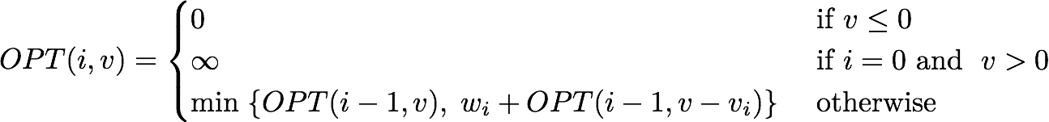
Knapsack problem: dynamic programming II
Def. OPT(i, v) = min weight of a knapsack for which we can obtain a solution of value ≥ v using a subset of items 1,..., i.
Note. Optimal value is the largest value v such that OPT(i, v) ≤ W.
Case 1. OPT does not select item i.
OPT selects best of 1, …, i – 1 that achieves value v.
Case 2. OPT selects item i.
Consumes weight w_{i}, need to achieve value v – v_{i}.
OPT selects best of 1, …, i – 1 that achieves value v – v_{i}.
Notes:
OPT(i, v) = \begin{cases}
0 &\mbox{ if } v \le 0 \\
\infty &\mbox{ if } i = 0 \mbox{ and } \; v > 0 \\
\min \; \{OPT(i-1, v), \; w_i + OPT(i-1, v - v_i) \} & \mbox{ otherwise }
\end{cases}

Slide 58
Knapsack problem: dynamic programming II
Theorem. Dynamic programming algorithm II computes the optimal value in O(n² vmax) time, where vmax is the maximum of any value.
Pf.
The optimal value V* ≤ n vmax.
There is one subproblem for each item and for each value v ≤ V*.
It takes O(1) time per subproblem. ▪
Remark 1. Not polynomial in input size!
Remark 2. Polynomial time if values are small integers.
Notes:
polynomial if values are small

Slide 59
Knapsack problem: polynomial-time approximation scheme
Intuition for approximation algorithm.
Round all values up to lie in smaller range.
Run dynamic programming algorithm II on rounded/scaled instance.
Return optimal items in rounded instance.
item | value | weight
1 | 934221 | 1
2 | 5956342 | 2
3 | 17810013 | 5
4 | 21217800 | 6
5 | 27343199 | 7
item | value | weight
1 | 1 | 1
2 | 6 | 2
3 | 18 | 5
4 | 22 | 6
5 | 28 | 7
original instance (W = 11)
rounded instance (W = 11)

Slide 60

Knapsack problem: polynomial-time approximation scheme
Round up all values:
0 < ε ≤ 1 = precision parameter.
v_{max} = largest value in original instance.
θ = scaling factor = ε v_{max} / 2n.
Observation. Optimal solutions to problem with are equivalent to optimal solutions to problem with .
Intuition. close to v so optimal solution using is nearly optimal; small and integral so dynamic programming algorithm II is fast.

Slide 61

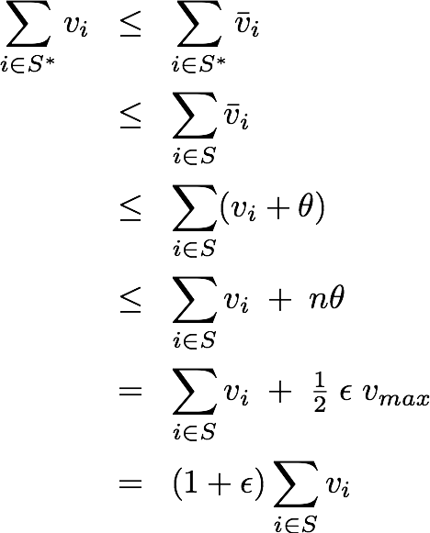
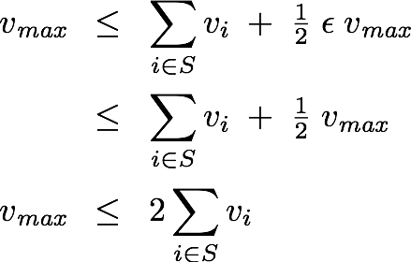
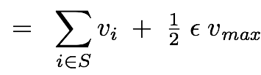
Knapsack problem: polynomial-time approximation scheme
Theorem. If S is solution found by rounding algorithm and S* is any other feasible solution, then
Pf. Let S* be any feasible solution satisfying weight constraint.
always round up
solve rounded
instance optimally
choosing S* = { max }
never round up
by more than θ
| S | ≤ n
thus
θ = ε v_{max} / 2n
v_{max} ≤ 2 Σ_{i ∈ S} v_{i}
Notes:
WLOG assume no individual item has weight w_n that exceeds weight limit W all by itself
(1 + \epsilon) \sum_{i \in S} v_i \;\; \ge \;\; \sum_{i \in S^*} v_i
\sum_{i \in S^*} v_i \;\;& \le \;\; \sum_{i \in S^*} \bar v_i \\
\;\;& \le \;\; \sum_{i \in S} \bar v_i \\
\;\;& \le \;\; \sum_{i \in S} (v_i + \theta) \\
\;\;& \le \;\; \sum_{i \in S} v_i \; + \; n \theta \\
\;\;& = \;\; \sum_{i \in S} v_i \; + \; \tfrac{1}{2} \; \epsilon \; v_{\text{\em max}} \\
\;\;& = \;\; (1 + \epsilon) \sum_{i \in S} v_i \\
v_{\text{\em max}} \;\;& \le \;\; \sum_{i \in S} v_i \; + \; \tfrac{1}{2} \; \epsilon \; v_{\text{\em max}} \\
\;\;& \le \;\; \sum_{i \in S} v_i \; + \; \tfrac{1}{2} \; v_{\text{\em max}} \\

Slide 62

Knapsack problem: polynomial-time approximation scheme
Theorem. For any ε > 0, the rounding algorithm computes a feasible solution whose value is within a (1 + ε) factor of the optimum in O(n³ / ε) time.
Pf.
We have already proved the accuracy bound.
Dynamic program II running time is , where

