Slide 1
Notes:
<number>

Slide 2
Notes:
<number>

Slide 3
Notes:
<number>

Slide 4
Notes:
<number>

Slide 5
Notes:
<number>

Slide 6
Notes:
<number>

Slide 7
Notes:
<number>

Slide 8
Notes:
<number>

Slide 9
Notes:
<number>

Slide 10
Notes:
<number>

Slide 11
Notes:
<number>

Slide 12
Notes:
<number>

Slide 13
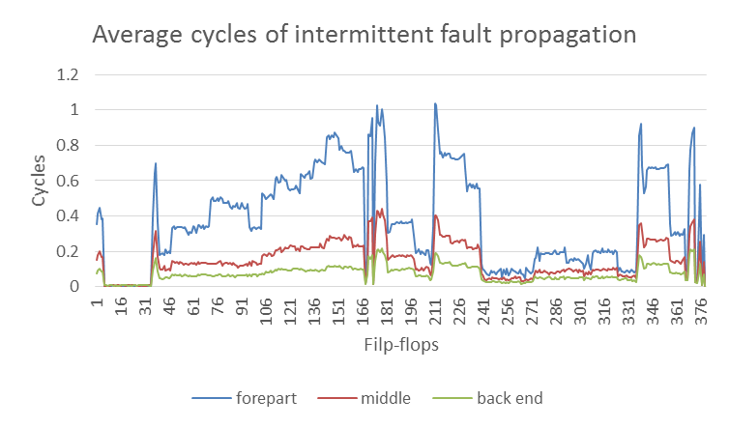

Slide 14
Notes:
Precision on SVM, RNN, LSTM
<number>

Slide 15
Notes:
Precision on SVM, RNN, LSTM
<number>

Slide 16
Notes:
Precision on SVM, RNN, GBDT, LSTM
<number>

Slide 17
Notes:
Recall on SVM, RNN, GBDT, LSTM
<number>

Slide 18
Benchmark | b3 | b9 | b8 | b10 | b13 | b7 | b11 | b4 | b5 | b12 | b15 | B14
# gates | 144 | 146 | 157 | 174 | 310 | 380 | 622 | 632 | 821 | 963 | 7922 | 8567
# FF | 30 | 28 | 21 | 17 | 53 | 49 | 31 | 66 | 34 | 121 | 449 | 245
# hidden states | 10 | 20 | 32 | 20 | 32 | 32 | 32 | 32 | 32 | 10 | 360 | 256
T per step
Notes:
<number>

Slide 19
Notes:
Precision on SVM, RNN, LSTM
<number>

Slide 20
Notes:
Precision on SVM, RNN, LSTM
<number>

Slide 21
Notes:
Precision on SVM, GBDT, RNN, LSTM
<number>

Slide 22
Notes:
Recall on SVM, GBDT, RNN, LSTM
<number>

Slide 23
Notes:
<number>
B12_precision

Slide 24
Notes:
<number>
B12_recall

Slide 25
Notes:
<number>
B15_precision

Slide 26
Notes:
<number>
B15_recall

Slide 27
Notes:
<number>
FF selection

Slide 28
Notes:
Recall on SVM, GBDT, RNN, LSTM
<number>

Slide 29
Intermittent faults at forepart in b13 benchmark (310 logic gates, 53 flip-flops)
About 2000 negative samples in testing dataset.
n/p sample ratio | SVM |  | RNN |  | GBDT |  | LSTM
 | Precision | Recall | Precision | Recall | Precision | Recall | Precision | Recall
1:1 | 100.00% 1868/1868 | 93.92% 1868/1989 | 100.00% 1989/1989 | 100.00% 1989/1989 | 100.00% 1614/1614 | 81.85% 1614/1989 | 100.00% 1964/1964 | 100.00% 1989/1989
5:1 | 100.00% 371/371 | 94.16% 371/394 | 100.00% 393/393 | 99.75% 393/394 | 100.00% 331/331 | 84.01% 331/394 | 100.00% 394/394 | 100.00% 394/394
50:1 | 100.00% 33/33 | 64.71% 33/51 | 100.00% 50/50 | 98.04% 50/51 | 100.00% 33/33 | 64.71% 33/51 | 100.00% 50/50 | 98.04% 50/51
500:1
TODO
Notes:
<number>

Slide 30
Intermittent faults at forepart in b5 benchmark (821 logic gates, 34 flip-flops)
About 2000 negative samples in testing dataset.
n/p sample ratio | SVM |  | RNN |  | GBDT |  | LSTM
 | Precision | Recall | Precision | Recall | Precision | Recall | Precision | Recall
1:1 | 96.85% 1320/1363 | 65.54% 1320/2014 | 95.92% 1739/1813 | 86.35% 1739/2014 | 99.93% 1441/1442 | 71.55% 1441/2014 | 99.84% 1912/1915 | 94.94% 1912/2014
5:1 | 87.62% 269/307 | 64.66% 269/416 | 97.75% 261/267 | 62.74% 261/416 | 99.64% 276/277 | 66.35% 276/416 | 100.00% 345/345 | 82.93% 345/416
50:1 | 100.00% 8/8 | 20.00% 8/40 | 100.00% 22/22 | 55.00% 22/40 | 100.00% 18/18 | 45.00% 18/40 | 100.00% 25/25 | 62.50% 25/40
500:1
TODO
Notes:
<number>

Slide 31
Permanent faults in b12 benchmark (963 logic gates, 121 flip-flops)
About 4000 negative samples in testing dataset.
n/p sample ratio | SVM |  | RNN |  | GBDT |  | LSTM
 | Precision | Recall | Precision | Recall | Precision | Recall | Precision | Recall
1:1 | 99.75% 3151/3159 | 79.47% 3151/3965 | 99.57% 3498/3513 | 88.22% 3498/3965 | 99.87% 3031/3035 | 76.44% 3031/3965 | 99.95% 3922/3924 | 98.92% 3922/3965
5:1 | 98.82% 668/676 | 80.87% 668/826 | 98.81% 746/755 | 90.31% 746/826 | 99.68% 632/634 | 76.51% 632/826 | 99.75% 810/812 | 98.06% 810/826
50:1 | 100.00% 48/48 | 51.61% 48/93 | 100.00% 85/85 | 91.40% 85/93 | 100.00% 74/74 | 79.57% 74/93 | 100.00% 86/86 | 92.47% 86/93
500:1 | 100.00% 9/0 | 53.33% 8/15 | 100.00% 13/13 | 86.67% 13/15 | 100.00% 13/13 | 80.00% 12/15 | 100.00% 13/13 | 93.33% 14/15
TODO
Notes:
<number>

Slide 32
Notes:
<number>
B13 precision

Slide 33
Notes:
<number>
B13 recall

Slide 34
Notes:
<number>
B5 precision

Slide 35
Notes:
<number>
B5 recall

Slide 36
Notes:
<number>
B12 precision

Slide 37
Notes:
<number>
B12 recall

