Slide 1
WEB APPLICATION • CAMPUS TRANSPORTATION
BUS
MANAGEMENT
SYSTEM
A Smart Digital Platform for Campus Transportation Management
Digitizing campus transportation through centralized management and role-based access.

Slide 2
01 / PROBLEM SPACE
Traditional bus management
breaks at every handoff.
Scattered channels, manual records and physical passes create friction for every role.
Manual
records
Scattered
information
Route
complexity
Driver
coordination
Student
access gaps
Physical
passes
“The solution is to bring transportation management, route information and user access into one centralized digital platform.”
BUS MANAGEMENT SYSTEM / 02
02

Slide 3
02 / ROLE-BASED DESIGN
One platform. Three focused experiences.
Centralized data; interfaces tailored to responsibility.
BUS MANAGEMENT SYSTEM
ADMIN
DRIVER
STUDENT
Management • routes • pickup points • driver data
Assigned route • bus info • duty access
Bus • route • pickup • digital pass
CENTRAL CONTROL • FASTER ACCESS • DIGITAL PASS • ORGANIZED DATA
BUS MANAGEMENT SYSTEM / 03
03

Slide 4
03 / ENGINEERING
System architecture & technology
KEY ENGINEERING CONCEPTS
USER INTERFACE
ADMIN DASHBOARD DRIVER DASHBOARD STUDENT DASHBOARD AUTHENTICATION
Role-based access control
CRUD data management
Authentication & security
Centralized data
Responsive web interface
Modular dashboards
APPLICATION LOGIC
ROLE WORKFLOWS BUS / ROUTE / PICKUP MANAGEMENT USER-SPECIFIC VIEWS
DATA LAYER
USER DATA BUS DATA ROUTE DATA PICKUP DATA
WEB APPLICATION
DEPLOYMENT
BUS MANAGEMENT SYSTEM / 04
04

Slide 5
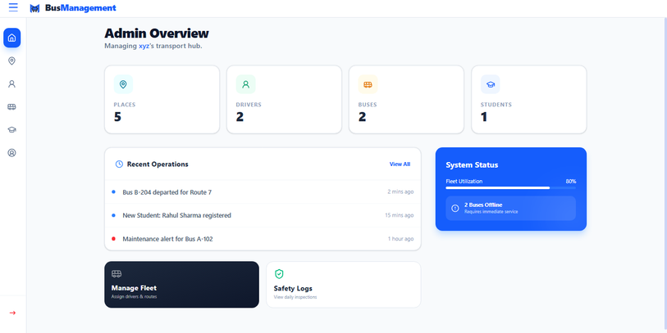
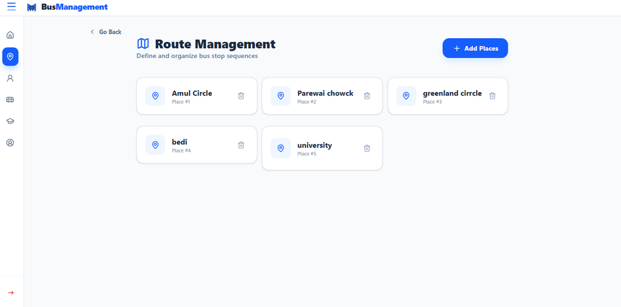
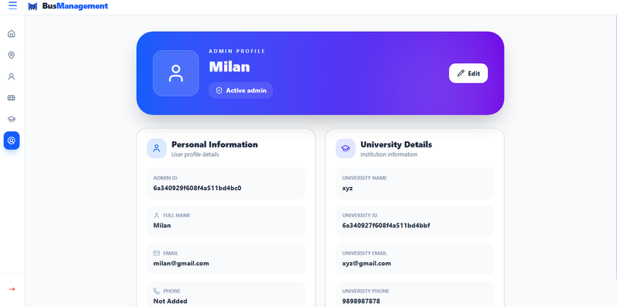
04 / ADMIN MODULE
Centralized transportation control
ADMIN LOGIN
DASHBOARD
BUS
ROUTES
PICKUP
DRIVERS
PROFILE
OVERVIEW
Summary cards, operations and system status
ROUTES
Pickup places and add-place actions
PROFILE
Personal and university details
BUS MANAGEMENT SYSTEM / 05
05

Slide 6
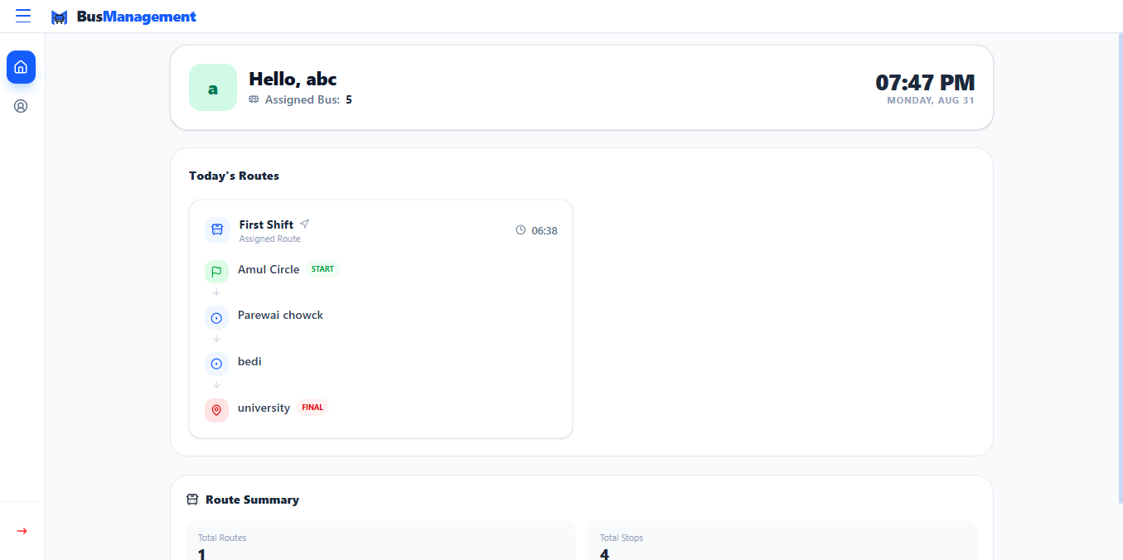
05 / DRIVER MODULE
Focused route experience
DRIVER
LOGIN
DASHBOARD
ASSIGNED
BUS / ROUTE
ROUTE
INFO
TRANSPORT
DUTY
“Right information for the right role.”
Dedicated dashboard • assigned bus and route visibility • no unnecessary administrative controls
BUS MANAGEMENT SYSTEM / 06
06

Slide 7
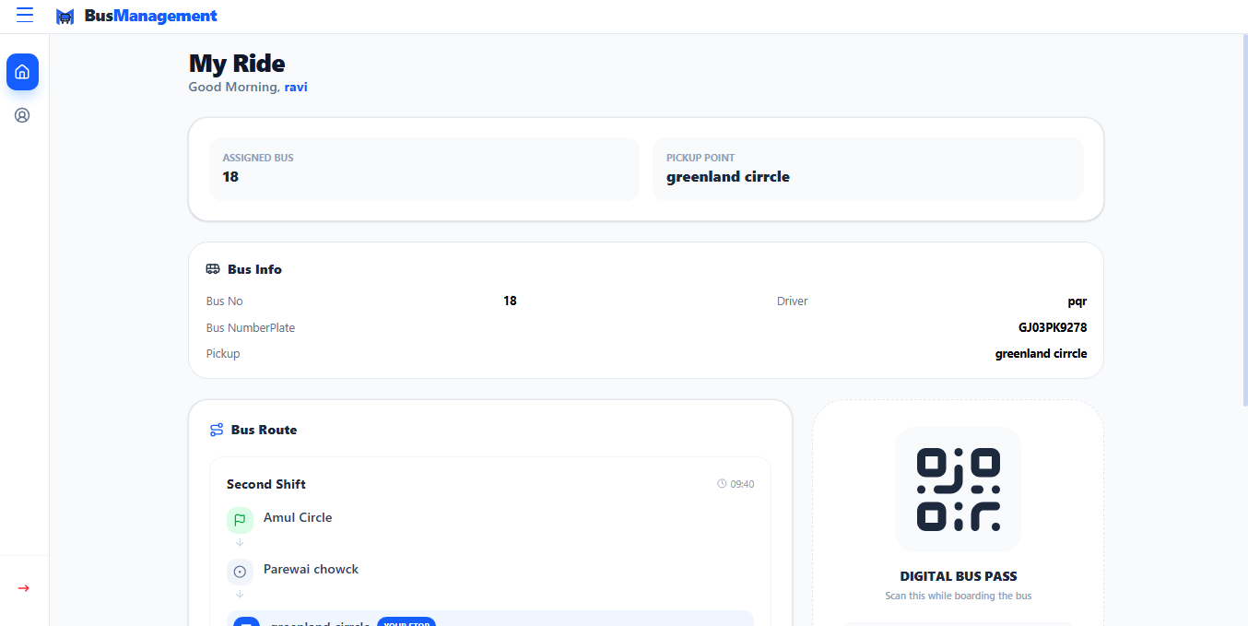
06 / STUDENT EXPERIENCE
Bus information at a glance
LOGIN
DASHBOARD
BUS DETAILS
ROUTE
PICKUP
DIGITAL PASS
Replacing scattered transportation information with a simple digital student experience.
DIGITAL BUS PASS
QR-enabled transportation identity for easy boarding access.
BUS MANAGEMENT SYSTEM / 07
07

Slide 8
07 / END-TO-END FLOW
How the system works
ADMIN
SYSTEM DATA
DRIVER
STUDENT
DIGITAL PASS
Adds / updates transportation info
Bus + route + pickup + driver
Views assigned information
Views bus + route + pickup
Transportation identity
ROLE-BASED ACCESS
Dedicated interface per responsibility
CENTRALIZED INFORMATION
Organized data within one system
BETTER ACCESSIBILITY
No manual communication dependency
BUS MANAGEMENT SYSTEM / 08
08

Slide 9
08 / VALUE
Key features & benefits
From transportation records to a connected digital experience.
Role-based
dashboards
Admin transport
management
Route + pickup
management
Driver route
information
Student bus
information
Digital bus
pass
Centralized
data
User-specific
interfaces
LESS MANUAL SHARING • EASIER MANAGEMENT • IMPROVED ACCESS • ORGANIZED WORKFLOW
BUS MANAGEMENT SYSTEM / 09
09

Slide 10
09 / FUTURE WORK
Future scope & project resources
NEXT CAPABILITIES
Push notifications
Route optimization
Occupancy monitoring
Automated alerts
Usage analytics
QR pass verification
College-system integration
CURRENT
SYSTEM
SMART
NOTIFICATIONS
ANALYTICS
MOBILE
ECOSYSTEM
SOURCE CODE / GITHUB
https://github.com/Jarvish1xyz/Bus-Management
LIVE PROJECT
https://busofcampus.vercel.app/
BUS MANAGEMENT SYSTEM / 10
10

Slide 11
BUS MANAGEMENT SYSTEM
Thank You
A centralized approach to smarter campus transportation.

