Slide 1
Version Control
Ben Wasserman (benjamin@cmu.edu)
15-441 Computer Networks
Recitation 3

Slide 2
What is version control?
Revisit previous code versions
Backup projects
Work with others
Find where things broke

Slide 3
Version Control Workflow
Check for any remote updates
Do your work
Test your work
Check differences, try to isolate changes
Check for any remote updates
Commit your work

Slide 4





Options
Git
Subversion (svn)
Mercurial (hg)
Bazaar (bzr)
CVS
Dropbox
Others…

Slide 5
svn
svn Repository
Usually remotely hosted,
shared with a team.
svn checkout
svn update
svn commit
svn commit
Working Copy
Your private universe,
before commit.

Slide 6
git
git push
git push
kernel@ghub
torvalds
jaharkes
No notion of “working copy”–each
is a full repository.
git pull
git pull
git push
git pull
bgilbert
abalacha
git pull
wolf
git pull

Slide 7
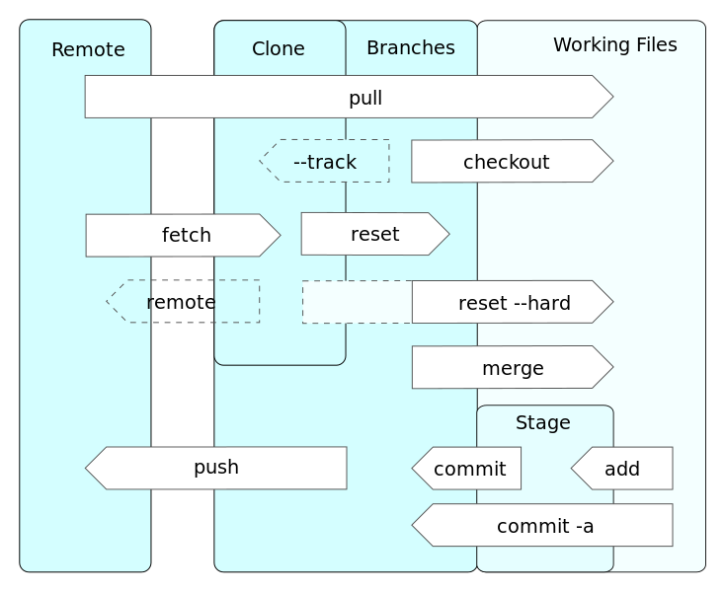

Slide 8
Creating a Repository (repo)
Create locally
git init .
Create remote
git init –-bare
Clone local copy
git clone git://path/to/repo

Slide 9
--bare or not?
No-bare
Creates a repository in your working directory
Don’t need to create multiple copies of your repo
Won’t help if you nuke the directory/disk
This is probably what you need if you’ll work in AFS
--bare
Creates a “server copy” for hosting the project
Workflow more similar to svn (but still better)
Everyone pushes to shared bare repo (like svn)
You don’t work in this copy; must clone elsewhere
You want this to develop on your PC

Slide 10
Aside: network protocols
Use different protocols to pull/push to repositories.
If on the same computer:
git://path/to/repo
If hosted on AFS
ssh+git://path/to/repo
No ssh keys for AFS, sorry

Slide 11
Aside: Configure git
git config --global user.name “Ben Wasserman”
git config --global user.email “benjamin@cmu.edu”

Slide 12
Clone
Pull a copy of the repo to develop on
git clone git://path/to/repo
git clone ssh+git://unix.andrew.cmu.edu/afs/andrew/course/15/441-641/ANDREWID/ANDREWID-15-441-project-1.git

Slide 13
status
Which files changed?
Which files aren’t being watched?
Which files are stashed for commit?
git status

Slide 14
Pull
Get latest updates from remote copy
git pull
If this fails, you probably need to commit any unsaved changes

Slide 15
Commit
Merge your changes into the repository
git add foo.c …
git commit
Only if all changed files are relevant to the commit
git commit –a

Slide 16
Push
Don’t push broken code!!
git push
If this fails, you probably need to pull first

Slide 17
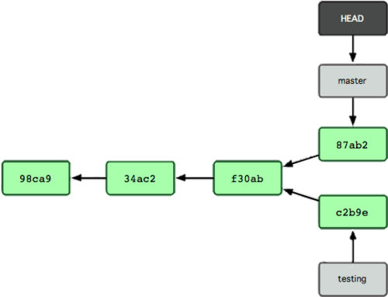
Branch & Merge
Work on something different, without disturbing master/trunk
git branch branch_name
git checkout branch_name
do stuff…
git checkout master
git merge branch_name

Slide 18
Tag
Mark a revision as “final” or “ready”
git tag tag_name
git push --tags

Slide 19

Remote Hosting
github.com
bitbucket.org
svnhub.com
AFS
Google code
Sourceforge

Slide 20
Aside: AFS Permissions
To make a bare repo in AFS that someone else can pull/push from:
Make a new directory in your home dir
fs sa ANDREWID rlidwk
git init --bare

Slide 21
Good practices
Small commits
Useful messages
Commit frequently
Develop in branches
Tag releasable versions

Slide 22
Small commits
Only change one thing per commit
When something breaks, easier to trace

Slide 23
Helpful commit messages
Say what you changed
Keep the first line short
Make commits easy to find
www.commitlogsfromlastnight.com

Slide 24
Commit Frequently
Make changes, commit them
When something breaks, go to the commit that broke it
Only push when ready for others to get the changes
Don’t make your teammates hate you

Slide 25
Git questions?

Slide 26
Checkpoint 2
Add basic HTTP server
Read RFC 2616
Start by parsing and building HTTP headers
Serve error messages
Then HEAD requests
Then GET
Then POST

Slide 27
Wireshark
Packet monitoring software
Install it. Use it.
You will want this to examine the HTTP headers you’re sending/receiving
Do the Wireshark question on HW1

Slide 28
All questions?

