Slide 1
Angels (Open SSL)
and D(a)emons
15-441: Computer Networks
Matt Mukerjee
David Naylor
Ben Wasserman

Slide 2


Extras
ssl_example.c
ssl_client.py
daemonize.c
(on course website)

Slide 3
PJ1 Final Submission
SSL
CGI
Daemonize

Slide 4
SSL

Slide 5
Getting a...
Domain Name

Slide 6
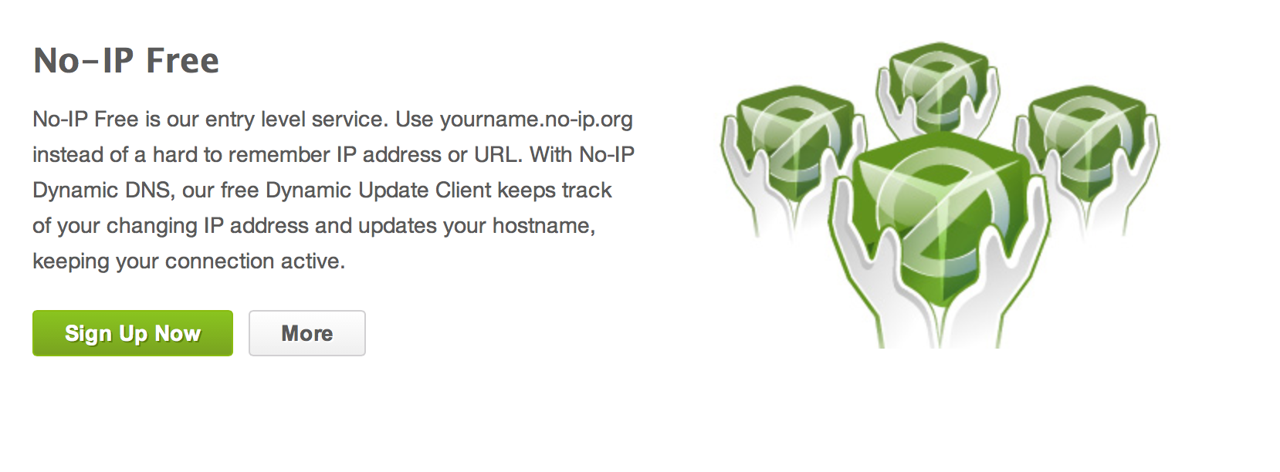
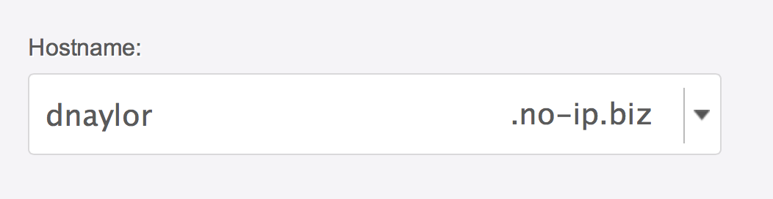
Create a Domain Name
Get a free domain name from No-IP
Use your Andrew ID as the hostname

Slide 7
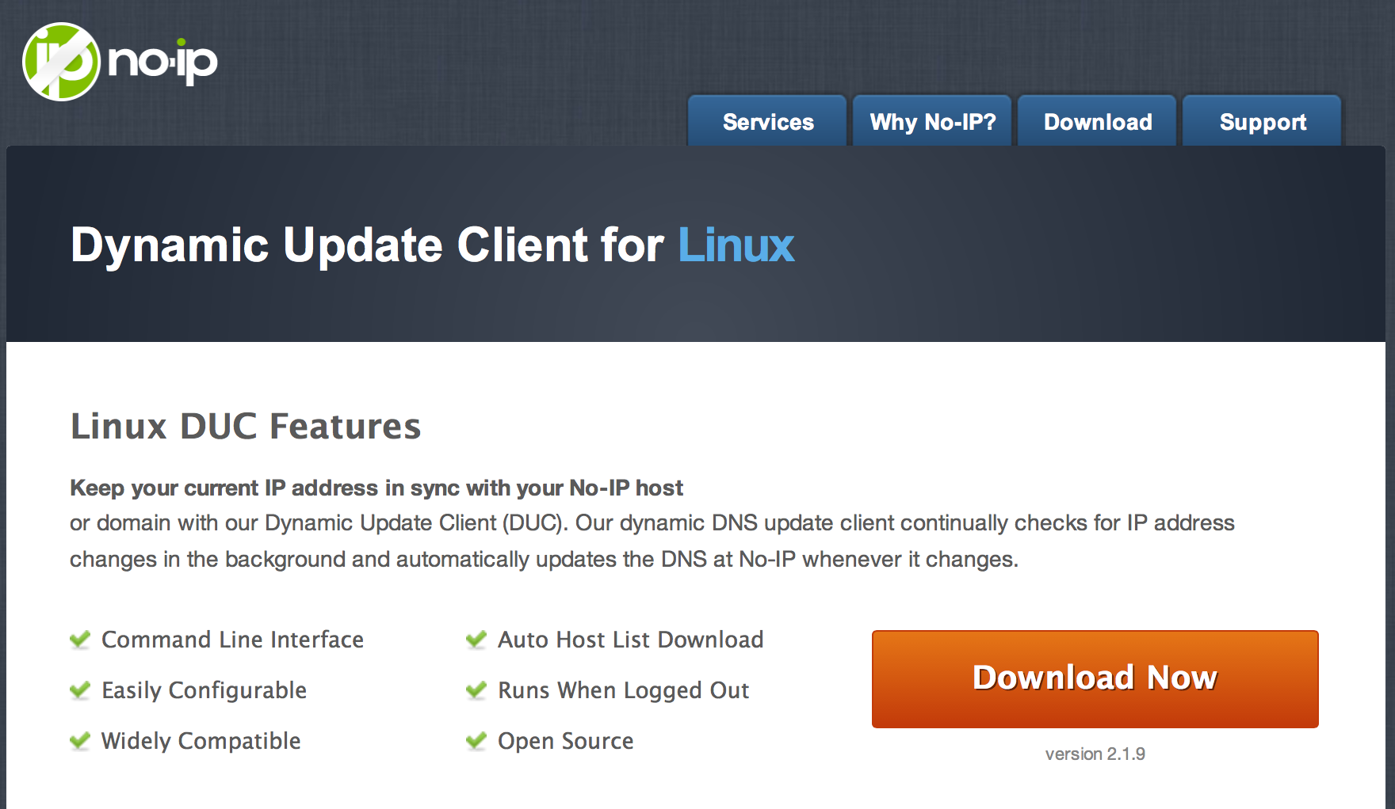
Get the Update Client
You don't have root, so...
  Just build (make), don't install (make install)
  Run manually when your IP changes

Slide 8
Create No-IP Conf File
./noip2 -C -c noip.conf
[dnaylor@unix3 ~/noip-2.1.9-1]$ ./noip2 -C -c noip.conf
Auto configuration for Linux client of no-ip.com.
Please enter the login/email string for no-ip.com <username>
Please enter the password for user '<username>' ****************
Only one host [dnaylor.no-ip.biz] is registered to this account.
It will be used.
Please enter an update interval:[30]
Do you wish to run something at successful update?[N] (y/N)
New configuration file 'noip.conf' created.

Slide 9
Update Your IP Address
./noip2 -c noip.conf -i 108.17.82.243
[dnaylor@unix3 ~/noip-2.1.9-1]$ ./noip2 -c noip.conf -i 108.17.82.243
IP address detected on command line.
Running in single use mode.

Slide 10
Getting a...
Certificate

Slide 11
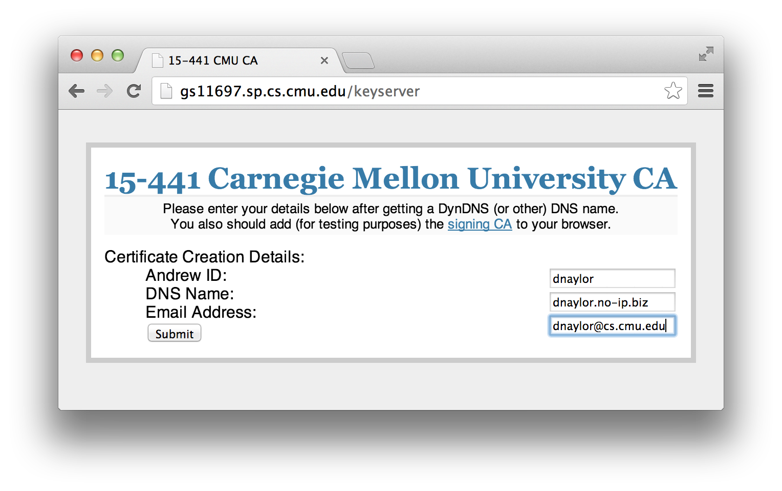
15-441 Certificate Authority
http://gs11697.sp.cs.cmu.edu/keyserver

Slide 12
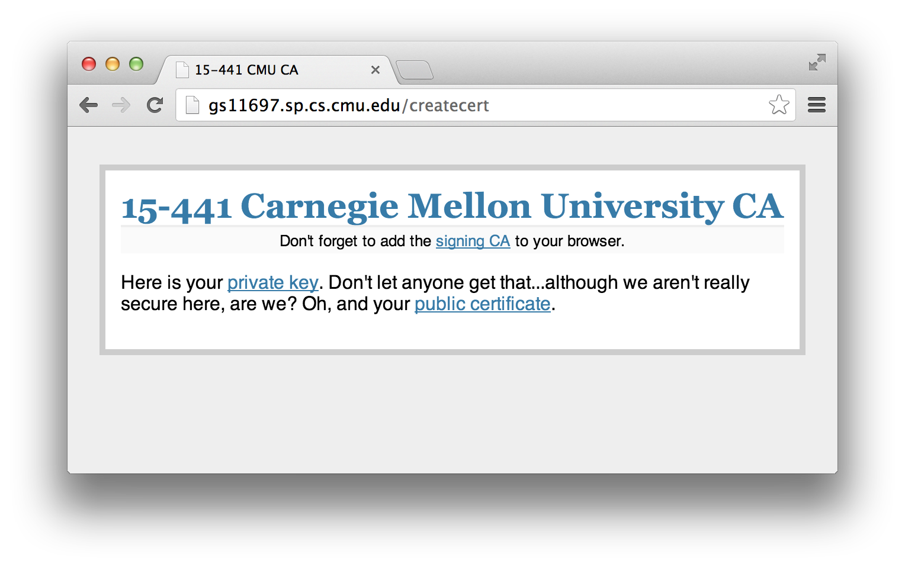
You Need 3 Things
1) CA certificate
2) Your private key
3) Your certificate

Slide 13
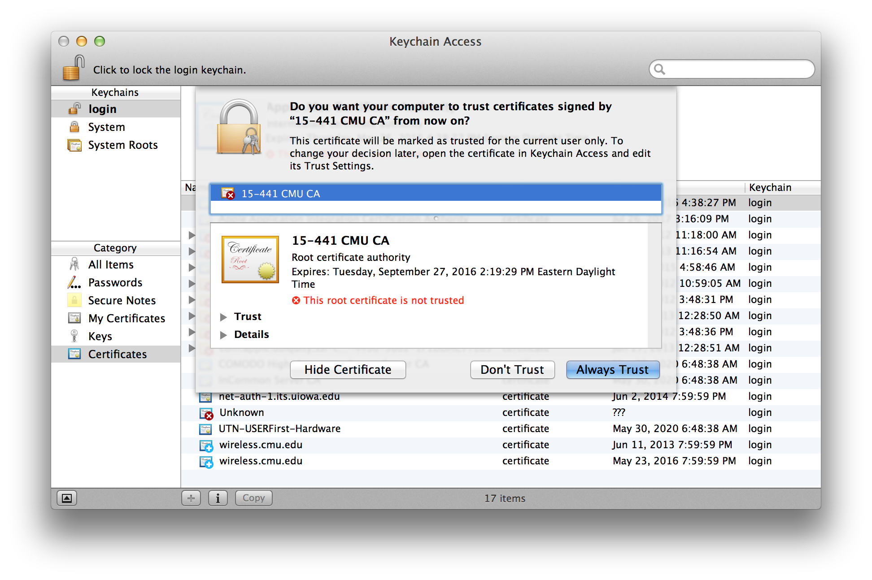
Add CA Cert to Your System/Browser
e.g., add to OSX Keychain

Slide 14
Implementing an...
SSL Server

Slide 15


What is SSL?
Standard behind secure communication on the Internet.
Provides confidentiality & integrity
Sits between transport & application
SSL
SSL
Transport
Transport

Slide 16
OpenSSL Toolkit
Command line tools, SSL library, and crypto library
Can do a lot more than SSL
  Message digests
  Encryption and decryption of files
  Digital certificates
  Digital signatures
  Random number generation

Slide 17
SSL Server In a Nutshell
Use the OpenSSL library, here is a link to their documentation.
Create a second server socket in addition to the first one, use the passed in SSL port from the command line arguments.
Add this socket to the select() loop just like your normal HTTP server socket.
Whenever you accept connections, wrap them with the SSL wrapping functions.
Use the special read() and write() SSL functions to read and write to these special connected clients
In the select() loop, you need to know if a socket you are dealing with is SSL wrapped or not
Use appropriate IO depending on the 'type' of socket---although use select() for all fd's
Use your private key and certificate file that you obtained earlier.

Slide 18
Open SSL headers
/* OpenSSL headers */
#include <openssl/bio.h>
#include <openssl/ssl.h>
#include <openssl/err.h>

Slide 19
Initialization Steps
Global System Initialize
  SSL_library_init()
  SSL_load_error_strings()
Initialize SSL_METHOD and SSL_CTX
  meth=SSLv23_method();
  ctx=SSL_CTX_new(meth);
Loading keys
  SSL_CTX_use_certificate_file(...)
  SSL_CTX_use_PrivateKey_file(...)

Slide 20
Global Initialization
SSL_library_init()
  registers the available SSL/TLS ciphers and digests.
SSL_load_error_strings()
  Provide readable error messages.

Slide 21
SSL_METHOD
To describe protocol versions
SSLv1, SSLv2 and TLSv1
  SSL_METHOD* meth = TLSv1_method();

Slide 22
SSL_CTX
Data structure to store keying material
Reused for all connections; make ONE for your server
  SSL_CTX* ctx = SSL_CTX_new(meth);

Slide 23
SSL_CTX_use_certificate_file()
Loads the first certificate stored in file into ctx.
The formatting type of the certificate must be specified from the known types
  SSL_FILETYPE_PEM
  SSL_FILETYPE_ASN1.
  Our CA generates files of PEM format
int SSL_CTX_use_certificate_file(SSL_CTX *ctx, const char *file, int type);

Slide 24
  SSL_CTX_use_PrivateKey_file()
Adds the first private key found in file to ctx.
The formatting type of the certificate must be specified from the known types:
  SSL_FILETYPE_PEM
  SSL_FILETYPE_ASN1.
  Our CA generates files of PEM format
int SSL_CTX_use_PrivateKey_file(SSL_CTX *ctx, const char *file, int type);

Slide 25
Wrapping Connections
Create new SSL structure using SSL_new()
Connect it to the socket using SSL_set_fd()
Perform handshake using SSL_accept()
Read and write using SSL_read() and SSL_write()
Perform shutdown at the end, also need to clear state and close underlying I/O socket etc.
As always, check for return value and handle errors appropriately!

Slide 26
SSL_new()
Creates a new SSL structure
Create one per connection
Inherits the settings of the underlying context.
  SSL* ssl = SSL_new(ctx);

Slide 27
SSL_set_fd()
Tell the SSL object which socket it will wrap
  int SSL_set_fd(SSL *ssl, int fd);

Slide 28
SSL_accept
SSL_accept - wait for a TLS/SSL client to initiate a TLS/SSL handshake
  int SSL_accept(SSL *ssl)
(Do this after a standard accept().)

Slide 29
SSL_read and SSL_write
SSL_read to read bytes from a TLS/SSL connection
int SSL_read(SSL *ssl, void *buf, int num);
SSL_write to write bytes to a TLS/SSL connection
int SSL_write(SSL *ssl, const void *buf, int num);
NOTE:
  The data are received in records (with a maximum record size of 16kB for SSLv3/TLSv1).
  Only when a record has been completely received, it can be processed (decryption and integrity check)

Slide 30
SSL_shutdown
Shuts down an active TLS/SSL connection.
int SSL_shutdown(SSL *ssl);
(Then do a standard close().)

Slide 31
BIO - Optional
I/O abstraction provided by OpenSSL
Hides the underlying I/O and can set up connection with any I/O (socket, buffer, ssl etc)
BIOs can be stacked on top of each other using push and pop!
NOTE: You don't have to necessarily use BIO for this project! The next few slides describe creating BIO and working with it.

Slide 32
BIO_new()
Returns a new BIO using method type.
Check BIO_s_socket(), BIO_f_buffer(), BIO_f_ssl()
Check BIO_new_socket()
BIO * BIO_new(BIO_s_socket());
  BIO_set_fd(sbio, sock, BIO_NOCLOSE);

Slide 33
SSL_set_bio()
Connects the BIOs rbio and wbio for the read and write operations of the TLS/SSL (encrypted) side of ssl
  void SSL_set_bio(SSL *ssl, BIO *rbio, BIO *wbio)

Slide 34
Example of Stacking BIOs
buf_io = BIO_new(BIO_f_buffer());
/* create a buffer BIO */
ssl_bio = BIO_new(BIO_f_ssl());
/* create an ssl BIO */
BIO_set_ssl(ssl_bio, ssl, BIO_CLOSE);
/* assign the ssl BIO to SSL */
BIO_push(buf_io, ssl_bio);

Slide 35
BIO_read() and BIO_write()
Attempts to read len bytes from BIO b and places the data in buf.
int BIO_read(BIO *b, void *buf, int len);
Attempts to write len bytes from buf to BIO b.
int BIO_write(BIO *b, const void *buf, int len);

Slide 36
SSL
Questions?

Slide 37
Daemonizing

Slide 38
Orphaning
Fork the process to create a copy (child)
Let parent exit!
The child will become child of init process
  Start operating in the background
int pid = fork();
if (pid < 0) exit(EXIT_FAILURE); /* fork error */
if (pid > 0) exit(EXIT_SUCCESS); /* parent exits */
/* child (daemon) continues */

Slide 39
Process Independence
Process inherits parent's controlling tty; need to detach
Server should not receive signals from the process that started it
Operate independently from other processes
setsid() /*obtain a new process group*/

Slide 40
Close File Descriptors
Close all open descriptors inherited
int i;
for (i = getdtablesize(); i >= 0; --i)
close(i);
Connect standard I/O descriptors (stdin 0, stdout 1, stderr 2) to /dev/null
i = open(“/dev/null”,O_RDWR); /* open stdin */
dup(i) /* stdout */
dup(i) /* stderr */

Slide 41
File Creation Mask
Servers run as super-user
Need to protect the files they create
File creation mode is 750 (complement of 027)
  umask(027);

Slide 42
Running Directory
Server should run in a known directory
    chdir(“/servers/”);

Slide 43
Mutual Exclusion
We want only one copy of the server (file locking)
Record pid of the running instance!
  'cat lisod.lock' more efficient than 'ps -ef | grep lisod'
lfp = open(lock_file, O_RDWR|O_CREAT, 0640);
if (lfp < 0)
exit(EXIT_FAILURE); /* cannot open */
if (lockf(lfp, F_TLOCK, 0) < 0)
exit(EXIT_SUCCESS); /* cannot lock */
sprintf(str, "%d\n", getpid());
write(lfp, str, strlen(str)); /*record pid to lockfile */

Slide 44
Logging
You sent stdout and stderr to /dev/null, so you need to log to a file!

Slide 45
Daemonizing
Questions?

