Slide 1
Project 3
Video Streaming
15-441: Computer Networks
Matt Mukerjee
David Naylor
Ben Wasserman

Slide 2
This is a brand new project.
There will be bumps.
Thanks for your patience :)

Slide 3
If all goes well, we'll be packaging up
this project for other Universities!
You're helping future
generations of CS students!

Slide 4
Video CDN: The Real World

Slide 5
Video CDN: Your System

Slide 6
Your Job: 2 Parts
HTTP Proxy
Adaptive bitrate selection
DNS Server
Load balancing

Slide 7


HTTP Proxy
Proxy
Browser requests video chunks
Proxy forwards request to server, returns data to browser
Proxy estimates throughput, selects appropriate bitrate for each chunk
Re-using project 1 code is fine

Slide 8
HTTP Proxy

Slide 9
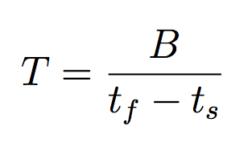
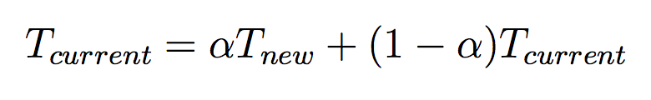
HTTP Proxy
Throughput Estimation
Per chunk
Average:
Exponentially-Weighted Moving Average (EWMA)
size of chunk
time chunk transfer
from server completed
time request received

Slide 10
HTTP Proxy
Bitrate Selection
Modify Request-URI
500 Kbps
/path/to/video/big_buck_bunny_500Seq2-Frag3
1 Mbps
/path/to/video/big_buck_bunny_1000Seq2-Frag3

Slide 11
DNS Server
Load Balancing
Round robin
Geographic proximity
  Real world: IP prefix → location mapping
  This project: Link State Advertisements
!!! This is not realistic, but it's easy and teaches you about LSA !!!

Slide 12
Network Simulator
We provide a network simulator!
More details in PDF

Slide 13
Logistics
Starter Code
  Virtual machine
  Download VirtualBox
Submission
  Goal: Autolab
  Submit a tarball either way

Slide 14
Project 3
Video Streaming
15-441: Computer Networks
Matt Mukerjee
David Naylor
Ben Wasserman

