Slide 1
Testing
in the Trenches
15-441: Computer Networks
Matt Mukerjee
David Naylor
Ben Wasserman

Slide 2


Extras
liso_prototype.py

Slide 3
What are these?
Apache, Cherokee, lighttpd, nginx, Unicorn,Tornado, gws,

Slide 4
What are these?
Web Servers!
Apache, Cherokee, lighttpd, nginx, Unicorn,Tornado, gws, Liso
So, what's used to test these can also test this

Slide 5
Idea 1: Stress Testing Tools
apachebench – concurrency, GETs, HEADs, POSTs, custom header data
Siege – a bit more configurable with URLs file
Others — Read up online, find tests for web servers

Slide 6
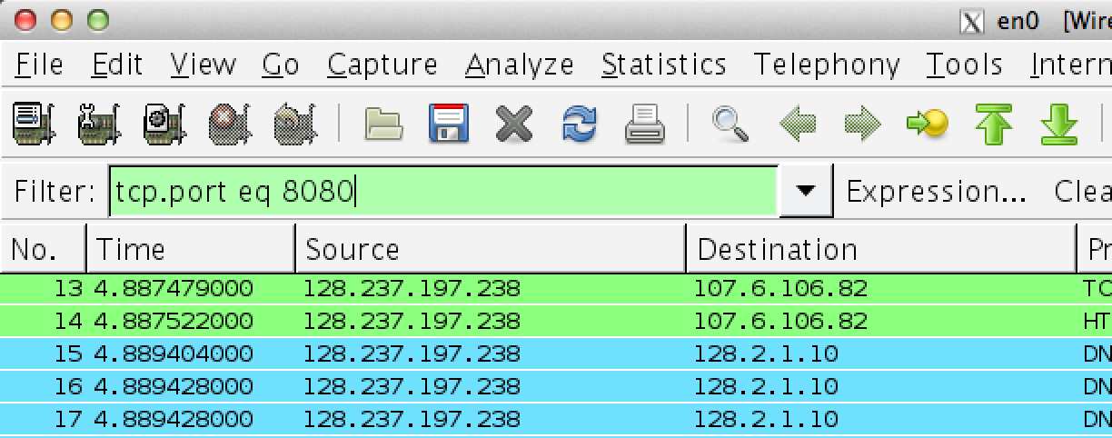
Idea 2: Real World Browsers
Send requests from Chrome/Firefox/etc.
Use Wireshark to help debug errors

Slide 7
Idea 3: (Python) Scripting
Let libraries do it: import urllib2
Rolling your own test suite:
  Craft requests in files
  Send via sockets
  Check returned bytes

Slide 8
Testing: Think Evil, Be Evil
The World
You
Hates you
Is your enemy
Is relentless 24/7
Problem: You must let your
enemies communicate with
you. 15-441 made you.

Slide 9
Testing: Think Evil, Be Evil
The World
You
How can the world get in?
  That thin line in? Ports 80 and 443
  You're welcoming it in with each recv()

Slide 10
Testing: Think Evil, Be Evil
The World
You
What can the world get in?
  The World sends you bytes
What happens when you get:
Good bytes – designed to work normally
Random bytes – !@#$()*&##($*)
Bad bytes – designed to break you

Slide 11
Taint Analysis – Kinda
We aren't formal, we don't care
  Formal verification – would be nice
  Also, can't explore every possibility, but...
We want a back-of-the-envelope approach
  Start with thought experiments
  The World, the thin line in, and You
  Then make these happen in real life
  Leave absolutely nothing to chance
  Make no assumptions

Slide 12
Make No Assumptions
If you expect 4096 sized buffers
  You better be checking 4095
  and 4097
  And 8192+, 200MB+, ...
If you expect METHOD == GET, HEAD or POST
  You better check for DELETE, TRACE
  And IL&*$73j
If you expect the Request URI to be a file
  You better check for non-existent files
  And illegal file paths

Slide 13
“Oh, I know what will happen,
no need to test that case.”
How wonderful, you can compile, link, execute, and simulate clients with the x86 component of your human brain!

Slide 14
No, hell no.

Slide 15
No, hell no.
You better make a minimal test case.
And then run it.

Slide 16
No, hell no.
You better make a minimal test case.
And then run it.
Know what will happen by making it happen.

Slide 17
So...
This leads to robustness
This leads to well-tested network code
This leads to happy 100% in 15-441
Think outside the box
Test like crazy—as much as possible

Slide 18
Testing in the Trenches
15-441: Computer Networks
Matt Mukerjee
David Naylor
Ben Wasserman

