Slide 1
HTTP Parsing
15-441: Computer Networks
Matt Mukerjee
David Naylor
Ben Wasserman

Slide 2
Homework 1
Please write your name and andrew id
Submit hardcopy in class please!
Don’t just show calculations without any explanation.
  Need partial credits?
Please make it legible
  If not, type it up!

Slide 3
PJ 2 CP 2
GET, POST and HEAD requests
Read the documents first to understand the rules.
RFC 2616
Check the annotated RFC

Slide 4
HTTP request
Request =
  Request-Line ;
  *(( general-header ;
  request-header ;
  entity-header ) CRLF) ;
  CRLF [ message-body ] ;

Slide 5
HTTP request
Request =
  GET /path/file.html HTTP/1.1
  Host: www.host1.com:80
  User-Agent: MyBrowser/1.0
  [blank line here]

Slide 6
HTTP request
Request =
  POST /path/script.cgi HTTP/1.1
  Host: www.host1.com:80
  User-Agent: MyBrowser/1.0
  Content-Type: application/x-www-form-urlencoded
  Content-Length: 32
  name=mukerjee&age=25

Slide 7
HTTP response
Response =
  Status-Line ;
  *(( general-header ;
  response-header ;
  entity-header ) CRLF) ;
  CRLF [ message-body ] ;

Slide 8
HTTP response
Response =
  HTTP/1.1 200 OK
  Date: Fri, 20 Sep 2013 23:59:59 GMT
  Content-Type: text/html
  Content-Length: 1354
  <html>
  ...

Slide 9
Tools
Use tools to look at these requests and see the pattern for real
  Wireshark
    http://www.wireshark.org/
  Use the dumper code (dumper.py)
  Play with the headers
    Tamperdata
    Poster
  Online tools
    http://web-sniffer.net/

Slide 10
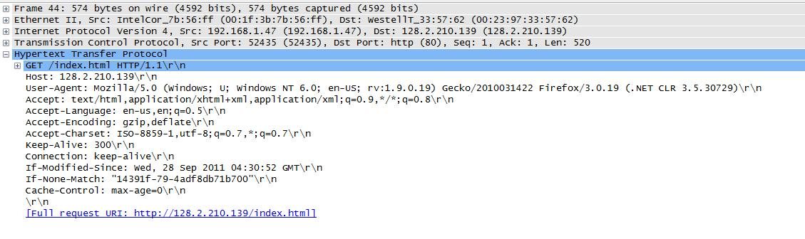
Sample GET request
GET request was done on this page.
Do you see the pattern?
Notes:
Accept - request header (media types that are acceptable)

Slide 11
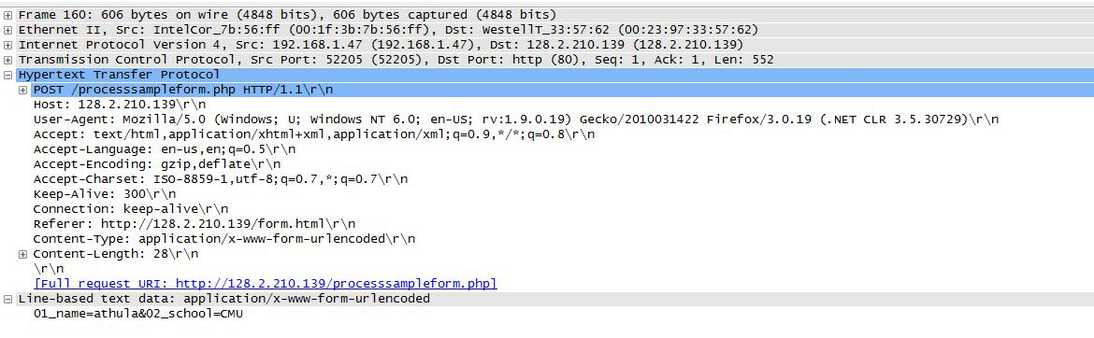
Sample POST request
POST method called while submitting this form.
Can you identify the values that were submitted?

Slide 12
HEAD is similar to GET!
(just without the data)

Slide 13
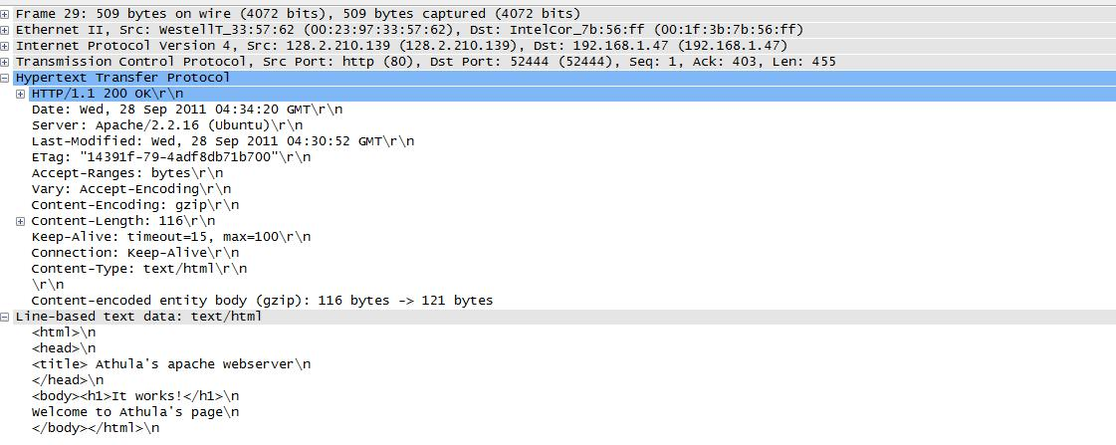
Sample GET response

Slide 14
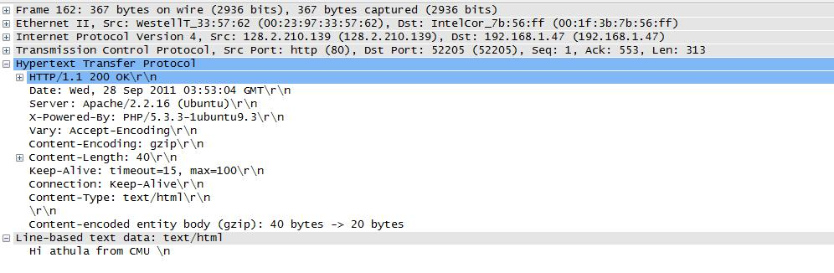
Sample POST response
For this checkpoint you just have to send status code. More on dynamic content later!

Slide 15
Minimal Implementation
Status codes
  200_OK
  404_NOT_FOUND
  411_LENGTH_REQUIRED
  500_INTERNAL_SERVER_ERROR
  501_NOT_IMPLEMENTED
  503_SERVICE_UNAVAILABLE
  505_HTTP_VERSION_NOT_SUPPORTED

Slide 16
Minimal Implementation
General Headers
  Connection
  Date
Response Headers
  Server should always be: Liso/1.0
Entity Headers
  Content-Length
  Content-Type
  Last-Modified

Slide 17
Be careful with the buffers!
Requests may straddle multiple recv calls
  Need to maintain state information.
If request header size > 8192 bytes
  For now, send error message and disconnect.

