Slide 1
There is no such thing as TCP TCP Congestion Control
15-441: Computer Networks
Matt Mukerjee
David Naylor
Ben Wasserman

Slide 2
Background
RFC 793 – Original TCP RFC
RFC 2001 – Close language to class
RFC 5681 – More up-to-date RFC 2001
http://dl.acm.org/citation.cfm?id=52356 – Van Jacobson, Congestion Avoidance and Control
Linux: man tcp

Slide 3
The Learning TCP Problem
Slide's versions
Book's version
RFC versions
Research paper versions
Version in your head
Then, there's the multiple real-world implementations

Slide 4
Learn Exact Versions of TCP
Tahoe
Reno
New Reno
Vegas
That's the goal here unfortunately

Slide 5
As always, experimenting on your own with a real implementation is the only way you will learn anything valuable.

Slide 6
So, we're making
you implement your own.

Slide 7
Problem: Avoid congestion with no central coordination, no knowledge from peers, and no direct network feedback.
All you see are, essentially, ACKs.

Slide 8
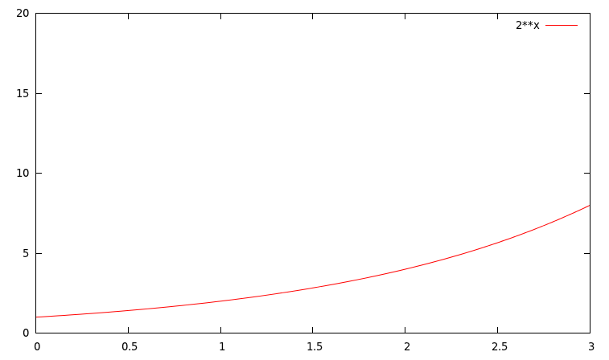
New Connection: Slow Start [Tahoe]
Intuition: Don't flood, but quickly optimize
Start really small: 1 SMSS
Grow really fast: exponentially
Occurs: beginning of TCP, after timeout

Slide 9
ssthresh
cwnd – congestion window
  Governs data transmission (with rwnd)
  SMSS == sender maximum segment size
  On segment ACK, cwnd += SMSS
ssthresh – slow start threshold
  Use slow start when cwnd < ssthresh
  Use congestion avoidance when cwnd > ssthresh
Typically, ssthresh starts at 65535 bytes.

Slide 10
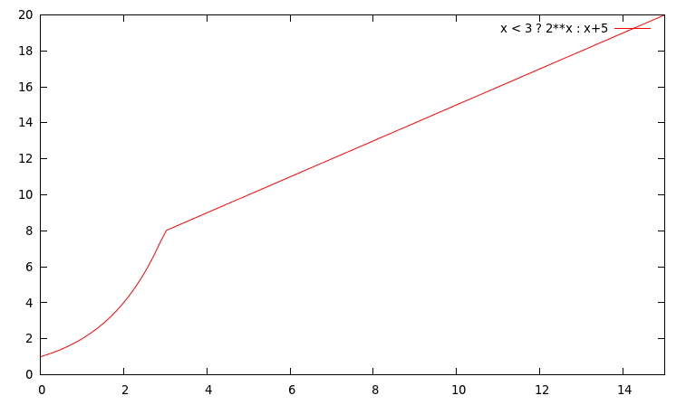
CA: Additive Increase
On ACK: cwnd += SMSS*SMSS/cwnd
Takes over when cwnd > ssthresh
ssthresh = min(cwnd,rwnd) / 2 when congestion
If congestion is a timeout, cwnd = SMSS

Slide 11
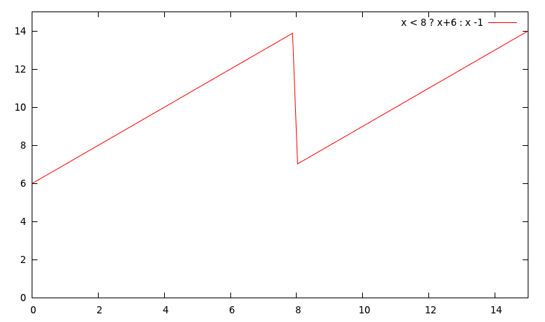
CA: Multiplicative Decrease
Appears depending on congestion control
  Most likely [Reno]: 3 Duplicate ACKs
On a timeout, set cwnd = cwnd / 2

Slide 12
Fast Retransmit [Tahoe]
Receiver sends duplicate ACKs
Immediately on out-of-order segment
Sender receives >= 3 duplicate ACKs
Immediately retransmit segment
  cwnd = SMSS
  Slow start
[Reno] Fast Recovery until non-duplicate ACK

Slide 13
Fast Recovery [Reno, New Reno]
ssthresh = cwnd / 2
cwnd = ssthresh [+ 3*SMSS] (in RFC)
Each time another duplicate ACK arrives,
  cwnd += SMSS
  Transmit new segment if allowed [New Reno]
When ACK for new data arrives
  cwnd = ssthresh
If timeout again, slow start with cwnd = SMSS

Slide 14
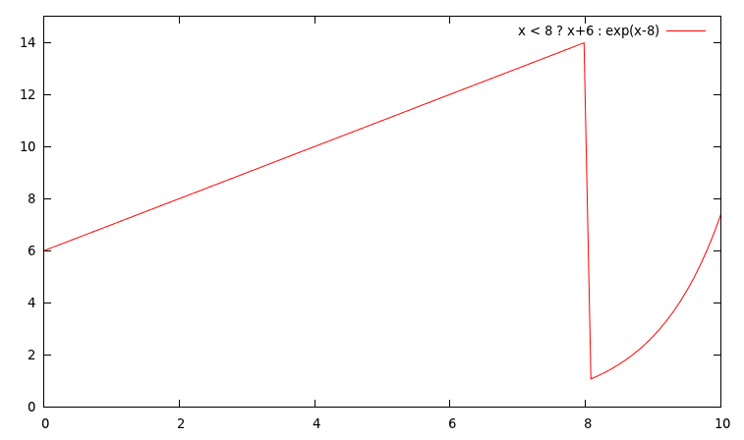
Timeout Events [Tahoe, Reno]
Both treat these the same: drop to slow start
ssthresh = cwnd / 2
cwnd = SMSS

Slide 15
Experimenting on Your Own
getsockopt() – on a TCP socket
Transfer large amounts of data
Check out TCP_INFO
Returns a struct tcp_info;

Slide 16
/usr/include/netinet/tcp.h
struct tcp_info
u_int8_t tcpi_state;
u_int8_t tcpi_ca_state;
u_int8_t tcpi_retransmits;
u_int8_t tcpi_probes;
u_int8_t tcpi_backoff;
u_int8_t tcpi_options;
u_int8_t tcpi_snd_wscale : 4, tcpi_rcv_wscale : 4;
u_int32_t tcpi_rto;
u_int32_t tcpi_ato;
u_int32_t tcpi_snd_mss;
u_int32_t tcpi_rcv_mss;
u_int32_t tcpi_unacked;
u_int32_t tcpi_sacked;
u_int32_t tcpi_lost;
u_int32_t tcpi_retrans;
u_int32_t tcpi_fackets;
/* Times. */
u_int32_t tcpi_last_data_sent;
u_int32_t tcpi_last_ack_sent; /* Not remembered, sorry. */
u_int32_t tcpi_last_data_recv;
u_int32_t tcpi_last_ack_recv;
/* Metrics. */
u_int32_t tcpi_pmtu;
u_int32_t tcpi_rcv_ssthresh;
u_int32_t tcpi_rtt;
u_int32_t tcpi_rttvar;
u_int32_t tcpi_snd_ssthresh;
u_int32_t tcpi_snd_cwnd;
u_int32_t tcpi_advmss;
u_int32_t tcpi_reordering;
u_int32_t tcpi_rcv_rtt;
u_int32_t tcpi_rcv_space;
u_int32_t tcpi_total_retrans;
};

Slide 17
Cheating TCP: Foul Play
What happens with two TCP streams, one from each host, on a 10 Mbps link?

Slide 18
Cheating TCP: Foul Play
What happens with two TCP streams, one from each host, on a 10 Mbps link?
Name them host A and host B. What if host A opens 10 TCP streams? Host B keeps only 1 TCP stream?

Slide 19
Cheating TCP: Foul Play
What happens with two TCP streams, one from each host, on a 10 Mbps link?
Name them host A and host B. What if host A opens 10 TCP streams? Host B keeps only 1 TCP stream?
Fair sharing across streams...
No notion of logical peers

Slide 20
P2P Research: Bandwidth Trading
UVA limited dorm links in dorm rooms
We had high-speed WiFi between us
What if we all colluded?
Merging many TCP flows out-of-band :-)
Fun senior thesis project
P2P Bandwidth Trading (economics+CS)

Slide 21

GitHub:
Git it, got it, good.
git clone git://github.com/theonewolf/15-441-Recitation-Sessions.git

