Slide 1
You Aren't a
One-Person Army: Introducing ZeroMQ
15-441: Computer Networks
Matt Mukerjee
David Naylor
Ben Wasserman

Slide 2
Don't waste time in the future reinventing the wheel.
This is an engineering snafu.

Slide 3
If ZeroMQ didn't exist, it would be necessary to invent it. ZeroMQ simply seems to me a "bare necessity" nowadays.
Gonzalo Diethlem
The more time I spend with ZeroMQ, the less I can think of a reason I'd ever have to open up a raw TCP or UDP socket.
Andrew Cholakian

Slide 4
ZeroMQ: Panacea?
30+ Languages: C, C++, Python, Java...
Transport: inproc, IPC, TCP, multicast
Patterns: req-rep, pub-sub, push-pull, ...
Async by design: separate IO thread
Built for speed: originally for stock trading
OS-agnosticism: Linux, Windows, OS X
Vibrant community, active development
Linux Kernel someday soon?

Slide 5
ZeroMQ, Zero Setup
Versus: Qpid, OpenAMQ, RabbitMQ, *MQ
No middleware
No messaging broker (lose persistance)
Embedded, linked library
Messaging fabric becomes part of app

Slide 6
Which brings us back to the science of programming. To fix the world, we needed to do two things.
One, to solve the general problem of "how to connect any code to any code, anywhere".
Two, to wrap that up in the simplest possible building blocks that people could understand and use easily.

Slide 7
Usage: zguide mostly in C
http://zguide.zeromq.org/
Use ZeroMQ 2.1 Stable

Slide 8
ZeroMQ is a new way of thinking about concurrency, multicore systems, distributed systems, and network programming.
It changes your world view.
Not many libraries can do that...

Slide 9
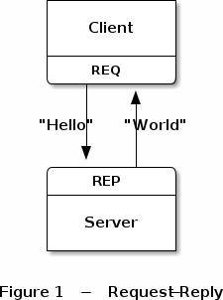
Request-reply

Slide 10
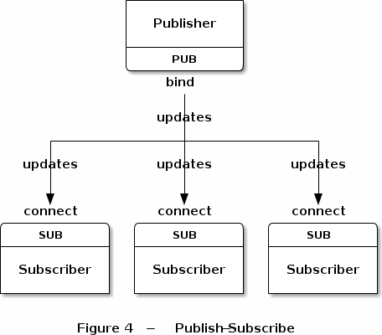
Publish-Subscribe

Slide 11
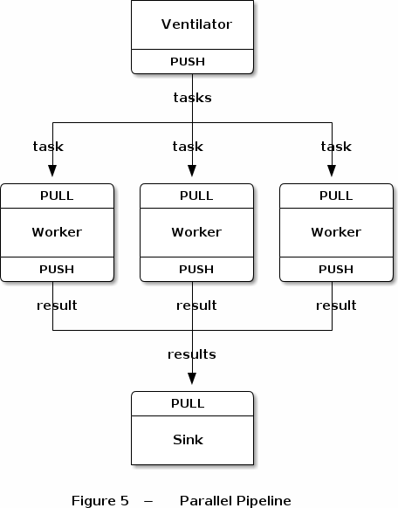
Pipeline or Push-Pull

Slide 12
Multicore, Multithreading?
ZeroMQ

Slide 13
we don't need mutexes, locks, or any other form of inter-thread communication except messages sent across ØMQ sockets

Slide 14
Network Programming?
ZeroMQ

Slide 15
It gives you sockets that carry whole messages across various transports like in-process, inter-process, TCP, and multicast.
You can connect sockets N-to-N with patterns like fanout, pub-sub, task distribution, and request-reply.

Slide 16
Use all cores and machines?
ZeroMQ

Slide 17
It presents a familiar BSD socket API but that hides a bunch of message-processing machines that will slowly fix your world-view about how to design and write distributed software.

Slide 18
ZeroMQ Keeps on Giving
Great open source community example
Excellent documentation
Superbly engineered C++ core
Very active mailing list

Slide 19
Publisher in C (1)
#include <stdio.h>
#include <stdlib.h>
#include <string.h>
#include "zmq.h"
int main (void)
{
void *context = zmq_init(1);
void *publisher = zmq_socket(context, ZMQ_PUB);
zmq_bind(publisher, "tcp://*:5556");
srand((unsigned) time(NULL));
while(1) {
int zipcode, temperature, relhumidity;
zipcode = rand() % 100000;
temperature = (rand() % 215) - 80;
relhumidity = (rand() % 50) + 10;
char update[20];

Slide 20
Publisher in C (2)
sprintf(update, "%05d %d %d", zipcode, temperature, relhumidity);
zmq_msg_t message;
zmq_msg_init_size(&message, strlen(update));
memcpy(zmq_msg_data(&message), update, strlen(update));
zmq_send(publisher, &message, 0);
zmq_msg_close(&message);
}
zmq_close(publisher);
zmq_term(context);
return 0;
}

Slide 21
Subscriber in Python (1)
#!/usr/bin/env python
import sys
import zmq
context = zmq.Context()
socket = context.socket(zmq.SUB)
socket.connect("tcp://localhost:5556")
filter = "10001"
socket.setsockopt(zmq.SUBSCRIBE, filter)

Slide 22
Subscriber in Python (2)
total_temp = 0
for update_nbr in range(5):
string = socket.recv()
print string
zipcode, temperature, relhumidity =\ string.split()
total_temp += int(temperature)
print "Average temperature was %dF" % ( total_temp / update_nbr)

Slide 23
PJ3 Extra Credit [10 Points]
Create a ZeroMQ bridge w/ your protocol
Email Wolf telling you did this...
Use the reliable data transport protocol
ZMQ message size cap at 256MB
Produce a 'zmq_bridge' executable on 'make ec'
Take two parameters:
  'zmq_bridge <port1> <port2>'
port1 – SUB socket
port2 – PUB socket

Slide 24
PJ3 EC Picture
Deep Space Relay
zmq_bridge
PUB reverse connect
'Earth'
SUB connect
'Mars'
port1
port2
“secret sauce here”

Slide 25
Don't waste time in the future reinventing the wheel.
This is an engineering snafu.

Slide 26

GitHub:
Git it, got it, good.
git clone git://github.com/theonewolf/15-441-Recitation-Sessions.git

