Slide 1
HTTP Parsing
15-441: Computer Networks
Matt Mukerjee
David Naylor
Ben Wasserman

Slide 2
Homework 1
Please write your name and andrew id
  2 answer sheets without name, need to claim!
Don’t just show calculations without any explanation.
  Need partial credits?
Please make it legible
  If not, type it up!

Slide 3
PJ 2 CP 2
GET, POST and HEAD requests
Read the documents first to understand the rules.
RFC 2616
Check the annotated RFC

Slide 4
HTTP request
Request =
  Request-Line ;
  *(( general-header ;
  request-header ;
  entity-header ) CRLF) ;
  CRLF [ message-body ] ;

Slide 5
HTTP response
Response =
  Status-Line ;
  *(( general-header ;
  response-header ;
  entity-header ) CRLF) ;
  CRLF [ message-body ] ;

Slide 6
Tools
Use tools to look at these requests and see the pattern for real
  Wireshark
    http://www.wireshark.org/
  Use the dumper code
  Play with the headers
    Tamperdata
    Poster
  Online tools
    http://web-sniffer.net/

Slide 7
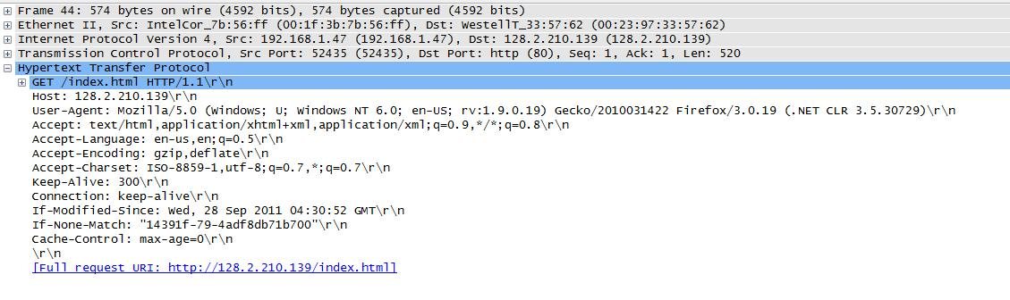
Sample GET request
GET request was done on this page.
Do you see the pattern?
Notes:
Accept - request header (media types that are acceptable)

Slide 8
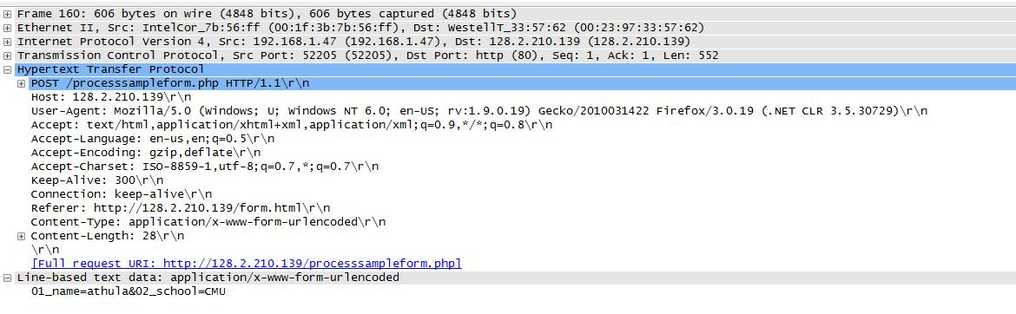
Sample POST request
POST method called while submitting this form.
Can you identify the values that were submitted?

Slide 9
HEAD is similar to GET!

Slide 10
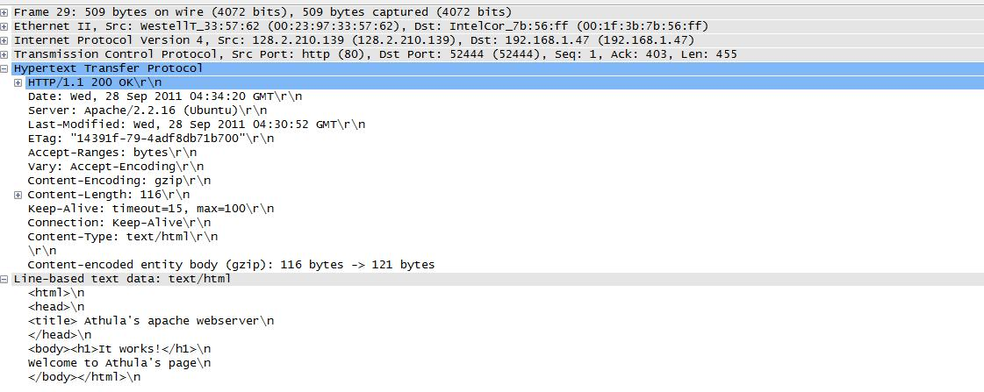
Sample GET response
.

Slide 11
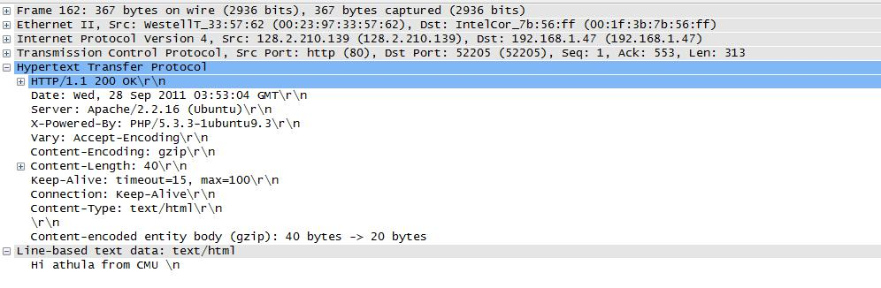
Sample POST response
For this checkpoint you just have to send status code. More on dynamic content later!

Slide 12
Minimal Implementation
Status codes
  200_OK
  404_NOT_FOUND
  411_LENGTH_REQUIRED
  500_INTERNAL_SERVER_ERROR
  501_NOT_IMPLEMENTED
  503_SERVICE_UNAVAILABLE
  505_HTTP_VERSION_NOT_SUPPORTED

Slide 13
Minimal Implementation
General Headers
  Connection
  Date
Response Headers
  Server should always be: Liso/1.0
Entity Headers
  Content-Encoding
  Content-Length
  Content-Type
  Last-Modified

Slide 14
Be careful with the buffers!
Requests may straddle multiple recv calls
  Need to maintain state information.
If request header size > 8192 bytes
  For now, send error message and disconnect.

