Slide 1
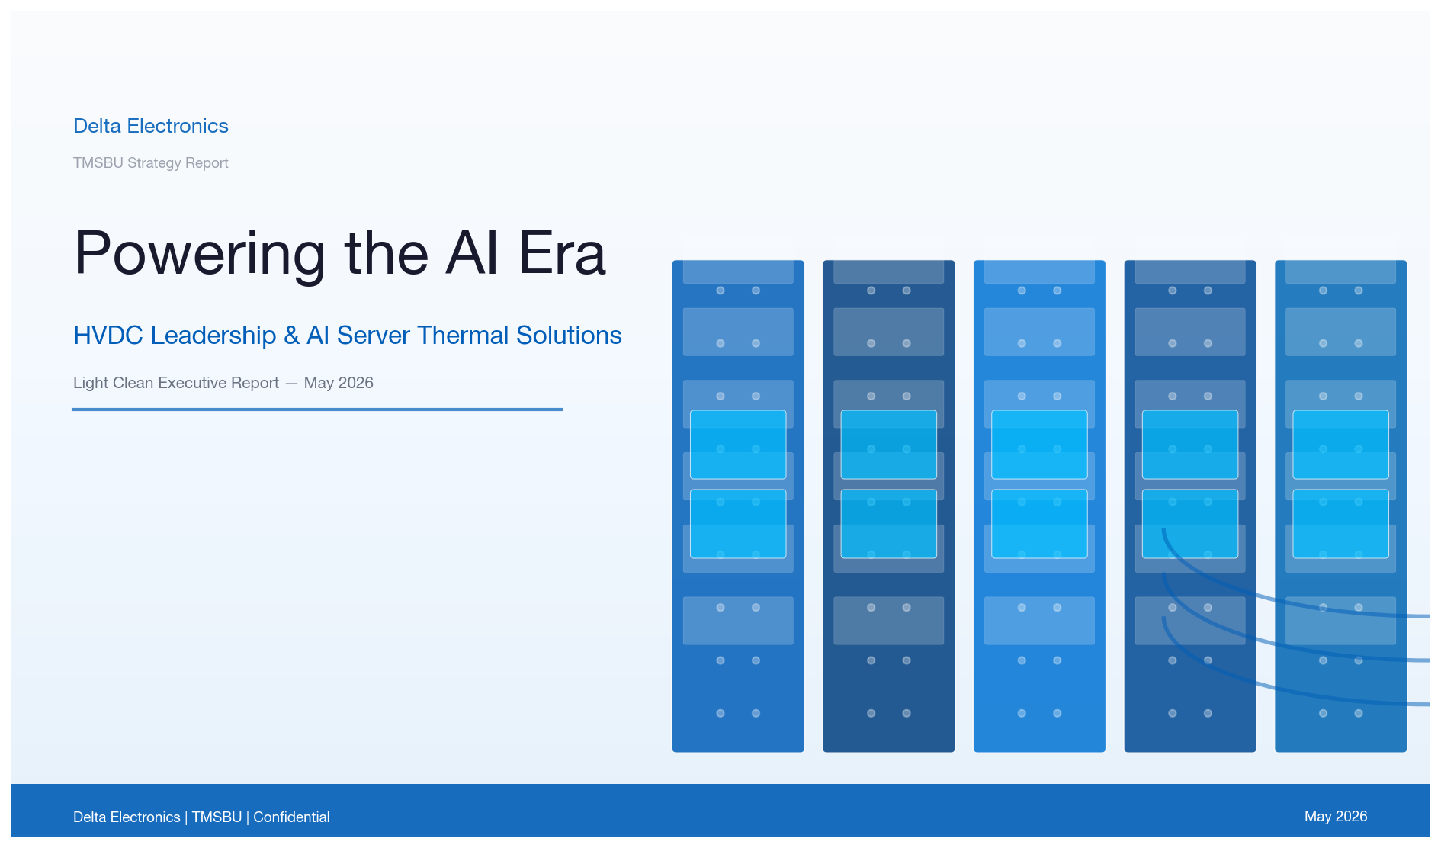
Delta Electronics
TMSBU Strategy Report
Powering
the AI Era
HVDC Leadership & AI Server Thermal Solutions
Light Clean Executive Report — May 2026
Delta Electronics | TMSBU | Confidential
Notes:
Cover: Left text panel + right cover image. Clean white + Delta Blue. No dark background.

Slide 2
Delta Electronics | TMSBU Strategy
02
Executive Summary
Five strategic imperatives for Delta TMSBU in the AI-powered data center era
HVDC leadership + liquid cooling capability = strategic differentiator for Delta TMSBU
$39.1B
700W+
60%
$3.2B
BBB
AI Power TAM 2028E
GPU TDP Threshold
Liquid Cooling 2026E
TMSBU SOM (High)
Credit Rating
Global AI server power
infrastructure market
GB200 NVL72 pushes
thermal limits
Air cooling reaches
physical ceiling
Serviceable opportunity
for Delta TMSBU
Delta investment-grade
financial strength
▲ 24% CAGR
Stable
▲ from 20% in 2023
Scenario-based
Stable
02
Notes:
Executive Summary: 5 KPI cards — white background, Delta Blue numbers, clean consulting style.

Slide 3
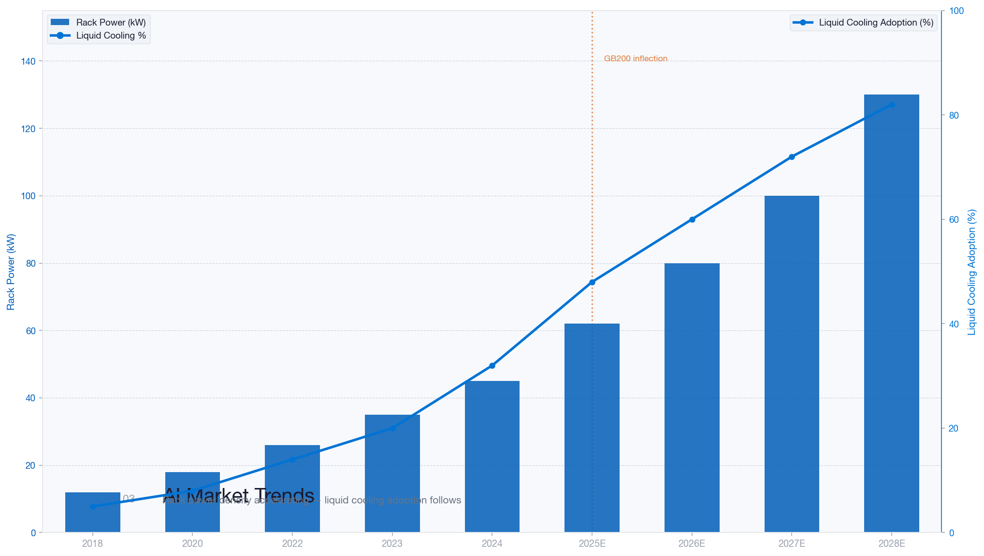
Delta Electronics | TMSBU Strategy
03
AI Market Trends
Rack power density accelerating — liquid cooling adoption follows
GB200 inflection (2025E): GPU TDP 1,000W+ triggers rack power >80kW — liquid cooling is the only viable path
Notes:
AI Market Trends: Bar + line dual-axis chart, clean white bg. GB200 inflection annotated.

Slide 4
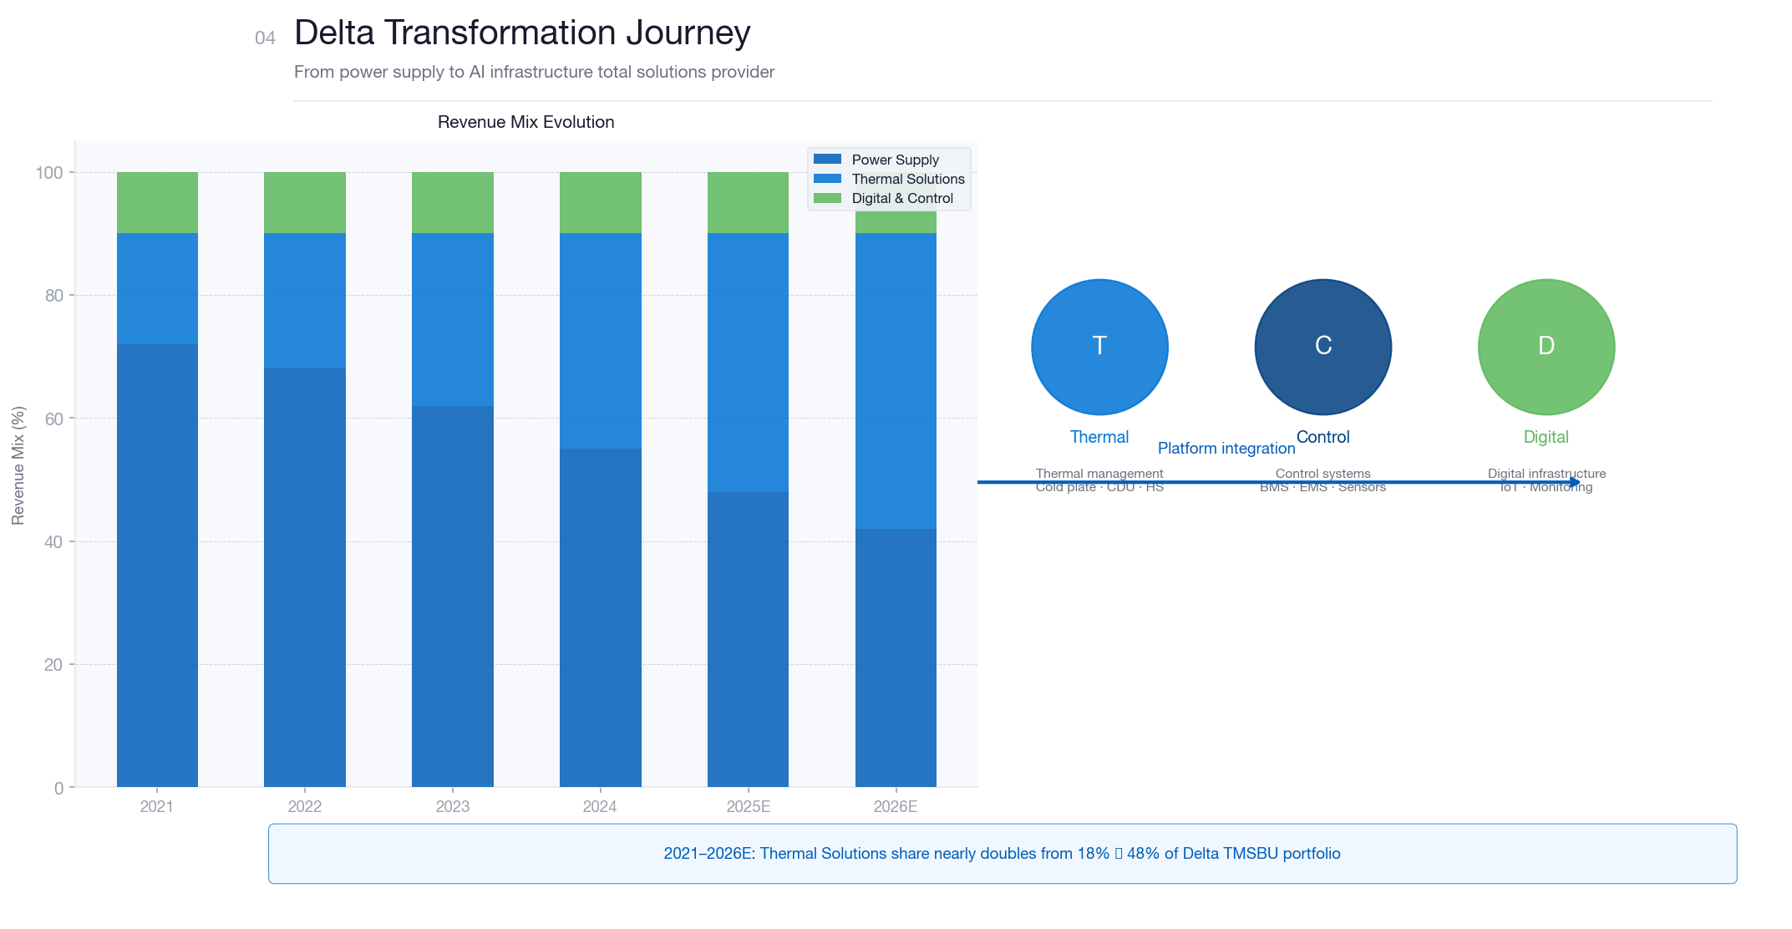
Delta Electronics | TMSBU Strategy
04
Delta Transformation Journey
From power supply to AI infrastructure total solutions provider
2021–2026E: Thermal Solutions share nearly doubles from 18% to 48% of Delta TMSBU portfolio
Notes:
Delta Transformation: Revenue mix stacked bars + platform capability icons. Light clean style.

Slide 5
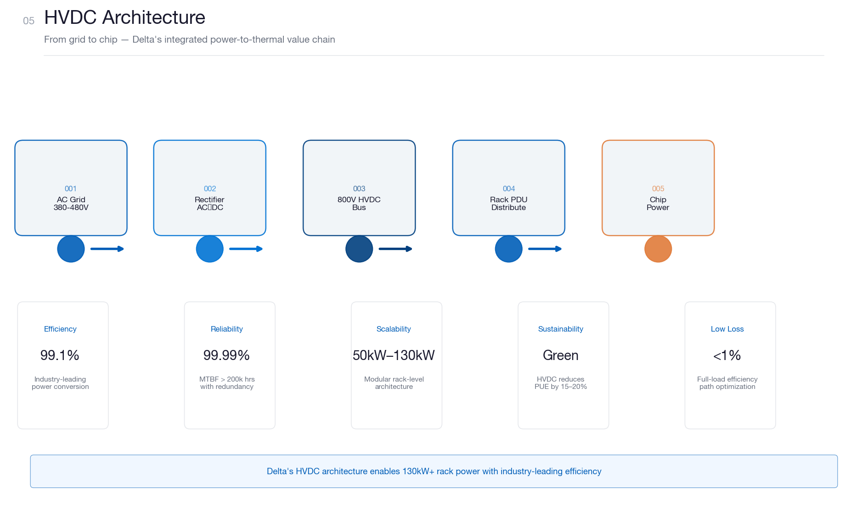
Delta Electronics | TMSBU Strategy
05
HVDC Architecture
From grid to chip — Delta's integrated power-to-thermal value chain
Delta's HVDC architecture enables 130kW+ rack power with industry-leading 99.1% efficiency
Notes:
HVDC Architecture: 5-stage flow diagram + 5 capability cards. Clean corporate engineering style.

Slide 6
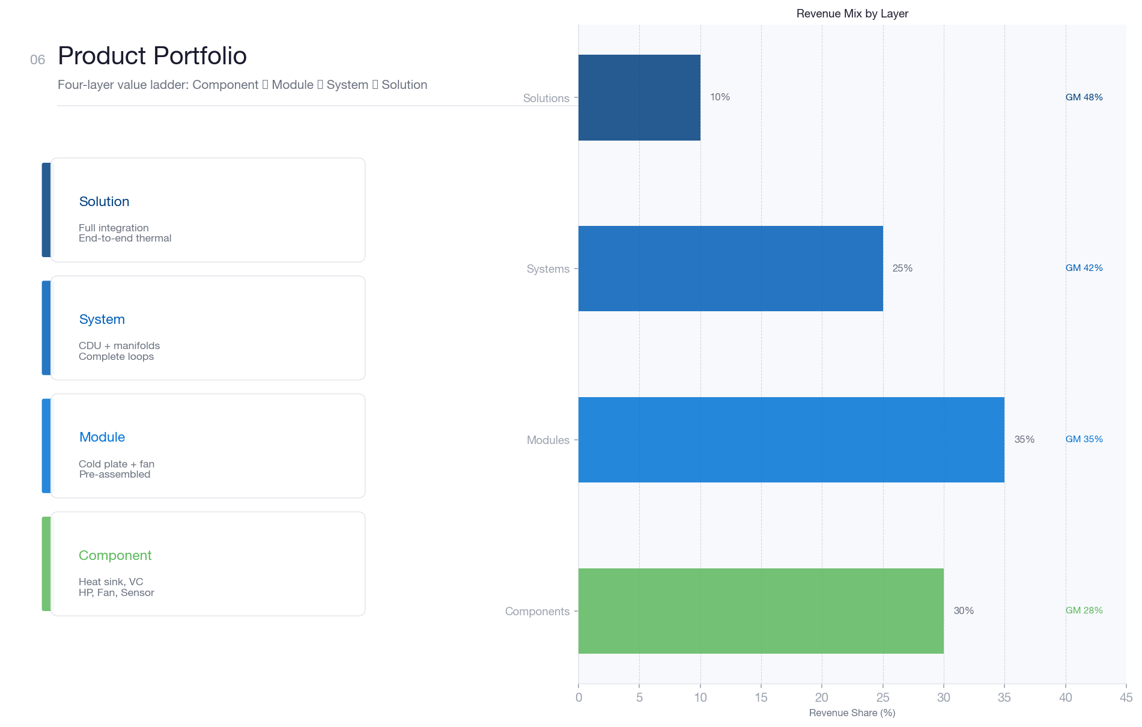
Delta Electronics | TMSBU Strategy
06
Product Portfolio
Four-layer value ladder: Component → Module → System → Solution
Each layer adds customer value: Components (30%) → Modules (35%) → Systems (25%) → Solutions (10%)
Notes:
Product Portfolio: 4-layer ladder + revenue mix horizontal bars. Apple-style product grid.

Slide 7
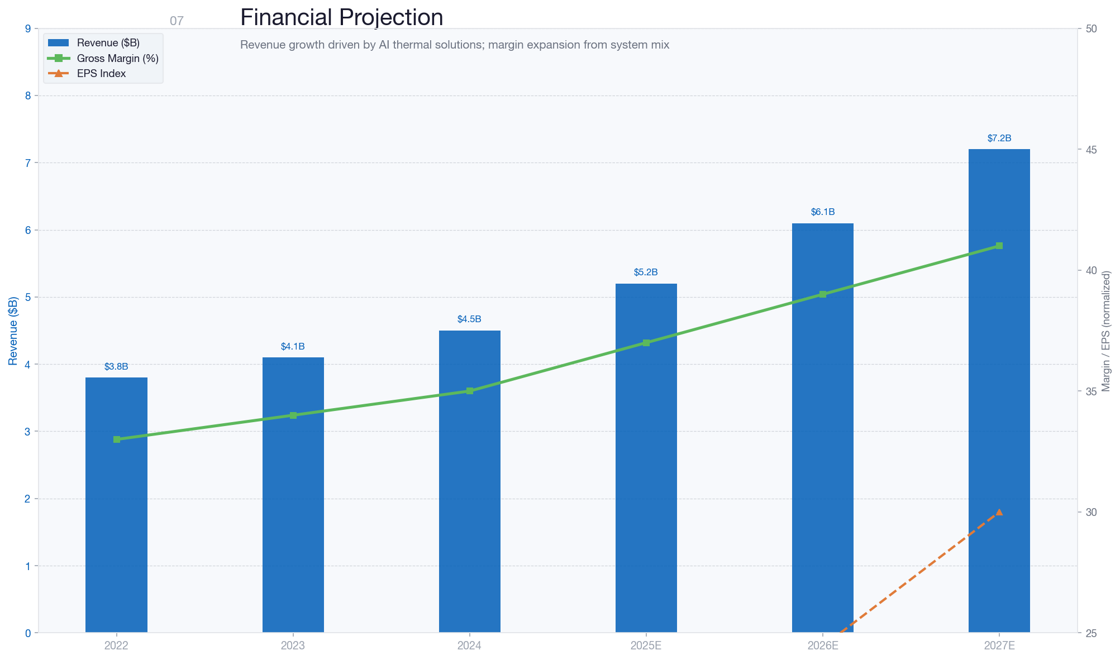
Delta Electronics | TMSBU Strategy
07
Financial Projection
Revenue growth driven by AI thermal solutions; margin expansion from system mix
Revenue: $3.8B (2022) → $7.2B (2027E) | Gross Margin: 33% → 41% | EPS growth +125%
Notes:
Financial Projection: Revenue bar chart ($B) + Gross Margin line. Delta Blue bars, green line. Clean.

Slide 8
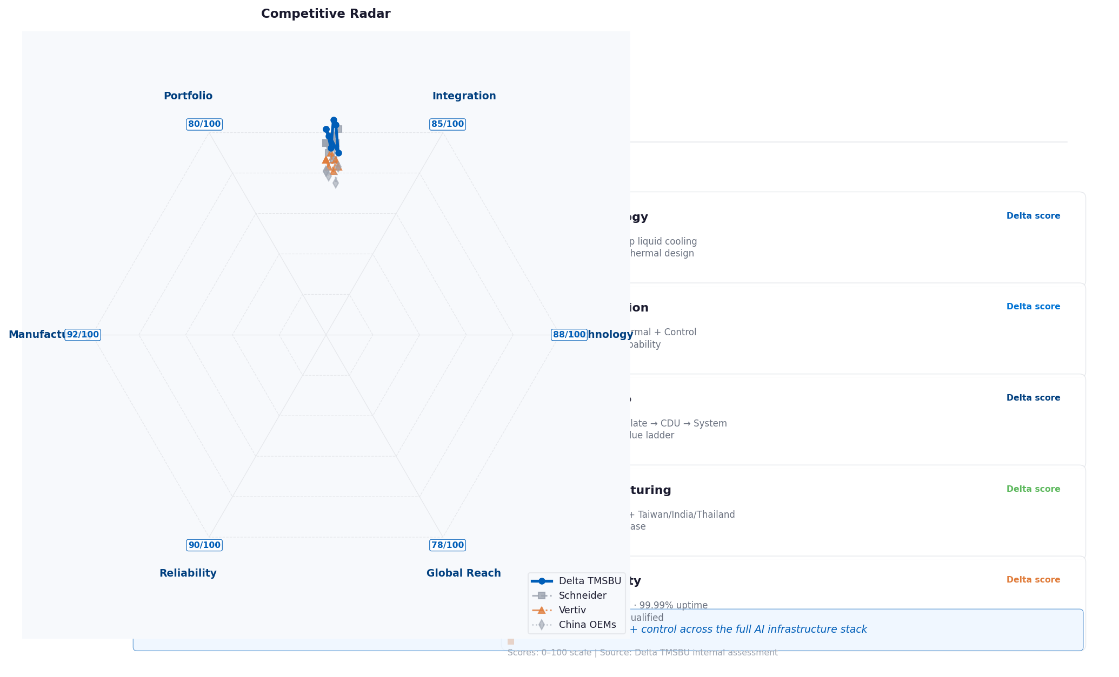
Delta Electronics | TMSBU Strategy
08
Competitive Advantages
Delta TMSBU vs. global competitors — six-dimension strategic positioning
Delta's competitive moat: integrated power + thermal + control across the full AI infrastructure stack
Notes:
Competitive Advantages: Radar chart (Delta vs. Schneider vs. Vertiv) + 5 strength cards. Clean consulting style.

Slide 9
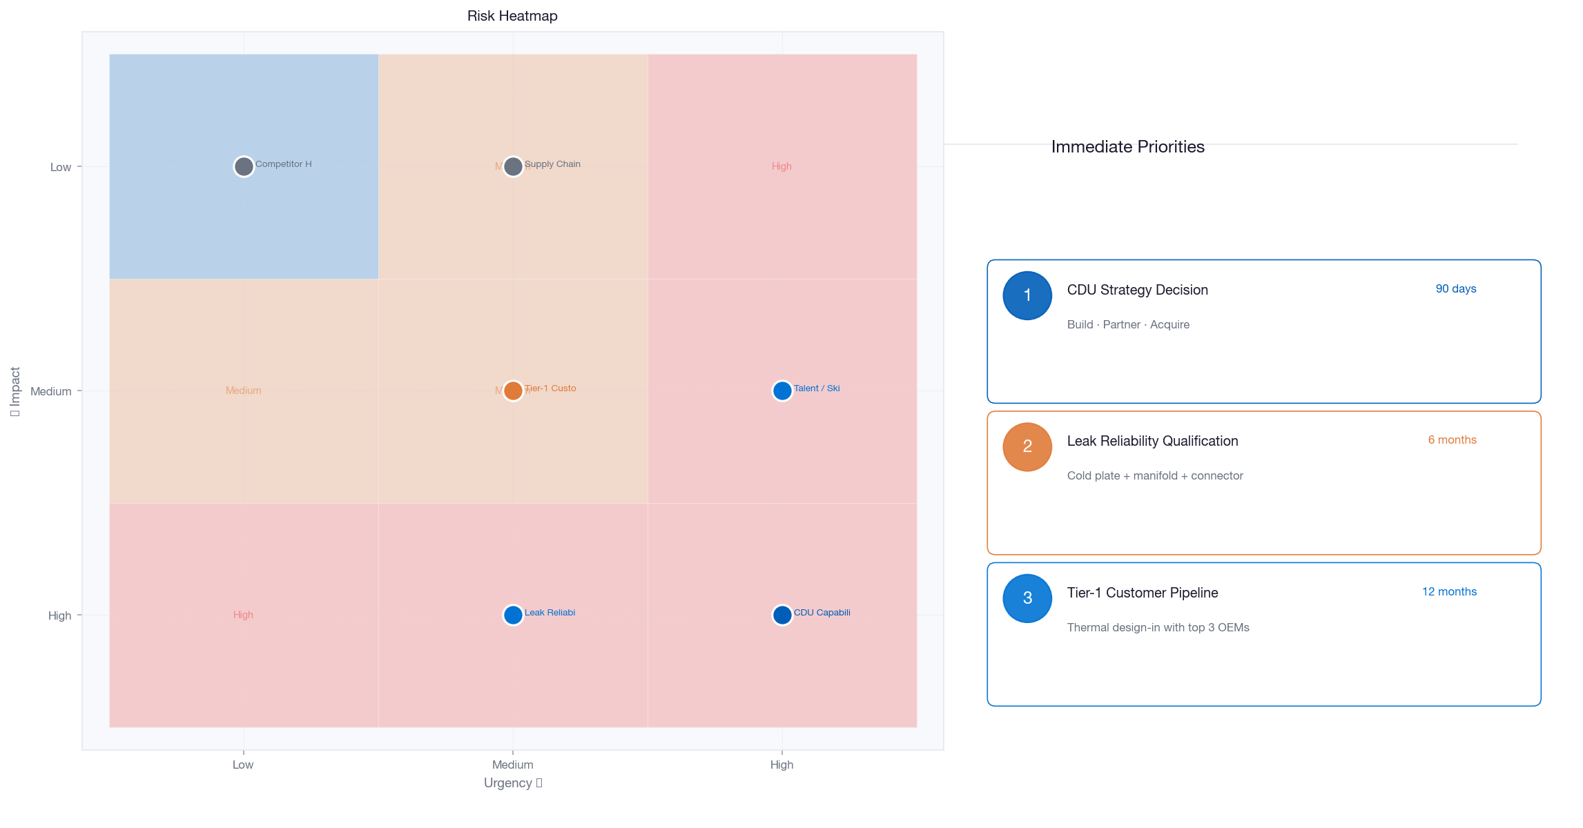
Delta Electronics | TMSBU Strategy
09
Capability Gap & Risk Assessment
Impact × Urgency matrix — strategic risk prioritization for TMSBU leadership
Top risk: CDU strategy (90-day decision window) | Leak reliability (6-month qualification) | Tier-1 pipeline (12-month)
Notes:
Risk Assessment: Impact × Urgency heatmap + 3 immediate priorities. No long tables. Clean.

Slide 10
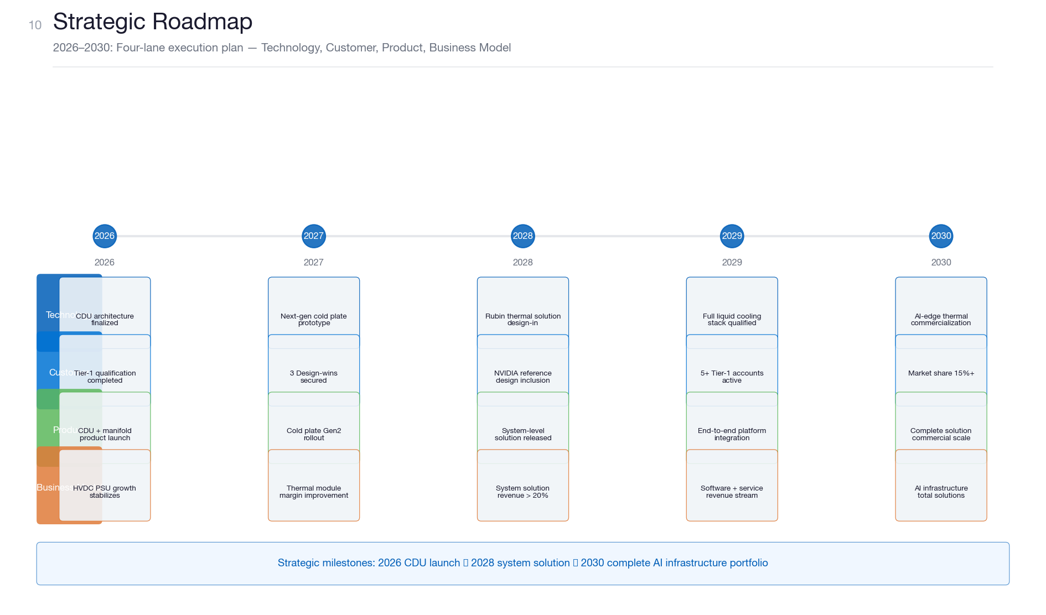
Delta Electronics | TMSBU Strategy
10
Strategic Roadmap
2026–2030: Four-lane execution plan — Technology, Customer, Product, Business Model
Milestones: 2026 CDU launch → 2028 system solution → 2030 complete AI infrastructure portfolio
Notes:
Strategic Roadmap: 4-lane × 5-phase horizontal timeline. Clean corporate future vision style.

